Slide 1





AgriQFS: Quantum-Classical Hybrid Feature Selection for Temporal UAV Imagery
Harshitha Manjunatha¹, Prabha Sundaravadivel²*, Henry A. Torbert³, and Lakshman S. Tamil¹ ¹ The University of Texas at Dallas, Richardson, TX, USA, ² The University of Texas at Tyler, Tyler, TX, USA ³ National Soil Dynamics Laboratory, USDA Agricultural Research Service (ARS), Auburn, AL, USA
Presented By
Harshitha Manjunatha PhD Candidate

Slide 2
Motivation
Accurate cotton defoliation monitoring is difficult because UAV imagery captures real field variability, not clean laboratory conditions.
We use UAV orthomosaic RGB imagery to monitor cotton before and after defoliation.
The goal is to distinguish pre-defoliation canopy from post-defoliation exposed structures.
This matters because defoliation timing affects harvest readiness, input decisions, and crop quality.
The challenge is that field imagery changes with texture, canopy density, soil visibility, illumination, and scene complexity.
So, the core problem is not only classification but finding robust features under real agricultural variability.

Slide 3
Research Contribution
This work proposes a hybrid feature-selection framework that combines interpretable agricultural descriptors with quantum-emulated search.
This study is grounded in interpretable feature descriptors extracted from cotton UAV imagery, capturing spectral, textural with defoliation.
It introduces a variational quantum circuit (VQC) to search for compact feature subsets that preserve discriminative information.
The method evaluates whether interaction-aware quantum-inspired selection can outperform standard classical feature-selection baselines.
The selected subset is then used by a classical Support Vector Machine with a Radial Basis Function (RBF) kernel for final prediction.
The main contribution is a hybrid quantum-classical pipeline that improves interpretability, keeps deployment practical, and studies quantum ideas in an agricultural remote-sensing setting.

Slide 4

Why Quantum Computing?
Before understanding more about quantum computers, we need to understand the concepts of quantum physics.
Quantum physics puts everything into question. It defies every intuition which we have about our natural world.
Figure 1: view of quantum-enhanced search

Slide 5
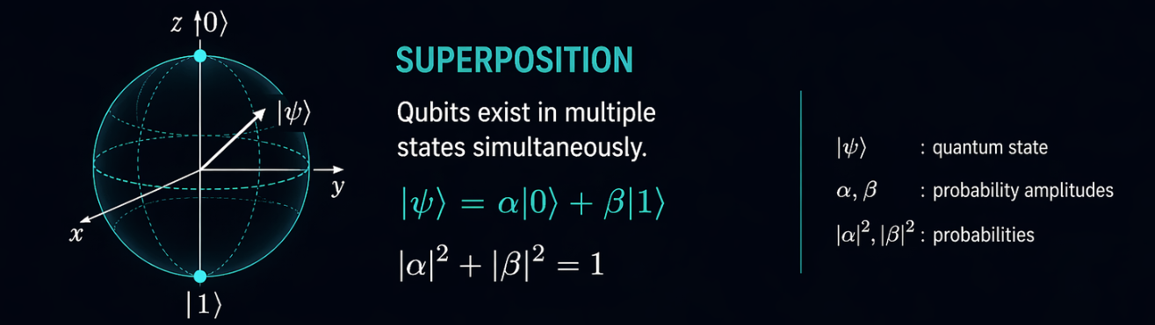
Superposition
A quantum system can hold multiple possible states in play until measurement forces a single outcome
Classically, a state is this or that.
In quantum mechanics, a state can be this and that until it is measured.
That makes superposition a powerful idea for exploring many candidate solutions at the same time.
Figure 2: Single-qubit state on the Bloch sphere

Slide 6
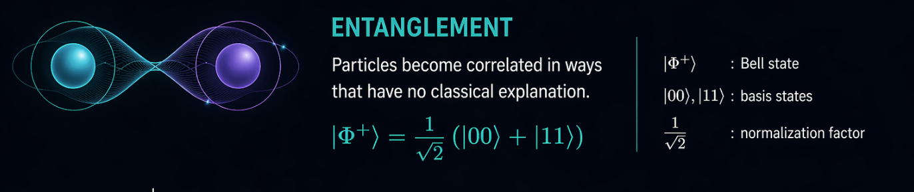
Entanglement
Two quantum states can become linked so strongly that they stop behaving like independent objects.
Classically, we often rank one feature at a time..
Quantum systems can encode relationships between parts of the system directly.
That is why entanglement is the most natural bridge to interaction-aware feature selection.
Figure 3: Correlated two-qubit Bell state

Slide 7
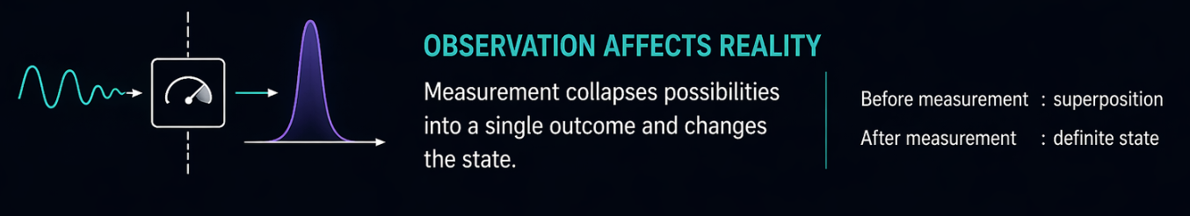
Tunneling
Quantum systems can cross barriers that would trap a purely classical search process
Classical optimization can get stuck behind a barrier in the search. landscape.
Quantum behavior allows probability to appear on the other side. of that barrier.
That is why tunneling is often used as the mental model for better global search.
Figure 4: Quantum tunneling through an energy barrier

Slide 8
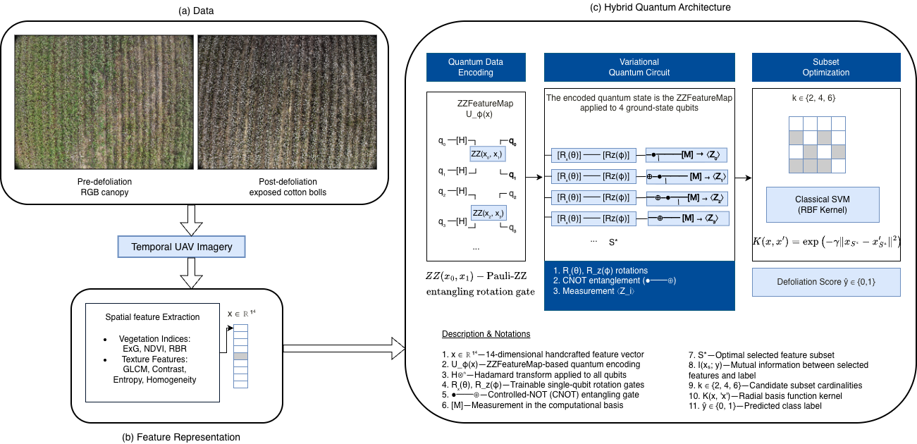
Overview of the Hybrid Quantum-Classical Feature-Selection Pipeline
A quantum-emulated feature-selection stage is coupled with a classical classifier to balance interaction-aware search with practical inference
Figure 5: Overview of the Hybrid Quantum-Classical Feature-Selection Pipeline

Slide 9
Hybrid Quantum-Classical Approach
We do not run on a physical quantum computer, we emulate the quantum circuit in Python to study whether quantum-inspired feature interactions improve feature selection
This research work uses a variational quantum circuit (VQC) as a feature selector.
The quantum part is simulated on a classical computer using Python and Qiskit on macOS.
This lets us test superposition, entanglement, and interaction-aware search in a reproducible way without requiring real quantum hardware.
The selected subset is then passed to a classical Support Vector Machine with a Radial Basis Function (RBF) kernel, which keeps the final pipeline practical and deployable.
So the contribution is a hybrid workflow: quantum-emulated search for better feature subsets, classical learning for stable prediction.

Slide 10
Why the Hybrid Architecture Is Effective
The framework assigns each paradigm to the stage where it contributes most: quantum modeling for subset discovery, classical learning for stable inference
The architecture balances expressivity, interpretability, and operational feasibility.
The final inference stage remains classical, which keeps the prediction path computationally stable and operationally realistic.
The variational quantum circuit is used for feature selection, where interaction structure matters most.
The hybrid value is not replacing classical learning, but improving the feature-selection stage that feeds it.

Slide 11
Why the Method Is Most Reliable
AgriQFS is most adaptative when the task demands compact, interpretable feature selection under challenging imaging conditions
Interaction-Dominated Regimes:
Its advantage increases when useful information is distributed across interacting descriptors rather than isolated within a single feature.
Perturbed Imaging Conditions:
under glare and additive sensor noise, where stable subset selection becomes more challenging. This aligns with robustness under field variability.
Interpretability for Domain Science
The final subset remains understandable in agronomic and remote-sensing terms.
That makes the method easier to analyze scientifically than an opaque end-to-end representation.

Slide 12

The Role of the 4-Qubit Configuration
the 4-qubit configuration provides the clearest balance between compact feature selection, preserved class structure, and practical interpretability
What 4 qubits mean here
The 4-qubit setting corresponds to selecting a compact subset of descriptors for downstream classification.
This regime produces the most interpretable and practically useful subset.
Why this regime is important
Too small a subset can lose important structure.
Too large a subset reduces compactness and weakens the argument for efficient selection.
The 4-qubit case offers the best ground for experimentation
Figure 6: Qubit State Duality

Slide 13
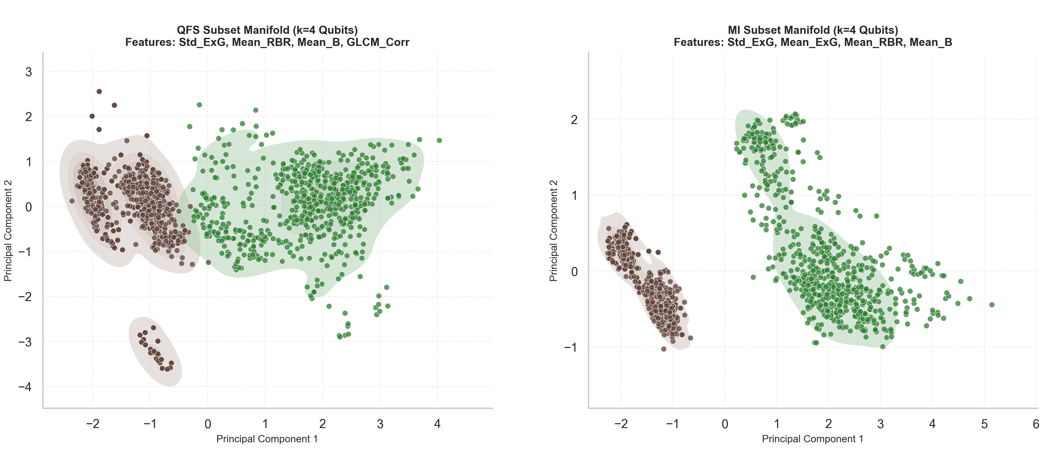
Why a Compact Subset Still Works
PCA of the selected descriptors shows that discriminative structure is preserved without relying on the full feature set
Class Structure Preserved The selected subset retains visible separation between pre- and post-defoliation states in the projected feature space.
Compact but Informative This separation is achieved with a small descriptor set, indicating that the selected features preserve discriminative information efficiently.
Figure 7: PCA projection of the QFS-selected k=4 feature space

Slide 14



Interpretable 14-D Feature Representation
The framework operates on physically meaningful descriptors derived from UAV imagery, capturing spectral response, texture organization, and exposed-structure geometry relevant to cotton defoliation
Vegetation Indices
These descriptors capture canopy color shifts associated with senescence, exposure, and boll visibility.
They provide the spectral foundation for separating pre- and post-defoliation field states.
ExG, visible-band NDVI, and RBR.
GLCM Texture
Texture descriptors quantify spatial organization in the canopy, including smoothness, contrast, and structural regularity.
These are important because defoliation changes not only color, but also the spatial pattern of exposed and vegetated regions.
Correlation, Contrast, Energy, Entropy, and Homogeneity.
Morphological / Structural Descriptors
Structural descriptors summarize the geometry of exposed regions after canopy change becomes visible.
They complement spectral and textural features by encoding shape-level variation tied to exposed cotton structures.
$$ExG=2G−R−B$$
$$Contrast =i\sum_{i}{\sum_{j}{{(i - j)}^{2} P(i, j)}}$$
C = $\frac{4πA}{P^{2}}$

Slide 15
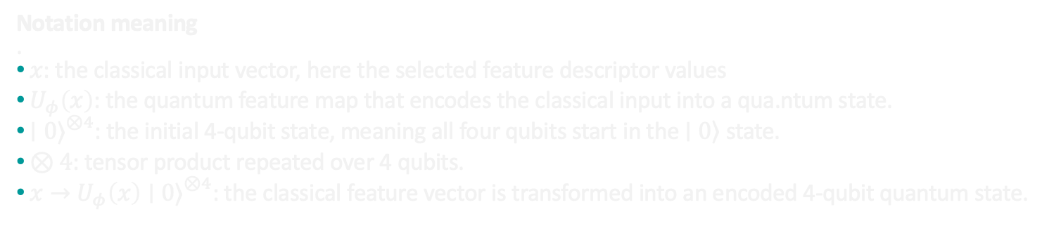
Quantum Encoding
Candidate feature subsets are mapped into a 4-qubit representation so that descriptor interactions can be expressed within the quantum state before scoring
1
2
3
4
Input Candidate subset of descriptors from the 14-D feature space
Feature Map Classical descriptor values are embedded using the ZZFeatureMap
Interaction Encoding Pairwise relationships are introduced into the quantum phase.
Prepared State The encoded state becomes the input to the variational circuit.
$$x→U_{φ}\left(x\right){\left|0\right\rangle }^{⊗4}$$
Notation meaning
.
$x$: the classical input vector, here the selected feature descriptor values
${ U}_{φ}\left(x\right)$: the quantum feature map that encodes the classical input into a qua.ntum state.
$∣0{\left.⟩\right.}^{⊗4}$: the initial 4-qubit state, meaning all four qubits start in the $\left.∣0\right\rangle$ state.
$⊗4$: tensor product repeated over 4 qubits.
$x→U_{φ}\left(x\right)∣0{\left.⟩\right.}^{⊗4}$: the classical feature vector is transformed into an encoded 4-qubit quantum state.

Slide 16
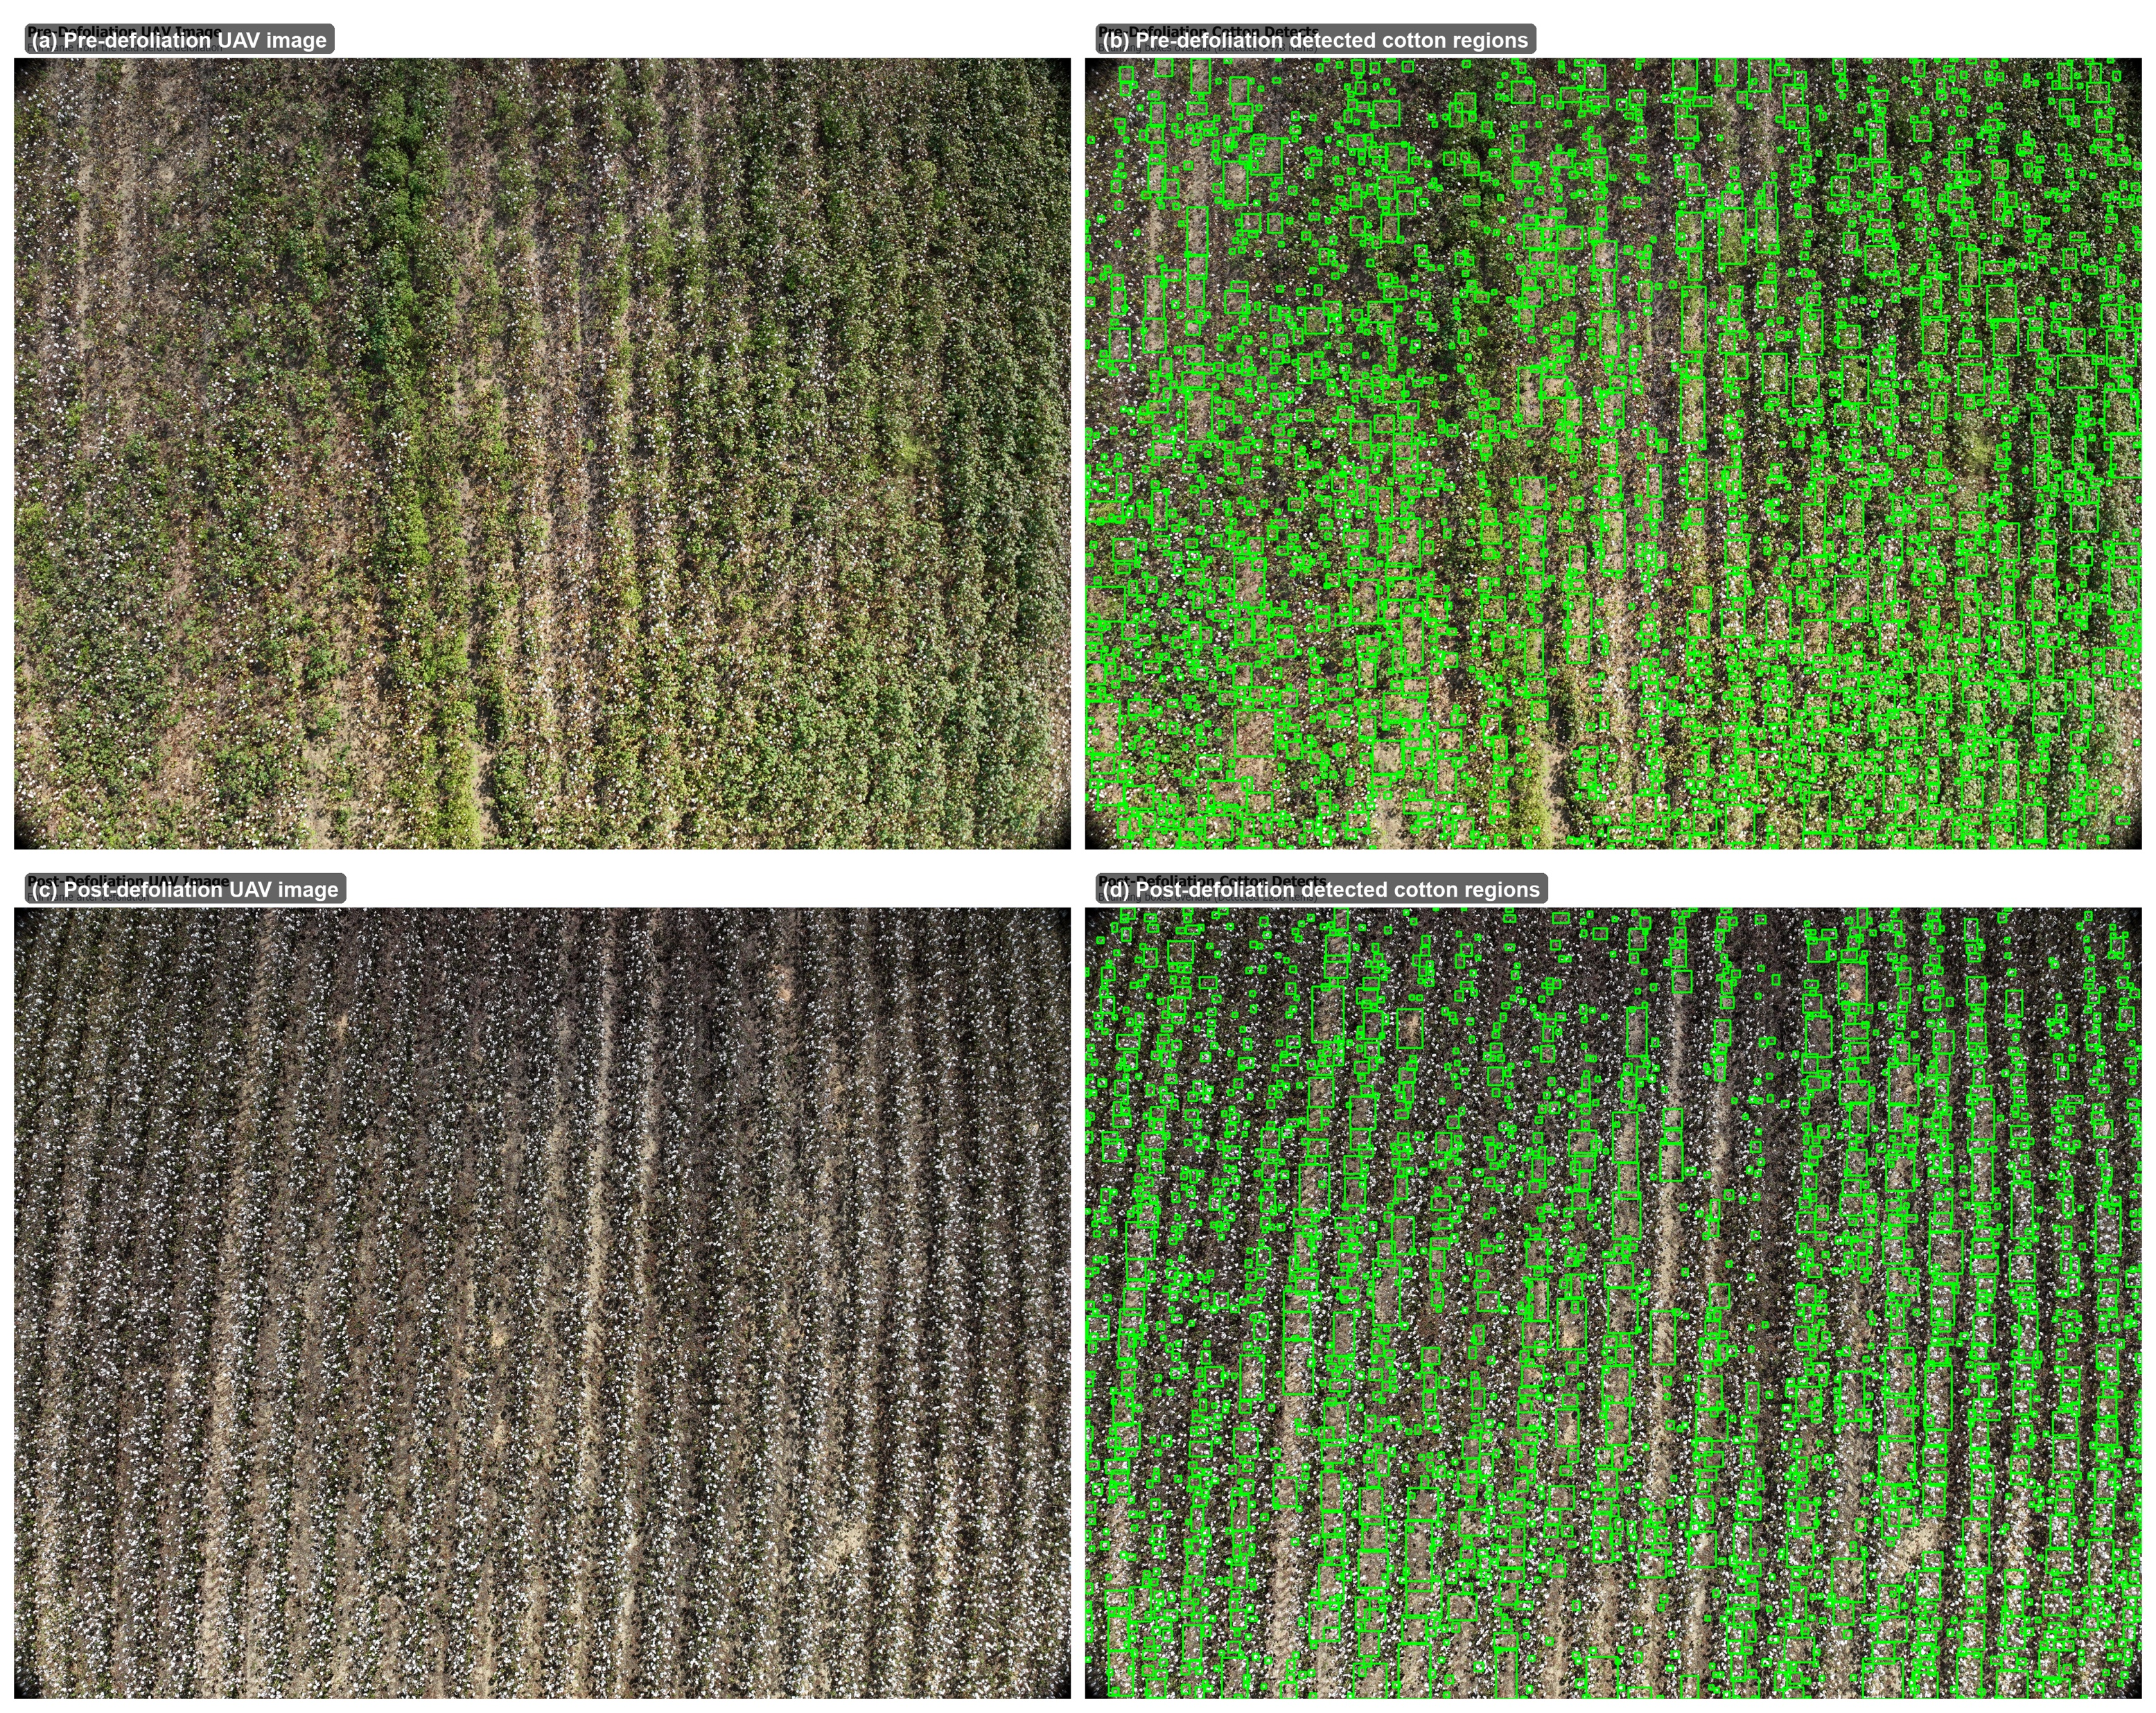
Pre- and Post-Defoliation Field Scenes with Detected Cotton Regions
UAV imagery shows the field before and after defoliation, alongside the corresponding detected cotton regions used for scene-level qualitative assessment
Figure 8: (a) Pre-defoliation UAV scene, (b) detected cotton regions before defoliation, (c) post-defoliation UAV scene, & (d) detected cotton regions after defoliation

Slide 17
Robustness Across Imaging Conditions
The table compares subset-selection methods under fog, glare, shadow, and additive noise to evaluate how stable each selected feature
Method
Fog
Glare
Shadow
Noise (σ = 0.15)
AgriQFS (QFS-k4)
0.8301
0.6280
0.7699
0.4903
MRMR (MI-k4)
0.9054
0.5935
0.9634
0.4624
RFE-k4
0.8667
0.6237
0.7699
0.4516
NonExG-k4
0.7333
0.5742
0.7699
0.4602
Table 1 :Comparative Robustness of Feature-Selection Methods
AgriQFS (QFS-k4): Agricultural Quantum Feature Selection, using a quantum-emulated search to select 4 features.
MRMR (MI-k4): Minimum Redundancy Maximum Relevance, a mutual-information filter baseline with 4 features.
RFE-k4: Recursive Feature Elimination, a wrapper-based 4-feature baseline.
NonExG-k4: an ablation baseline excluding the Excess Green cue to test subset dependence.
Our framework is more effective because it performs interaction-aware subset selection, allowing complementary spectral and textural cues to be chosen jointly

Slide 18
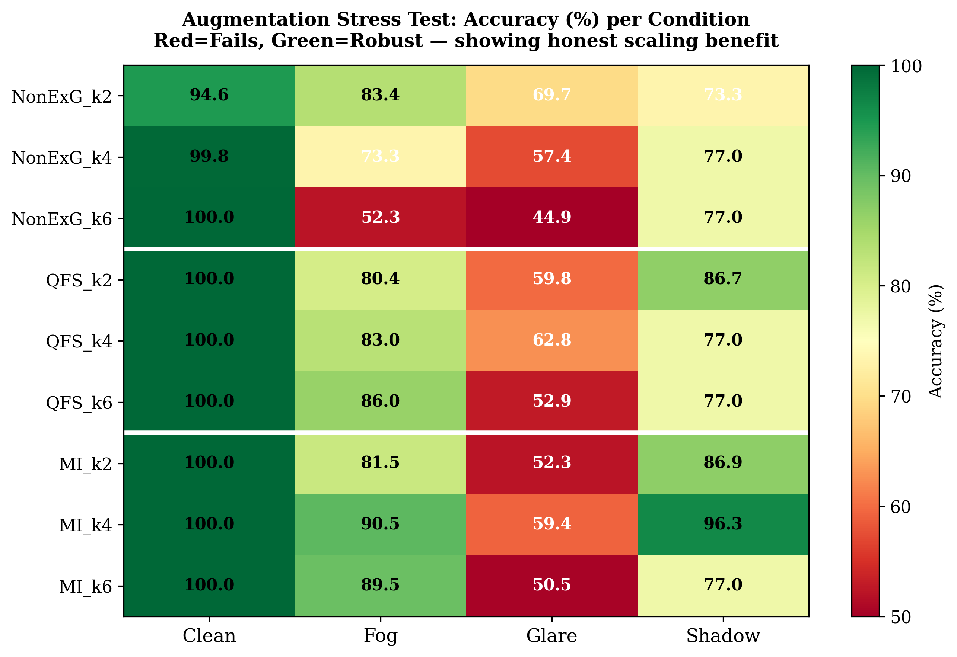
Robustness Landscape Across Perturbed Imaging Conditions
The heatmap compares subset-selection strategies across clean and perturbed conditions to reveal where quantum-guided feature selection remains most competitive under field-relevant stress
Figure 9: Condition-Wise Accuracy of QFS, NonExG, and Mutual-Information Baselines

Slide 19
Conclusion
The study shows that quantum-guided subset selection can produce compact, interpretable feature sets for cotton defoliation assessment from UAV imagery
This work presented a hybrid quantum-classical framework for feature selection in cotton defoliation monitoring from UAV imagery.
The method operates on interpretable spectral, textural, and structural descriptors.
The results show that AgriQFS identifies a compact subset that preserves discriminative structure between pre- and post-defoliation states.
Under clean conditions, the framework achieves strong performance while also maintaining low false-positive behavior, which is important for field reliability.
Under perturbed conditions, the method is not uniformly best across every scenario, but it remains competitive and shows its clearest value in regimes where interaction-aware selection matters.
Overall, supports the idea that quantum-emulated feature selection is scientifically useful as a subset-discovery mechanism, even when final inference remains classical method.

Slide 20
Future Work
Extend the framework from the current descriptor space to larger and more diverse feature sets, including multispectral or hyperspectral imaging data.
Evaluate the method across additional seasons, fields, cultivars, and acquisition conditions to test generalization beyond the current study setup.
Investigate whether the framework can support finer-grained defoliation estimation, more than pre-/post-defoliation discrimination.
Integrate the method into a broader precision-agriculture LLM decision pipeline, where robust feature selection supports prescription mapping and field-scale monitoring

Slide 21
Publications and Accepted Work
H. Manjunatha, P. Sundaravadivel, S. Borah, L. Tamil, P. Knight, H. Torbert, S. Kumpatla, "Beyond Green: Domain-Aware Self-Validated Instance Counting for Loropetalum and Non-Green Ornamental Species using Annotation-Free Robustness Metrics", In Proceedings of CVPR, Jun 2026. Accepted
A. Kode, H. Manjunatha, S. S. Borah, H. A. Torbert, P. Sundaravadivel, "Scalable Voice-Controlled Drone Autonomy: From Edge-Deployed Single Agents to Distributed HITL Swarm Simulations,” Accepted DCAS 2026.
H. Manjunatha, S. Borah, A. Anand, P. Sundaravadivel, L. Tamil, S. Kumpatla, P. Knight, H. Torbert, "Comparative Analysis of Large Language Models for Multimodal Agricultural Intelligence in Precision Nursery Management Systems", In Proceedings of LLM Conference, Dec 2025. Accepted LLM conference 2025.
P. Sundaravadivel, H. Manjunatha, K. Narasimhamurthy, et al., "Ros-AI: An LLM-Enhanced Scalable Multimodal Framework for UAV-Based Rose Bloom Analysis in Precision Agriculture", TechRxiv Preprint, Oct 2025. DOI: 10.36227/techrxiv.176108108.86171044/v1.
M. Syed, A. Anand, S. Borah, H. Manjunatha, P. Sundaravadivel, P. Knight, P. Gowda, H. Torbert, "MagCount: A Digital Framework for Automated Counting of Southern Magnolias for Inventory Management in Nurseries", In Proceedings of IPPS, Oct 2025.
H. Manjunatha, P. Sundaravadivel, S. Borah, L. Tamil, S. Kumpatla, P. Knight, H. Torbert, "AI-driven Tool for High-dimensional Phenotyping of Rose Flowers using Hyperspectral Imaging", In Proceedings of IPPS, Oct 2025.

Slide 22
References
[1] H. Zhao, C. Ren, X. Li, T. Lin, et al., “Diagnostic study of defoliation and boll opening effects on machine-harvested cotton using multi-source UAV remote sensing data,” Industrial Crops and Products, vol. 237, p. 121827, 2025, doi: 10.1016/j.indcrop.2025.121827.
[2] P. Chen, W. Xu, Y. Zhan, W. Yang, J. Wang, and Y. Lan, “Evaluation of cotton defoliation rate and establishment of spray prescription map using remote sensing imagery,” Remote Sensing, vol. 14, no. 17, p. 4206, 2022, doi: 10.3390/rs14174206.
[3] N. Aierken, B. Yang, Y. Li, P. Jiang, G. Pan, and S. Li, “A review of unmanned aerial vehicle based remote sensing and machine learning for cotton crop growth monitoring,” Computers and Electronics in Agriculture, vol. 227, pt. 2, p. 109601, 2024, doi: 10.1016/j.compag.2024.109601.
[4] Y. Wang, Z. Zhang, C. Xiao, T. Zhang, K. Yu, C. Zhang, Q. Liao, F. Li, S. Wan, G. Cao, X. Tang, M. Du, and Z. Li, “Characterizing cotton defoliation progress via UAV-based multispectral-derived leaf area index and analysis of influencing factors,” Remote Sensing, vol. 18, no. 4, p. 609, 2026, doi: 10.3390/rs18040609.
[5] L. Zhang, B. Sun, D. Zhao, C. Shan, G. Wang, C. Song, P. Chen, and Y. Lan, “Prediction of cotton FPAR and construction of defoliation spraying prescription map based on multi-source UAV images,” Computers and Electronics in Agriculture, vol. 220, p. 108897, 2024, doi: 10.1016/j.compag.2024.108897.
[6] J. Tan, J. Ding, Z. Wang, L. Han, X. Wang, Y. Li, Z. Zhang, S. Meng, W. Cai, and Y. Hong, “Estimating soil salinity in mulched cotton fields using UAV-based hyperspectral remote sensing and a Seagull Optimization Algorithm-Enhanced Random Forest Model,” Computers and Electronics in Agriculture, vol. 221, p. 109017, 2024, doi: 10.1016/j.compag.2024.109017.
[7] E. Gil-Fuster, J. Eisert, and C. Bravo-Prieto, “Understanding quantum machine learning also requires rethinking generalization,” Nature Communications, vol. 15, art. no. 2277, 2024, doi: 10.1038/s41467-024-45882-z.
[8] F. Hu, S. A. Khan, N. T. Bronn, G. Angelatos, G. E. Rowlands, G. J. Ribeill, et al., “Overcoming the coherence time barrier in quantum machine learning on temporal data,” Nature Communications, vol. 15, art. no. 7491, 2024, doi: 10.1038/s41467-024-51162-7.
[9] S. Raubitzek, S. Schrittwieser, A. Schatten, and K. Mallinger, “Quantum inspired kernel matrices: Exploring symmetry in machine learning,” Physics Letters A, vol. 525, p. 129895, 2024, doi: 10.1016/j.physleta.2024.129895.
[10] D. Pranjić, B. C. Mummaneni, and C. Tutschku, “Quantum annealing-based feature selection,” Neurocomputing, vol. 658, p. 131673, 2025, doi: 10.1016/j.neucom.2025.131673.
[11] B. Kaushik, A. Rajpal, and N. Kumar, “QEFS: Quantum evolutionary feature selector for a real quantum computer,” Applied Soft Computing, early access, 2026, Art. no. 114965, doi: 10.1016/j.asoc.2026.114965.
[12] Y. Vivek, V. Ravi, and P. R. Krishna, “Quantum-inspired evolutionary algorithms for feature subset selection: A comprehensive survey,” Quantum Information Processing, vol. 24, no. 7, art. no. 196, 2025, doi: 10.1007/s11128-025-04787-6.
[13] A. K. Mandal and B. Chakraborty, “Quantum computing and quantum-inspired techniques for feature subset selection: A review,” Knowledge and Information Systems, early access, 2024, doi: 10.1007/s10115-024-02282-5.

Slide 23
Thanks for listening!
GitHub: https://github.com/harshitha-8
LinkedIn: https://www.linkedin.com/in/harshitha-manjunatha/

