Slide 1

Orthopedic walker fall detection
Activity Logging Using Motion Classification

Slide 2

Team-3
V. Abhinav
AM.EN.U4CSE21060
V. Naga Varnika
AM.EN.U4CSE21059
Ch. Harshitha
AM.EN.U4CSE21018

Slide 3
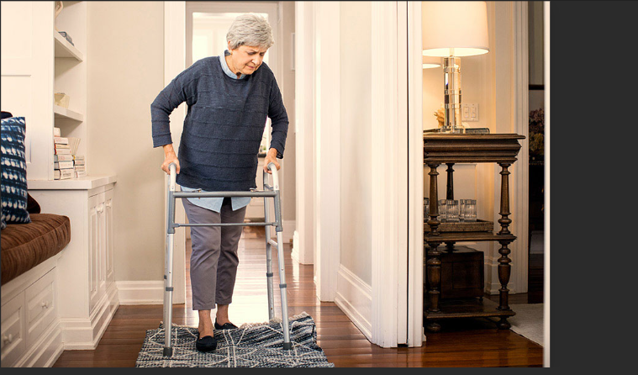

Problem Statement
Fall incidents among elderly individuals and patients with limited mobility who rely on orthopedic walkers pose a significant risk to their safety and well-being.

Slide 4

Datasets

Slide 5
The Dataset for the project is taken from Kaggle
The actual data is taken from the sensors on orthopedic walkers, wearable devices, and a combination of sources.
Walker Fall Detection Dataset (kaggle.com)
Data Source

Slide 6
Accelerometer Features (acc):
acc_x_0 to acc_x_8: Accelerometer readings along the X-axis.
acc_y_0 to acc_y_8: Accelerometer readings along the Y-axis.
Gyroscope Features (gy):
gy_x_0 to gy_x_159: Gyroscope readings along the X-axis.
gy_y_0 to gy_y_159: Gyroscope readings along the Y-axis.
Label:
The target variable.
Features

Slide 7
The falls are Labelled as:
Idle: Represents periods of no movement, indicating that the walker is stationary.
Step: Capture moments when an individual takes a step using the walker.
Movement: Covers any movement that is not considered a step or a fall, such as when carrying the walker or adjusting its position.
Fall: Denotes cases in which the walker tips over and falls to the ground from an upright position.
Labelling

Slide 8
Data Volume
Data Quality
The dataset has 961 columns, with the first column being 'label' and the rest being sensor readings.
The sensor readings are likely from three axes (X, Y, and Z) for both accelerometer (acc) and gyroscope (gy).
The numerical values in these columns represent the sensor readings over time.
Missing Values:
Simple Mean Imputer is used.
Outliers:
Z-score handling is used.
Duplicates:
Duplicates are dropped.

Slide 9
Models
Used

Slide 10
Extra Trees (Extremely Randomized Trees) is an ensemble learning method that builds multiple decision trees during training and merges them together for more robust predictions.
Unlike traditional Random Forests, Extra Trees not only bootstrap samples but also randomly select features at each split point in the trees. This adds an extra layer of randomness, making it more resistant to overfitting.
Extra Trees aims to strike a balance between bias and variance. By introducing additional randomness, it often reduces overfitting, making it suitable for various types of datasets.
Extra Trees can be computationally more efficient than Random Forests because it requires fewer computations to find the optimal split at each node due to the random feature selection.
Extra Trees

Slide 11
Random Forest is an ensemble learning method that builds multiple decision trees during training and merges them together to get a more accurate and stable prediction.
Random Forest employs bootstrap sampling, meaning that each tree is trained on a random subset of the original dataset with replacement. This introduces diversity among the trees.
At each split in the tree, Random Forest considers a random subset of features for making the split decision. This helps decorrelate the trees and avoid overfitting.
The combination of bootstrap sampling and feature randomness helps reduce the variance of the model, making Random Forest less prone to overfitting compared to individual decision trees.
Random
Forest

Slide 12
Support Vector Machines(SVM) is a powerful algorithm for binary classification tasks, making it suitable for scenarios where the goal is to classify instances into "fall" or "non-fall" categories.
SVM aims to find a hyperplane that maximizes the margin between different classes. This can contribute to better generalization performance on unseen data.
SVM can efficiently handle non-linear decision boundaries through the use of kernel functions, such as the radial basis function (RBF) kernel. This allows SVM to capture complex relationships in the data.
SVM can handle high-dimensional data, which is beneficial if your fall detection dataset contains a large number of features or sensor inputs.
SVM

Slide 13
Result & Analysis

Slide 14
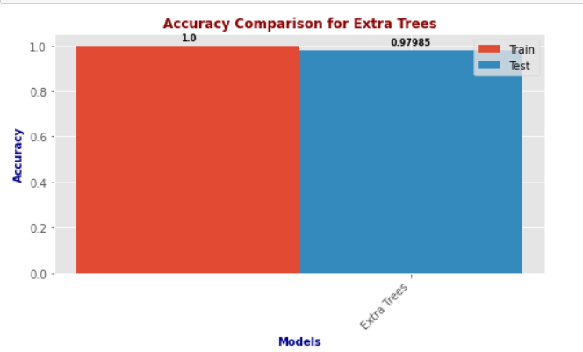
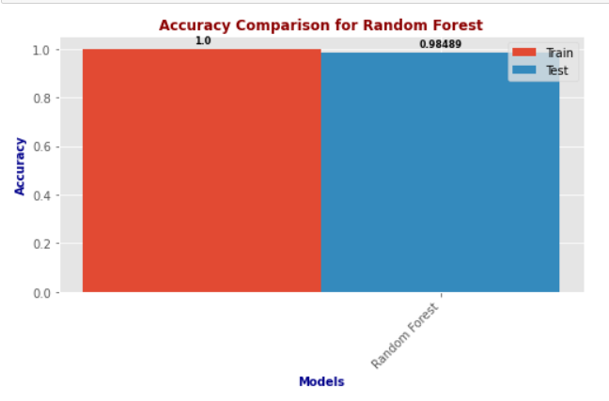
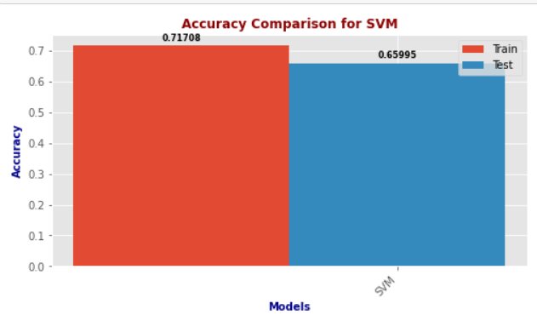
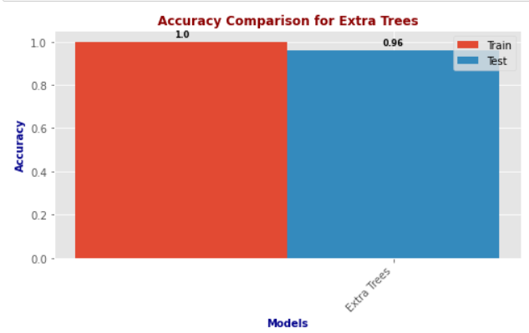
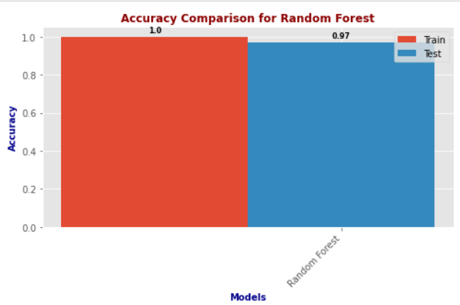
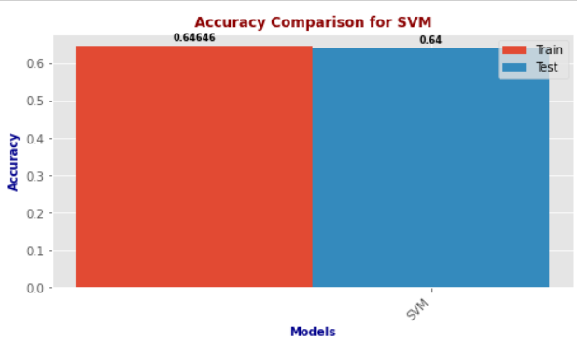
Accuracies
Dataset-1
Dataset-2

Slide 15
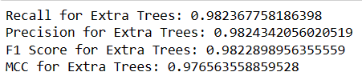
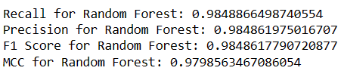
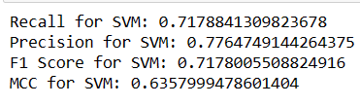
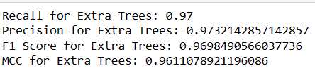
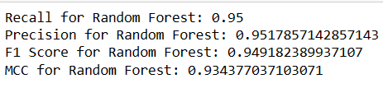
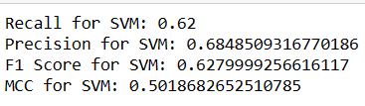

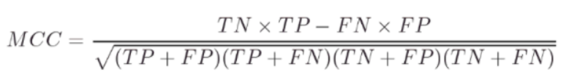

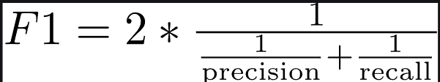
Dataset-1
Dataset-2
Performance
Metrics

Slide 16
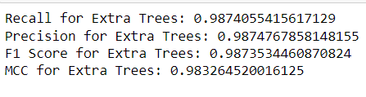
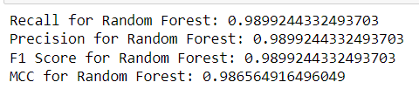
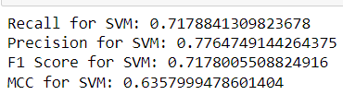
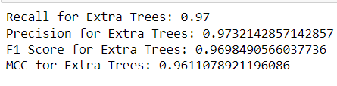
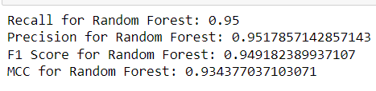
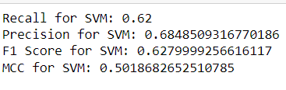
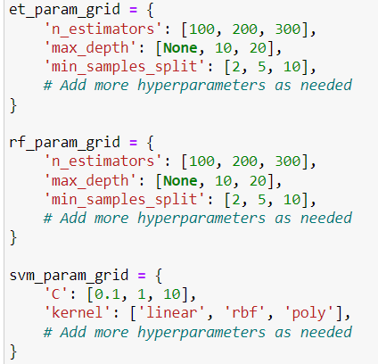
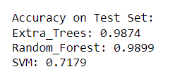
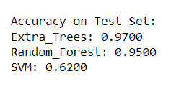
Dataset-1
Dataset-2
Hyperparameter
Tuning

Slide 17
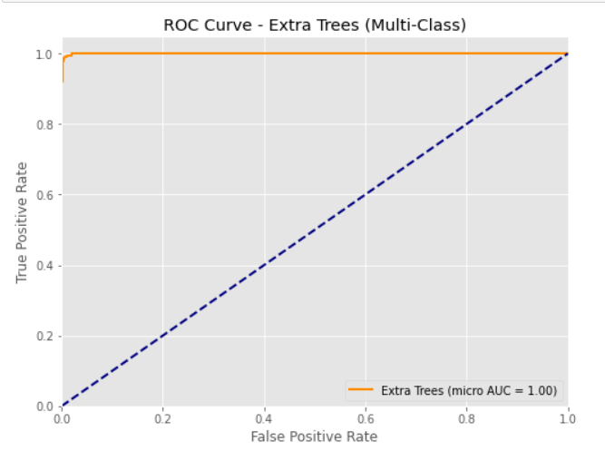
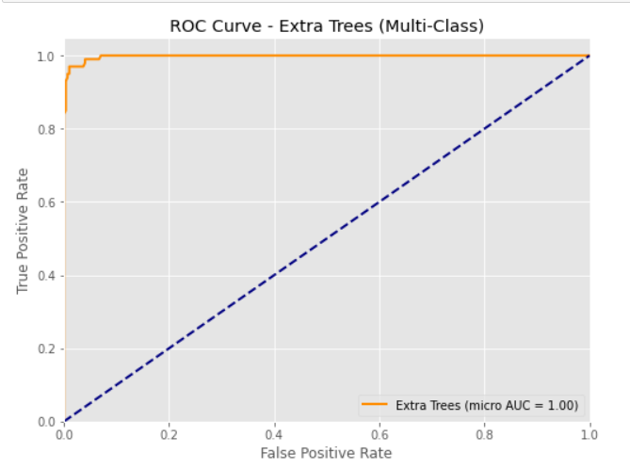
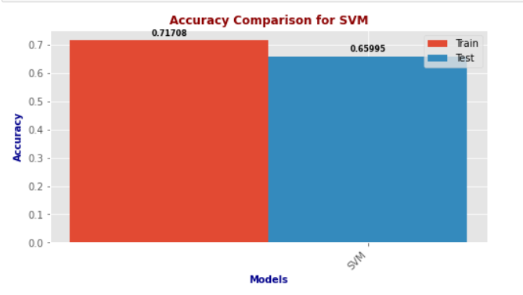
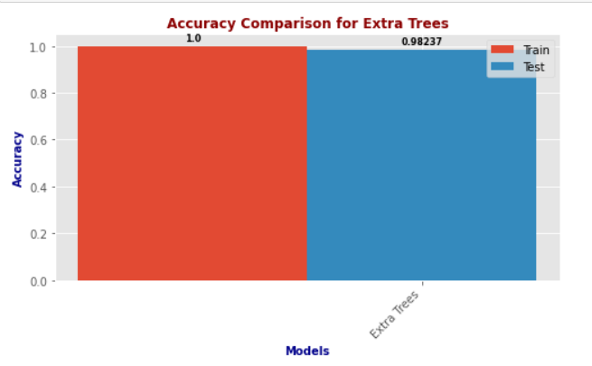
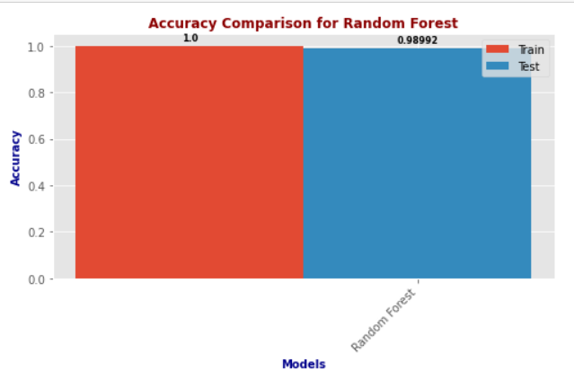
ROC curves
Dataset-2
Dataset-1
Performance: The Extra Trees classifier appears to have perfect performance for this multi-class classification task. This is indicated by the Area Under the Curve (AUC) of 1.00. An AUC of 1.00 means that the model has a perfect distinction between the positive class and the negative class.
True Positive Rate (TPR): The curve touches the top left corner of the plot, which means it has a high true positive rate. This indicates that the model correctly identified a high proportion of positive instances.
False Positive Rate (FPR): The low false positive rate suggests that the model has a low rate of incorrectly classifying negative instances as positive.
Comparison to Random Guessing: The blue dashed line represents the line of no-discrimination (random guessing), running diagonally from (0,0) to (1,1). The fact that the orange line (representing the Extra Trees classifier) is far above this line indicates that the model is performing significantly better than random guessing.
Remember, while an AUC of 1.00 is ideal, it’s also important to consider the context and the cost of false positives and false negatives in the specific application of the model. It’s always a good idea to use additional metrics to evaluate the model’s performance.

Slide 18
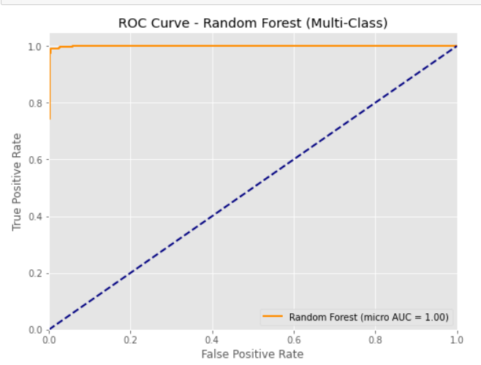
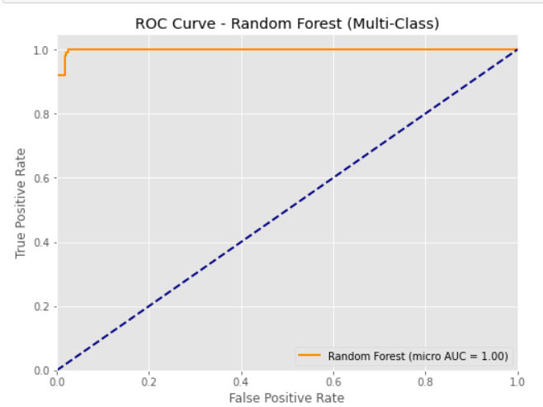
Dataset-1
Dataset-2
ROC curves
Performance: The Extra Trees classifier appears to have perfect performance for this multi-class classification task. This is indicated by the Area Under the Curve (AUC) of 1.00. An AUC of 1.00 means that the model has a perfect distinction between the positive class and the negative class.
True Positive Rate (TPR): The curve touches the top left corner of the plot, which means it has a high true positive rate. This indicates that the model correctly identified a high proportion of positive instances.
False Positive Rate (FPR): The low false positive rate suggests that the model has a low rate of incorrectly classifying negative instances as positive.
Comparison to Random Guessing: The blue dashed line represents the line of no-discrimination (random guessing), running diagonally from (0,0) to (1,1). The fact that the orange line (representing the Extra Trees classifier) is far above this line indicates that the model is performing significantly better than random guessing.
Remember, while an AUC of 1.00 is ideal, it’s also important to consider the context and the cost of false positives and false negatives in the specific application of the model. It’s always a good idea to use additional metrics to evaluate the model’s performance.

Slide 19
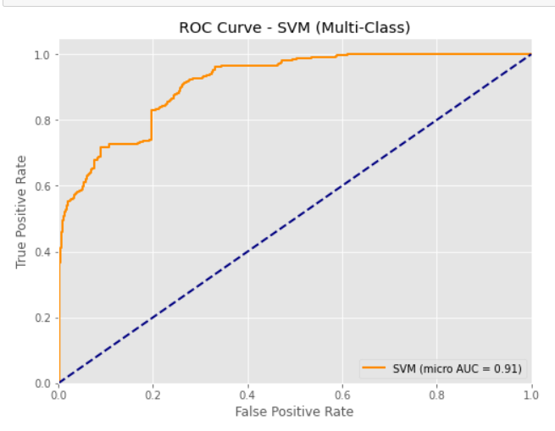
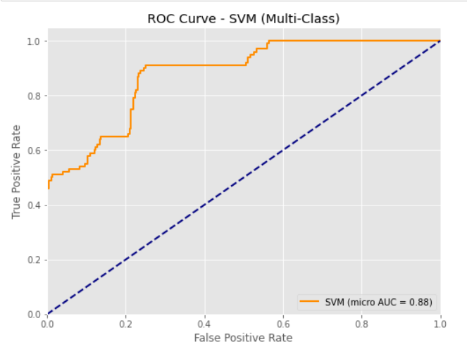
Dataset-1
Performance: The Extra Trees classifier appears to have perfect performance for this multi-class classification task. This is indicated by the Area Under the Curve (AUC) of 0.91 and0.88.Which means that the model has a perfect distinction between the positive class and the negative class.
True Positive Rate (TPR): The curve touches the top left corner of the plot, which means it has a high true positive rate. This indicates that the model correctly identified a high proportion of positive instances.
False Positive Rate (FPR): The low false positive rate suggests that the model has a low rate of incorrectly classifying negative instances as positive.
Comparison to Random Guessing: The blue dashed line represents the line of no-discrimination (random guessing), running diagonally from (0,0) to (1,1). The fact that the orange line (representing the Extra Trees classifier) is far above this line indicates that the model is performing significantly better than random guessing.
Remember, while an AUC of those ranges is ideal, it’s also important to consider the context and the cost of false positives and false negatives in the specific application of the model. It’s always a good idea to use additional metrics to evaluate the model’s performance.
ROC curves
Dataset-2

Slide 20
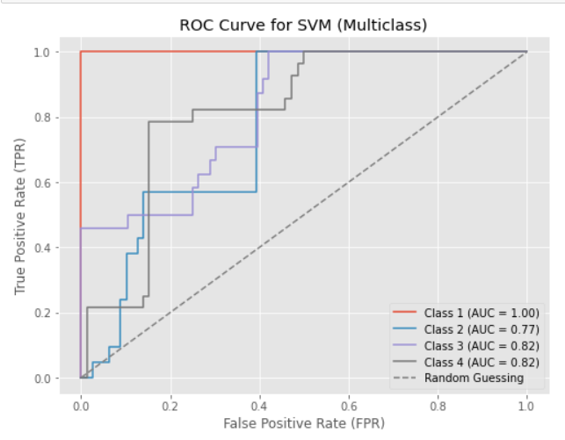
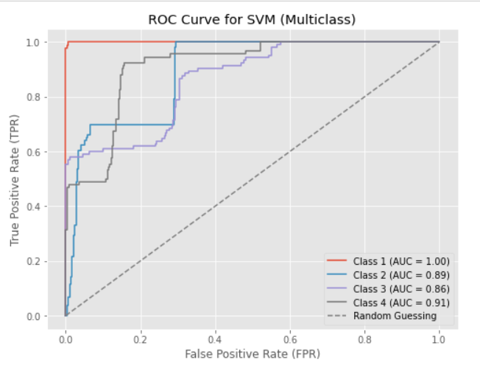
Conclusion
ROC curves

Slide 21
In this machine learning project, our goal was to develop an accurate, economical, and reliable solution for fall detection in individuals relying on orthopedic walkers. The primary focus was on enhancing the safety and well-being of elderly individuals and patients with limited mobility.
Considering the accuracies of the 3 models we used, Random Forest gives the highest accuracy. Given its consistently high performance and adaptability, Random Forest stands as the preferred choice for the implementation of an accurate, economical, and reliable fall detection system for individuals relying on orthopedic walkers.
ROC curves

Slide 22
Thank You
ROC curves

