Slide 1
E-Commerce Sales Analysis

Slide 2

Introduction
E-Commerce, or electronic commerce, refers to the buying and selling of goods and services using the internet. It has transformed the traditional retail landscape by offering consumers the convenience of shopping from anywhere at any time analyzing this data allows businesses to improve decision-making, personalize marketing, optimize inventory, and enhance the overall customer experience.

Slide 3
objectives
Understand Sales Performance Over Time
Identify High-Performing Locations and Time Periods
Explore Product-Level Insights
Detect Patterns and Relationships in Data
Provide Actionable Business Insights

Slide 4
Libraries
import pandas as pd
import matplotlib.pyplot as plt
import seaborn as sns
import warnings
warnings.filterwarnings('ignore')

Slide 5
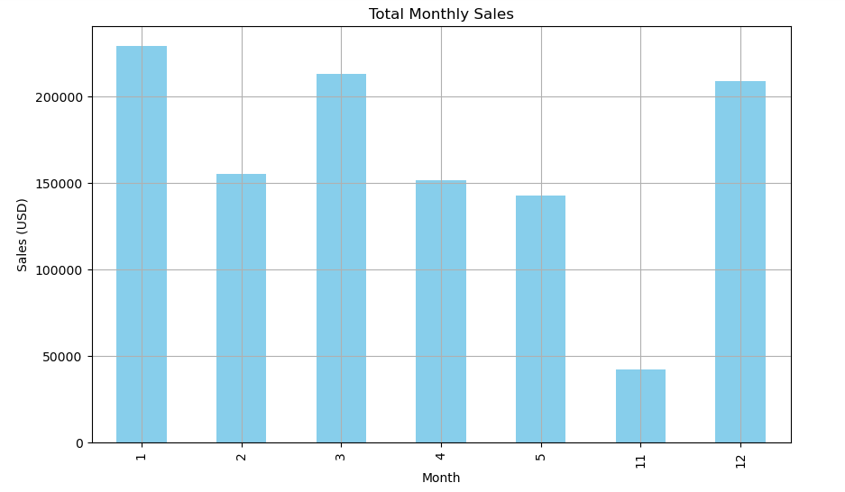
Monthly Sales Analysis
Visualizes total monthly sales using a bar chart.

Slide 6
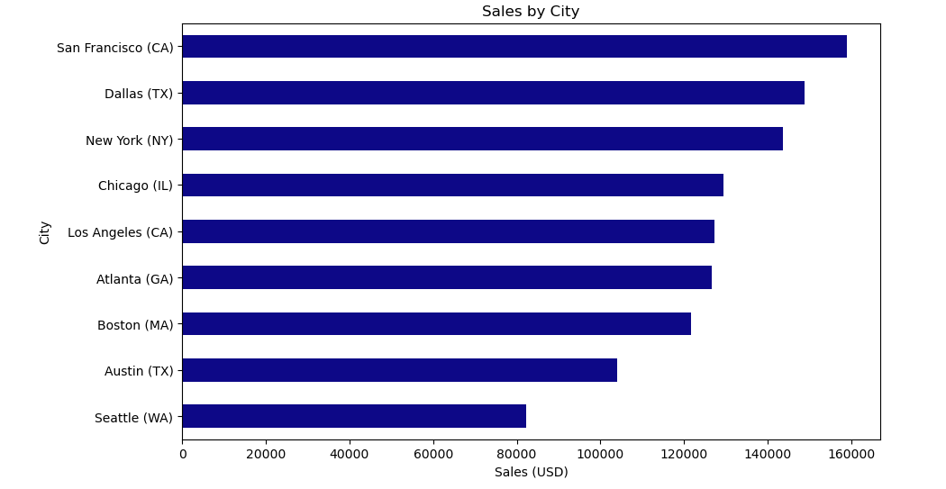
Sales by City
Shows which cities have the highest sales with a horizontal bar chart.

Slide 7
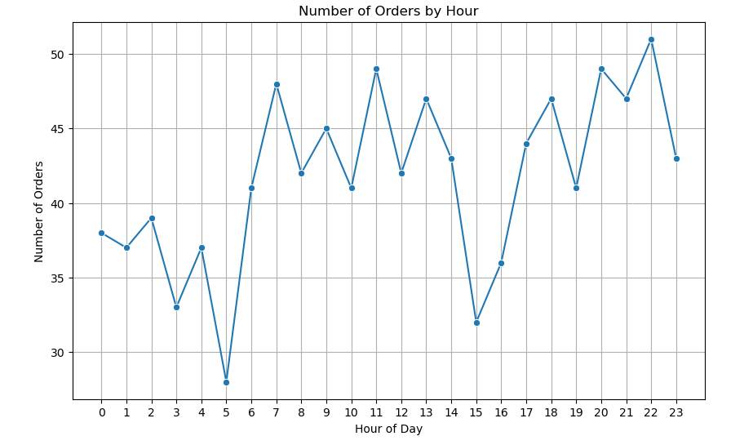
Orders by Hour
Line graph displaying number of orders at each hour.

Slide 8
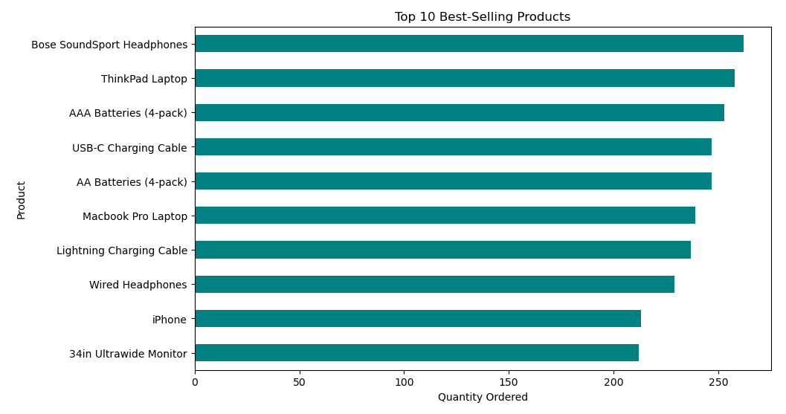
Best-Selling Products
Horizontal bar chart of top 10 best-selling products.

Slide 9
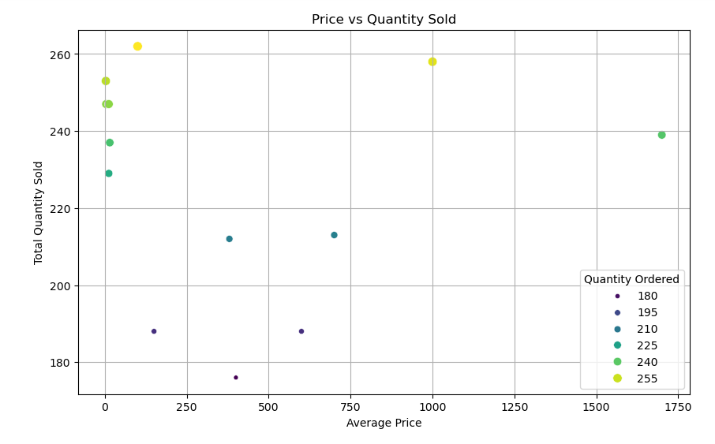
Price vs Quantity Scatter Plot
Scatter plot showing relationship between price and quantity sold.

Slide 10
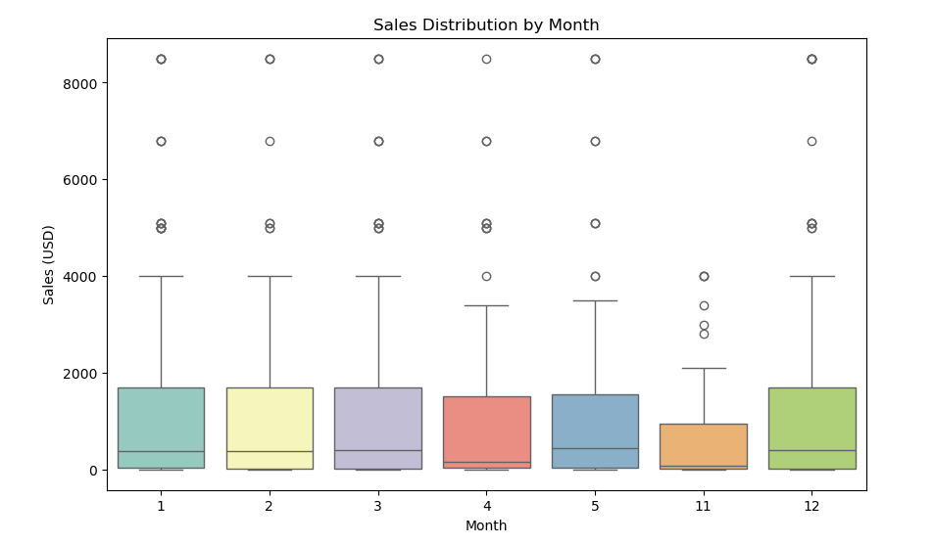
Monthly Sales Distribution
Box plot to identify spread and outliers in monthly sales.

Slide 11
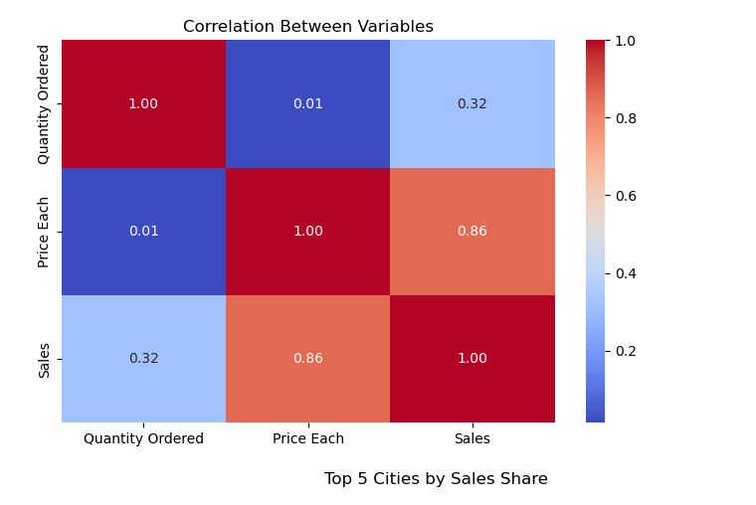
Correlation Heatmap
Displays how Quantity, Price, and Sales relate to one another.

Slide 12
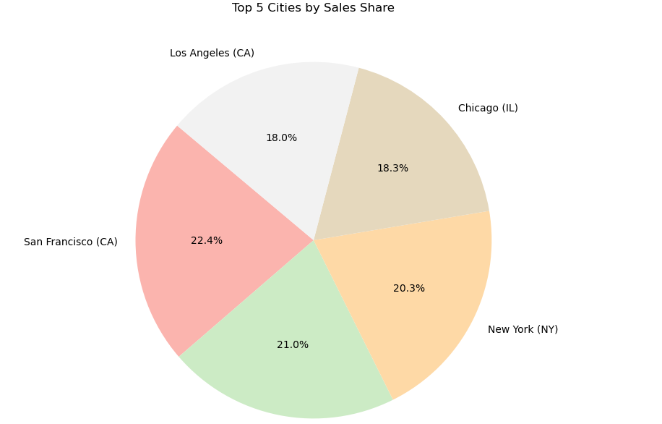
Pie Chart of Top 5 Cities
Pie chart showing percentage of sales from top 5 cities.

Slide 13
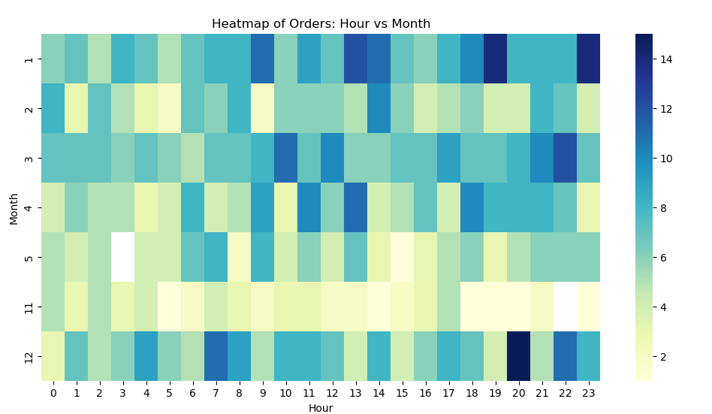
Heatmap by Hour & Month
Shows order density based on time of day and month.

