Slide 1


VISVESVARAYA TECHNOLOGICAL UNIVERSITY
Belgaum - 590 018
Universal Driver Drowsiness Detection System using Computer vision
Presented By:
HARSHITHA M V 1AY22AI038
Under the Guidance of
Dr Vijayashekar S S
HoD, Dept of AI&ML

Slide 2
Content
Abstract
Introduction
Problem Statement
System Architecture
Methodology
Future scope
Conclusion

Slide 3
Abstract
Driver drowsiness is one of the major causes of road accidents worldwide, leading to loss of lives and property. Continuous monitoring of a driver’s alertness is therefore essential to ensure road safety. This project presents a Universal Driver Drowsiness Detection System based on real-time computer vision techniques.
The system is implemented using Python, OpenCV, Flask, and Pygame, making it cost-effective, fast, and reliable. The use of a web-based interface allows real-time monitoring through a browser.

Slide 4
Introduction
Driver drowsiness is a major cause of road accidents due to reduced alertness, slow reaction time, and loss of concentration.
Traditional safety systems cannot monitor the mental state of the driver in real-time.
This project proposes a real-time Driver Drowsiness Detection System using Computer Vision techniques.
The system continuously monitors eye activity and triggers an alarm when drowsiness is detected, ensuring enhanced road safety.

Slide 5
Problem statement
Over 20% of road accidents occur due to driver fatigue.
No real-time alert mechanism exists in most vehicles.
Human life is highly dependent on timely fatigue detection.
Manual monitoring is unreliable and impractical.
Need for an automated, real-time, intelligent safety system.

Slide 6
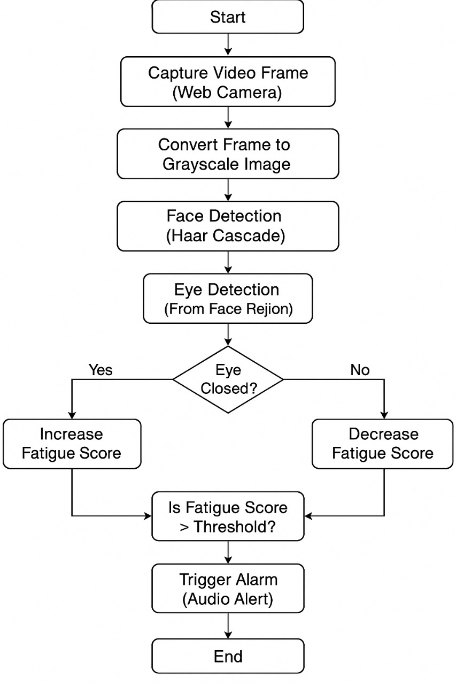
System Architecture

Slide 7
METHODOLOGY
Step-by-Step Process:
Capture live video frames using OpenCV
Convert to grayscale for faster processing
Detect face using Haar Cascade
Detect eyes from face region
Monitor eye closure duration
Increase fatigue score if eyes closed
Trigger alarm if threshold crossed

Slide 8
Conclusions
The Driver Drowsiness Detection System successfully detects fatigue in real time using computer vision.
The system uses a webcam, Haar Cascade classifiers, and fatigue scoring to monitor eye activity continuously.
An instant audio alarm is generated when drowsiness is detected, ensuring immediate alert to the driver.

Slide 9
Thank you

