Slide 1
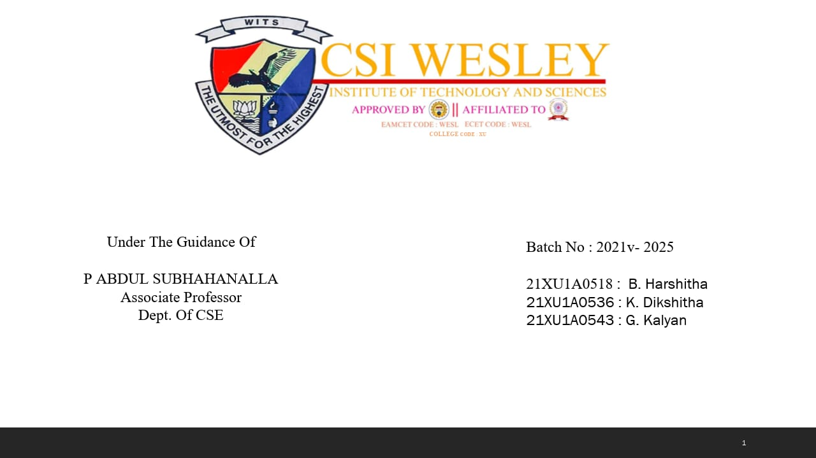

Slide 2
CONTENTS
Introduction
Literature Survey
Existing System
Proposed System
Software requirements
Hardware requirements
Architecture
Advantages

Slide 3
Disadvantages
Objectives
Modules
Algorithms for stock market prediction
Comparison of Models
Model performance metrics
Conclusion
References

Slide 4
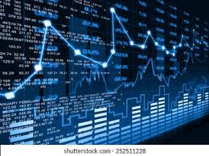
Introduction
The stock market facilitates the buying and selling of securities, including stocks, bonds, and derivatives, enabling investors to trade ownership in companies and debt instruments.
It serves as an indicator of economic health, reflecting the overall performance and confidence in the economy based on stock price movements and trading volumes.

Slide 5
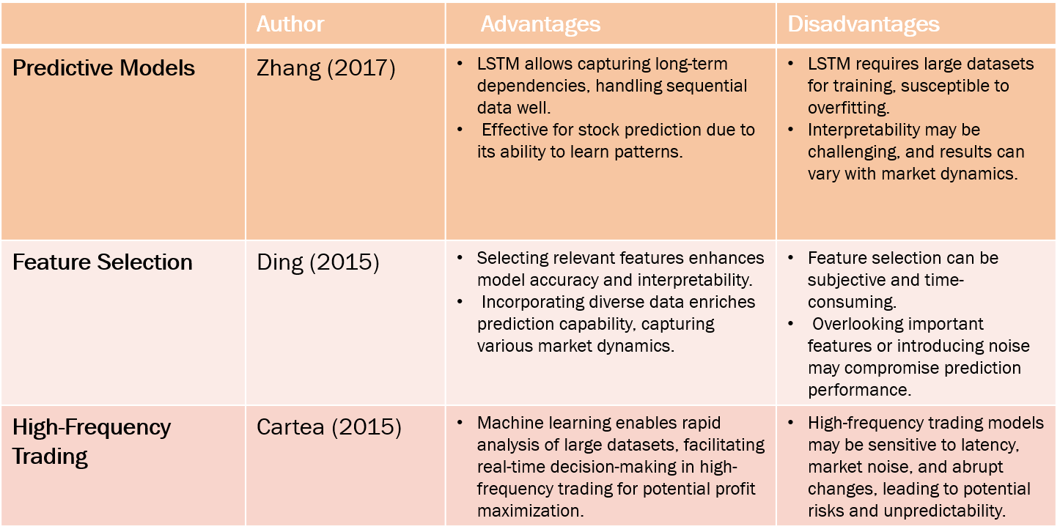
Literature Survey

Slide 6
Existing Systems
Alpha Vantage: Provides real-time and historical equity data through an API, allowing users to perform technical analysis and build predictive models.
Quandl: Offers a wide range of financial and economic data, including real-time stock prices, which can be used for building predictive models and backtesting trading strategies.
StockViz: A platform that provides real-time stock market data, analysis tools, and predictive analytics for traders and investors.

Slide 7
Proposed System
We propose a method to enhance stock market prediction accuracy by combining sentiment analysis on Twitter data with high-frequency data analysis.
This method aims to capture market dynamics and public sentiment towards specific companies. We collect and preprocess tweets to understand public sentiment, then extract features to capture market dynamics.
These features, combined with sentiment analysis results, train a machine learning model for stock price prediction.
Our model, evaluated using historical stock data and Twitter sentiment data, shows improved prediction accuracy over traditional methods, highlighting the potential of high-frequency data analysis in stock market prediction.

Slide 8
Software Requirements
programming language : machine learning, python
Data base : CSV files
Web server : Flask
Frame Works : YAHOO, Twitter API
IDE : PyCharm, Visual studio, IDE
Version Control : Git
Web Server : XAMP server

Slide 9
HARDWARE REQUIREMENTS
Processor : Amd Ryzen 5
RAM : Minimum 4 GB
Storage : Minimum 25 GB
Internet Connection : Stable broadband connection for server deployment and testing

Slide 10
Advantages
Enhanced Prediction Accuracy: Our model combines sentiment analysis on Twitter data with high-frequency data analysis, improving prediction accuracy by capturing market dynamics and public sentiment towards specific companies.
Comprehensive Market Understanding: By integrating sentiment analysis with high-frequency data analysis, our model provides a more comprehensive understanding of the market, enabling better-informed decision-making.

Slide 11
Disadvantages
Limited Predictive Power: Alpha Vantage and Quandl lack sentiment analysis integration, limiting insights into market sentiment and potential price movements.
Data Silos: These platforms focus on financial data, not integrating with news or social media, limiting analysis scope.
Complexity and Cost: Implementing and maintaining these models can be complex and costly, requiring specialized knowledge, whereas sentiment analysis models are simpler to implement.

Slide 12
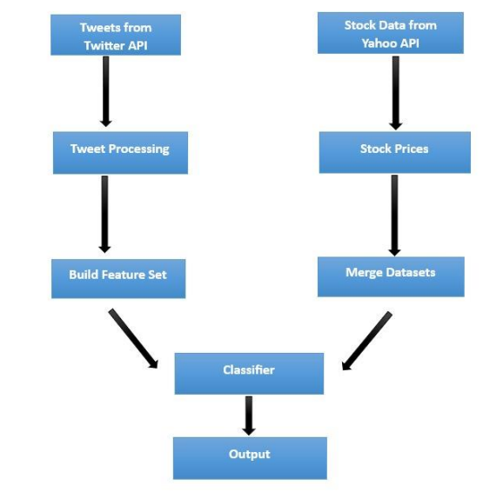
Architecture

Slide 13
Objectives
Building a Stock market prediction model using machine learning algorithms and sentiment analysis. Using machine learning algorithms to build an accurate predictive model.
By using Sentimental Analysis, we are analyzing the people’s opinion based on that we are predicting the accuracy.
Taking twitter tweets into consideration, the historic data and the tweets are being compared based on that we are selecting the best one of it.

Slide 14
Modules
Data Collection and Preparation
Data Transformation and Algorithm Application
Model Evaluation and Deployment
Random Forest
Linear Discriminant Analysis

Slide 15
Methodology
Data Collection:
This investigation makes use Stock_tweets and Stock_yfinance_Data Datasets
APIs: Utilize APIs provided by financial data sources like Alpha Vantage, Yahoo Finance, or Google Finance to gather real-time or historical stock price data.
Social Media APIs: Platforms like Twitter, Reddit, or Stock Twits offer APIs to fetch relevant tweets or posts related to specific stocks.

Slide 16
Methodology
Data preprocessing:
Data Cleaning: Removing stopwords, punctuation, and other noise from the text data.
Data Transformation: Data transformation is a crucial step in preparing data for analysis or modeling. In the context of a stock prediction project using sentiment analysis, data transformation involves converting raw data into a format suitable for analysis or feeding into machine learning models.
Sentiment analysis:
In this step we are calculating the percentage in the form of positive ,neural and negative.

Slide 17
Methodology
Feature Set Creation:
In the context of a stock prediction project using sentiment analysis, feature extraction involves converting raw data into numerical representations that can be used as inputs to machine learning models.
Model training:
Once you've extracted relevant features from your data, the next step in a stock prediction project using sentiment analysis is to train machine learning models. Train the Random forest and SVM models with the merged dataset.

Slide 18
Methodology
Prediction:
After completion of training the model for stock prediction using sentiment analysis, the next steps involve making predictions on new data and evaluating the model's performance. Use the trained model to make predictions on new or unseen data. This data should be separate from the training, validation, and test sets used during model development.

Slide 19
Algorithms for stock market prediction
Random Forest(RF):
Random Forest is a popular ensemble learning algorithm used in both classification and regression tasks. It helps in reducing overfitting and increasing model robustness.
Linear Discriminant Analysis(LDA):
LDA can handle both linear and non-linear decision boundaries through the use of different kernel functions. LDA is effective in high-dimensional spaces and is robust against overfitting, especially in cases where the number of features exceeds the number of samples.

Slide 20
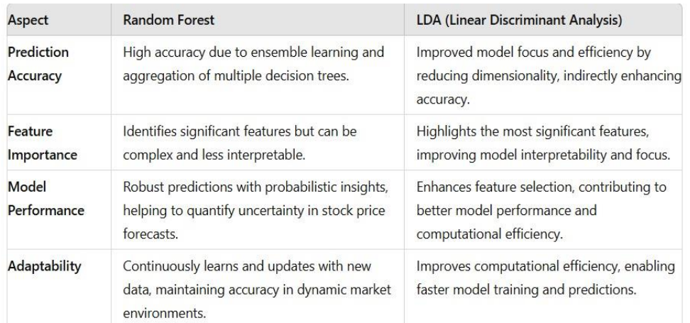
Comparison of Models

Slide 21
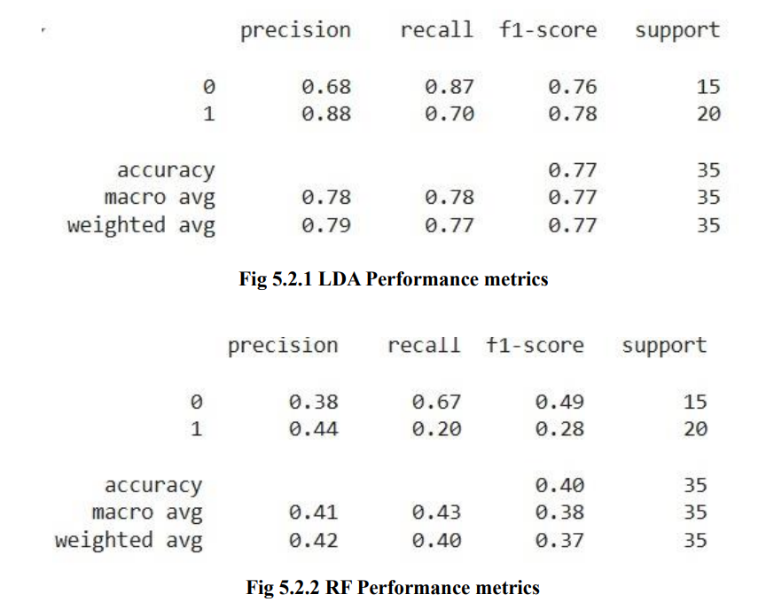
Model Performance metrics

Slide 22
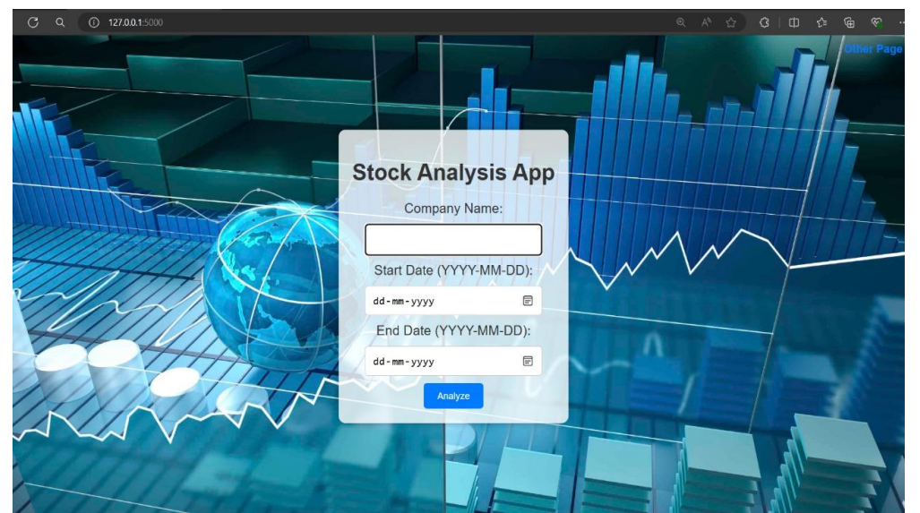
Results

Slide 23
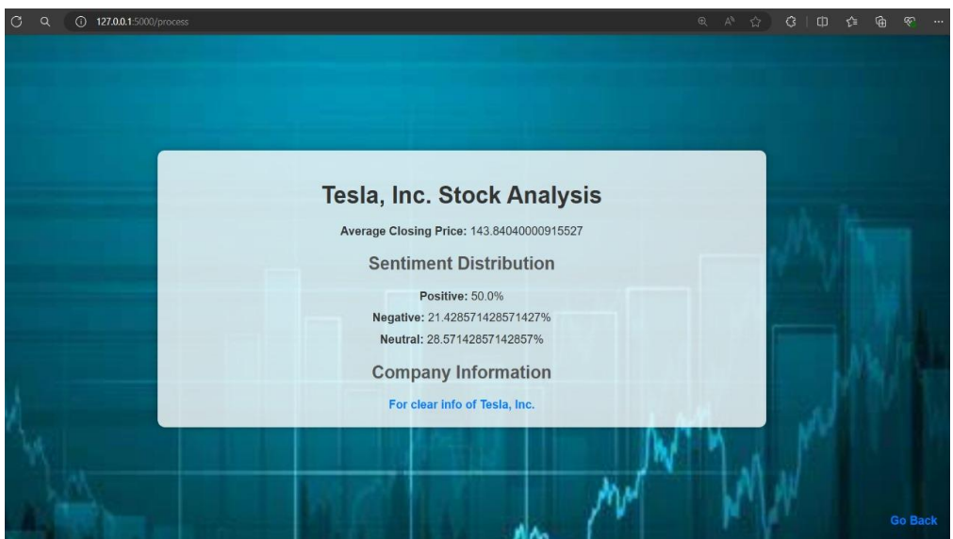
Results

Slide 24
Conclusion
By leveraging machine learning techniques to analyze historical market data and sentiment analysis of Twitter tweets, we developed a predictive model capable of capturing market movements with higher accuracy.
However, careful attention to data quality, model evaluation, and continuous improvement is essential for realizing the full potential of this approach.

Slide 25
References
T. Fischer and C. Krauss, “Deep learning with long short-term memory networks for financial market predictions,” Eur. J. Oper. Res., vol. 270,no. 2, pp. 654–669, Dec. 2017.
X. Wu, Q. Ye, H. Hong, and Y. Li, “Stock selection model based on machine learning with wisdom of experts and crowds,” IEEE Intell. Syst., vol. 35, no. 2, pp. 54–64, Mar. 2020.
M. Jiang, L. Jia, Z. Chen, and W. Chen, “The two-stage machine learning ensemble models for stock price prediction by combining mode decomposition, extreme learning machine and improved har-mony search algorithm,” Ann. Oper. Res., vol. 309, pp. 553–585,Jun. 2020

Slide 26


