Slide 1

CASE PROJECT
Presented by Harshitha Challa
1

Slide 2
Introduction
Facebook Live Sellers Dataset:
The Facebook Live Sellers in Thailand dataset contains information about the Facebook pages of 10 Thai fashion and cosmetics retail sellers.
Sales Prediction Dataset:
The dataset provided contains information about the advertising expenditures of a company on various platforms (TV, Radio, newspapers) and the corresponding sales of a product.
2

Slide 3
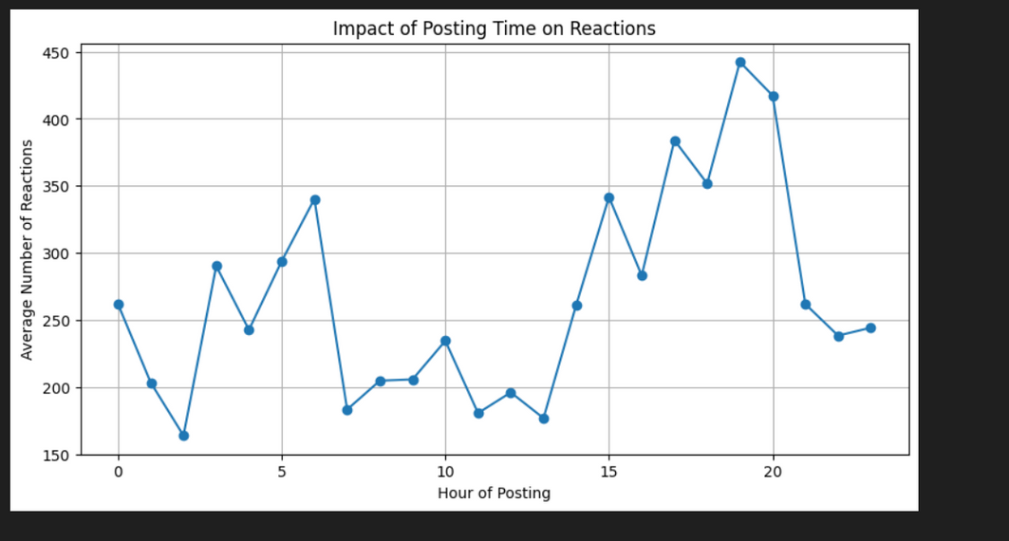
Insights:
Reactions are highest between 3 PM - 9 PM, peaking around 8 PM, making evenings the best time to post
Early morning sees lower reactions , suggesting minimal user activity during this period.
Engagement remains stable but lower between 10 AM - 2 PM, before increasing in the afternoon.
Posting between 3 PM - 9 PM can maximize engagement, while A/B testing and content type analysis can further optimize reach.
3

Slide 4
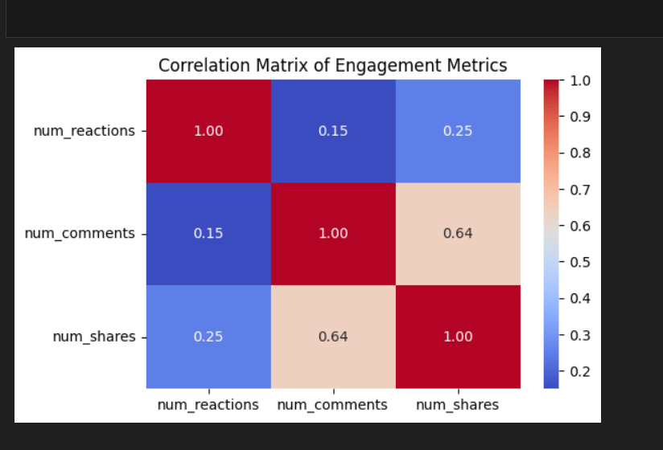
num_reactions has a low correlation with num_comments and num_shares, indicating that reactions alone do not strongly influence comments or shares.
num_comments and num_shares show a stronger correlation , suggesting that posts with more comments are more likely to be shared.
The weak correlation between reactions and other engagement metrics suggests that users may react to a post without necessarily commenting or sharing.
To maximize engagement, posts should encourage discussions and shares, rather than relying solely on reactions.
4
4

Slide 5
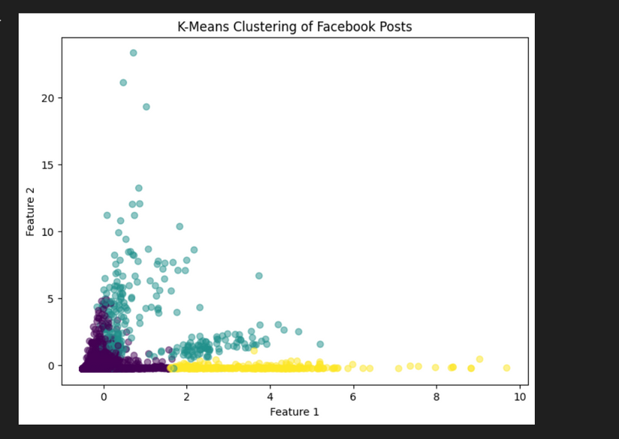
The clustering algorithm has grouped Facebook posts into different engagement levels, with clear low, medium, and high activity clusters.
A large portion of posts is clustered at the lower end, indicating that most posts receive low engagement.
Some posts fall into moderate and high interaction categories, showing variations in audience response.
Understanding these clusters can help optimize content strategies—highly engaging posts can be analyzed to replicate successful patterns.
5

Slide 6
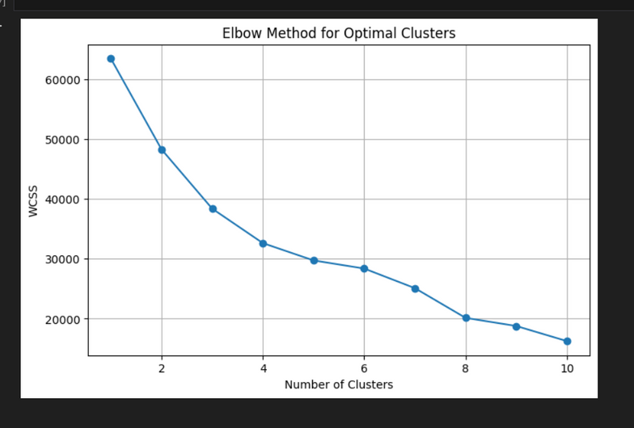
The Elbow Method helps determine the optimal number of clusters (K) in K-Means clustering.
The X-axis represents the number of clusters, while the Y-axis shows the Within-Cluster Sum of Squares (WCSS).
The graph shows a sharp decline in WCSS initially, then starts to flatten around K = 4 or 5, indicating the optimal cluster count.
Choosing K = 4 or 5 balances variance reduction and model efficiency, avoiding excessive clusters.
6

Slide 7
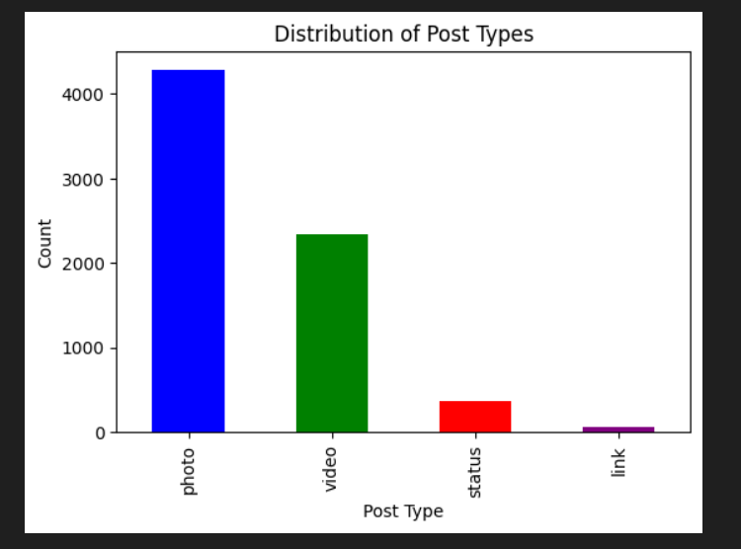
Photos dominate the post types, making up the largest share, indicating that image-based content is the most popular.
Videos are the second most common post type, showing that visual media (photos & videos) are key engagement drivers.
Status updates and links are far less frequent, suggesting that text-based content is less preferred by sellers and audiences.
This distribution suggests that businesses should focus more on photo and video posts to maximize engagement.
7

Slide 8
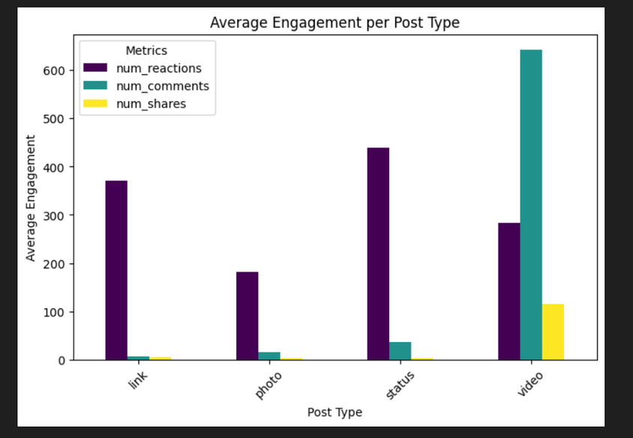
Videos receive the highest number of comments, suggesting they drive the most audience interaction and discussion.
Links and status posts generate more reactions than photos, showing that users engage emotionally with these post types.
Photo posts have moderate engagement, with lower reactions and comments compared to other post types.
Shares are highest for video posts, indicating that video content is more likely to be shared and spread virally.
8
8

Slide 9
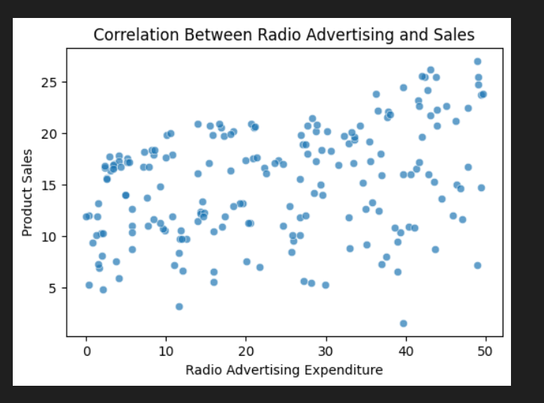
The points align closely with the red dashed line, showing the model's predictions are generally accurate.
Most points are near the ideal line, but some deviations suggest errors, especially for higher values.
Some predictions fall above or below the red line, indicating occasional underestimation or overestimation.
The points cluster around the diagonal, proving the model is a reliable predictor with minor inaccuracies.
9

Slide 10
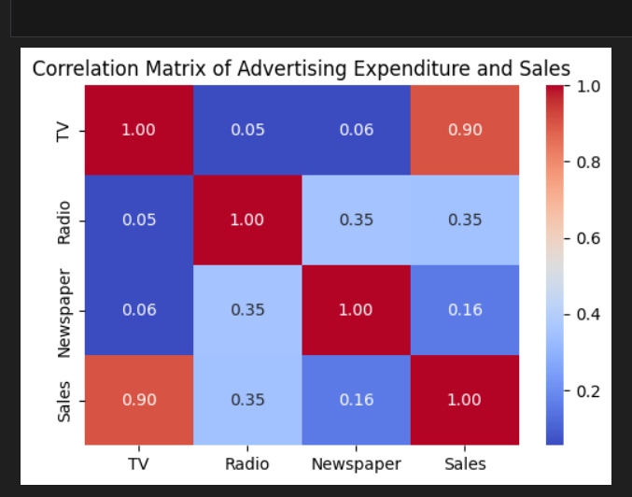
With a 0.90 correlation, TV ads significantly boost sales, making them the most effective channel.
A 0.35 correlation indicates that radio ads help sales but are far less impactful than TV ads.
With only a 0.16 correlation, newspaper ads contribute minimally to sales growth.
Low correlations suggest ad spending across platforms can be managed independently.
10

Slide 11
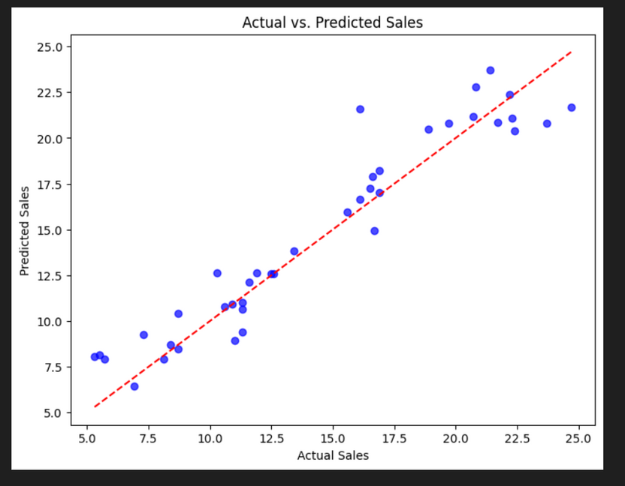
The points align closely with the red dashed line, showing the model's predictions are generally accurate.
Most points are near the ideal line, but some deviations suggest errors, especially for higher values.
Some predictions fall above or below the red line, indicating occasional underestimation or overestimation.
The points cluster around the diagonal, proving the model is a reliable predictor with minor inaccuracies.
11

Slide 12
THANK YOU
12

