Slide 1





TNWISE2025
HACKATHON FOR WOMEN IN SCIENCE & ENGINEERING
THEME: INCLUSIVE MOBILITY AND TRANSPORTATION
TITLE: SMART WHEELCHAIR FOR PHYSICALLY CHALLENGED PEOPLE
COLLEGE: Avinashilingam Institute for Home science and Higher Education for Women
TEAM LEADER NAME: ASHIKA B

Slide 2

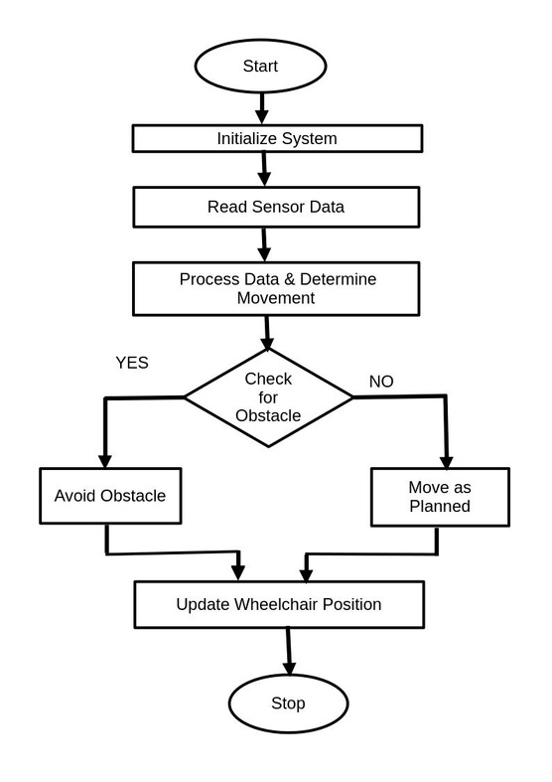
PROBLEM STATEMENT :
Traditional wheelchairs lack smart features, limiting mobility and safety for users with disabilities.
OBJECTIVES OF THE WORK:
To design a smart navigation system for wheelchairs.
To enable autonomous movement with obstacle detection using ultrasonic sensors
.To integrate GPS tracking for real-time location monitoring.
Enhanced Mobility and Independence
To develop a mobile application for remote control and tracking.
To create a modular kit that can be attached to any standard wheelchair.

Slide 3
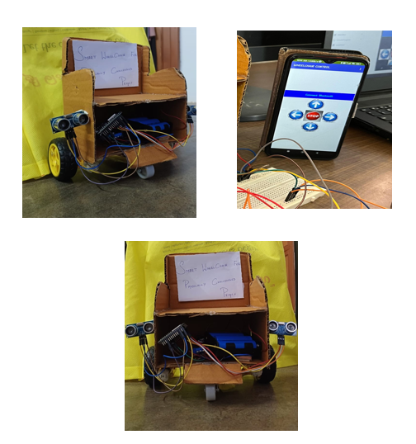
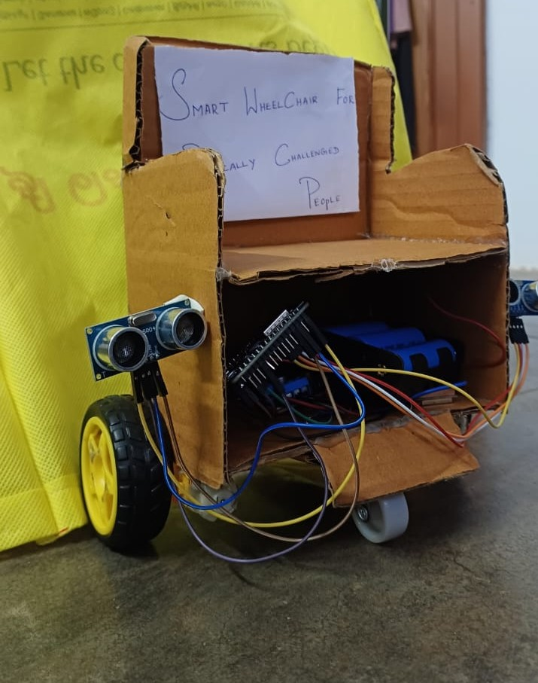
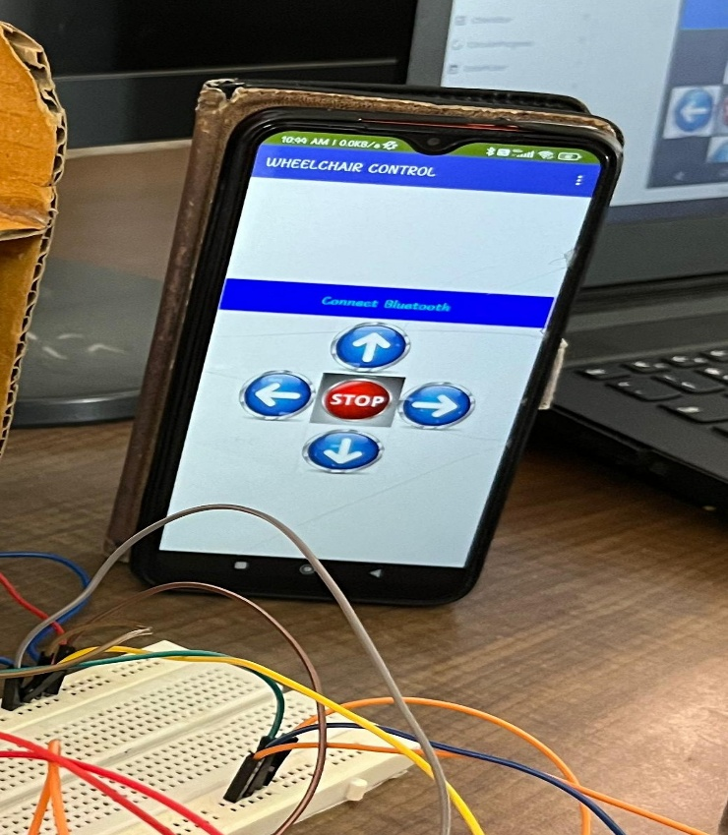
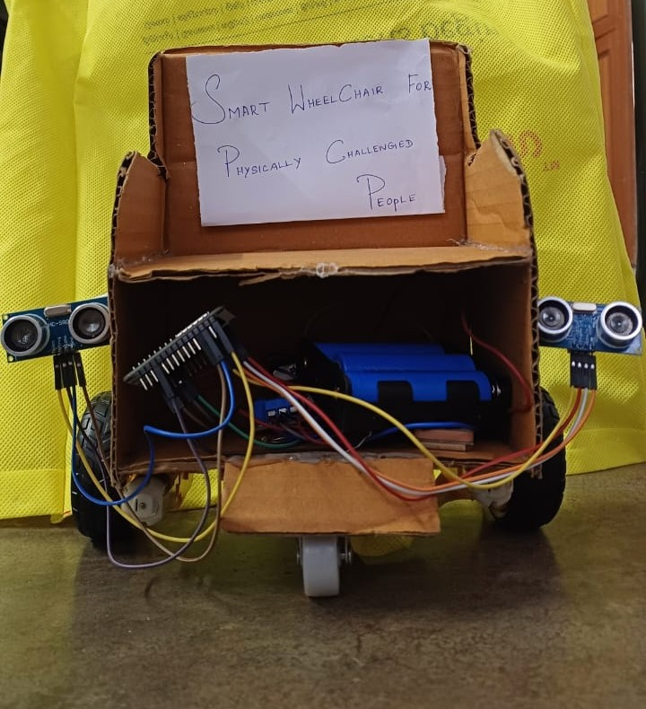
PROJECT DESCRIPTION:
The Smart Wheelchair is an innovative solution designed to upgrade traditional wheelchairs with advanced features like autonomous movement, obstacle detection, mobile control, and GPS tracking.
Using ultrasonic sensors, the system detects obstacles in real-time and automatically adjusts the wheelchair’s path to ensure user safety.
It also connects to a mobile application that allows users or caregivers to manually control the wheelchair and view its current location via an integrated GPS module.
This system is designed as a modular kit that can be attached to most standard wheelchairs, making it highly customizable and adaptable.
With options for mechanical modifications based on user needs, the Smart Wheelchair aims to provide greater independence, safety, and mobility for individuals with physical disabilities.

Slide 4
CONCLUSIONS:
This smart wheelchair enhances mobility for disabled individuals through automation, obstacle detection, and GPS tracking. Its modular design allows easy adaptation to existing wheelchairs, offering a cost-effective alternative. While obstacle detection, battery efficiency, and connectivity require refinement, future upgrades like radar can improve precision. Overall, this smart wheelchair system represents a significant step forward in assistive technology, offering a practical and scalable solution for enhanced mobility.

Slide 5
TEAM MEMBER DETAILS:
TEAM MEMBER 1 :
TEAM MEMBER 2 :
TEAM MEMBER 3 :
NAME: Ashika. B
SEMESTER: VI
YEAR: III-Year
DEPARTMENT: Electronics and Communication of Engineering
NAME: Harshitha. J
SEMESTER:VI
YEAR: III-Year
DEPARTMENT: Electronics and Communication of Engineering
NAME: Swathi. S
SEMESTER: VI
YEAR: III-Year
DEPARTMENT: Electronics and Communication of Engineering
TEAM MENTOR NAME:
NAME: Dr. D. Veera Vanitha
DESIGNATION: Associate Professor
DEPARTMENT: Electronics and Communication of Engineering
COLLEGE: Avinashilingam Institute for Home Science and Higher Education for Women

