Slide 1


VISHVESVARAYA TECHNOLOGY UNIVERSITY “JNANA SANGAM”, BELAGAVI-590018
MYSURU ROYAL INSTITUTE OF TECHNOLOGY
DEPARTMENT OF ELECTRONICS & COMMUNICATION ENGINEERING
Academic Year: 2025 - 2026
Presentation on The Mini Project [BEC586] Home Automation Using HC-05 Bluetooth Module
AKASH M [4MU23EC003]
HARSHITHA C N [4MU23EC020]
HARSHITHA S [4MU23EC021]
KISHAN KUMAR K P [4MU23EC028]
Mini project Mentor
Prof.ramya shree a n
AsSISTANT Professor
Dept. of ECE

Slide 2
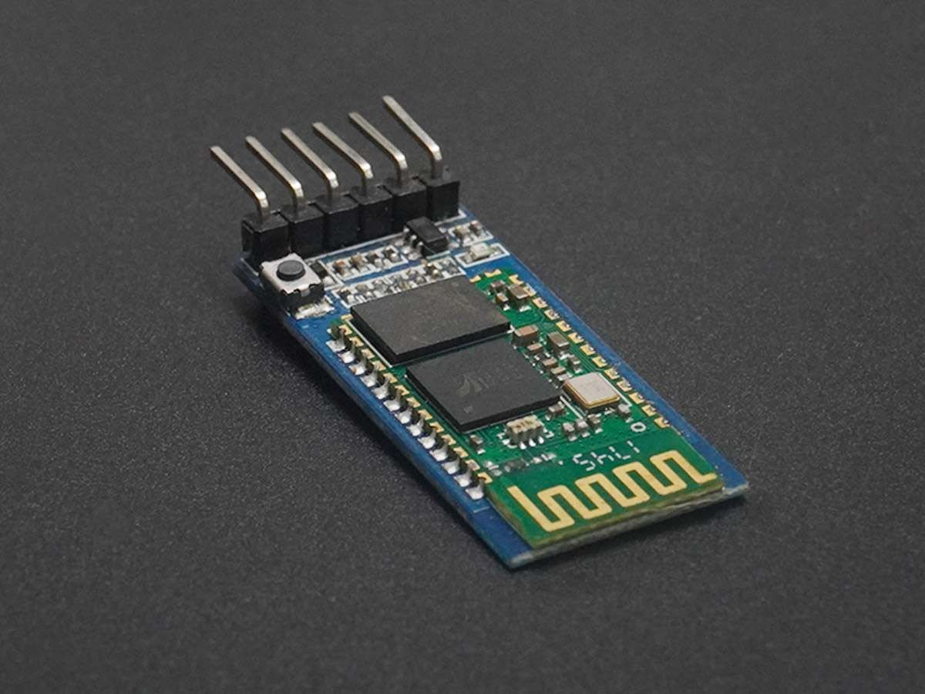
Content
Abstract
Introduction
Problem Statement
Objectives
Hardware/Software Specification
Methodology
Results and Discussion
Benefits of the project
Applications
Conclusion
References

Slide 3
Abstract
The project presents a smart home automation system utilizing an STM32 microcontroller and the HC-05 Bluetooth module for wireless control of household appliances.
Designed to enhance comfort, convenience, and energy efficiency, this system allows users to operate devices such as fans and LEDs remotely through a mobile application.
The HC-05 module enables Bluetooth communication, while the STM32 microcontroller processes user commands and controls output devices via a relay module powered by a regulated 5V supply. Powered by a 3.7V Li-Ion battery with onboard voltage conversion,
This solution provides an efficient and low-cost approach to modern home automation.

Slide 4

Introduction
With the growing popularity of smart homes, the need for straightforward and cost-effective automation solutions has increased. This project aims to enable wireless control of appliances like fans and LEDs, enhancing user convenience and household efficiency.
The HC-05 Bluetooth module acts as a wireless interface between a mobile device and the STM32 microcontroller, leveraging the UART protocol for reliable communication. Users can control home devices remotely via a mobile application, eliminating the need for physical switches and allowing flexible control from anywhere within Bluetooth range.
By integrating a relay module and efficient power management using a Li-Ion battery and buck converter, the system achieves both portability and reliability, making it a robust introductory platform for modern IoT and embedded system applications.

Slide 5

Problem Statement
“Many homes still rely on manual operation of electrical appliances, which can be inconvenient and inefficent”.
This project aims to address the lack of a simple, cost-effective solution for remote home appliance control using Bluetooth technology and an embedded microcontroller.
This STM32 Bluetooth project solves the problem of inconvenient manual control of home appliances by enabling users to wirelessly operate devices using a mobile application.

Slide 6
Objectives
1. To design and implement a wireless system for controlling home appliances such as fans and LED lights using Bluetooth technology and a mobile application.
2. To enhance user convenience and energy efficiency by allowing remote activation and deactivation of devices through the STM32 microcontroller and relay interface
3. To create a reliable and user-friendly home automation prototype that demonstrates the integration of wireless communication, embedded control, and practical power management using readily available electronic components.

Slide 7
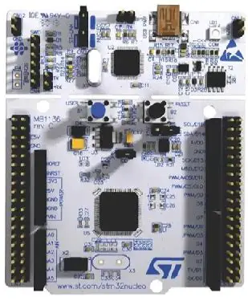
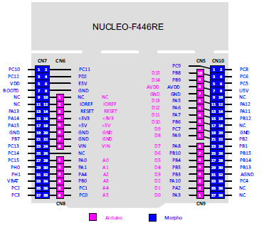
Hardware Specification
1. Microcontroller: STM32F446RE
32-bit ARM Cortex MCU with UART communication support.
MCU Core: ARM Cortex-M
Operating Voltage: 3.3V
Clock Speed: Typically up to 180 MHz
Communication: UART, SPI, I2C support
STM32F446RETX

Slide 8
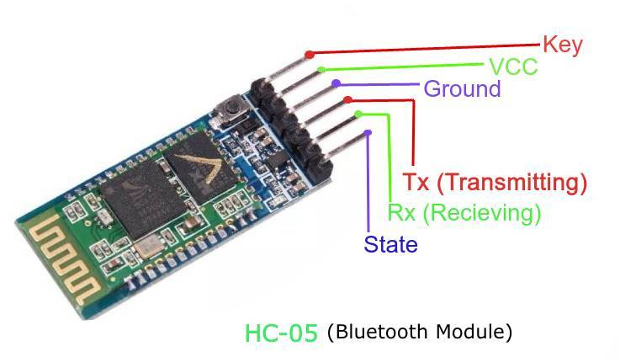
2. Bluetooth Module: HC-05
– Serial Bluetooth module for wireless communication.
Bluetooth Version: 2.0+EDR (Enhanced Data Rate)
Operating Voltage: 3.3V to 6V
Communication Interface: UART (serial communication)
Range: Up to 10 meters (approx. 33 feet) in open space (Class 2 Bluetooth)
Baud Rates: Configurable from 9600 bps to 1382400 bps
Operating Frequency: 2.4 GHz ISM band
Modes: Master/Slave configurable
Compatibility: Supports Android, Windows, and other Bluetooth-enabled devices

Slide 9
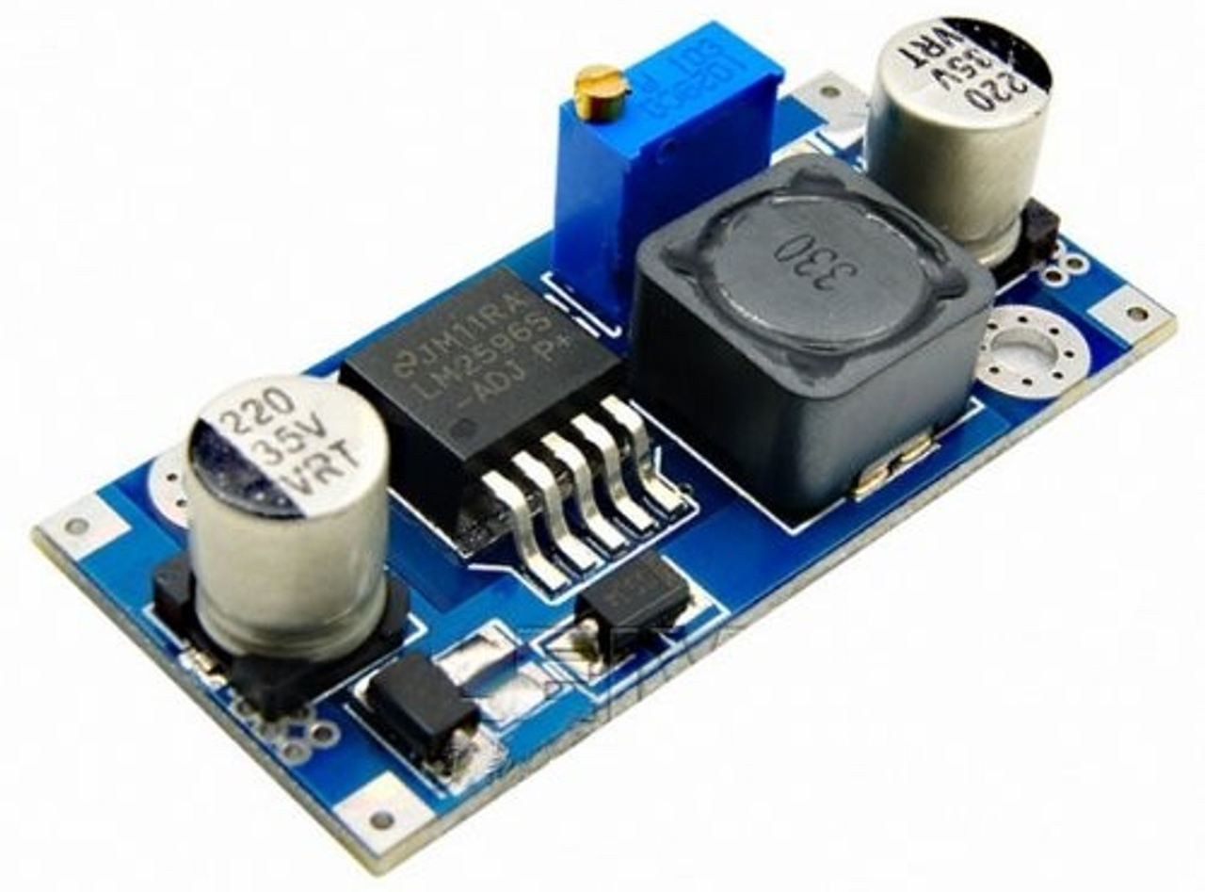
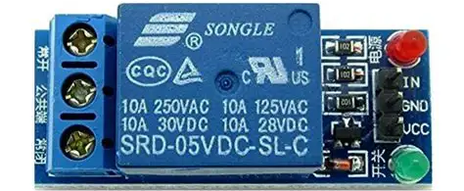
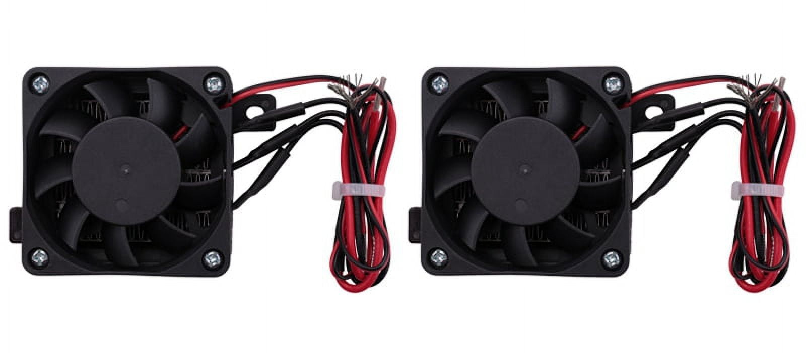
3.Power Regulation: Buck Converter module
Is used to step up and regulate 5V output from 3.7V battery.
Converts higher voltage to a stable 5V output.
Efficient DC-DC converter that maintains voltage regulation.
Powers 5V components like relay module and fan.
4.Relay Module: 5V Relay
Electromechanical switch controlled by STM32 via 5V signal
Isolates control signals from high-power appliances.
Switches the 5V fan ON/OFF safely.
Coil Voltage: 5V DC
Switching Current: Usually up to 10A for appliances
5V RELAY MODULE
5.Load: 5V Dual-Fan Unit
Typical low voltage fan used in cooling or ventilation.
Powered directly by regulated 5V supply, switched via relay.
DUAL FAN UNIT

Slide 10
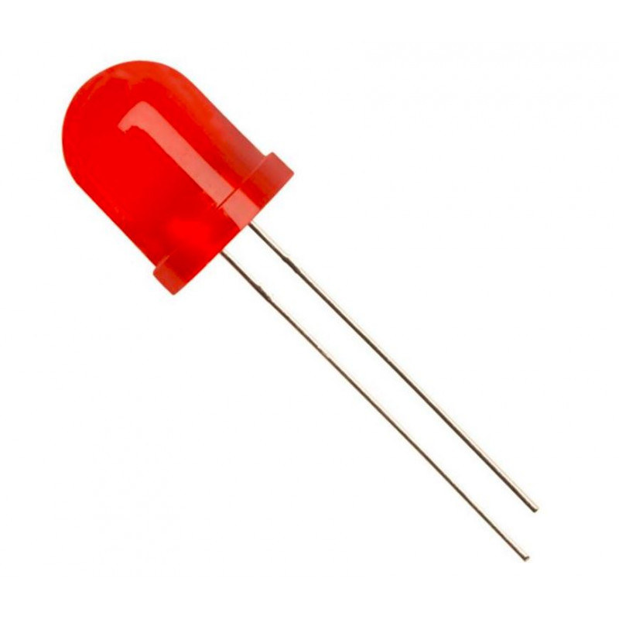
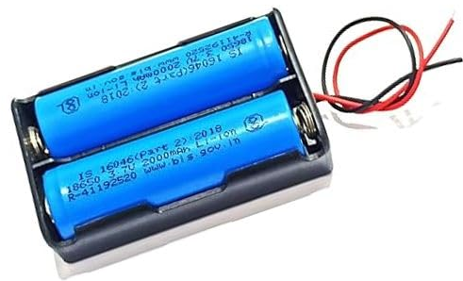
4.LED (Home Appliance Lighting Simulation):
Operating Voltage: 2V to 3.3V
Forward Current: 10mA to 20mA
Power Rating: Around 0.06W to 0.1W
Purpose: Visual indicator and simulated home lighting control
LED
5. 3.7V Li-Ion Battery Pack:
Rechargeable lithium-ion battery providing a compact power source.
Offers good energy density for portable applications.
Supplies power to the entire circuit.
LI-ION BATTERY
Supporting Components: Connecting wires, breadboard, resistors , and power connectors.
Software Specification:
STM32CubeIDE software
Programming language:embedded C

Slide 11
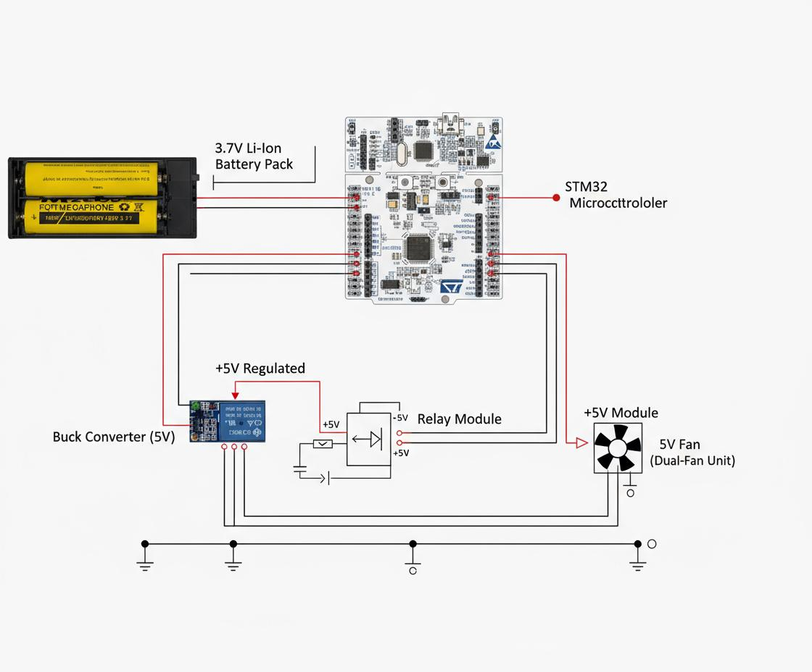
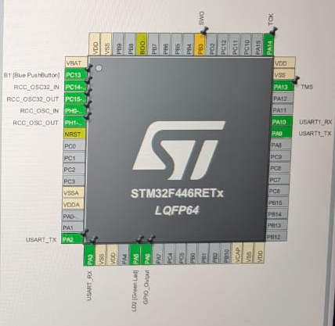
PINOUT CONFIGURATION
CIRCUIT DIAGRAM

Slide 12
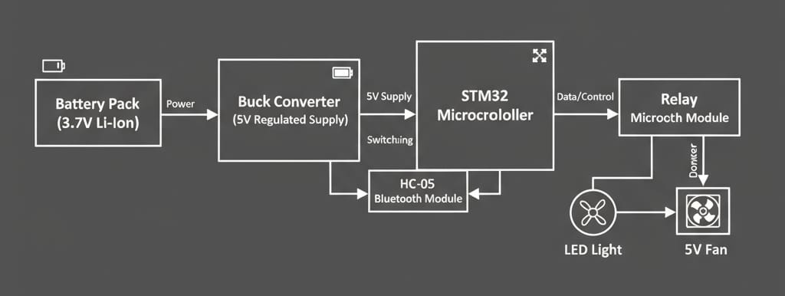
Block Diagram:

Slide 13
Explanation of the block diagram:
Battery Pack (3.7V Li-Ion): This is the primary power source providing 3.7V for the system.
Buck Converter (5V Regulated Supply): This converts and regulates the battery voltage up to a stable 5V needed to power other components.
STM32 Microcontroller: Acts as the brain of the system, controlling operations, interpreting Bluetooth commands, and sending control signals.
HC-05 Bluetooth Module: Facilitates wireless communication between the STM32 and a mobile device, enabling remote control.
Relay Microtech Module: Receives control signals from STM32 to switch connected appliances ON or OFF safely.
LED Light and 5V Fan: Represent the home appliances being controlled—LED simulates lighting, and the fan simulates typical household appliance load.
Power flows from the battery through the buck converter to maintain a steady 5V supply. The microcontroller communicates with the Bluetooth module to receive commands and then actuates the relay module to control the appliances accordingly, allowing wireless home automation control

Slide 14
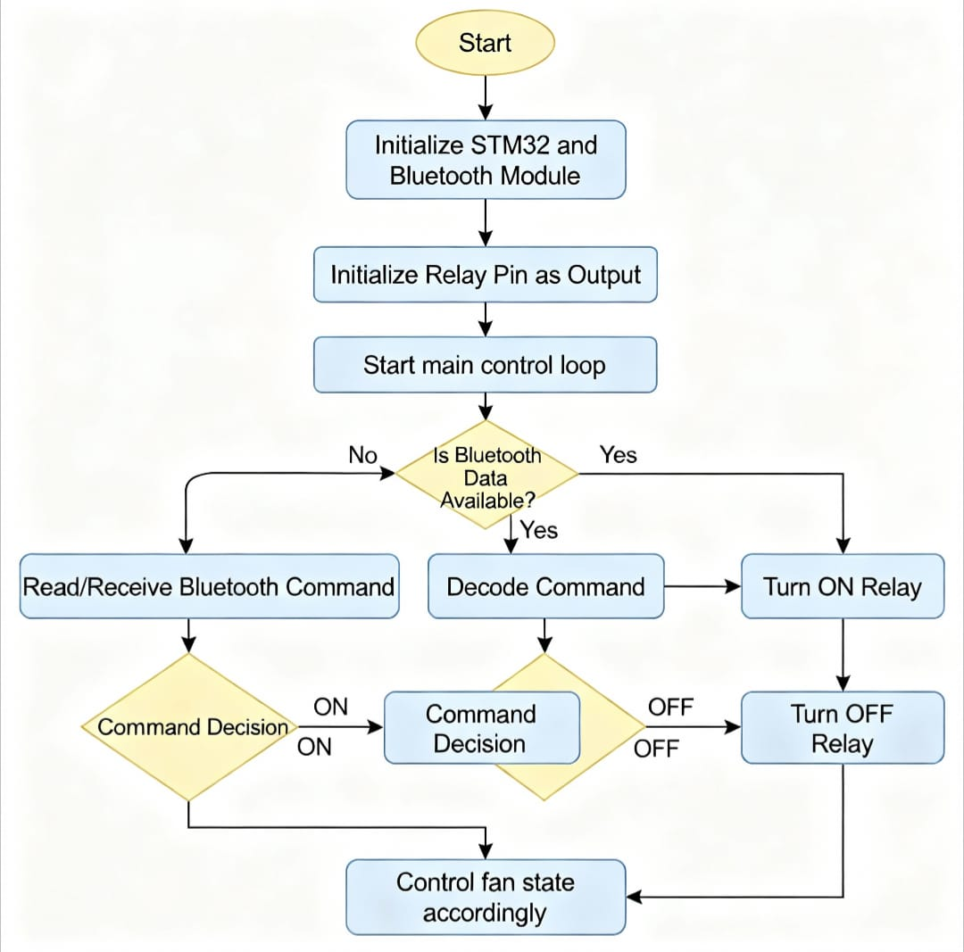
Flow Chart:
Start: The system is powered on by the battery supply.
Initialization: The STM32 microcontroller and HC-05 Bluetooth module are initialized to get ready for communication.
Wait for Command: The microcontroller waits and listens for commands from the connected mobile app over Bluetooth.
Receive Command: Once a command is received, it is decoded to understand the user’s instruction.
Decision: Based on the decoded command, the system decides whether to turn the relay ON or OFF.
Control Relay: The relay module is activated or deactivated to switch the connected appliance (e.g., a fan) ON or OFF accordingly.

Slide 15
Results and Discussion:
In this smart home automation project, the STM32 microcontroller with HC-05 Bluetooth module successfully enabled wireless control of home appliances, specifically the LED light and 5V fan.
Results:
Reliable Bluetooth communication was established between the mobile device and the HC-05 module, allowing stable transmission of control commands.
The STM32 decoded the incoming commands and accurately controlled the relay module to switch the LED light and fan ON/OFF.
The buck converter provided a stable 5V regulated supply to the relay, fan, and other peripherals from the 3.7V Li-Ion battery, ensuring uninterrupted operation.
The system demonstrated fast response times and consistent operation within the Bluetooth range (up to 10 meters).

Slide 16
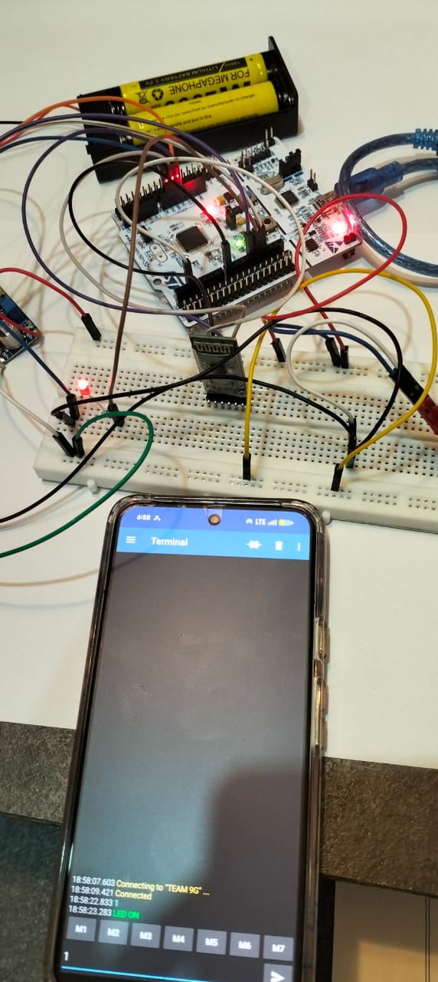
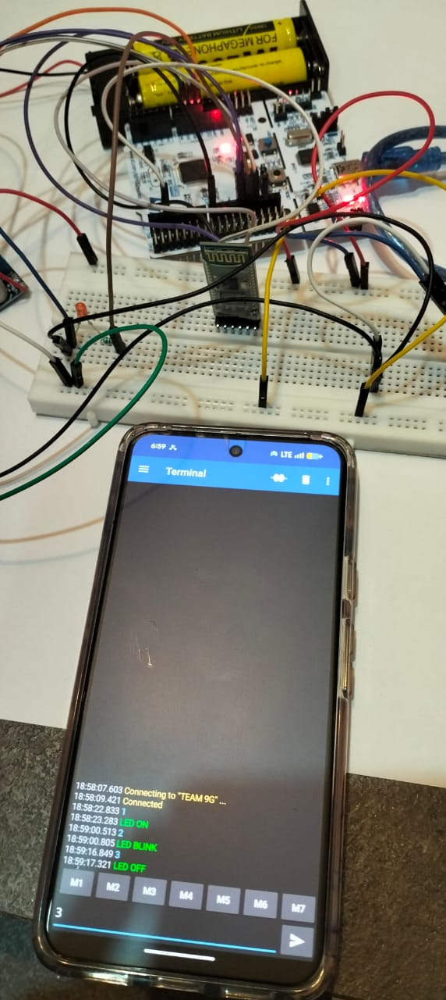
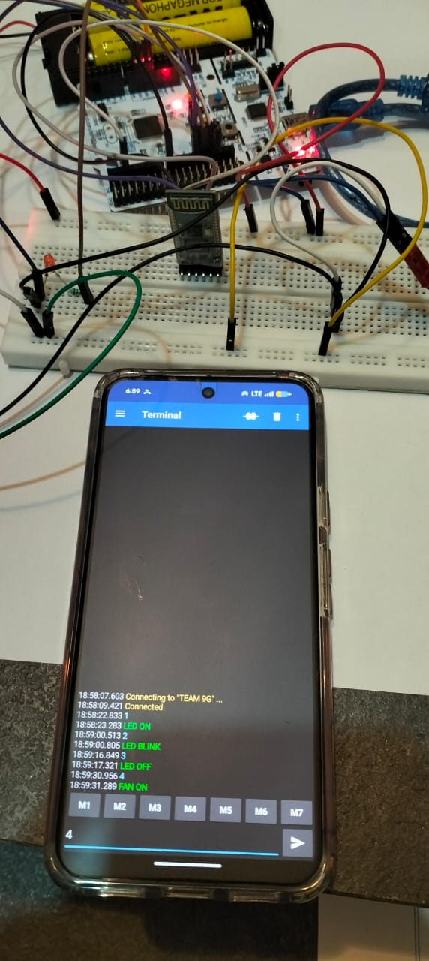
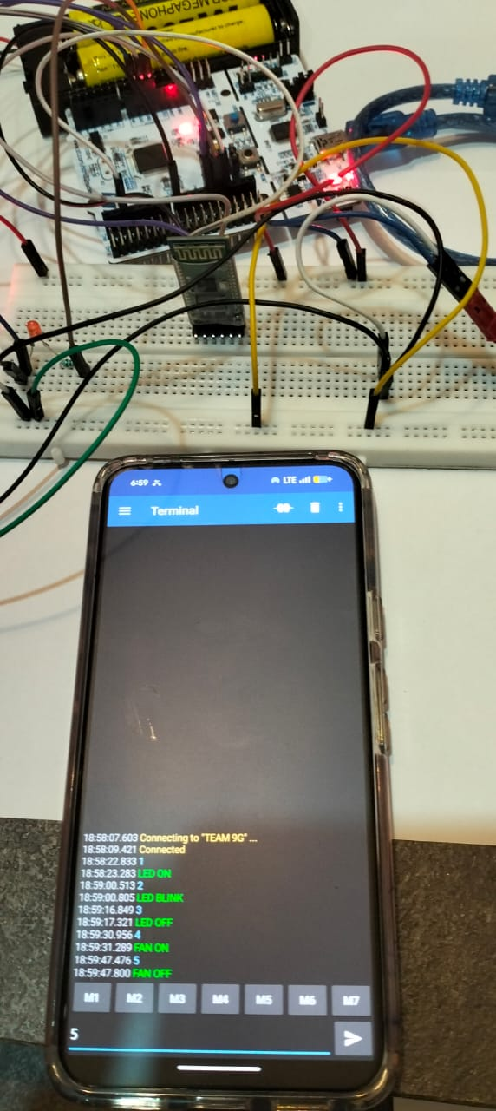
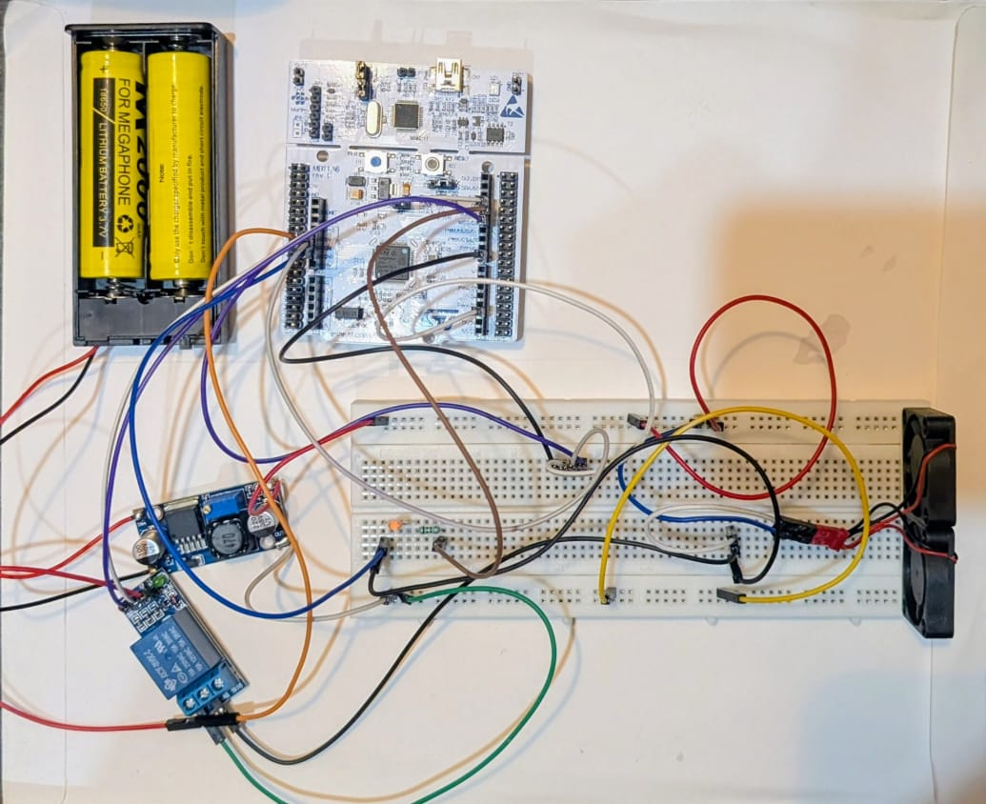
[b]
[c]
[d]
[a] =>command=1 =>LED ON
[b] => command=3 =>LED OFF
[c] =>command=4 =>FAN ON
[d] =>command =5 =>FAN OFF
[e] =>hardware interfacing
[e]
16

Slide 17
Discussion:
The project effectively automates lighting and fan control, which are common home appliance functions, enhancing convenience and energy savings.
By using Bluetooth-based control, the system avoids the need for complex wiring or internet connectivity, making it affordable and easy to implement.
The relay module provides electrical isolation, improving safety when controlling high-power appliances.
The rechargeable Li-Ion battery and efficient power management contribute to the system's portability and sustainability.
Benefits of the project:
Convenience: Enables remote wireless control of home appliances via Bluetooth, eliminating the need for manual operation and offering greater ease of use.
Energy Efficiency: Allows users to switch appliances ON/OFF as needed, reducing unnecessary power consumption and helping save energy.
Cost-Effective: Uses affordable components like STM32 microcontroller and HC-05 Bluetooth, making it accessible and budget-friendly.
Portability: Battery-powered system with regulated supply allows deployment in various locations without dependency on mains power.

Slide 18
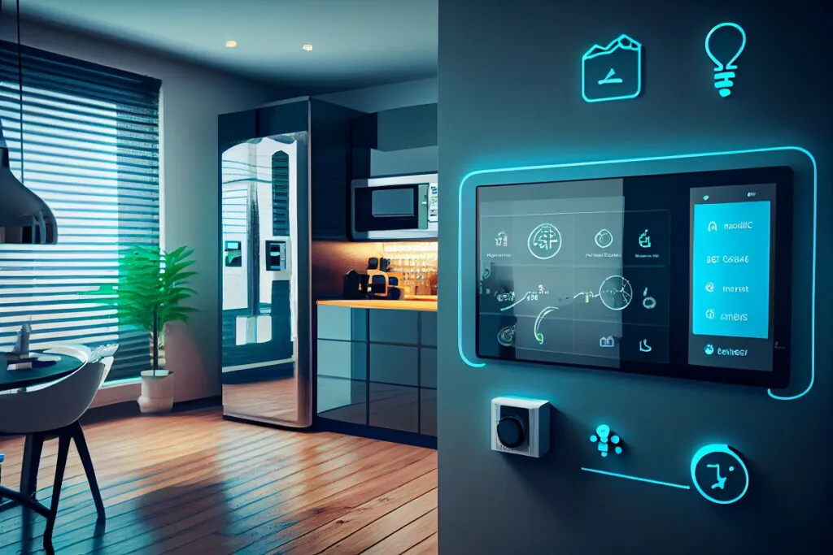
Applications:
Reliable Bluetooth Control
Accurate Relay Switching
Stable 5V Power Supply
Fast Response Time
Convenience and Energy Saving
Safe Electrical Isolation
Cost-Effective and Portable
Educational Embedded Platform

Slide 19
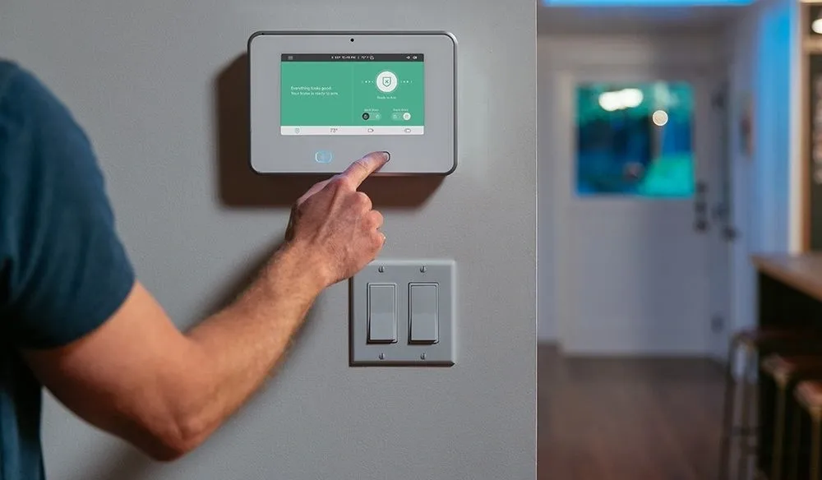
Conclusion:
This smart home automation project successfully demonstrates the use of an STM32 microcontroller and HC-05 Bluetooth module for wireless control of home appliances like LED lights and fans.
The system provides a reliable and efficient solution for remote appliance control, enhancing convenience, safety, and energy savings. The use of a buck converter ensures stable power supply, and the relay module safely switches the appliances.
This project is cost-effective, portable, user-friendly, and scalable, making it suitable for practical home automation applications as well as educational purposes in embedded systems and wireless technology.

Slide 20
References:
STM32 Microcontroller Datasheet and Reference Manual - STMicroelectronics.
HC-05 Bluetooth Module User Manual and Specifications.
Buck Converter Module Datasheet – Manufacturer-specific details.
Relay Module Datasheets - Standard 5V relay module specifications.
Smart Home Automation using Bluetooth - Relevant academic papers and project guides.
STM32CubeIDE and Keil Development Tools documentation.
Various online tutorials and technical blogs on embedded home automation using STM32 and Bluetooth modules.
These materials provide technical specifications, design guidelines, and development support used in this project.

Slide 21

Thank you

