Slide 1
SRU
AWS Lab — Product Review
PRODUCT NAME
SMART VISITOR COUNTER
Team: Smart Visitor Counter Team Batch: 40 Section: CSE Review: 11 November 2026
Team Members
01
B. Arun Reddy
2503A51155
02
A. Harshitha
2503A51156
03
B. Preethi
2503A51159
04
P. Trishul
2503A51164
05
Arshiya Taranum
2503A51175
AWS LAB | PRODUCT REVIEW
School of CS & AI • SR University
01/10

Slide 2
SRU
Background & Introduction
Introduce the product
SMART VISITOR COUNTER
• Counts people entering and leaving a location.
• Designed for small buildings, labs, shops and institutions.
• Helps monitor occupancy without maintaining a manual count.
• Shows the current visitor count and activity trends on a web dashboard.
ENTRY
→
EXIT
Buttons generate entry / exit events.\nThe cloud updates the count and dashboard.
AWS LAB | PRODUCT REVIEW
School of CS & AI • SR University
02/10

Slide 3
SRU
Problem Statement, Gap & Objectives
Existing problem / gap
Product objectives
• Manual visitor counting can be inaccurate.
• Counts may not be updated consistently during busy periods.
• Paper-based records make it difficult to view hourly activity.
• A simple, low-cost digital monitoring option is useful.
• Record entry and exit events using a simulated counter.
• Process events through a cloud-based backend.
• Store current count and event history in DynamoDB.
• Present current occupancy and daily hourly activity in a dashboard.
AWS LAB | PRODUCT REVIEW
School of CS & AI • SR University
03/10

Slide 4
SRU
Methodology & System Architecture
Visitor event → HTTPS request → cloud processing → database update → dashboard refresh
INPUT
FRONTEND / API
AWS BACKEND
OUTPUT
→
→
→
ESP32 / Wokwi\nEntry & Exit buttons
HTTPS POST\nLambda Function URL
AWS Lambda\nDynamoDB tables
Visitor dashboard\nCurrent & hourly count
AWS DATA FLOW
visitor-http-ingest Lambda updates VisitorCounter and appends to VisitorEvents.\nvisitor-hourly-activity Lambda groups today’s entry events by hour.\nDashboard read endpoint supplies the current count; browser refreshes the display.
AWS LAB | PRODUCT REVIEW
School of CS & AI • SR University
04/10

Slide 5
SRU
AWS Services Used & Their Purpose
AWS SERVICE | PURPOSE IN PRODUCT | IMPLEMENTATION / EVIDENCE
AWS Lambda | Processes visitor events and dashboard queries. | HTTP ingest, hourly activity and read functions.
Amazon DynamoDB | Stores current count and event history. | VisitorCounter and VisitorEvents tables.
AWS Lambda Function URL | Provides HTTPS endpoints for requests. | ESP32 simulation and dashboard call Lambda URLs.
Amazon CloudWatch | Supports monitoring and troubleshooting. | Lambda execution logs and lifecycle records.
Region used: us-east-1 | AWS IoT Core and Amazon S3 were not used in this prototype.
AWS LAB | PRODUCT REVIEW
School of CS & AI • SR University
05/10

Slide 6
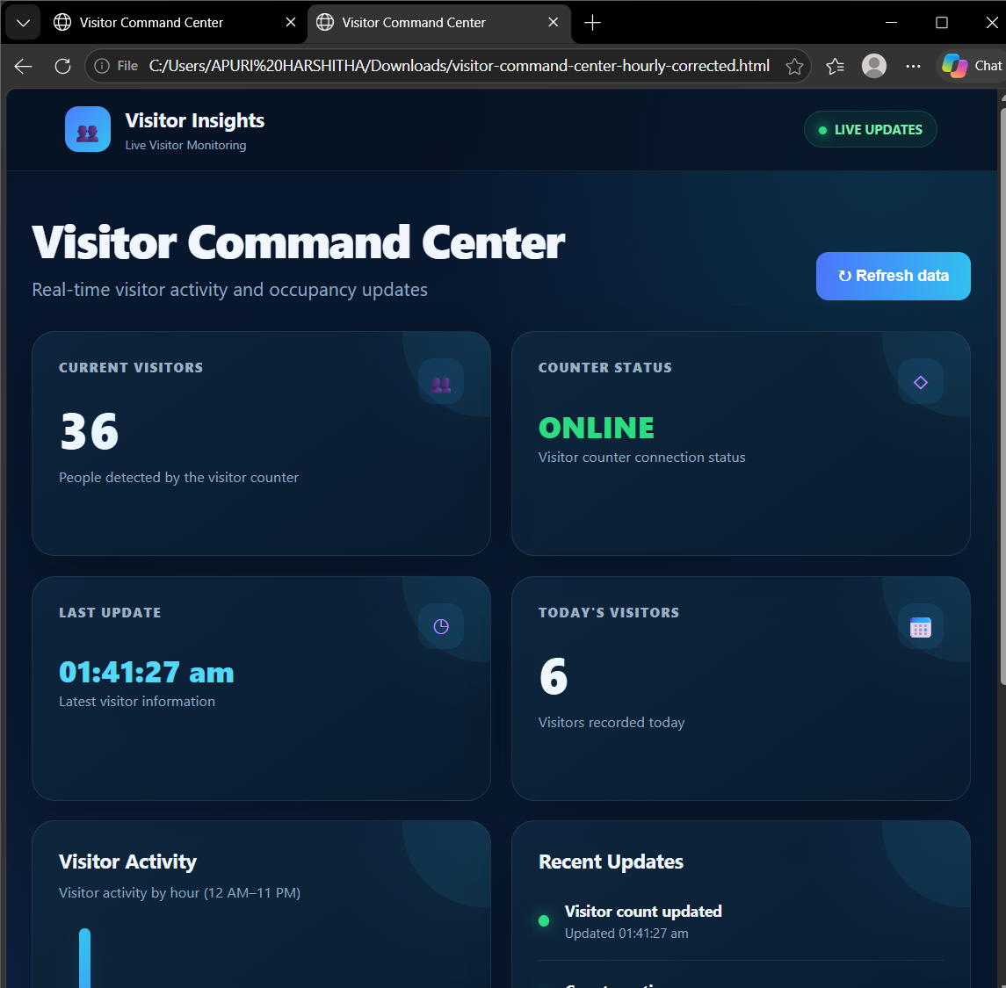
SRU
Product Implementation & Results
Evidence of functionality
• Entry request increments the visitor count.
• Exit request decrements the count.
• Exit at zero is safely rejected.
• Event records are stored in DynamoDB.
• Dashboard shows current visitors and today’s entries.
Implementation status: cloud backend tested; ESP32 input simulated in Wokwi; dashboard executed in browser.
AWS LAB | PRODUCT REVIEW
School of CS & AI • SR University
06/10

Slide 7
SRU
Product Demonstration & Access Link
Demonstrate the product
Current count API:
https://5uhzrf5ihrpmlbmjjgujnri4xi0gskst.lambda-url.us-east-1.on.aws/
Event ingest API:
https://e2c3pzw5sqftpuj7is3nod46de0zrdor.lambda-url.us-east-1.on.aws/
Hourly activity API:
https://cwjopqghcdc7rote4gosq2p6ku0zvlpt.lambda-url.us-east-1.on.aws/
Deployment status:
Cloud functions and database deployed; Wokwi input simulated; dashboard browser-hosted.
1-minute demo: press Entry in Wokwi → verify HTTP response → view DynamoDB event → refresh dashboard → test Exit and zero-count protection.
AWS LAB | PRODUCT REVIEW
School of CS & AI • SR University
07/10

Slide 8
SRU
Real-World Applications of the Product
Target users
Practical use cases
Benefits / impact
• Small shops and retail stores
• Libraries and study rooms
• College labs and office spaces
• Track visitors entering and leaving
• Monitor occupancy during busy hours
• Review daily entry activity
• Reduces manual counting effort
• Provides a live count view
• Keeps timestamped event history
The prototype demonstrates the core counting workflow; real deployment requires physical sensor validation.
AWS LAB | PRODUCT REVIEW
School of CS & AI • SR University
08/10

Slide 9
SRU
Limitations & Future Scope
Current limitations
Planned improvements
• Input device was simulated in Wokwi; no physical sensor deployment.
• HTTPS certificate verification is relaxed in the prototype.
• Dashboard is browser-hosted and not a public production deployment.
• Testing was limited to the demonstrated scenarios.
• Connect a physical ESP32 with IR sensors.
• Enable certificate validation and tighter IAM permissions.
• Add authentication and role-based access.
• Improve offline buffering, alerts and long-term analytics.
AWS LAB | PRODUCT REVIEW
School of CS & AI • SR University
09/10

Slide 10
SRU
Thank You!
THANK YOU!
Questions & Discussion
SMART VISITOR COUNTER • BATCH 40
AWS LAB | PRODUCT REVIEW
School of CS & AI • SR University
10/10

