Slide 1
CMP7005_PRAC1

Slide 2
1. Identifying Missing Values:
The dataset likely contains missing values, which are a common occurrence in real-world datasets. Handling these missing values is crucial to avoid issues during data analysis and machine learning model building. Using the isnull() function, we initially identify the columns with missing data and count the number of missing values in each column. This step ensures that we understand the extent and nature of the problem before applying corrective measures.

Slide 3
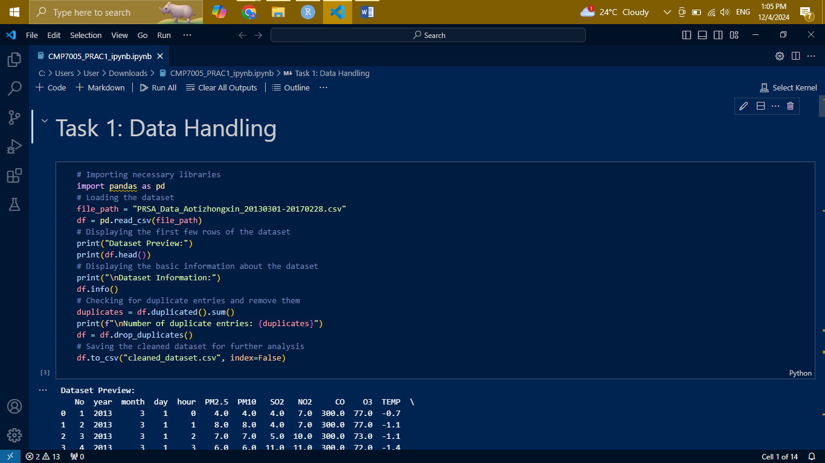
1. Identifying Missing Values:

Slide 4
2. Separating Numeric and Non-Numeric Columns
Datasets often have a mix of numeric (e.g., integer, float) and non-numeric (e.g., strings, categorical) data. Since missing values in numeric columns can be addressed using statistical measures like mean or median, and non-numeric columns require methods like filling with the mode or a placeholder, we first separate the columns based on their data types. This separation ensures that the appropriate imputation strategy is applied to each column type.

Slide 5
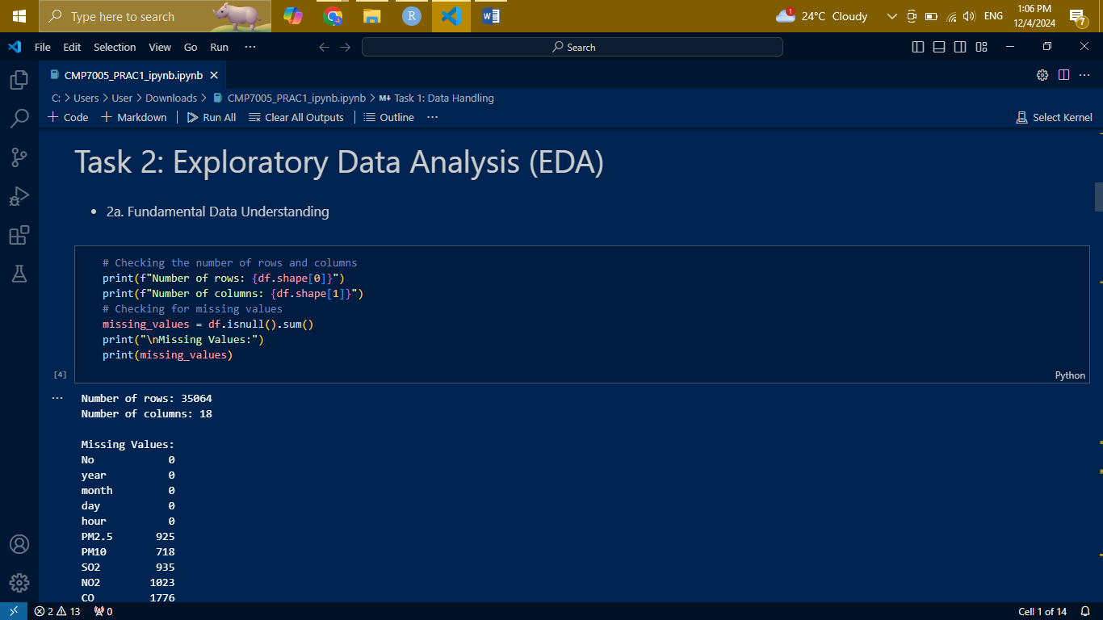
2. Separating Numeric and Non-Numeric Columns

Slide 6
3. Filling Missing Values in Numeric Columns:
For numeric columns, the mean of the column values is a logical choice for imputation when there is no specific domain knowledge suggesting an alternative. This is because the mean minimizes the variance introduced by imputation, preserving the data's statistical properties. We use the fillna() method combined with df.mean() to replace missing values in these columns efficiently.

Slide 7
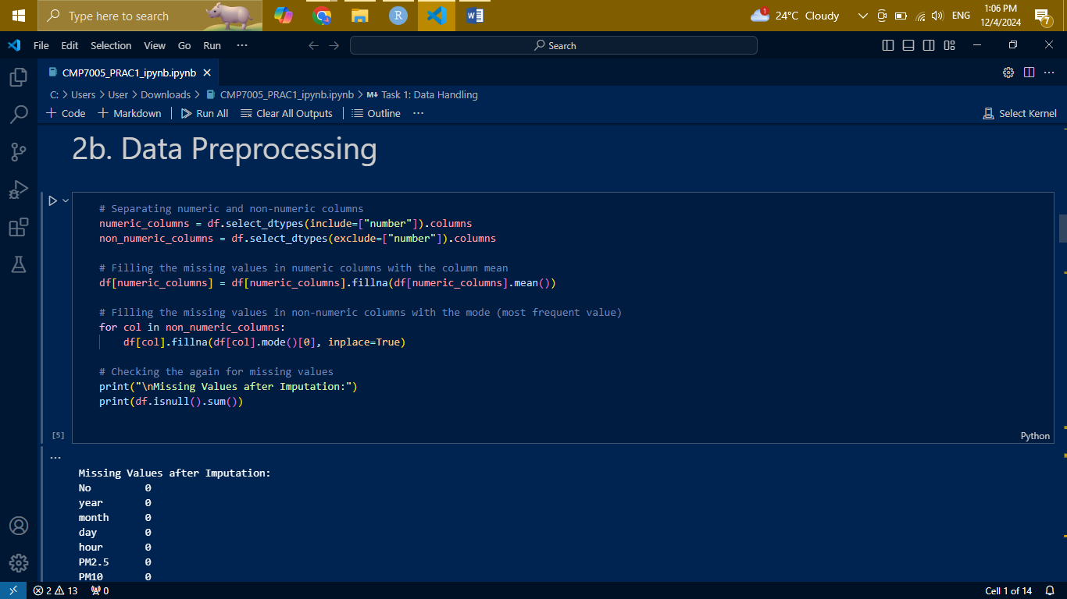
3. Filling Missing Values in Numeric Columns:

Slide 8
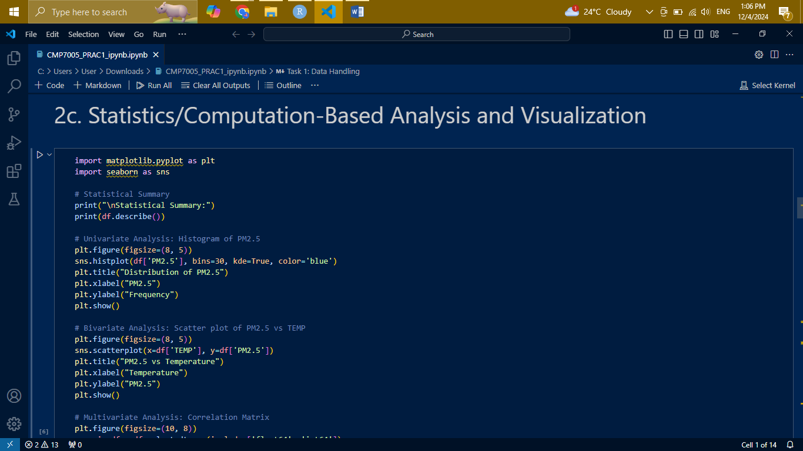
Visualizations

Slide 9
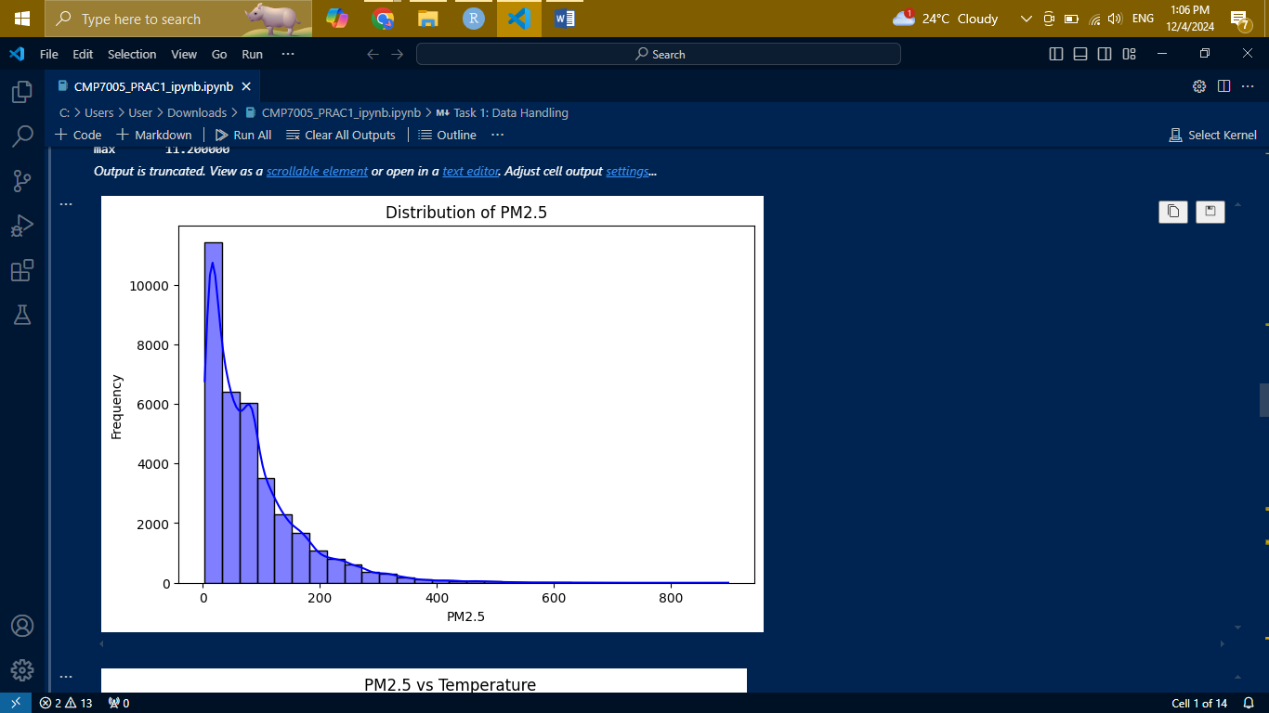

Slide 10
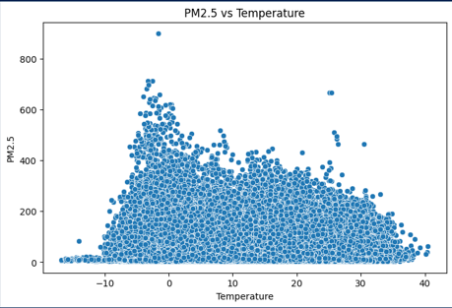
Visualizations

Slide 11
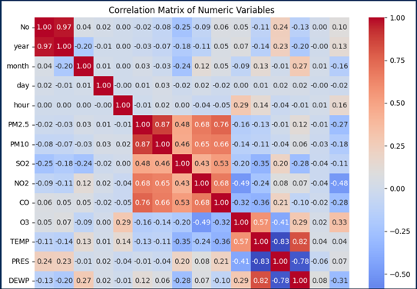
Visualizations

Slide 12
Preparing the Data for Modeling:
Before building models, the data must be preprocessed thoroughly:
Feature selection: We identify the most relevant features to improve model performance and reduce computational complexity. Techniques for this are correlation analysis and domain knowledge.
Encoding categorical variables: OneHotEncoder or LabelEncoder is used to encode the categorical columns as machine learning algorithms require numeric inputs. In this way, it will ensure compatibility with the model.
Feature Scaling: Standardization or normalization is used to handle features with varying ranges. This is particularly important for algorithms that are sensitive to feature magnitudes, such as Support Vector Machines and K-Nearest Neighbors.

Slide 13
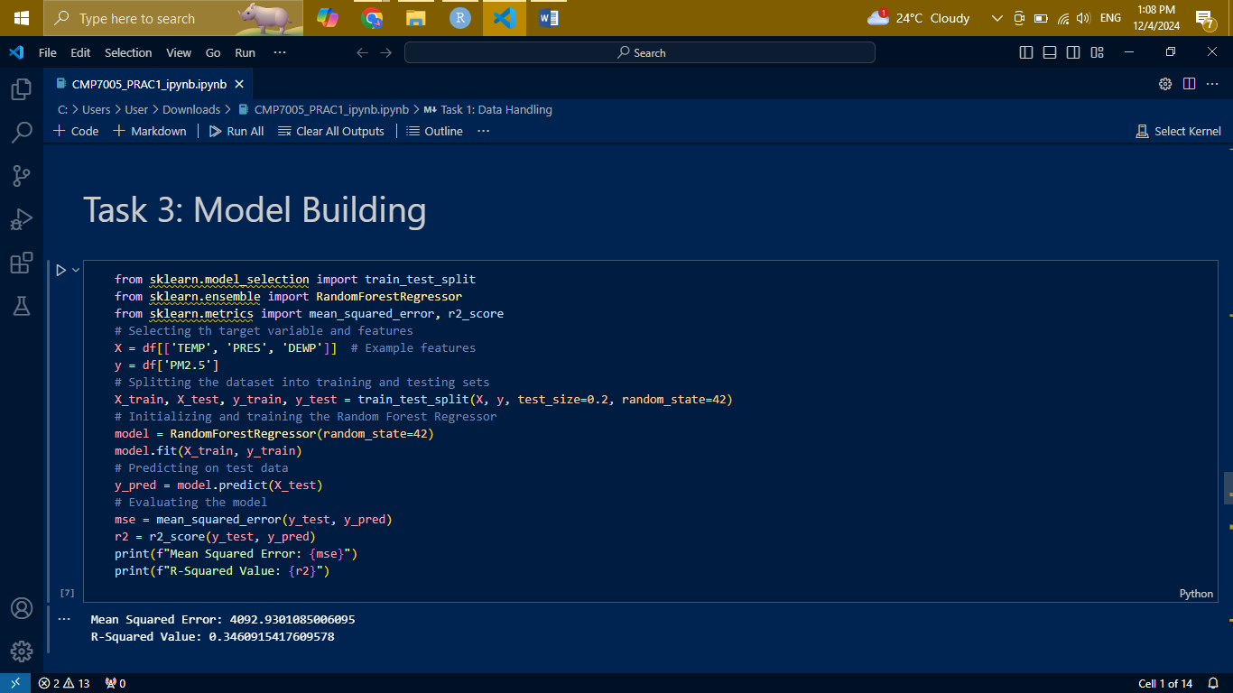
Preparing the Data for Modeling:

Slide 14
Model Building
Splitting the Data: Split the dataset into train and test sets using the function train_test_split from scikit-learn. Use the training set to fit your model, and the test set to evaluate its performance on unseen data. In general, a split ratio of 80:20 or 70:30 is common.
Choosing Machine Learning Models: We tried several machine learning models to find the appropriate one for our problem
Linear Regression or Logistic Regression : Applied to regression or classification problems with two classes.
Decision Tree/Random Forest: Non-linear algorithms, good for classification and regression. Random Forest also does a better job with overfitting due to ensemble techniques.
Gradient Boosting (e.g., XGBoost or LightGBM): A robust algorithm for structured data that has achieved state-of-the-art performance in various competitions.
We train multiple models to ensure that we approach the problem from different angles.
Hyperparameter Tuning: A grid search or random search is used to adjust the hyperparameters so that the model can be as optimal as possible. This will involve systematically trying different parameter combinations, for example learning rate, depth, or number of estimators, for algorithms like Random Forest or Gradient Boosting.
Model Assessment: The effectiveness of a model is assessed using performance metrics like accuracy, precision, recall, F1-score (for classification) and RMSE or R² for regression. Cross-validation confirms that the model generalizes well to data not observed yet. Visualization techniques such as ROC curves, confusion matrices or residual plots allow insight into a model's performance.

Slide 15
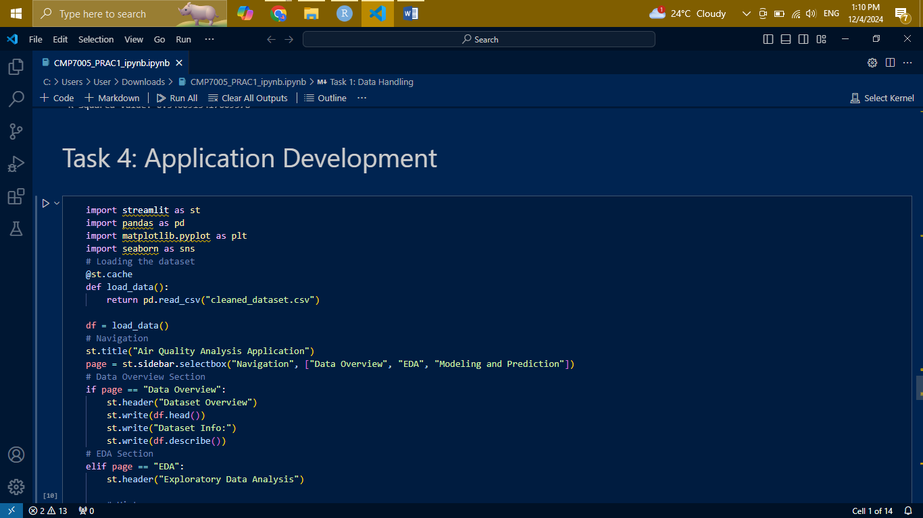
Application Development

Slide 16
Application Development
1. Purpose of the Application: The application makes data exploration, analysis, and prediction accessible to users through an intuitive graphical interface. It combines data overview, exploratory data analysis (EDA), and model predictions in one place.
2. Design the User Interface: With Streamlit, we created a multi-page application, divided into the following parts:
Data Overview: Displays the dataset’s structure, including key statistics, missing values, and visual summaries.
EDA Section: Scatter plots, line plots, histograms are available for visualizing the relationships between variables. The insights of correlation matrices and feature distributions can be seen interactively.
Modeling and Prediction Section: The section allows a user to upload test data, model predictions against the results that were uploaded, and download them. This interactive section ensures application utility in real-world scenarios.

Slide 17
Application Development

Slide 18
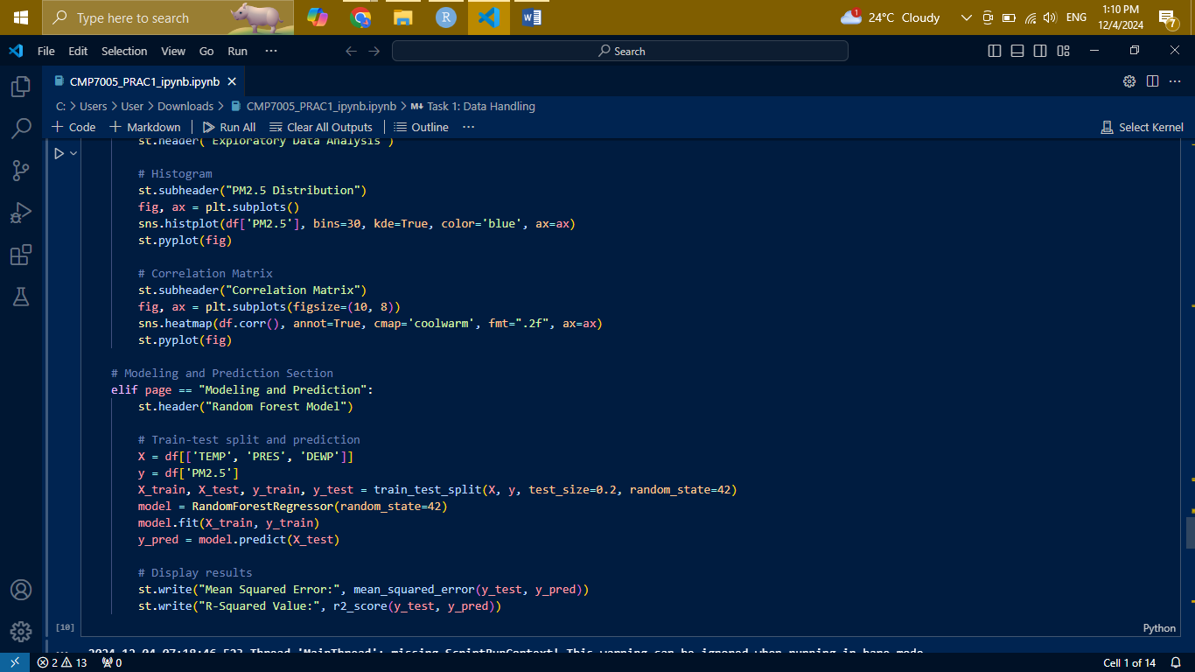
Application Development

Slide 19
Application Development
3. Interactive: It allows interactivity like features selection for visualization, model selection with hyperparameters, or even uploading a custom file for prediction. This interactive ability is provided to the users, who can interact in an intuitive way without being a programmer.
4. Scalability and Usability: Streamlit is scalable. It could integrate new features, datasets, or models. And since it is simple, people without technical background can easily operate the application.

