Slide 1
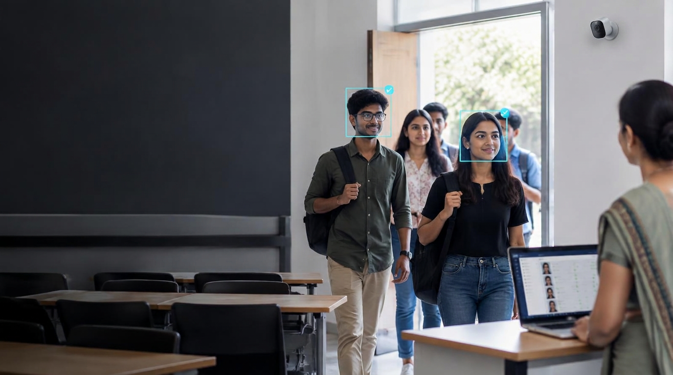
DSB & DB PROJECT
Smart Attendance
System
Using Facial Recognition
An Android-based approach to fast, accurate and accountable attendance management.
Live camera → Face match → Attendance record
Presented by Harshitha Bollineni
01 / 10

Slide 2
02
Objectives
What the solution is designed to achieve
1
Automate attendance
2
Recognize in real time
3
Record accurately
Replace repetitive manual marking with face-based verification.
Detect and identify registered users through a live camera.
Store the verified person, date and time automatically.
4
Reduce errors
5
Secure & synchronize
6
Enable administration
Minimize missed entries, duplicate work and proxy attendance.
Maintain user and attendance records in a centralized database.
Support user management, monitoring, reports and analytics.
DESIGN GOAL
Efficient • Accurate • Scalable
Real-time identification • Timestamped records • Centralized reporting

Slide 3
03
Problem Statement
Manual attendance creates operational friction and weakens record reliability
THE CURRENT REALITY
Time
A simple daily task
becomes a recurring
administrative burden.
Calling names and entering data delays sessions.
Accuracy
Human error produces missing or inconsistent records.
Scale
The challenge grows with every additional class, employee, register and reporting period.
Large groups make verification and follow-up difficult.
Control
Paper and spreadsheets limit monitoring and auditability.
Need: a reliable digital process that identifies people and records attendance automatically.

Slide 4
04
Existing System
Typical manual workflow and its practical limitations
✓
Call / sign
✓
Transcribe
✓
Verify
✓
Report
Teacher calls names or circulates a register.
Records move to paper sheets or spreadsheets.
Missing entries and disputes are checked manually.
Totals and percentages are prepared later.
Where the process breaks down
SLOW
Repeated every session
ERROR-PRONE
Missed or incorrect entries
PROXY RISK
Identity is not reliably verified
FRAGMENTED
Paper and files are hard to track
DELAYED
No live attendance view
MANUAL
Reports require extra effort
Manual identity confirmation is the central weakness.

Slide 5
05
Proposed System
Facial verification turns attendance into a controlled digital event
REGISTER
01
Create a profile and capture facial data in advance.
EXPECTED OPERATIONAL CHANGE
Manual marking
→
Automatic verification
RECOGNIZE
02
Match the live face with a registered identity.
Delayed entry
→
Real-time recording
Paper / sheets
→
Central database
RECORD
03
Write the attendance entry with date and time.
Manual totals
→
Automated reports
REVIEW
Limited visibility
→
Live administrator view
04
Monitor records and generate reports from the dashboard.
Faster • More accurate • Easier to audit
Real-time identification • Timestamped records • Centralized reporting

Slide 6
06
System Architecture
End-to-end data flow from camera capture to administrative insight
1
2
3
4
5
6
7
User / Student
Live Camera
Face Engine
Attendance
MongoDB
Admin Portal
Reports
Presents face
Captures frame
Detects + matches
Validates event
Stores record
Monitors + manages
Summarizes data
Practical safeguard
Only a successful match should create an attendance event; uncertain faces are flagged for review.
Stored attendance record
User ID • Date • Time • Verification result
Architecture separates capture, recognition, storage and reporting for easier maintenance.

Slide 7
07
Technology Stack
A practical web-and-vision stack for the attendance workflow
INTERFACE
BACKEND
FACE AI
DATABASE
HTML • CSS • JavaScript
Python • Flask
OpenCV • Face Recognition
MongoDB
User-facing attendance and administration screens.
Application logic, requests and service coordination.
Detection, encoding comparison and identification.
Student profiles, face identifiers and attendance records.
CONNECTIVITY
HARDWARE
DEVELOPMENT
PyMongo
Webcam / CCTV
Visual Studio Code
Database access and record operations from Flask.
Real-time image capture at the attendance point.
Coding, testing and project development.
Each technology supports a distinct layer: interface, logic, recognition, persistence or capture.

Slide 8
08
Working of the System
The recognition session follows a controlled, repeatable sequence
1
2
3
4
5
CAPTURE
DETECT
RECOGNIZE
VERIFY
RECORD
Camera reads a live frame.
OpenCV locates the face.
Face encoding is compared.
Registered identity is confirmed.
Attendance is saved in MongoDB.
If matched
Create one timestamped attendance entry and show confirmation.
If uncertain
Do not mark automatically; request another scan or administrator review.
Duplicate checks can prevent repeated marking in the same session.
Camera → Detection → Recognition → Verification → MongoDB

Slide 9
09
Key Features
Core capabilities mapped to everyday attendance operations
LIVE
Real-time recognition
AUTO
Automatic marking
TIME
Date & time
Identify registered users from a live camera feed.
Create attendance without manual name calling.
Keep a timestamp for every verified entry.
DATA
Central records
ADMIN
Management dashboard
REPORT
Reports & analytics
Store profiles and attendance in one database.
Manage students and review attendance status.
Review records and attendance percentages.
Practical result: less time spent marking attendance, fewer manual errors, and clearer administrative visibility.
Face-based verification also helps reduce proxy attendance.

Slide 10
SMART ATTENDANCE SYSTEM
Thank You
Questions & Discussion
A practical step toward faster, more reliable and accountable attendance management.
Camera → Recognition → Verification → Record
10 / 10

