Slide 1
DSB & DB PROJECT
Smart Attendance
System Using
Facial Recognition
FACE
RECOGNITION
An Android/web-oriented approach to fast, accurate and accountable attendance management.
ATTENDANCE
DATABASE
Live Camera → Face Match → Attendance Record
01 / 12
Review 2 • Complete Project Review
Presented by
Naeeni satwika - 2520090151
Harshitha.B - 2520080007
Krishnasree - 2520080009

Slide 2
02
Objectives
What the solution is designed to achieve
Automate attendance
Recognize in real time
Replace repetitive manual marking with face-based verification.
Detect and identify registered users through a live camera.
Record accurately
Reduce errors
Store the verified person, date and time automatically.
Minimize missed entries, duplicate work and proxy attendance.
Secure & synchronize
Enable administration
Maintain user and attendance records in a centralized database.
Support user management, monitoring, reports and analytics.
DESIGN GOAL
Efficient • Accurate • Scalable
DSB & DB PROJECT • Smart Attendance System
2/12

Slide 3
03
Problem Statement
Manual attendance creates operational friction and weakens record reliability
THE CURRENT REALITY
Time
Accuracy
A simple daily task becomes a recurring administrative burden.
The challenge grows with every additional class, employee, register and reporting period.
Calling names and entering data delays sessions.
Human error produces missing or inconsistent records.
Scale
Control
Large groups make verification and follow-up difficult.
Paper and spreadsheets limit monitoring and auditability.
NEED
A reliable digital process that identifies people and records attendance automatically.
DSB & DB PROJECT • Smart Attendance System
3/12

Slide 4
04
Existing System
Typical manual workflow and its practical limitations
1. Call / sign
2. Transcribe
3. Verify
4. Report
Teacher calls names or circulates a register.
Records move to paper sheets or spreadsheets.
Missing entries and disputes are checked manually.
Totals and percentages are prepared later.
SLOW
ERROR-PRONE
PROXY RISK
Repeated every session
Missed or incorrect entries
Identity is not reliably verified
FRAGMENTED
DELAYED
MANUAL
Paper and files are hard to track
No live attendance view
Reports require extra effort
CENTRAL WEAKNESS
Manual identity confirmation.
DSB & DB PROJECT • Smart Attendance System
4/12

Slide 5
05
Proposed System
Facial verification turns attendance into a controlled digital event
01 • REGISTER
02 • RECOGNIZE
03 • RECORD
04 • REVIEW
Create a profile and capture facial data in advance.
Match the live face with a registered identity.
Write the attendance entry with date and time.
Monitor records and generate reports from the dashboard.
EXPECTED OPERATIONAL CHANGE
Manual marking → Automatic verification | Delayed entry → Real-time recording
Paper / sheets → Central database | Manual totals → Automated reports
OUTCOME
Faster • More accurate • Easier to audit
DSB & DB PROJECT • Smart Attendance System
5/12

Slide 6
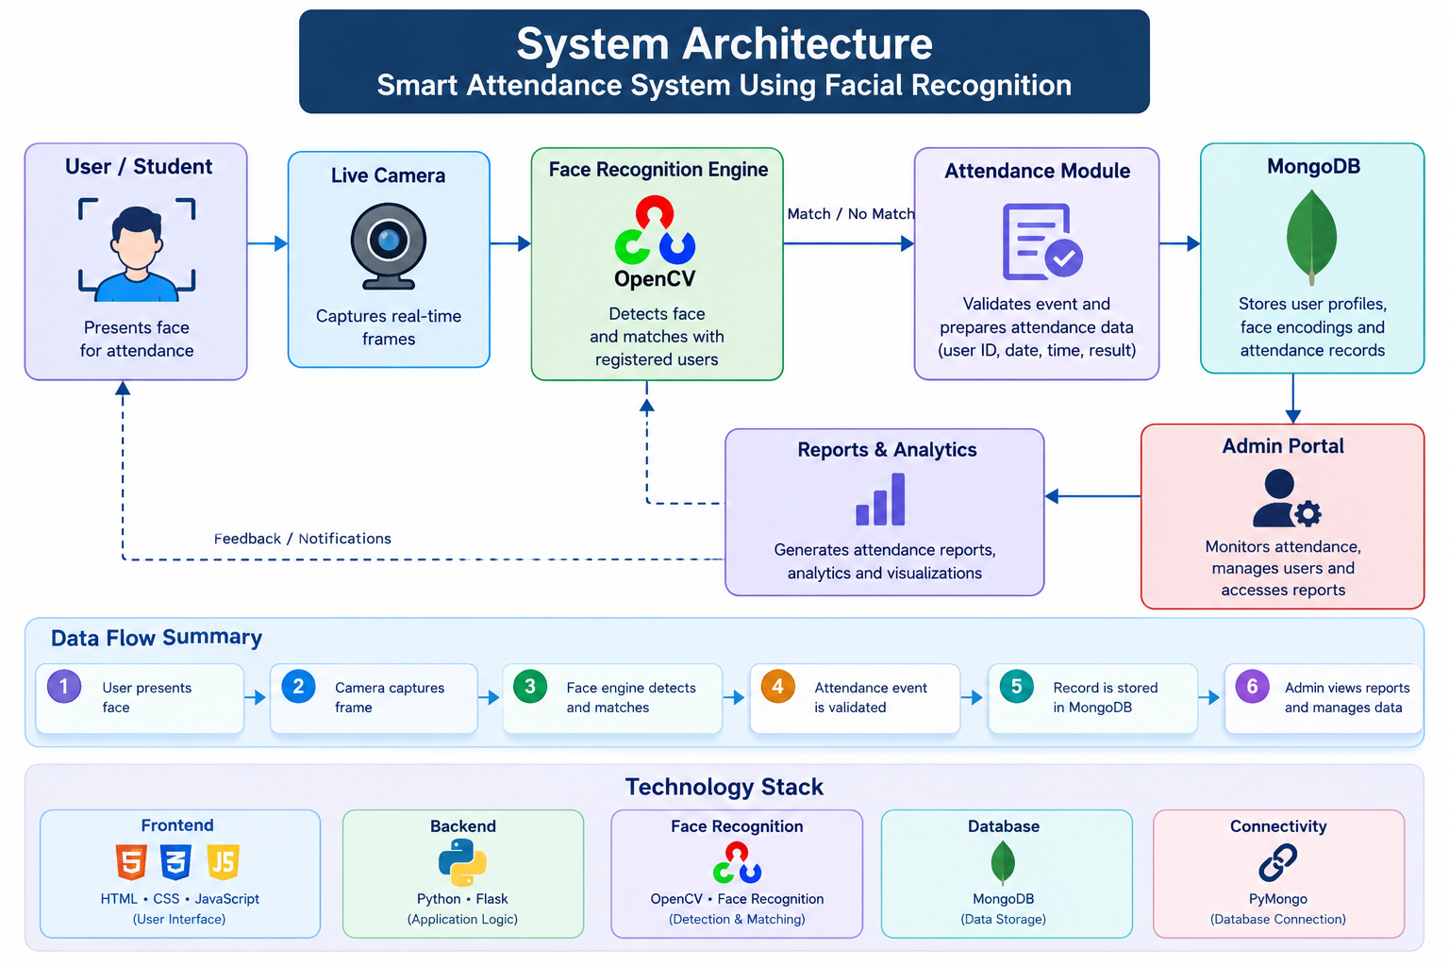
06
System Architecture
End-to-end data flow from camera capture to administrative insight
User / Student
Live Camera
Face Engine
Attendance
Presents face
Captures frame
Detects + matches
Validates event
Stored attendance record
User ID • Date • Time
Verification result
Reports
Admin Portal
MongoDB
Summarizes data
Monitors + manages
Stores record
Safeguard:
Only a successful match should create an attendance event; uncertain faces can be flagged for review.
DSB & DB PROJECT • Smart Attendance System
6/12

Slide 7
07
Technology Stack
Each technology supports a distinct layer of the attendance workflow
INTERFACE
HTML • CSS • JavaScript — User-facing attendance and administration screens.
BACKEND
Python • Flask — Application logic, requests and service coordination.
FACE AI
OpenCV • Face Recognition — Detection, encoding comparison and identification.
DATABASE
MongoDB — Student profiles, face identifiers and attendance records.
CONNECTIVITY
PyMongo — Database access and record operations from Flask.
HARDWARE / DEV
Webcam or CCTV • Visual Studio Code — Real-time capture, coding, testing and development.
DSB & DB PROJECT • Smart Attendance System
7/12

Slide 8
08
Database Design
MongoDB stores user profiles and attendance records centrally
USERS / STUDENTS
ATTENDANCE
_id
name • roll_no / employee_id
department • face_encoding
created_at
_id
user_id • date • time
status / verification result
optional image/reference path
ADMIN / MANAGEMENT
ATTENDANCE EVENT
Administrative identity and access information can be maintained separately from attendance records.
A verified match creates a timestamped event linked to the registered user.
RELATIONSHIP
One registered user → many attendance records
DSB & DB PROJECT • Smart Attendance System
8/12

Slide 9
09
System Workflow
From registration to attendance record and administrative review
1. Registration
2. Live Capture
3. Face Detection
4. Recognition
5. Verification
6. Record
Capture/store face data
Get frame from camera
Locate face in frame
Compare with registered identity
Confirm match
Save timestamped entry
IF MATCHED
Create one timestamped attendance entry and show confirmation. Duplicate checks can prevent repeated marking in the same session.
IF UNCERTAIN
Do not mark automatically; request another scan or administrator review.
DSB & DB PROJECT • Smart Attendance System
9/12

Slide 10
10
Key Features & Project Interface
Core capabilities mapped to everyday attendance operations
✓ Real-time face recognition
✓ Automatic attendance marking
UI / DEMO EVIDENCE
Place your actual project screenshots here:
• Login / registration
• Camera / recognition screen
• Attendance confirmation
• Admin dashboard
• Attendance report
✓ User registration & management
✓ Admin dashboard with live view
✓ Reports and attendance analytics
✓ Centralized database records
PROJECT OUTPUT
The system is designed to reduce manual marking effort, minimize errors, provide timestamped records and improve administrative visibility.
IMPORTANT
Use actual implementation screenshots during the final review to demonstrate the working system.
DSB & DB PROJECT • Smart Attendance System
10/12

Slide 11
11
Testing, Results & Observations
Review-2 evidence should be demonstrated using the actual implemented system
TEST CASES
OBSERVABLE OUTPUT
EVIDENCE TO SHOW
1. Registered face → verify identity
2. Unregistered face → reject / request review
3. Successful match → create attendance record
4. Repeat scan → prevent duplicate marking where implemented
5. Admin → view attendance records
6. Report → review attendance data
• Face detected
• Identity matched / not matched
• Attendance timestamp created
• Record stored in MongoDB
• Admin can review records
• Reports can summarize attendance
Insert actual screenshots or live-demo captures:
✓ Recognition screen
✓ MongoDB record
✓ Dashboard
✓ Attendance report
✓ Test-case output
Do not add numerical accuracy claims unless measured in your project.
DSB & DB PROJECT • Smart Attendance System
11/12

Slide 12
12
Conclusion, Limitations & Future Scope
Final project-review summary
CONCLUSION
LIMITATIONS
FUTURE SCOPE
The proposed system automates attendance through facial verification, timestamped records and centralized storage.
It addresses major weaknesses of manual attendance by reducing repetitive work and improving record visibility.
• Recognition depends on camera/image quality
• Lighting and face angle can affect detection
• Uncertain matches require review
• Security and privacy controls need careful implementation
• Real-world accuracy should be validated with project test data
• Mobile application support
• Liveness / anti-spoofing detection
• Integration with biometric devices
• AI-based attendance analytics & alerts
• Larger-scale deployment and testing
Thank You • Questions & Discussion
DSB & DB PROJECT • Smart Attendance System
12/12

