Slide 1
Oracle PeopleSoft ERP systems’ On-Prem to Cloud Migration PLAN
BY Harshitha Anuganti

Slide 2
Table of contents
Existing On-Prem Architecture.
Proposed High level Architecture on Cloud.
Compliance with NIST 800-171
Technology considerations – Containerization.
CI/CD pipelines.
Data Migration Plan.
Cloud Migration Roadmap – 1st year milestones.
Conclusion.

Slide 3
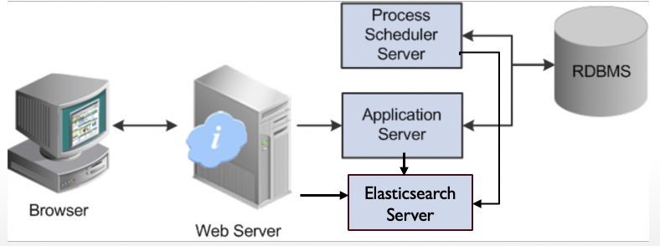
Existing On-Prem Architecture

Slide 4
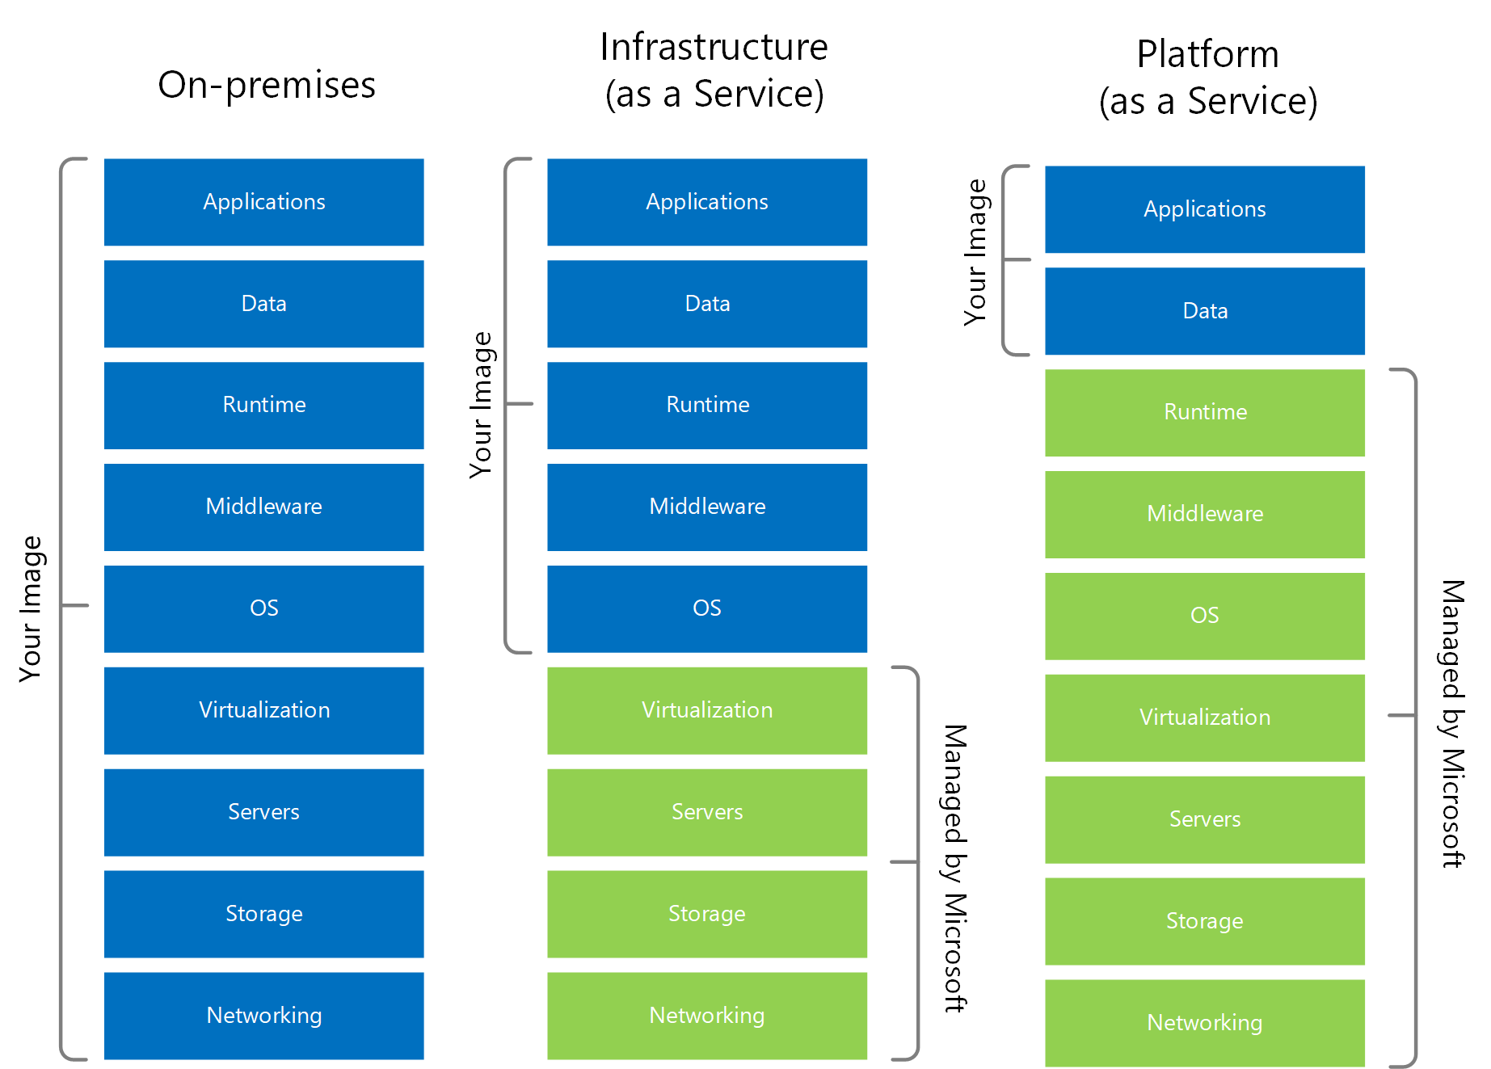
Issues with Lift & Shift
Using Paas models over the Virtual machines(Iaas) provides:
greater flexibility and scalability.
pay-as-you-go model=>cost cutdown.
No infrastructure management.

Slide 5
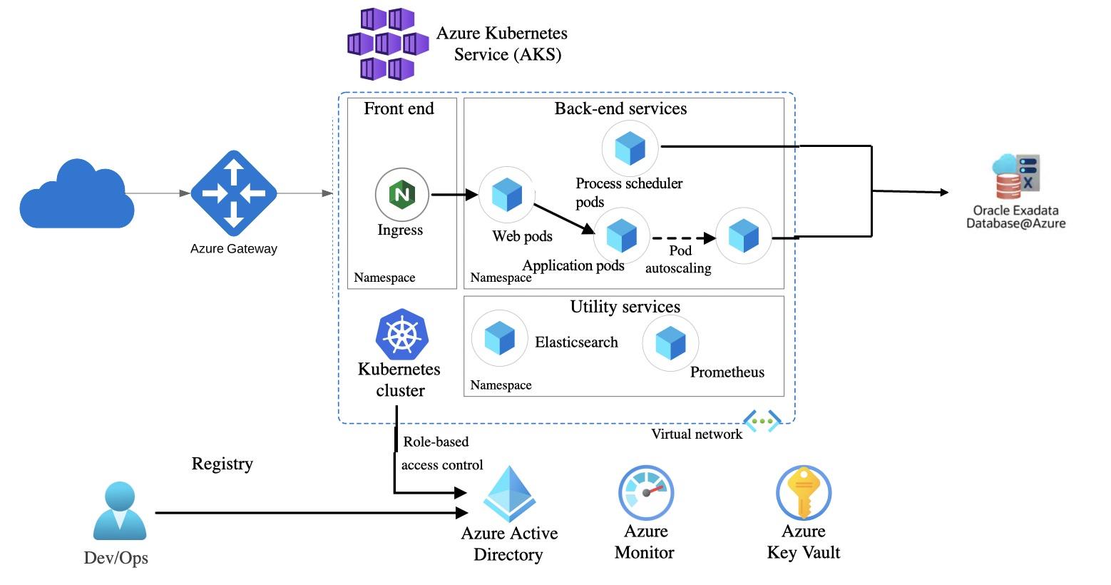
Proposed High level Architecture on Cloud

Slide 6
Compliance with NIST 800-171
Azure Government
Azure Government services can accommodate data that is subject to various US government regulations and requirements. To provide you with the highest level of security and compliance, Azure Government uses physically isolated datacenters and networks located in the US only

Slide 7
Technology considerations
Why Containerization?
quicker to deploy
Highly scalable and fault-tolerant systems.
AKS costs nothing; you pay only for the worker node resources instead of VMs, vnet, public IPs, load balancers, storage accounts.
Huge reduction in support and maintenance overhead. No patching and hardening (other than k8 upgrades). Massive reduction in platform deployment effort.

Slide 8
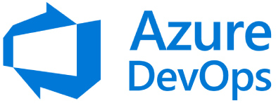
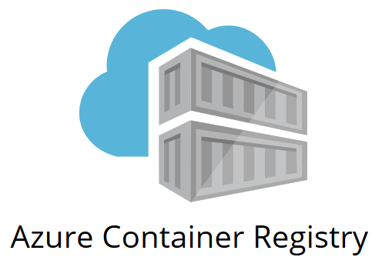
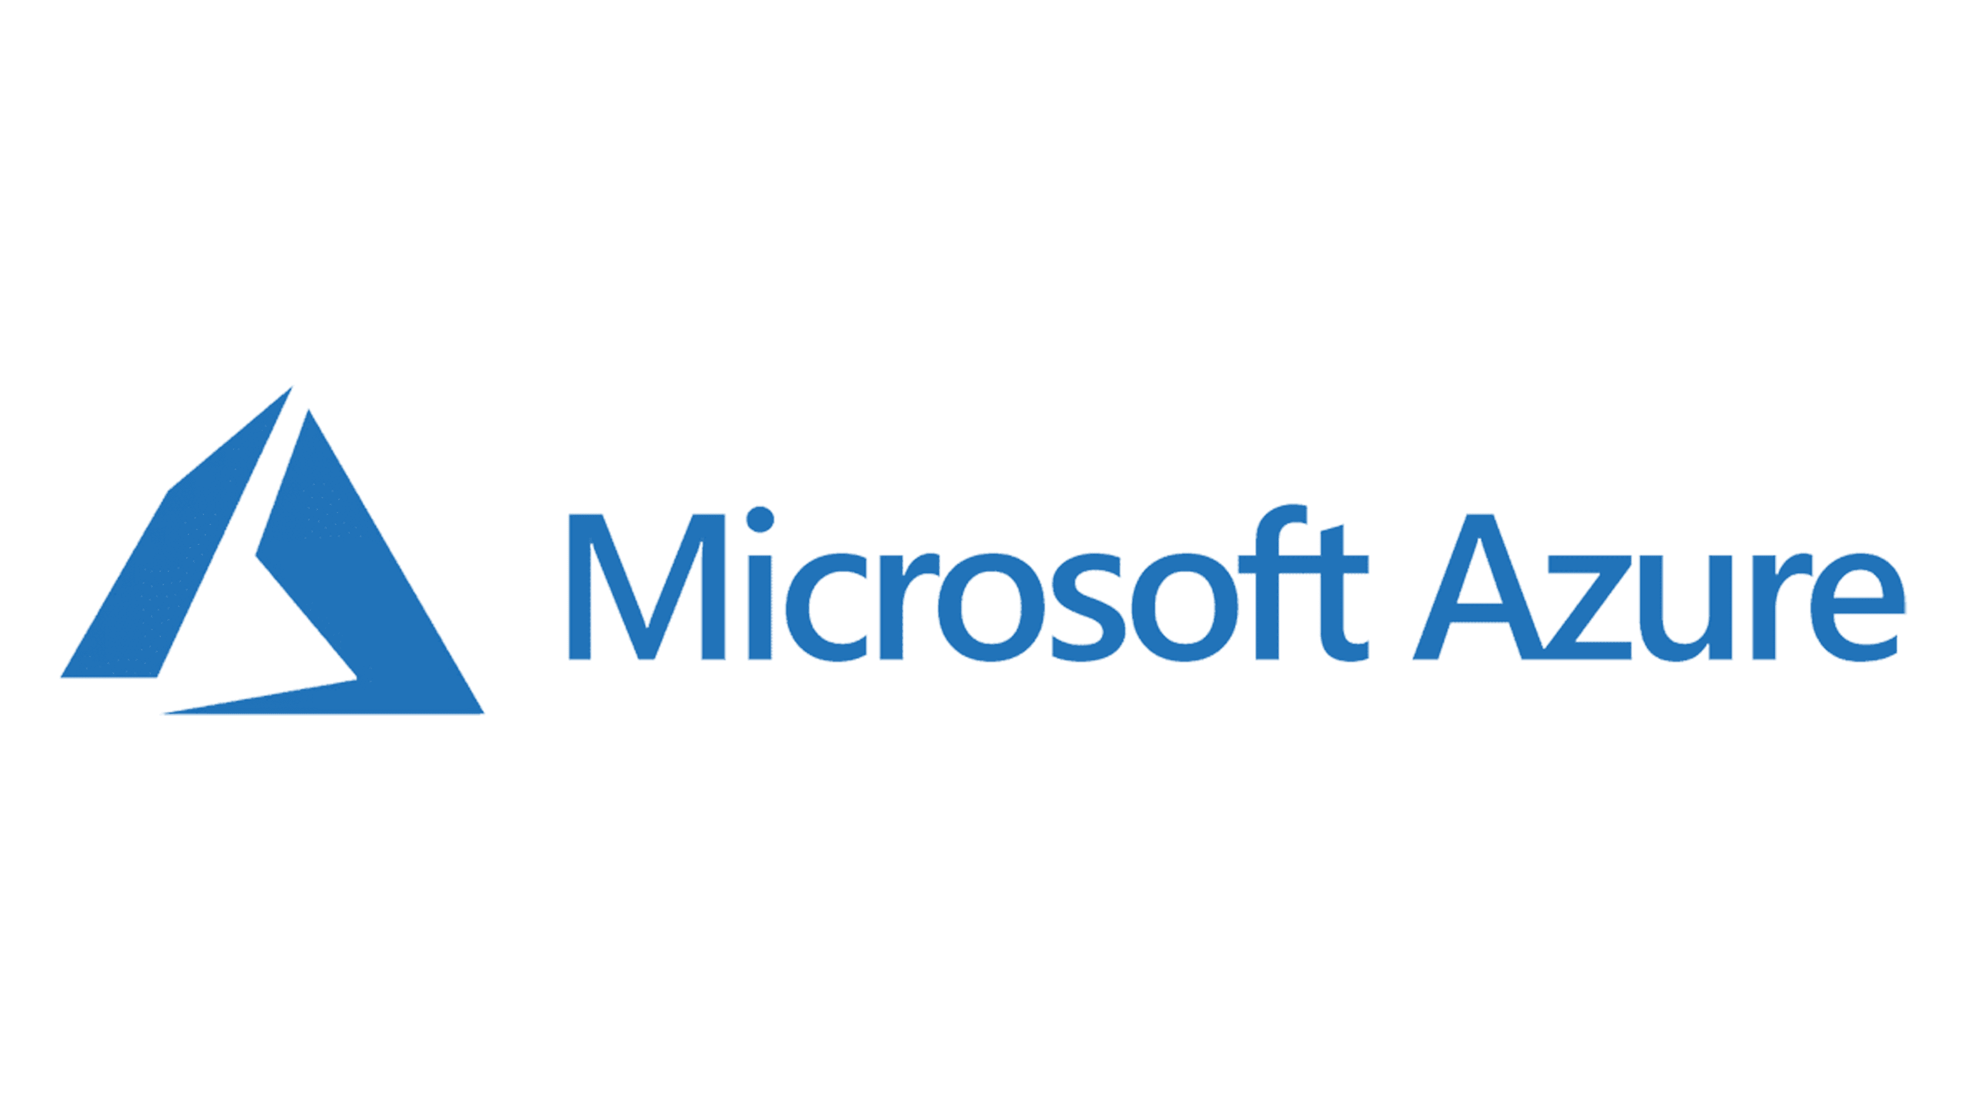
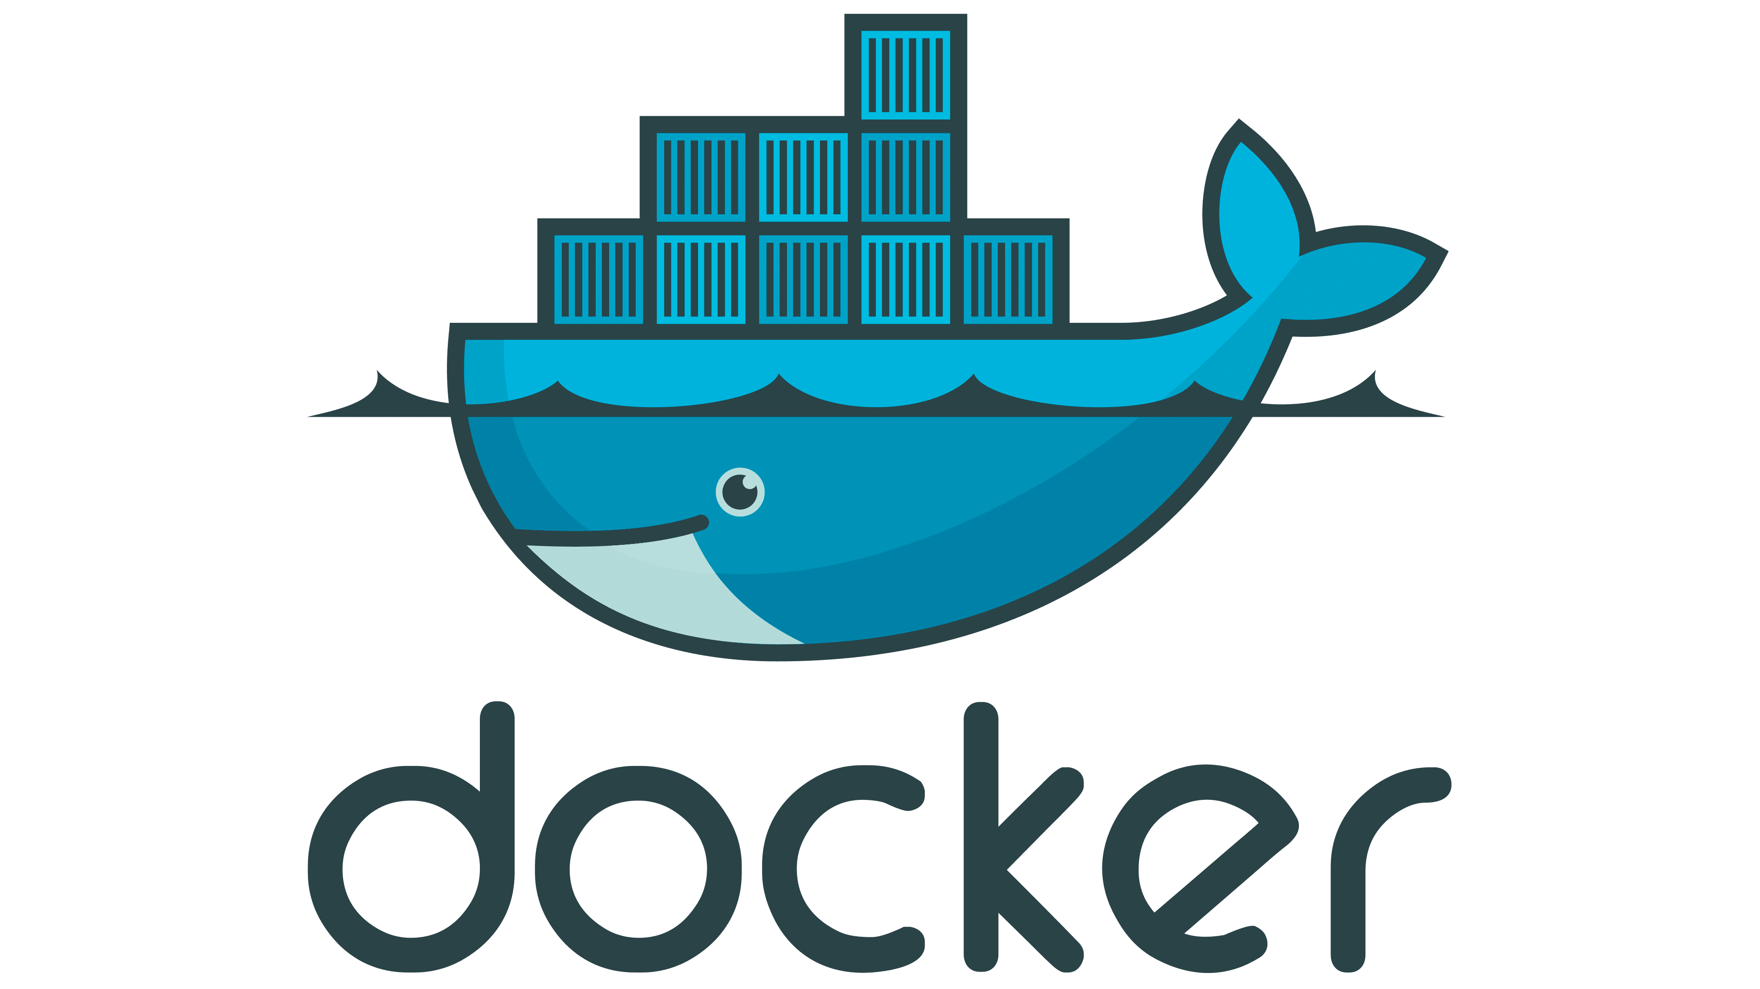

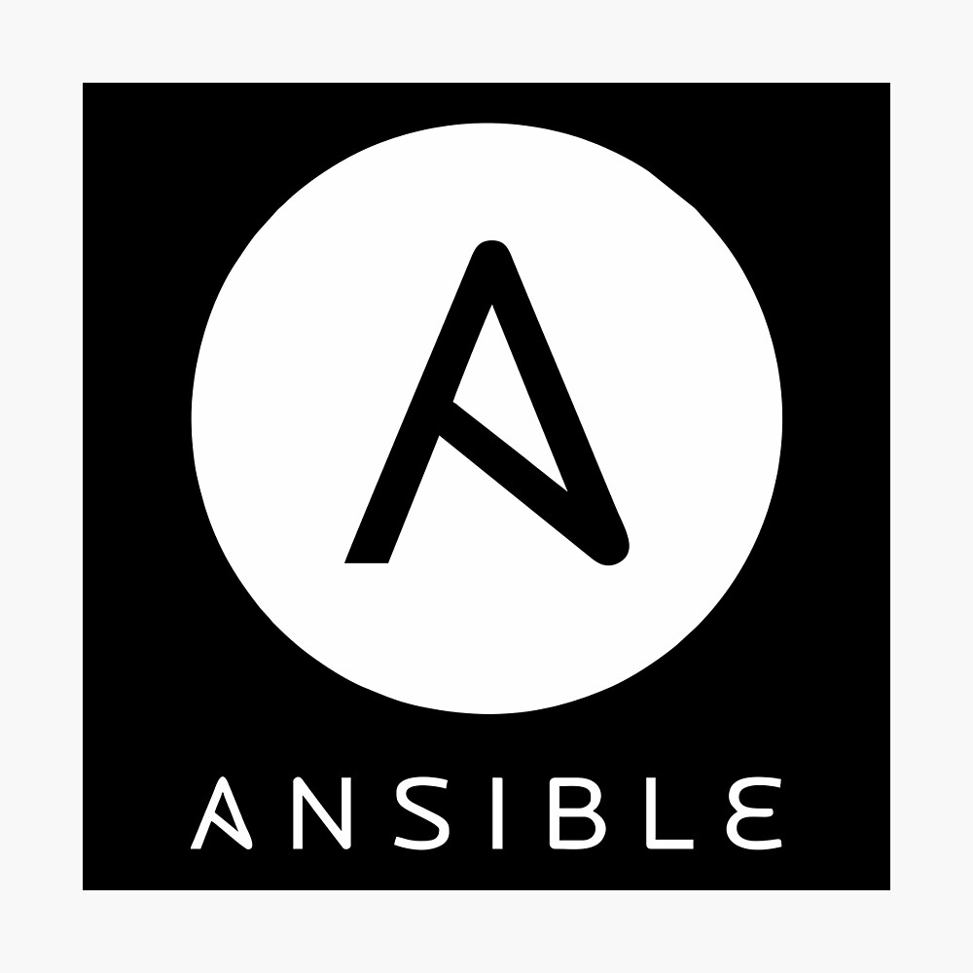

CI/CD Pipeline Design
Oracle PeopleSoft Artifacts
Build
Deploy

Slide 9
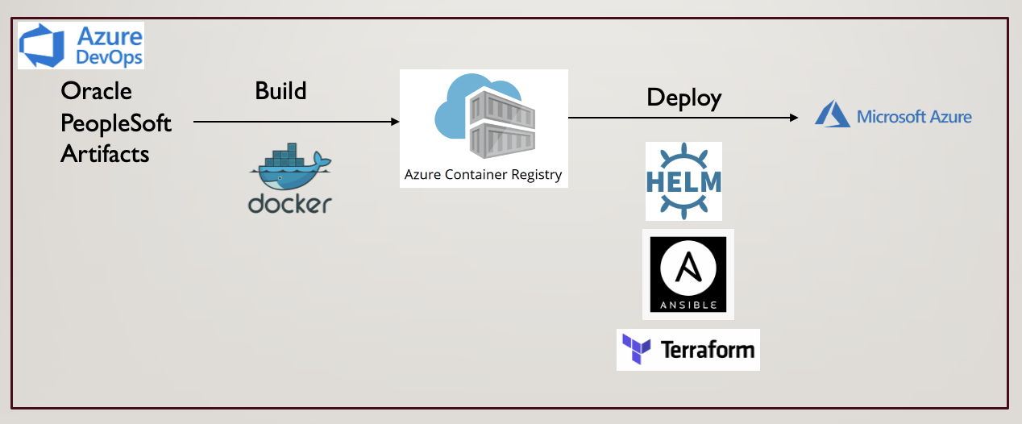
CI/CD Pipeline Design

Slide 10
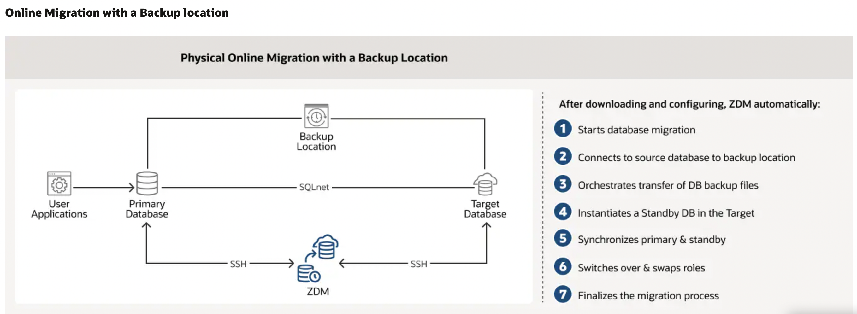
Data Migration Plan
Migrating to Oracle Database@Azure is similar to migrating to OCI.
Oracle provides automated migration solutions such Oracle Zero Downtime Migration

Slide 11
Cloud Migration Roadmap
Proof of Concepts (POCs)
Build Test environment.
Execute(Migrate Production)
Migrate with roll back strategy.
Operate & Optimize
Plan
Test and redesign if required.
Develop Strategy and Roadmap.
Document.
Setup Monitoring and Alerting.
Continuously improve.

Slide 12
1st year milestones
1st Quarter
2nd Quarter
3rd Quarter
4th Quarter
Planning.
Training and Upskilling.
Dockerize the services – web, app and batch.
Building local Kubernetes environments using helm
Validate
Develop Terraform scripts for infrastructure deployment and Ansible for helm charts’ deployment.
Validate.
Setup Monitoring and Alerting systems.
Spillovers.
Building the Test Environment.

Slide 13
Conclusion

Slide 14

Thank you

