Slide 1
Employee Data Analysis using Excel
STUDENT NAME: Harshitha Balaa.V
REGISTER NO:122202123
DEPARTMENT: B.COM CS
COLLEGE : Anna Adarsh College for Women

Slide 2
PROJECT TITLE
Employee Performance Analysis using Excel

Slide 3


AGENDA
Problem Statement
Project Overview
End Users
Our Solution and Proposition
Dataset Description
Modelling Approach
Results and Discussion
Conclusion
3/21/2024 Annual Review

Slide 4

PROBLEM STATEMENT
Performance Analysis is driven by a sports needs to understand and improve tactics, technique, and movement, achieved through the delivery of real and lapsed time objective feedback. The discipline focuses on enhancing interventions within the coaching process to elicit a performance gain and augment learning

Slide 5

PROJECT OVERVIEW
Employee performance evaluations provide a dedicated time for managers to focus on individual performance and growth and development opportunities. This is an ideal time for employees to discuss their salary, career goals and learn what they need to do to achieve those goals.

Slide 6

WHO ARE THE END USERS?
Every performance evaluation should be directly tied with that employee's job description. Determining who should evaluate the performance of the employee is the next decision. It could be their direct manager (most common method), subordinates, customers or clients, self, and/or peers

Slide 7

OUR SOLUTION AND ITS VALUE PROPOSITION
Conditional formatting - to highlight the missing values
2. Filtering to remove the missing values
3. Formula - to calculate the employee performance level
4. Pivot- to summarize
5.Graph-for data visualization
6. Pie chart - for data visualization

Slide 8
Dataset Description
EMPLOYEE PERFORMANCE ANALYSIS DATA SET IS TAKEN FROM EDUNET
DESCRIPTION
TOTAL FEATURES-26, FEATURES TAKEN FOR CONSIDERATION-9
EMP ID-NUMBER
NAME-TEXTEMPLOYEE TYPE
PERFORMANCE LEVEL
GENDER-MALE FEMALE
EMPLOYEE RATING-NUMBER
BUSINESS TYPE FIRST NAME
LAST NAME
EXIT DATE (USING CONDITIONAL FORMATTING)

Slide 9

THE "WOW" IN OUR SOLUTION
Performance level formula: IFS(Z8>=5,"VERY HIGH",Z8>=4,HIGH", Z8>=3,"MED","TRUE","LOW")
3/21/2024 Annual Review
9

Slide 10
MODELLING
1, Collection:
collected the data from EDUNET data set which was mentioned in the class
2. Feature collection:
selected 9 specific features from the total of 26 features
3. Data cleaning:
a) Identifying the missing values
b) Filtering the missing valuesa) Identifying the missing values
4. Performance level:
Applled the performance level formula=IFS(28-5,"VERYHIGH", Z8>-4,HIGH", 28-3,"MED","TRUE","LOW")
5. Summary:a) Using the pivot table classify the necessary fieldsb) Highlight the necessary data
6. Visualization:
Recommended graph
b) Pie chart
10

Slide 11
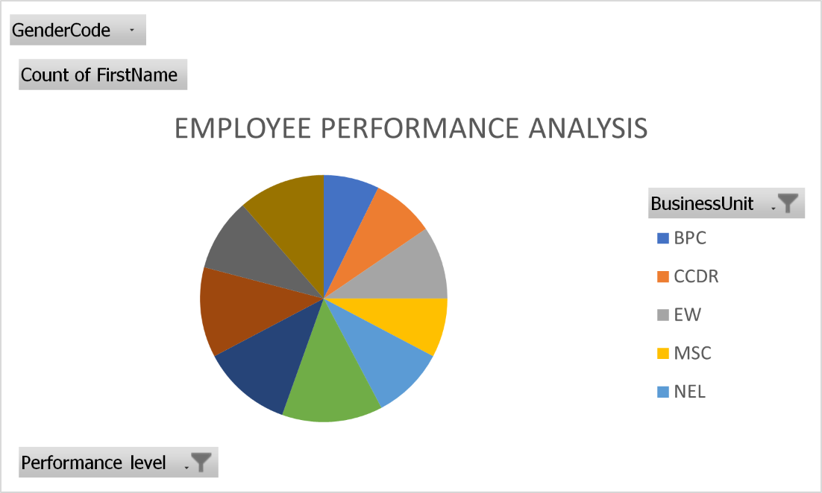
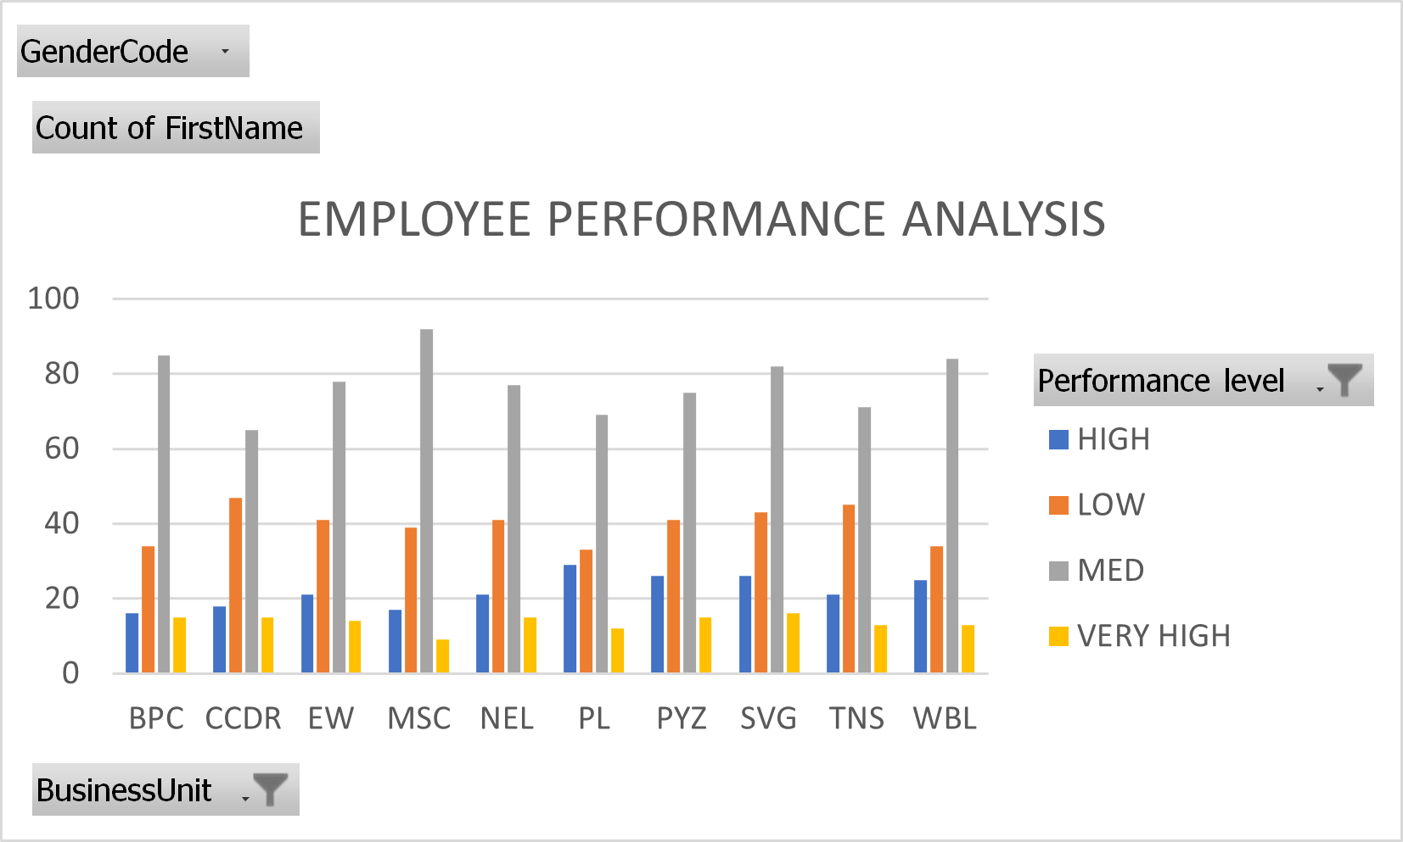
RESULTS
11

Slide 12
Conclusion According to the graph, the performance of the employe are expo line low of 40 and there are classification of high, very high,and medium.

