Slide 1
Smart Kitchen Assistant
Team Name : Codesky
Project Team :
Harshitha B. S.
Sumitaa S Deshbhandari
Rakshitha R

Slide 2
Problem Statement
In today’s fast-paced world, individuals often struggle with meal planning, ingredient tracking, and grocery shopping. People waste time figuring out what to cook, identifying available ingredients, and creating shopping lists. This results in inefficiencies, food wastage, and missed opportunities to prepare nutritious meals.
The Smart Kitchen Assistant aims to solve this problem by leveraging AI-powered image recognition, voice input, and real-time recipe suggestions. It detects ingredients through a camera or microphone, suggests relevant recipes based on available items, and generates a shopping list for missing ingredients—seamlessly integrated with online grocery platforms like Blinkit. This solution helps users cook smarter, reduce waste, and streamline grocery shopping from the comfort of their kitchen.

Slide 3
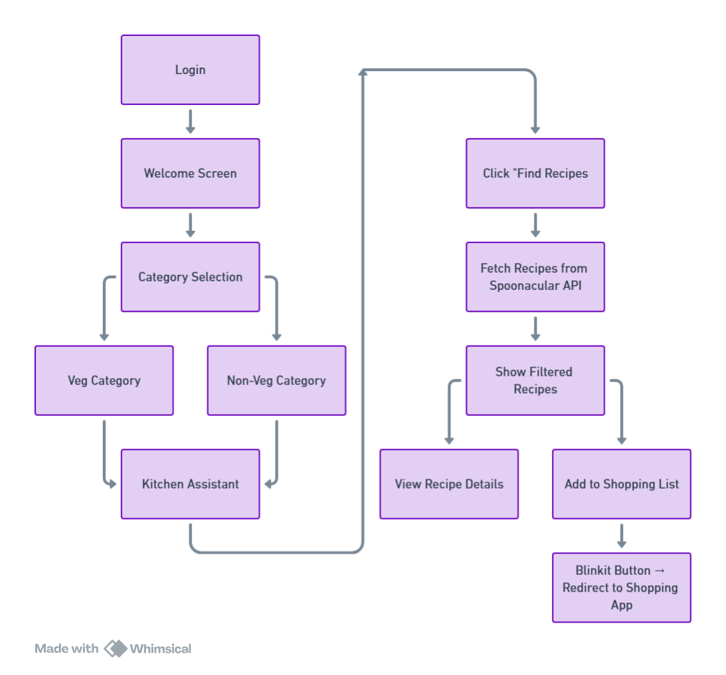
Flow/Architecture Diagram

Slide 4
Solution Overview
The Smart Kitchen Assistant is a web-based application designed to enhance the cooking experience using AI and modern web technologies. It offers an intuitive interface where users can:-
Detect Ingredients: Upload images or use their device's camera to automatically identify available ingredients using TensorFlow.js and the COCO-SSD model.
Voice Input: Use speech recognition to list ingredients verbally for a hands-free experience.
Get Recipe Suggestions: Based on detected or entered ingredients, the app fetches recipe suggestions using the Spoonacular API.
Detailed Recipe View: Upon selecting a recipe, users can view preparation steps, required ingredients, and nutritional details.
Shopping List Integration: Missing ingredients are automatically identified and displayed with links to purchase via Blinkit, simplifying the grocery shopping process.
Built with React.js, the Smart Kitchen Assistant combines user-friendly UI/UX with powerful backend intelligence, empowering users to make better meal decisions, minimize food waste, and save time in the kitchen.

Slide 5
Tech stack
Frontend
React.js – For building the interactive single-page UI.
React Router DOM – Manages page navigation (Login → Welcome → Category → Planner → Details).
TypeScript (.tsx) – Adds type safety and better development experience.
Custom CSS (App.css) – Used for responsive layout and styling.
Lucide React Icons – Used for modern UI icons like Mic, Camera, ChefHat, etc.
AI / Machine Learning
TensorFlow.js + COCO-SSD – Real-time object detection from webcam for ingredient recognition.
APIs & Integrations
Spoonacular API for recipes
Web Speech API – Converts voice input to text to add ingredients hands-free.
Utilities & Tools
Axios and Browser APIs - navigator.mediaDevices , window.SpeechRecognition

Slide 6
Implementation details
Login & Navigation
Uses React Router to navigate between:
Login → Welcome page → Category → Veg/Non-Veg selection → Input ingredients →Fetch and display Recipes → Choose Recipe → Recipe Instructions
Input Methods
Manual Input – User types ingredients in the input box.
Voice Input (Mic) – Captures ingredients using Web Speech API.
Image Detection (Camera and media upload) – Detects food items via webcam using COCO-SSD model.

Slide 7
Implementation details
Real-Time Features
Object detection runs via webcam.
Detected items are auto-added .
Voice input directly adds recognized ingredients.
Smart Shopping List
Adds missed ingredients to a smart shopping list.
User can remove individual items.
Order on Blinkit.

Slide 8
Thank You

