Slide 1

Web Application for Allocating Groups, Topics, and Supervisors for Group Discussions
CO7201 MSc Individual Project
Harshith Aiyannira Ganesh, MSc Advanced Computer Science
Harshith A G, MSc Advanced Computer Science

Slide 2
Contents
Aims and Objectives
Requirements
phase
Technical specification
System Architecture
Algorithm
Application features

Slide 3
Aims and Objectives
Develop a web App to assist students and academic staff
The web app automates the process of allocation of groups for students for “Personal and Group Skill” module
Allows Supervisors to specify their topic that they are willing to supervise, and students are allowed to select their preferred topic and submit
The overall goal of the web application is to improve accessibility and efficiency of the allocation process for all the users.

Slide 4
Requirements
Supervisor should specify the topic that they would like to supervise
Students should view the topics published by the supervisor
Student who is entitled to the module should be allowed to make choices of their preferences based on the topic they are interested in
Administrator will be able to run the algorithm and view the results of the algorithm
If the administrator approves the allocation after running the algorithm, admin should have the choice to make it visible with the allocation to each student

Slide 5
Phase 1
Users can register themselves to the application.
Assignment content must be proposed by the professor. Supervisor could edit the proposed topic and delete the topic.
Administrator could remove or edit the topic.
Administrator could register users or remove and monitor to see if all the professors have proposed topic where the Students could be accommodated. Students’ strength and topic required should be decided by the admin.
Students could suggest the content that they are interested in. If the professor approves the content, he would be in charge of the content.

Slide 6
Phase 2
Don’t allow users to register. Removing and uploading topics should not be allowed.
Students need to go through the topics proposed by the professors.
Admin could view the preferences, edit it or set preferences on behalf of students.
Students are allowed to submit their preferences based on the topics proposed.
Phase 3
Phase 4
Allocate the student based on the preferences they choose. Admin would run the algorithm to allocate the student into groups .
If the result seems good, inform it to the students and supervisor.

Slide 7

Technical Specification
The MERN Stack is a JavaScript stack designed to deploy full-stack web applications.
This Stack consists of 4 technologies
MongoDB(cross platform document oriented),
Express,
React
Nodejs
Styling and editors
Bootstrap, MaterialUI, FontAwesome and react prime(Styling and icons)
Visual Studio Code
Postman
Amazon simple email service

Slide 8
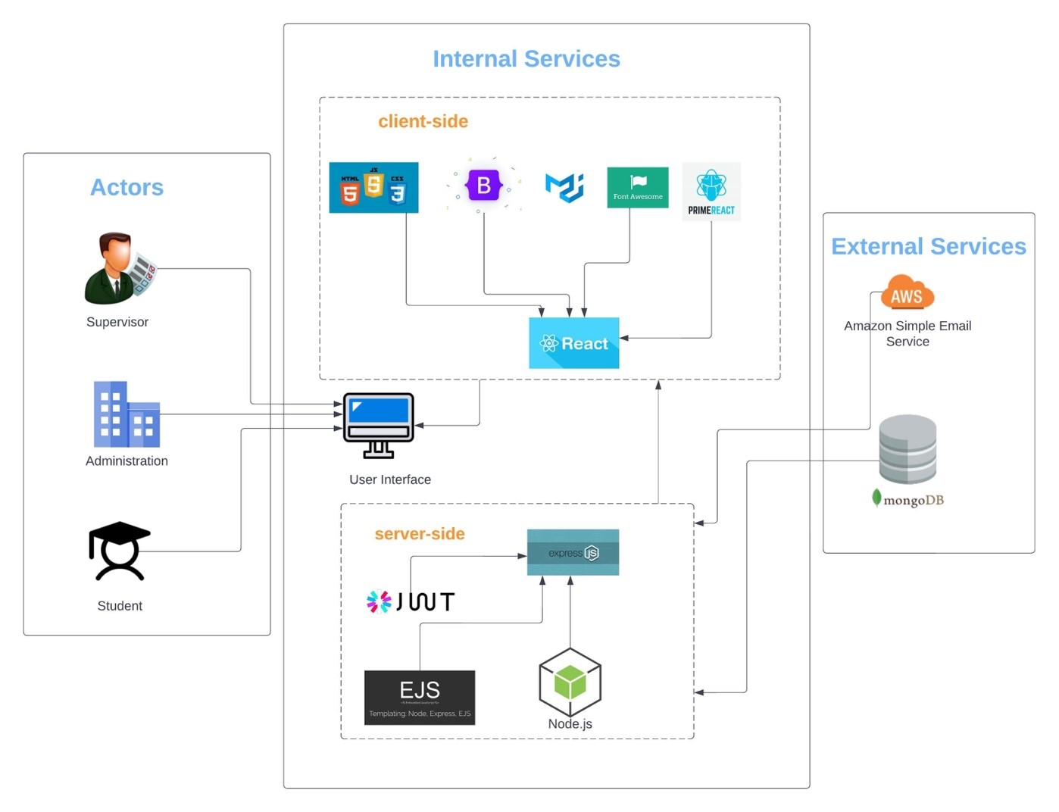
System Architecture
MERN Stack

Slide 9
Algorithm 1 n² Time complexity
Algorithm 2 n² Time complexity
Four fixed iterations
First preference of Students
Assign if available or else don’t allocate
Second preference of students
Repeat the same for all the preferences if room available allocate else randomly allocate
Student preferences
Preferred topics
Assign if available or don’t allocate
Next preference
Repeat the same for other preferences if room available in the topic allocate else next student

Slide 10
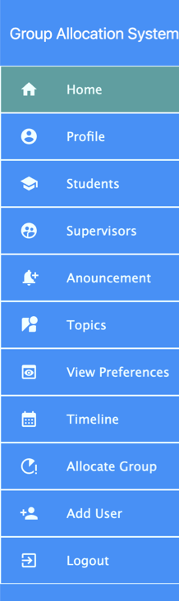
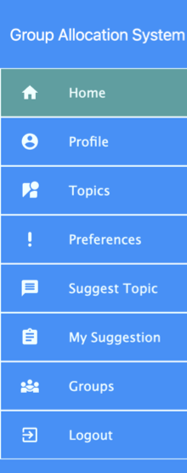
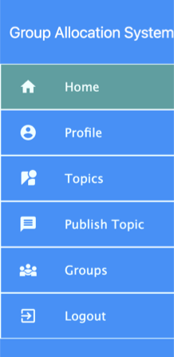
Application Features
Three Actors Administrator, Students and Supervisor with different functionalities.

Slide 11

Evaluation
Agile approach has been followed in the software development life cycle process.
Functional testing also known as component testing which will check if the functionality of each component is well implemented or not.
Integration testing is a kind of test done on the software to check the flow of the data between two features/modules.
System testing is the end-to-end testing of one flow of scenario and checks whether the application works as designed.
Regression testing have been done on the application where the new functionality is developed and tested to confirm that there is no impact due to new feature.
https://trello.com/b/VDpP6kJJ/msc-project-groupallocationsystem
../../other/Group Allocation TestCases.xlsx

Slide 12
Conclusion
This Web application is to give a graphical interface to students and academic staffs, where the supervisor uploads the topic that will be supervised, and the students will enter their choices in the topic they would like to work.
An algorithm would be developed to assist students and academic staff in group formation based on students’ interest. This would be managed by the administrator.
This platform would make all tasks more fluid and faster, as well as automate the process with less human intervention. This automated function will save lot of time and effort of academic staffs and students by reducing the manual procedure required and it would be more probable to create a group with similar interests.

Slide 13

Future Improvements
User experience in the application can be improved as currently it is developed with basic UI.
Automatic reminder to notify if the students haven't submitted the preferences and supervisors if they haven't uploaded any topics.
A chat box can be provided to interact with supervisors and students to discuss regarding the topics.
Inform students if the topic isn’t approved after the topic submission deadline.
Email body structure can be well defined.

Slide 14

Thank you

