Slide 1
Software Quality
Planning Quality
Defining Quality - ISO 9016
Quality Measures
Quantitative Quality Management Planning
Product Quality & Process Quality Metrics
Statistical Process Control
Capability Maturity Model
Enhancing software Quality

Slide 2
1. Planning Quality
Quality will be of concern at all stages of project planning and execution, but will be of particular interest at the following points in the Step Wise framework.

Slide 3
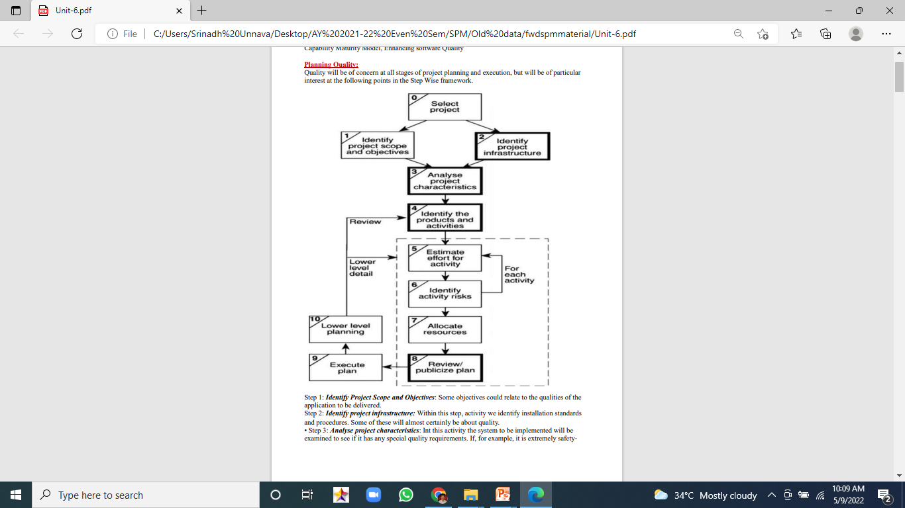
Planning Quality

Slide 4
2. Defining Quality:
Quality is a rather vague term and we need to define carefully what we mean by it.
For any software system, there should be three specifications:
a functional specification describing what the system is to do;
a quality (or attribute) specification concerned with how well the functions are to operate;
a resource specification concerned with how much is to be spent on the system.

Slide 5
ISO 9126:
Software systems are large and complex with lots of maintenance problems, while users expect high quality. However, it is hard to assess and assure quality.
The ISO/IEC 9126 standard has been developed to address software quality issues.
It specifies software product quality characteristics and sub-characteristics and proposes metrics for their evaluation.
It is generic, and can be applied to any type of software product by being tailored to a specific purpose.
It aims at eliminating any misunderstanding between customers and developers.

Slide 6
ISO 9126:
ISO 9126 provides a set of six quality characteristics: -
Functionality
Efficiency
Maintainability
Reliability
Usability
Portability
ISO (the International Organization for Standardization) IEC (the International Electrotechnical Commission)

Slide 7
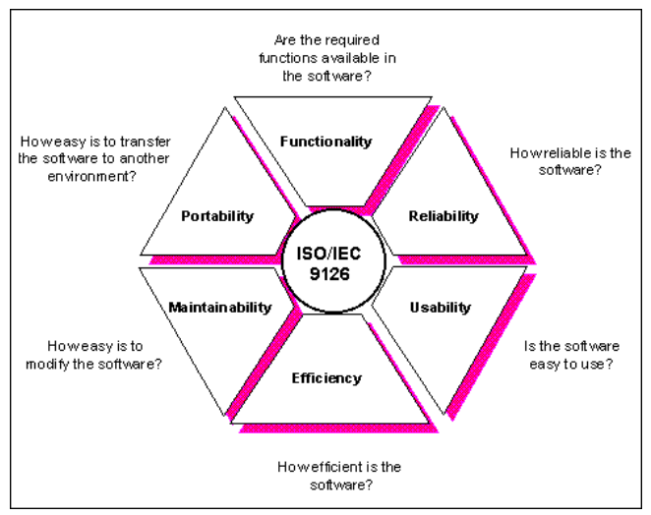
ISO 9126:

Slide 8
ISO 9126:
The proposed new edition of ISO/IEC 9126 will be divided into three parts:
ISO/IEC 9126-1: Information technology - Software quality characteristics and metrics - Part 1: Quality characteristics and sub characteristics.
ISO/IEC 9126-2: Information technology - Software quality characteristics and metrics - Part 2: External metrics
ISO/IEC 9126-3:Information technology - Software quality characteristics and metrics - Part 3: Internal metrics.

Slide 9
ISO 9126:
ISO 9126 suggests sub-characteristics for each of the primary characteristics.
Characteristic: Functionality
Sub-characteristics: Suitability, Accuracy, Interoperability, Compliance, Security
Characteristic: Reliability
Sub-characteristics: Maturity, Fault tolerance, Recoverability, Reliability Compliance

Slide 10
ISO 9126:
Characteristic: Usability
Sub-characteristics: Understandability, Learnability, Operability, Attractiveness, Usability Compliance
Characteristic: Efficiency
Sub-characteristics: Time behavior, Resource Utilization, Efficiency Compliance

Slide 11
ISO 9126:
Characteristic: Maintainability
Sub-characteristics: Analyzability, Changeability, Stability, Testability, Maintainability Compliance
Characteristic: Portability
Sub-characteristic: Adaptability, Instability, Co-existence, Replaceability, Portability Compliance

Slide 12
3. Quality Measures:
Each project will need to have its own measures devised to meet its own specific needs. The measures described relate to the final software products of a project.
Reliability
Maintainability
Extendibility: When measuring changeability we could identify two aspects: one is the ease with which existing code can be changed, while another could be the ease with which new functionality can be added.

Slide 13
4. Quantitative Quality Management Planning:
Setting the Quality Goal: Project managers set quality goals during the planning stages. The Quality goal for a project generally is the expected number of defects found during acceptance testing.
Two primary sources can be used for setting the quality goal: past data from similar projects and data from the Process capability baseline (PCB).

Slide 14
Quantitative Quality Management Planning:
If we set the quality target as the number of defects per function point, the following sequence of steps is used:
--> Set the quality goal in terms of defects per FP.
--> Estimate the expected productivity level for the project.
--> Estimate the size in FP as (expected productivity * estimated effort)
--> Estimate the number of AT (Acceptance Test) defects as ( Quality goal * Estimated size )

Slide 15
Quantitative Quality Management Planning:
Estimating Defects for Other Stages: Once the projects quality goal is set, we should estimate defect levels for the various quality control activities so that we can quantitatively control the quality. The approach for estimating defect levels for other phases is similar to the approach for estimating the defects in acceptance testing.

Slide 16
Quantitative Quality Management Planning:
Quality Process Planning: If the quality goal is based on the data from similar projects and the goal is higher that that of the similar projects, it is unreasonable to expect that following the same process as used in the earlier projects will achieve the higher quality goal. Hence, if a higher quality level is desired, the process must be suitably upgraded.

Slide 17
5. Product Quality & Process Quality Metrics:
Product metrics − Describes the characteristics of the product such as size, complexity, design features, performance, and quality level.
Process metrics − These characteristics can be used to improve the development and maintenance activities of the software

Slide 18
Product Quality & Process Quality Metrics:
The system development process is made up of a number of activities that are linked together so that the output from one activity is the input to the next. Thus, program testing will depend on there being a program to test that will be the product of the program coding stage.
Errors can enter the process at any stage. They can be introduced either because of a defect in the way a process is carried out, as when programmers make mistakes in the logic of their programs, or because information has not been passed clearly and unambiguously between stages.

Slide 19
Product Quality & Process Quality Metrics:
Errors should therefore be eradicated by careful examination of the products of each stage before they are passed on to the next. To do this, the following process requirements should be specified for each activity.
Entry requirements, which have to be in place before an activity can start.
Implementation requirements, which define how the process is to be conducted.
Exit requirements, which have to be fulfilled before an activity is deemed to have been completed.

Slide 20
Product Quality & Process Quality Metrics:
Product Quality Metrics
This metrics include the following −
Mean Time to Failure
Defect Density
Customer Problems
Customer Satisfaction

Slide 21
Product Quality Metrics:
Mean Time to Failure
It is the time between failures. This metric is mostly used with safety critical systems such as the airline traffic control systems, avionics, and weapons.
Defect Density
It measures the defects relative to the software size expressed as lines of code or function point, etc. i.e., it measures code quality per unit. This metric is used in many commercial software systems.

Slide 22
Product Quality Metrics:
Customer Problems:
It measures the problems that customers encounter when using the product. It contains the customer’s perspective towards the problem space of the software, which includes the non-defect oriented problems together with the defect problems.
The problems metric is usually expressed in terms of Problems per User-Month (PUM).
PUM = Total Problems that customers reported (true defect and non-defect oriented problems) for a time period + Total number of license months of the software during the period
Where,
Number of license-month of the software = Number of install license of the software × Number of months in the calculation period

Slide 23
Product Quality Metrics:
Customer Satisfaction
Customer satisfaction is often measured by customer survey data through the five-point scale −
Very satisfied
Satisfied
Neutral
Dissatisfied
Very dissatisfied
Satisfaction with the overall quality of the product and its specific dimensions is usually obtained through various methods of customer surveys. Based on the five-point-scale data, several metrics with slight variations can be constructed and used, depending on the purpose of analysis. For example − Percent of completely satisfied customers, Percent of satisfied customers, Percent of dis-satisfied customers, Percent of non-satisfied customers. Usually, this percent satisfaction is used.

Slide 24
Process Quality Metrics:
In-process quality metrics deals with the tracking of defect arrival during formal machine testing for some organizations. This metric includes −
Defect density during machine testing – based on the use of KLOC,FP, …
Defect arrival pattern during machine testing – week basis, …
Phase-based defect removal pattern – Reviews, Formal verifications
Defect removal effectiveness – In early defect removal

Slide 25
6. Statistical Process Control (SPC) :
SPC has been used with great success in manufacturing, and its use in software is also increasing.
A process is used to produce output, and the quality of the output can be defined in terms of certain quality characteristics.
A number of factors affect the variability in the value of these characteristics.

Slide 26
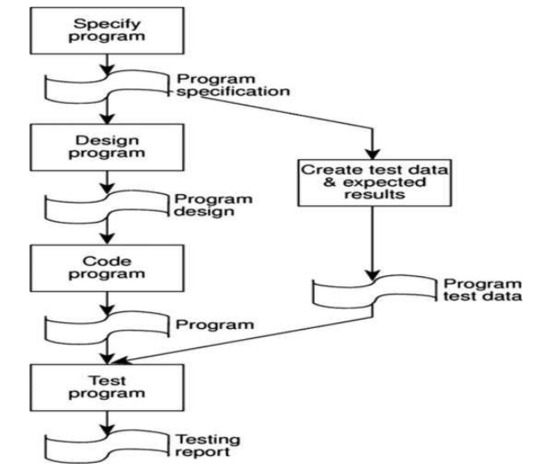
Statistical Process Control (SPC):

Slide 27
Statistical Process Control (SPC):
Statistical Process Control (SPC): SPC has been used with great success in manufacturing, and its use in software is also increasing.
A process is used to produce output, and the quality of the output can be defined in terms of certain quality characteristics.
A number of factors affect the variability in the value of these characteristics.
These factors can be classified into two categories: natural and assignable.

Slide 28
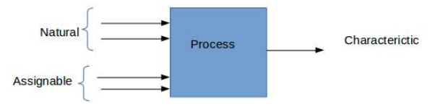
Statistical Process Control (SPC):

Slide 29
Statistical Process Control (SPC):
Natural causes are those that are always present and each of which contributes to the variability. It's not practical to control these causes unless process itself is changed.
Assignable causes, on the other hand are those that occur once in a while, have larger influence over variability in the process performance, and can be controlled.
A process is said to be under statistical control if the variability in the quality characteristics is due to natural causes only.

Slide 30
Statistical Process Control (SPC):
Control charts are a favorite tool for applying SPC. To build a control chart, the output of a process is considered to be a stream of numeric values representing the values. Groups of data are take from the streams, and the mean groups are plotted. A Lower control limit (LCI) and an upper control limit (UCL) are established.
To control a project, we can deploy SPC for “mini processes” that are executed during the course of the project, such as review process or testing process.

Slide 31
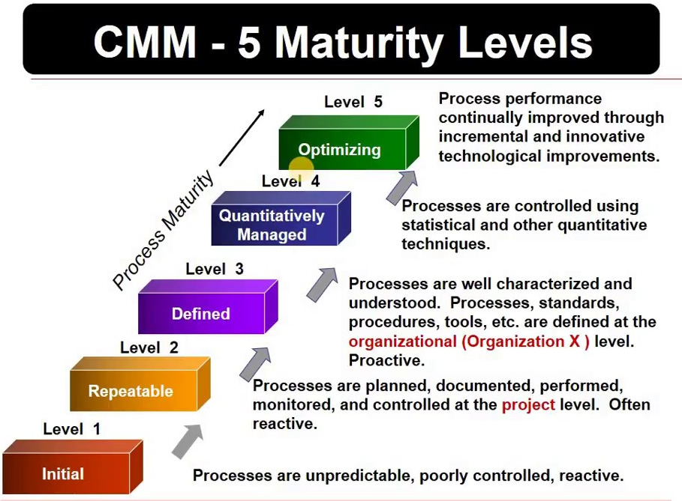
7. Capability Maturity Model (CMM) :

Slide 32
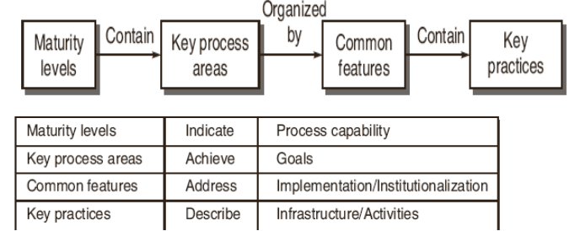
Capability Maturity Model (CMM) :

Slide 33
Capability Maturity Model (CMM) :
Maturity Levels: It is a layered framework providing a progression to the discipline needed to engage in continuous improvement
Key Process Areas: A Key Process Area (KPA) identifies a cluster of related activities that, when performed collectively, achieve a set of goals considered important.

Slide 34
Capability Maturity Model (CMM) :
Common Features: Common features include practices that implement and institutionalize a key process area. These five types of common features include: Commitment to Perform, Ability to Perform, Activities Performed, Measurement and Analysis, and Verifying Implementation.
Key Practices: The key practices describe the elements of infrastructure and practice that contribute most effectively to the implementation and institutionalization of the key process areas.

Slide 35
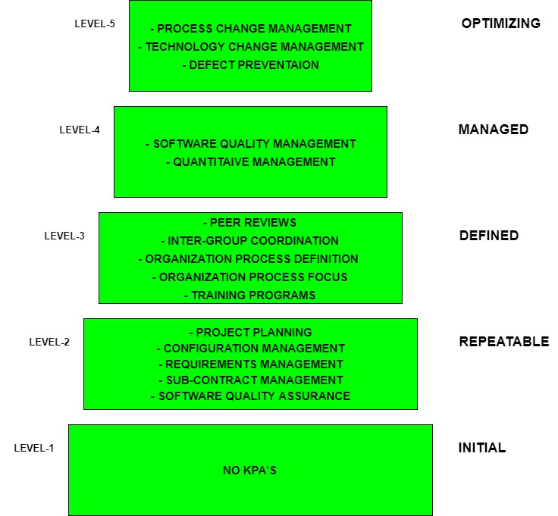
Capability Maturity Model (CMM) :

Slide 36
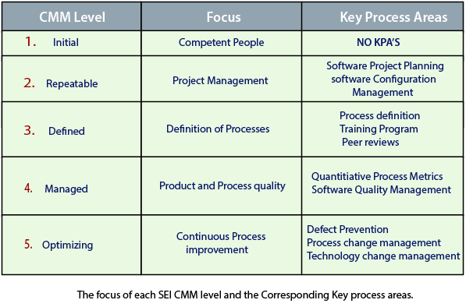
Capability Maturity Model (CMM) :

Slide 37
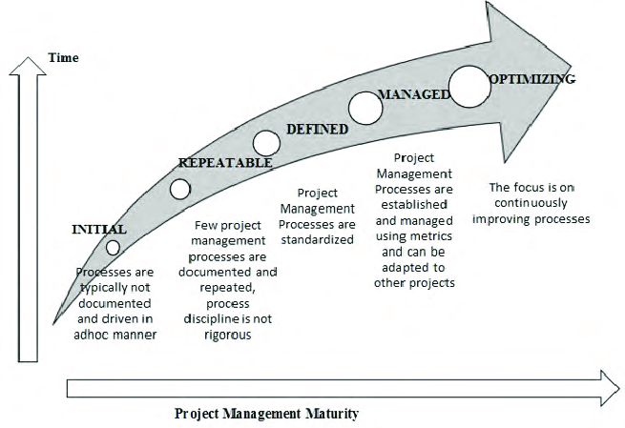
Capability Maturity Model (CMM) :

Slide 38
8. Enhancing software Quality : Three main themes
Increasing visibility
Procedural structure
Checking intermediate stages
Increasing visibility: A landmark in this movement towards making the software development process more visible was the advocacy by the American software guru, Gerald Weinberg, of 'egoless programming'. Weinberg encouraged the simple practice of programmers looking at each other's code.

Slide 39
Enhancing software Quality : Three main themes
Procedural structure: At first programmers were more or less left to get on with writing the programs, although there might be some general guidelines. Over the years there has been the growth of methodologies where every process in the software development cycle has carefully laid down steps.

Slide 40
Enhancing software Quality : Three main themes
Checking intermediate stages: It seems inherent in human nature to push forward quickly with the development of any engineered object until a 'working' model, however imperfect, has been produced that can then be 'debugged'. One of the elements of the move towards quality practices has been to put emphasis on checking the correctness of work at its earlier, conceptual, stages. We are now going to look at some specific techniques in more detail.

Slide 41
Enhancing software Quality :
Inspections:
The principle of inspection can be extended to any document that is produced at any stage of the development process.
For instance, test data needs to be reviewed - its production is usually not a high profile task even though errors can get through to operational running because of its poor quality.

Slide 42
Enhancing software Quality :
Structured programming and clean-room software development:
One of the people most closely associated with the origins of structured programming is Dijkstra.
In the late 1960s, software was seen to be getting more complex while the capacity of the human mind to hold detail remained limited.
It was also realized that it was impossible to test any substantial piece of software completely - there were just too many possible combinations of inputs. The most that testing could do was prove the presence of errors, not their absence.

Slide 43
Enhancing software Quality :
Formal methods:
In the section above on clean-room development, the use of mathematical verification techniques was mentioned.
These techniques use unambiguous, mathematically-based.
They are used to define pre-conditions and post-conditions for each procedure.

Slide 44
Enhancing software Quality :
Software quality circles:
Much interest has been shown in Japanese software quality practices.
The aim of the 'Japanese' approach is to examine and modify the activities in the development process in order to reduce the number of errors that they have in their end products.

Slide 45
Enhancing software Quality :
Software quality circles: The steps that the circle goes through in solving problems are:
Identify a list of problems
Select one problem to solve
Clarify the problem
Identify and evaluate the causes
Identify and evaluate the solutions
Decide on a solution
Develop an implementation plan
Present the plan to management
Implement the plan
Monitor the plan
***

