Slide 1
AI-Driven Crop Disease Prediction and Management System
CSE7101- Capstone Project
Review-2
Batch Number: ISE_23
Roll Number | Student Name
20221ISE0077 | HARSHITHA V
20221ISE0085 | TAANYA SUBBAIAH B
20221ISE0065 | M ASWIN
Under the Supervision of,
Dr. Murali Parameswaran
Professor
School of Computer Science and Engineering
Presidency University
Name of the Program: Information Science and Engineering
Name of the HoD: Dr. Zafar Ali Khan N
Name of the Program Project Coordinator: Ms. Suma N G
Name of the School Project Coordinators: Dr. Sampath A K , Dr. Geetha A

Slide 2
Content:
Abstract
Literature Survey
Objectives
Existing Methods and Drawbacks
Proposed Method & Feasibility Study
Block Diagram
Modules
Hardware/Software Requirements
Timeline
References

Slide 3
Abstract
Crop diseases significantly impact agricultural productivity and food security worldwide. Traditional disease detection methods rely on manual inspection, which is time-consuming, expensive, and often inaccurate. This project presents an AI-Driven Crop Disease Prediction and Management System that uses deep learning techniques to automatically detect plant diseases from leaf images. A custom Convolutional Neural Network (CNN) is trained on a benchmark agricultural dataset to classify crops as healthy or diseased. The system includes an explainable AI mechanism using Grad-CAM to highlight affected regions, increasing transparency and trust in predictions. Based on the detected disease, the system provides treatment and prevention recommendations through a user-friendly interface. The proposed solution is low-cost, scalable, and suitable for real-world deployment, helping farmers reduce crop loss and improve agricultural productivity.

Slide 4
Literature Survey:
Ref no. | Author(s) & Year | Approach / Method
[1] Mohanty et al., 2016 | CNN-based deep learning on PlantVillage dataset | Early use of CNNs for plant disease detection; achieved high accuracy but dataset limited to lab conditions.
[2] Too et al., 2019 | Fine-tuning deep learning models | Compared multiple pre-trained CNNs (e.g., VGG, ResNet); improved accuracy but required large compute resources.
[3] Ferentinos, 2018 | Deep CNN models for diagnosis | Trained CNNs on 58,000 images, achieved >99% accuracy; model less effective in real field conditions.
[4] Jiang et al., 2019 (IEEE Access) | Improved CNN for apple leaves | Real-time apple leaf disease detection; robust but crop-specific.

Slide 5
Literature Survey:
Ref no. | Author(s) & Year | Approach / Method
[5] Zhang et al., 2018 (IEEE Access) | CNN for maize leaf diseases | High accuracy on maize dataset; limited scalability to other crops.
[6] Yu & Son, 2020 (IEEE Access) | ROI-aware CNN | Focused on diseased regions in images; better precision but computationally heavy.
[7] Too et al., 2019 | Comparative DL study (repeat entry) | Reconfirmed CNN superiority; highlighted challenges of overfitting.
[8] Ferentinos, 2018 (repeat entry) | CNN-based plant disease models | Demonstrated scalability to multiple crops; limited dataset diversity.

Slide 6
Literature Survey:
Ref no. | Author(s) & Year | Approach / Method
[9] Li et al., 2021 (IEEE Access) | Review on deep learning in plant disease | Summarized advances in DL for agriculture; identified gaps in real-world deployment.
[10] Chen et al., 2021 (IEEE Access) | Improved CNN for tomato leaf diseases | Enhanced detection accuracy for tomato diseases; specific to one crop.

Slide 7
Objectives
Detect crop leaf diseases early using AI-driven methods.
Develop a reliable and accurate CNN-based classification model.
Provide farmers with actionable disease management recommendations.
Build a low-cost, user-friendly system (web/mobile).
Reduce yield loss and support sustainable agriculture.

Slide 8
Methodology
1. Data Collection
PlantVillage dataset with healthy & diseased leaf images
Covers multiple crops and disease categories
2. Preprocessing
Image resizing & normalization
Noise removal and data augmentation (rotation, flip, zoom)
3. Model Building
Custom CNN to extract disease features
Layers include convolution, pooling, dense and dropout

Slide 9
Methodology
4. Model Training
Trained using Adam optimizer & cross-entropy loss
Early stopping prevents overfitting
5. Disease Prediction
Model classifies input image into disease category
Outputs confidence score
6. Explainability (Grad-CAM)
Highlights infected regions on the leaf
Improves trust and model transparency
7. Recommendation System
Suggests treatment and prevention methods
User-friendly interface for farmers

Slide 10
Proposed Method
Proposed Method:
The system uses AI and Deep Learning (CNN) to detect crop diseases from leaf images.
Farmers upload crop leaf images using a mobile or web application.
Images are preprocessed (resizing, normalization, noise removal).
A trained CNN model identifies the disease and confidence score.
Grad-CAM highlights infected regions for transparency.
The system generates diagnosis and treatment suggestions.
Results are displayed through a user-friendly interface.
Outcome: Fast, accurate, and low-cost disease detection and guidance.

Slide 11
Feasibility Study
The proposed AI-based crop disease detection system is highly feasible from technical, economic, and operational perspectives. It uses readily available technologies such as CNN, TensorFlow, and OpenCV, and can run on basic computers and smartphones without special hardware. Since the software tools are open-source, the system involves minimal cost and is affordable to deploy. The simple interface ensures easy usage by farmers without technical knowledge, while data privacy and explainable AI (Grad-CAM) make the system ethically compliant. Additionally, the system promotes sustainable farming by reducing pesticide misuse and improving crop productivity, making it a practical and reliable solution for real-world application.

Slide 12
Block Diagram:
Data Collection
-Crop Images
-Public datasets
Preprocessing
-Resizing
-Augmentation
-Noise removal
Disease Detection Mode
-CNN
-Feature Extraction
-Classification
Recommendation System
-Fertilizer/Pesticide Advice
-Preventive Measures
Output
-Healthy//Diseased Result
-Suggested Treatment

Slide 13
Modules:
1. Image Acquisition Module
Captures crop leaf images using smartphone, camera, or dataset input.
2. Image Preprocessing Module
Resizes, normalizes, and cleans images; performs data augmentation to improve accuracy.
3. Disease Classification Module (CNN)
Uses a custom CNN model to detect diseases and classify crops from images.
4. Model Training & Early Stopping Module
Trains the model efficiently and stops training when performance stops improving.
5. Explainability Module (Grad-CAM)
Highlights infected areas on the leaf for transparent and trustworthy predictions.
6. Recommendation Engine Module
Provides treatment suggestions and preventive measures based on diagnosis.
7. User Interface Module
Allows users to upload images and view results through a simple web/mobile interface.

Slide 14
Hardware/Software Requirements:
Hardware:
Input Device: Smartphone/Camera.
Processing: Laptop/PC with GPU
Software:
Programming: Python
Frameworks: TensorFlow
Libraries: OpenCV, NumPy, Pandas, Matplotlib
Version Control: GitHub

Slide 15
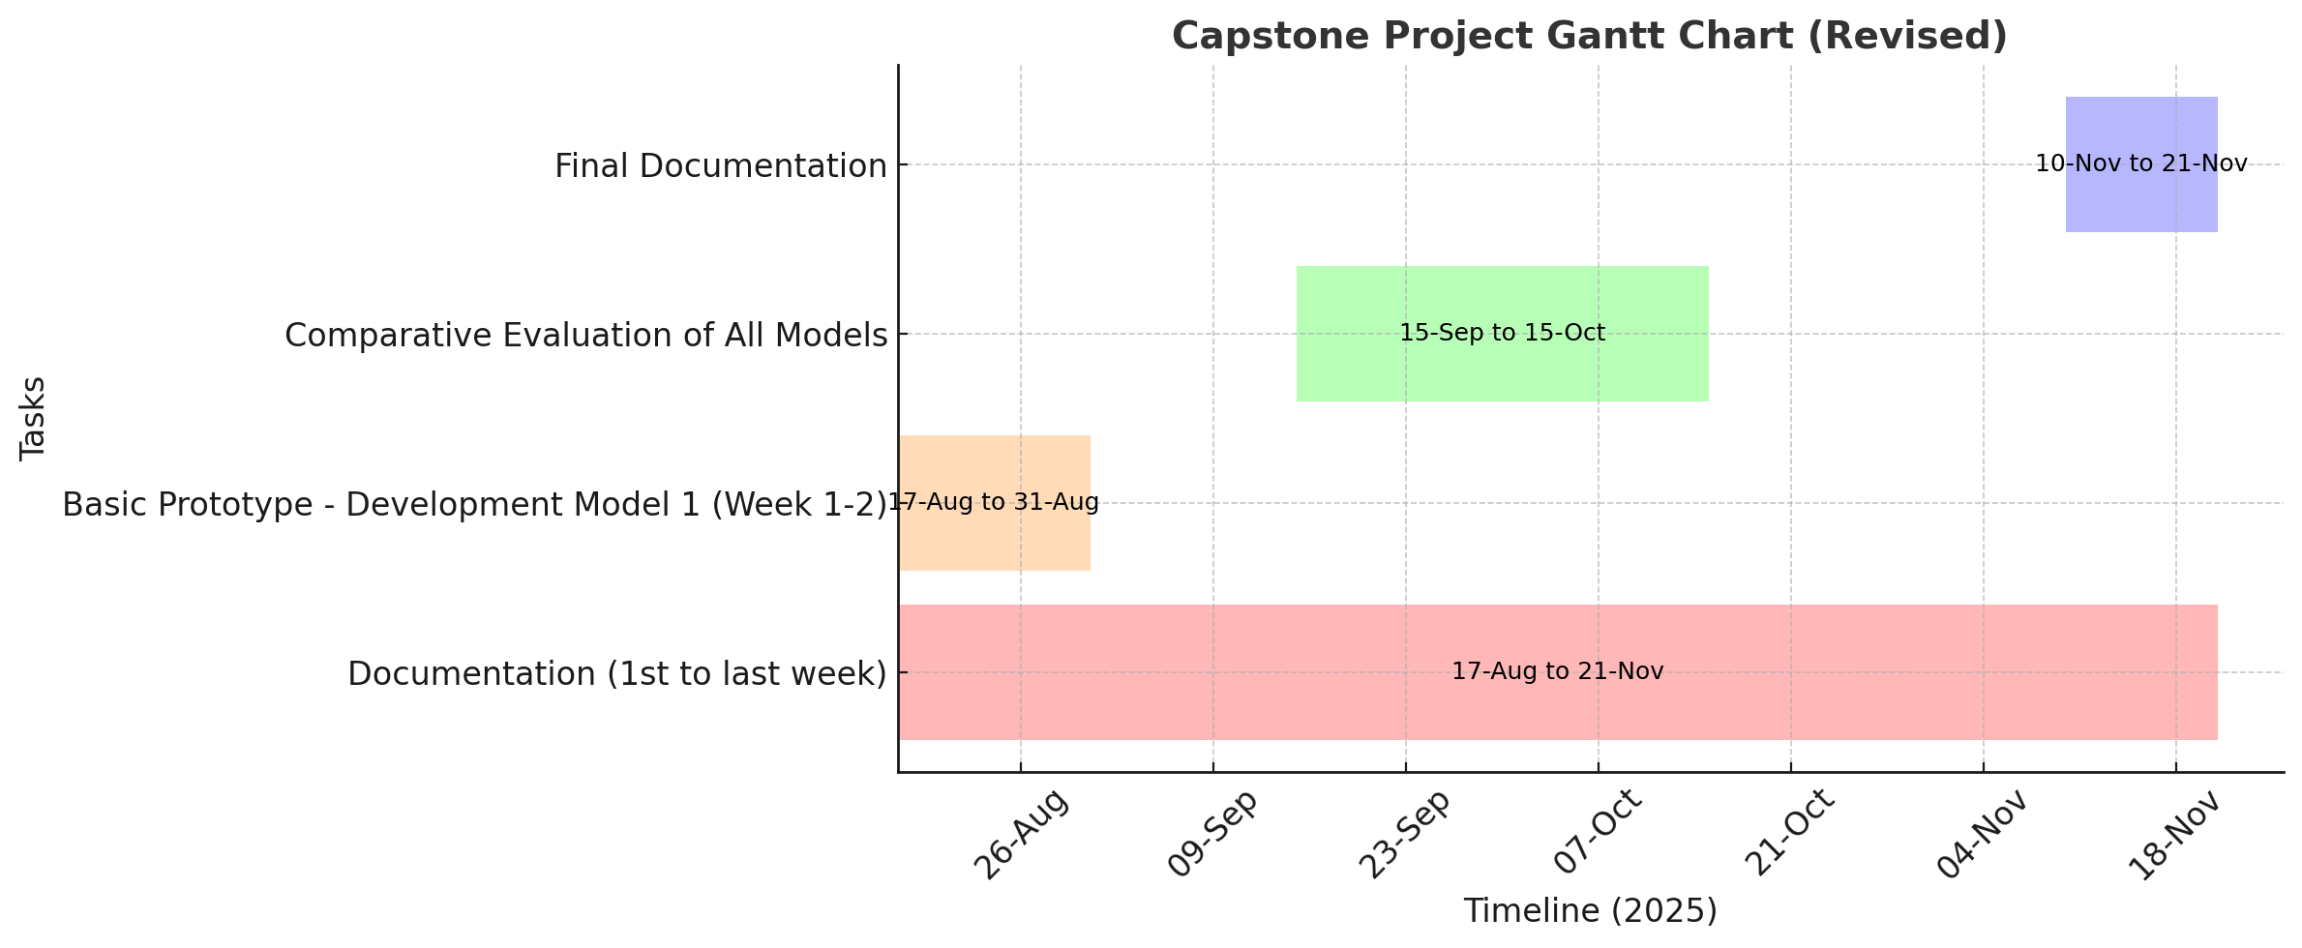
Timeline of the Project (Gantt Chart)

Slide 16
References (IEEE Paper format)
[1]. S. Mohanty, D. Hughes, and M. Salathé, “Using deep learning for image-based plant disease detection,” Frontiers in Plant Science, vol. 7, p. 1419, Sep. 2016.
[2]. A. Too, L. Yujian, S. Njuki, and L. Yingchun, “A comparative study of fine-tuning deep learning models for plant disease identification,” Computers and Electronics in Agriculture, vol. 161, pp. 272–279, Jun. 2019.
[3]. P. Ferentinos, “Deep learning models for plant disease detection and diagnosis,” Computers and Electronics in Agriculture, vol. 145, pp. 311–318, Feb. 2018.
[4]. P. Jiang, Y. Chen, B. Liu, D. He and C. Liang, “Real-Time Detection of Apple Leaf Diseases Using Deep Learning Approach Based on Improved Convolutional Neural Networks,” IEEE Access, vol. 7, pp. 59069–59080, 2019.
[5]. X. Zhang, Y. Qiao, F. Meng, C. Fan and M. Zhang, “Identification of Maize Leaf Diseases Using Improved Deep Convolutional Neural Networks,” IEEE Access, vol. 6, pp. 30370–30377, 2018.

Slide 17
References (IEEE Paper format)
[6]. H.-J. Yu and C.-H. Son, “Apple Leaf Disease Identification through Region-of-Interest-Aware Deep Convolutional Neural Network,” IEEE Access, vol. 8, pp. 60696–60706, 2020,
[7]. A. Too, L. Yujian, S. Njuki, and L. Yingchun, “A comparative study of fine-tuning deep learning models for plant disease identification,” Computers and Electronics in Agriculture, vol. 161, pp. 272–279, Jun. 2019.
[8]. P. Ferentinos, “Deep learning models for plant disease detection and diagnosis,” Computers and Electronics in Agriculture, vol. 145, pp. 311–318, Feb. 2018.
[9]. L. Li, S. Zhang and B. Wang, “Plant Disease Detection and Classification by Deep Learning—A Review,” IEEE Access, vol. 9, pp. 56683–56698, 2021.
[10]. J. Chen, W. Chen, B. Zhang, Z. Tao, Y. Wu and M. Han, “Detection of Tomato Leaf Disease Based on Improved Convolutional Neural Network,” IEEE Access, vol. 9, pp. 30812–30825, 2021, doi: 10.1109/ACCESS.2021.3069840.

Slide 18


