Slide 1
Employee Data Analysis using Excel
STUDENT NAME: HARSHITHA J
REGISTER NO: E22AF069,312215730, C35B8FB0BA9096E95B9472145A37C34A
DEPARTMENT: BCOM (A&F)SHIFT2
COLLEGE: PATRICIAN COLLEGE OF ARTS AND SCIENCE

Slide 2
PROJECT TITLE
Employee Performance Analysis using Excel

Slide 3


AGENDA
Problem Statement
Project Overview
End Users
Our Solution and Proposition
Dataset Description
Modelling Approach
Results and Discussion
Conclusion
3/21/2024 Annual Review

Slide 4

PROBLEM STATEMENT
1. Highlight areas of improvement and support needed by employees.
2. Increase fairness and transparency in performance evaluations.
3. Enable data-driven decisions for promotions, raises, and professional development opportunities.

Slide 5

PROJECT OVERVIEW
.
Analyzing the employee’s performance by considering various factors such as gender, performance score, ratings, achievement, etc.
In order to identify the trends and patterns of different categories of the employee such as high, medium, and low.

Slide 6

WHO ARE THE END USERS?
EMPLOYEES
EMPLOYER
MANAGERS OF THE ORGANIZATION

Slide 7

OUR SOLUTION AND ITS VALUE PROPOSITION
Formula- to find performance categories such as “VERY HIGH”,”HIGH”,”MEDIUM” OR “LOW”
Pivot table-summarize the data set
Graph- To visualize our data, to aid in better interpretation

Slide 8
Dataset Description
The employee data set is from Kaggle
it had 26 features initially
But we took into account only 11 features, which are: employee id first name last name employee type whether contract-based, part-time, or full-time employee status business unit performance rating from 1-5 department such as if the employee belongs to the production or sales department gender: female or male whether the performance score is met or not performance level classified as very high. High. Medium and low

Slide 9

THE "WOW" IN OUR SOLUTION
PERFORMANCE LEVEL=IFS(Z2>=5,”VERY HIGH”,Z2>=4,”HIGH”,Z2>=3,”MED”),TRUE,”LOW”)
3/21/2024 Annual Review
9

Slide 10
MODELLING
DATA COLLECTION
Downloaded “employee data set” from Kaggle
USING MICROSOFT EXCEL MADE THE FOLLOWING ANALYSIS:
FEATURE COLLECTION
of 26 features selected only features and colored them, chosen features are: employee id first name last name employee type whether contract-based, part-time, or full-time employee status business unit performance rating from 1-5 department such as if the employee belongs to the production or sales department gender: female or male whether the performance score is met or not performance level classified as very high. High. Medium and low
10

Slide 11
MODELLING
PERFORMANCE LEVEL
to convert performance ratings which are in numerical to categorize into a class either “very high”, “high”, “medium” or “low”, using the following formula:
PERFORMANCE LEVEL=IFS(Z2>=5,”VERY HIGH”,Z2>=4,”HIGH”,Z2>=3,”MED”),TRUE,”LOW”)
OPTED FOR PIVOT TABLE IN A NEW SHEET
Cast gender codes into filters,
performance level to legend,
business unit to Axis, and
count of first names to values.
SLICER
used a slicer to know information regarding employee type and set it off.
RECOMMENDED CHART
Used recommended chart to create an Employee performance analysis,
showing performance levels and 2 trendlines, each depicting low and high-level trends.
11

Slide 12
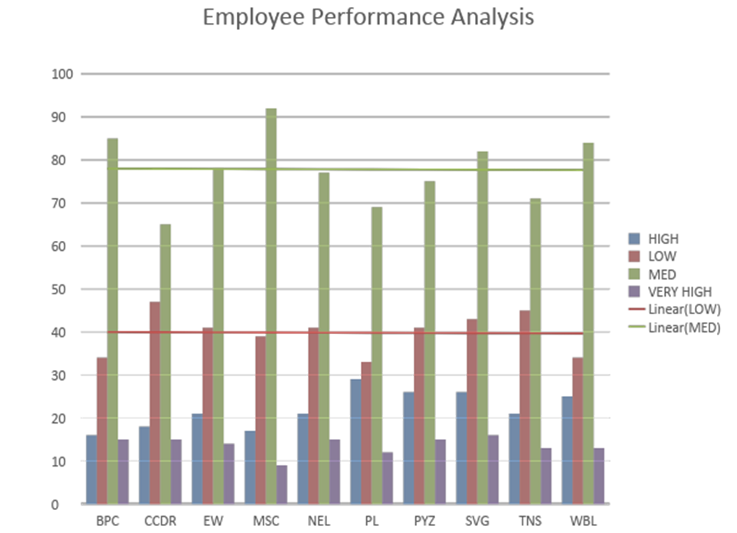
RESULTS
12

Slide 13
conclusion
From the performance analysis chart, we can say that, a lot of employee’s performance is not satisfactory and low, therefore we would have to bring in new policies and strategies such as incentives, recognition, detailing of work etc, to shift this trend to high or very high level.

