Slide 1

Vel Tech Rangarajan Dr. Sagunthala R&D Institute of Science and Technology
School of Computing
Department of Computer Science and Engineering
10211CS224 / FULL STACK APPLICATION DEVELOPMENT (JAVA)
PROJECT REVIEW : MILESTONE PROJECT – 2
Date: 20-04-2026
Tech Fest Event Ticket Booking System
SDG:9 - Industry, Innovation and infrastructure
SDG 12 – Responsible Consumption
Presented By:
Kakarla Harshitha – VTU25489 – 23UECS0750
Courses Handling Faculty:
Dr. S. Hemamalini M.E.,Ph.D.,

Slide 2
INTRODUCTION
1
Event ticket booking platforms allow users to browse, select, and purchase tickets for various events online. They simplify the process by eliminating the need for physical ticket counters.
These systems provide access to a wide range of events such as concerts, movies, sports, and conferences. Users can explore options based on date, location, and category.
The platform offers real-time seat availability and pricing information. This helps users make quick and informed booking decisions.
Secure online payment options are integrated for smooth transactions. Multiple payment methods like cards, UPI, and wallets are usually supported.
Users receive instant confirmation and digital tickets after booking. This reduces the risk of losing physical tickets and ensures convenience.
2
3
4
5
6
7
8
9

Slide 3
PROBLEM STATEMENT
1
Traditional ticket booking requires physical presence, causing long queues and inconvenience.
Lack of real-time updates leads to confusion in seat availability and booking status.
Manual systems are error-prone, resulting in incorrect or duplicate bookings.
Limited payment options reduce flexibility and slow down transactions.
Handling cancellations and refunds is difficult and often delayed in traditional systems.
2
3
4
5
6
7
8
9

Slide 4
OBJECTIVE(S)
1
To provide an easy and convenient online platform for booking event tickets.
To ensure real-time availability of seats and accurate booking information.
To enable secure and fast online payment options for users.
To reduce manual errors in ticket booking and management.
To offer quick confirmation and digital ticket generation.
To simplify cancellation, refund, and booking management processes.
To enhance user experience with notifications and personalized recommendations.
2
.
3
4
5
6
7
8
9

Slide 5
PROPOSED SYSTEM
1
The proposed system provides an online platform for users to search and book event tickets.
It ensures real-time seat availability and prevents overbooking issues.
The system supports secure online payment methods for smooth transactions..
It generates instant booking confirmation and digital tickets for users.
The system enhances user experience through notifications and personalized recommendations.
2
3
4
5
6
7
8
9

Slide 6
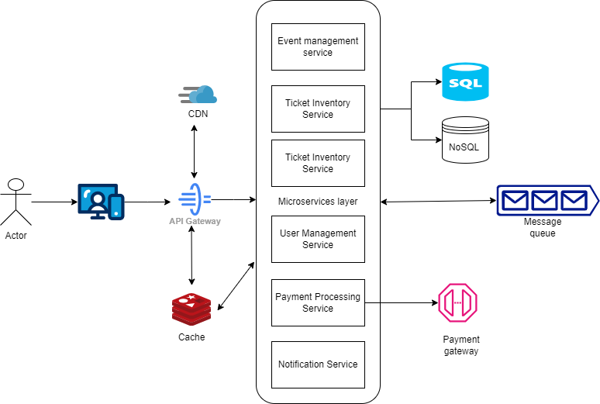
PROPOSED SYSTEM ARCHITECTURE
1
2
3
4
5
6
7
8
9
Input Layer: Users enter event details, select seats, and provide booking information through a web or mobile interface.
Processing Layer: The system validates user inputs, checks seat availability, processes payments, and manages booking logic.
Database Layer: Stores user data, event details, seat availability, and transaction records securely.
Output Layer: Displays booking confirmation, digital tickets, and notifications to the user..

Slide 7
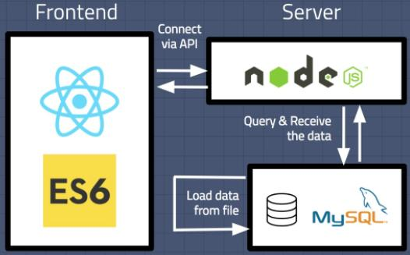
WORKFLOW
1
2
3
4
5
6
7
8
9

Slide 8
TECHNOLOGIES USED
1
Frontend: HTML, CSS, and JavaScript for building the user interface..
Backend: Java, Python, Node.js, or PHP for handling server-side logic.
Database: MySQL, PostgreSQL, or MongoDB for storing user and booking data
.
Tools: Razorpay, Stripe, or PayPal for secure online transactions. APIs: RESTful APIs for communication between frontend and backend systems. JWT or OAuth for secure user login and session management. AWS, Azure, or Google Cloud for hosting and scalability.
2
3
4
5
6
7
8
9

Slide 9
MODULE DESCRIPTION
Module 1: User Module Handles user registration, login, profile management, and browsing of available events.
Module 2: Event Management Module Allows admins to create, update, and manage event details, schedules, and ticket pricing.
Module 3: Booking Module Manages ticket selection, seat availability, booking process, and confirmation generation..
Module 4 : Payment Module: Handles secure payment processing, transaction verification, and payment status updates.
1
2
3
4
5
6
7
8
9

Slide 10
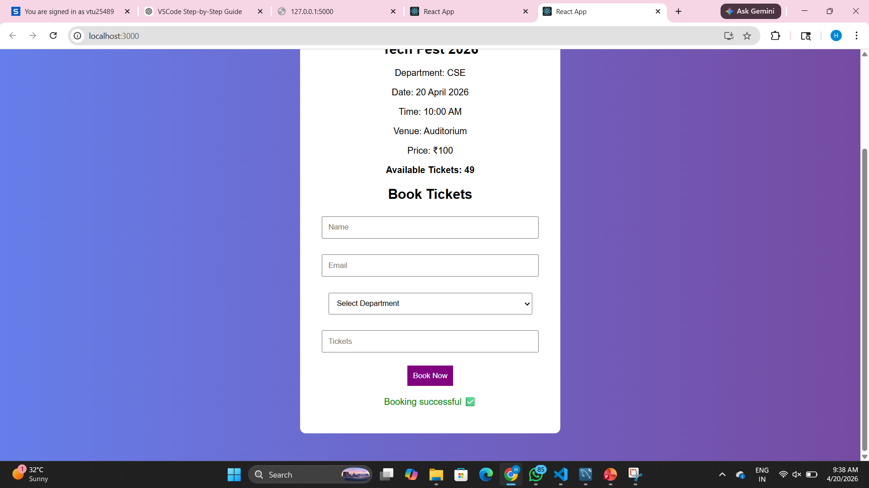
IMPLEMENTATION SCREENSHOTS
1
2
3
4
5
6
7
8
9

Slide 11
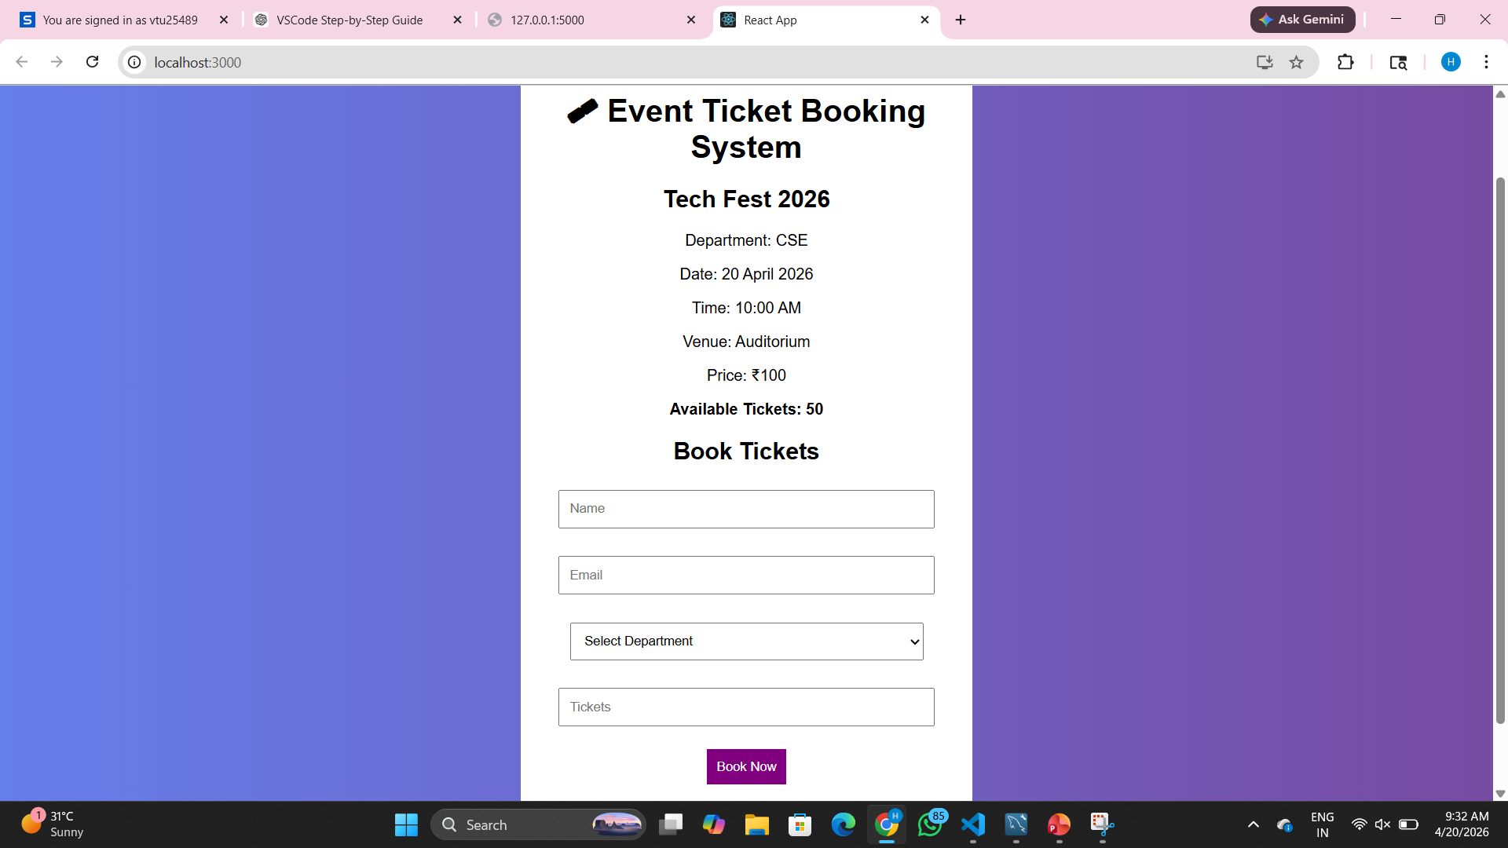
IMPLEMENTATION SCREENSHOTS
1
2
3
4
5
6
7
8(C)
9

Slide 12
ADVANTAGES & LIMITATIONS
1
Advantages:
Provides 24/7 access to book tickets anytime and from anywhere. Eliminates long queues and saves time for users.
Offers real-time seat availability and instant booking confirmation.
Supports multiple secure online payment options.
Enables easy management of bookings, cancellations, and refunds.ased tracking.
Limitations:
1.Requires internet access and basic technical knowledge to use.
2.System failures or server downtime can affect bookings.
3.Security risks like data breaches or payment fraud may occur.
4.Additional service charges may increase ticket cost.
5.Dependence on digital devices may limit access for some users.
2
3
4
5
6
7
8
9

Slide 13
Thank you

