Slide 1
AI COLLEGE COUNSELOR FOR PERSONALIZED CAREER AND COURSE ADVICE
Presented By
Team-16
K.BHAVANI(23NG1A5428)
K.HARSHITHA SAI (23NG1A5429)
Y.SIVA PRASAD (23NG1A5463)
K.PRASAD (23NG1A5423)

Slide 2
CONTENTS
ABSTRACT
KEYWORDS
INTRODUCTION
LITERATURE SURVEY
DATA COLLECTION AND ALGORITHMS
INPUTS AND OUTPUTS
IMPLEMENTATION
OVERVIEW
CONCLUSION

Slide 3
ABSTRACT
This presentation introduces an innovative AI-powered college counseling system designed to revolutionize career guidance in India.
The system provides highly personalized career recommendations and course suggestions by intelligently analyzing student profiles, academic interests, personality traits, and real-time labour market trends.
By leveraging advanced machine learning algorithms and comprehensive data analytics, this solution addresses the critical gap in traditional counseling services.

Slide 4
KEYWORDS
AI Counseling
Machine learning
Personalized career advice
Student success
Course recommendation
Educational technology

Slide 5
INTRODUCTION
AI College Counselor is a smart digital advisor designed to guide students in choosing the right career path and academic courses.
By analyzing each student’s interests, skills, and goals, it provides personalized recommendations, helping them make informed decisions about college programs, specializations, and future careers.
With quick responses and tailored suggestions, this AI counselor makes planning for higher education easier, more accurate, and student-focused.
Offers 24/7 access to guidance, reducing dependency on human counselors.

Slide 6
Improves decision-making through data-driven and unbiased recommendations.
Maintains data privacy, fairness, and ethical AI practices.
Supports human-AI collaboration, where AI assists counselors rather than replacing them.
Can be used in schools, colleges, universities, and career guidance platforms.
Incorporates Natural Language Processing (NLP) to interact with students through a chatbot interface.
Provides career path suggestions based on skills, aptitude, and job-market trends.
Applies predictive analytics to estimate student success, performance, and potential risks.

Slide 7
LITERATURE SURVEY
Proven Impact on Career Readiness Research from CareerVillage.org demonstrates that AI powered counseling improves student career readiness by an impressive 90%, significantly outperforming traditional methods.
College Match Point (2025) emphasizes critical factors: ensuring transparency in AI decision-making, maintaining equity across socioeconomic groups, and preserving authentic student voice in the counseling process.
Studies by UNIRANKS (2025) show AI successfully integrates psychometric assessments, labour market analytics, and personalized roadmaps to create holistic guidance systems.

Slide 8
DATA COLLECTION & ALGORITHMS
Student academic records
User input / questionnaires
Psychometric assessments/ Personality tests,
Institutional course catalogs
Labor-market and industry data Job openings
Interaction logs
Mostly from these topics the data is collected .

Slide 9
Algorithms
1. Recommendation Algorithms
2. Natural Language Processing Algorithms
3. Machine Learning Algorithms
4. Predictive Analytics

Slide 10
1. Recommendation Algorithms
Purpose: Suggest the best colleges, courses, and specialization options for a student.
Algorithms Used & What They Do
Content-Based Filtering Recommends options by matching student interests, skills, and academic profile with course/college features.
Collaborative Filtering Suggests courses or colleges chosen by students with similar profiles or academic behavior.
Hybrid Recommendation Combines content-based and collaborative filtering to improve accuracy and reduce limitations.
Matrix Factorization (SVD, ALS) Identifies hidden relationships between students and courses to predict suitable choices.

Slide 11
2. NLP Algorithms
Purpose: Enable the system to understand student queries and provide intelligent responses via a chatbot.
Algorithms Used & What They Do
Transformer Models (BERT, GPT, RAG) Understand context, generate responses, and retrieve accurate career/course information.
Intent Classification (SVM, Naive Bayes, Neural Networks) Identifies the student’s intent (e.g., career advice, course selection).
Named Entity Recognition (NER) Extracts important entities such as college names, courses, skills, and domains.
Text Similarity Algorithms (Cosine Similarity, SBERT) Matches student queries with relevant information or answers.

Slide 12
3. Machine Learning Algorithms
Purpose: Analyze student data to classify, cluster, and predict outcomes.
Algorithms Used & What They Do
Decision Trees Classifies students into streams or career paths based on features.
Random Forest Predicts career suitability or performance using multiple decision trees.
Support Vector Machine (SVM) Classifies students into career categories based on academic and psychometric data.
K-Means Clustering Groups students with similar interests, skills, or performance.
Gradient Boosting (XGBoost, LightGBM) Provides highly accurate predictions of success or career fit.

Slide 13
4. Predictive Analytics
Purpose: Predict student outcomes, career success, and risk factors.
Algorithms Used & What They Do
Logistic Regression Predicts probability of success, failure, or dropout risk.
Random Forest Estimates performance, career alignment, and success likelihood.
Neural Networks (ANN) Learns complex patterns to predict long-term career success.
Time-Series Models (LSTM, GRU) Predicts academic progress over time (semester-wise performance).
Survival Analysis Models Estimates time-to-event outcomes such as dropout or course completion.

Slide 14
INPUTS AND OUTPUTS
1.SKILLS
2. CAREER GOALS
3.EDUCATION
4.FIELD OF STUDY
5. GPA/GRADE/MARKS/PERCENTAGE
6.EXPERIENCE
7.PREVIOUS ROLES
8.PROJECTS AND ACHIEVEMENTS
These are the main inputs of AI College counselor

Slide 15
1.Recommended Career Paths ​
2. Recommended Courses​
3.Career Roadmap ​
4. Job opportunities ​
5. Available Courses ​
These are some outputs of the AI College counselor .​

Slide 16
IMPLEMENTATION
Implementation Steps (AI College Counselor)
Collect Data: student records, interests, psychometrics, course catalogs, job trends
Preprocess: clean, anonymize, encode features
Build Models: recommender (courses), classifier (career paths), chatbot (NLP/RAG)
Train & Evaluate: accuracy, precision/recall, user feedback
Deploy: API + interface, secure access & privacy controls
Monitor: update models, retrain, improve suggestions

Slide 17
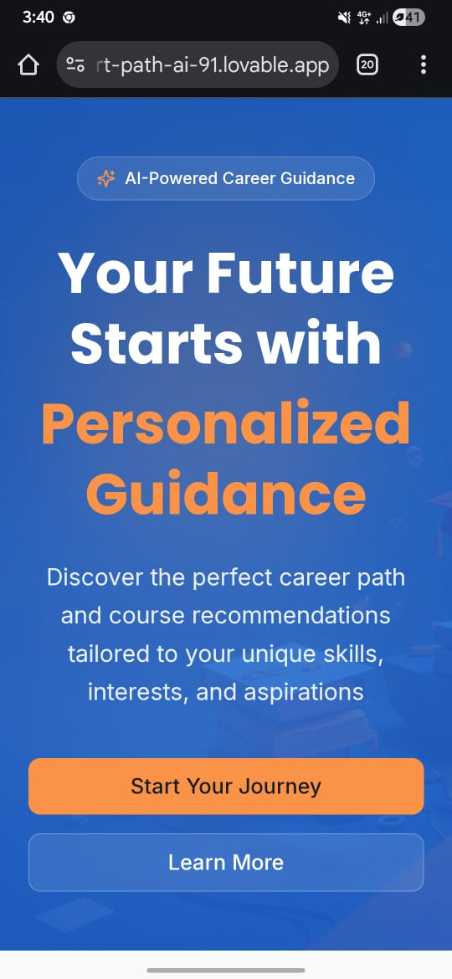
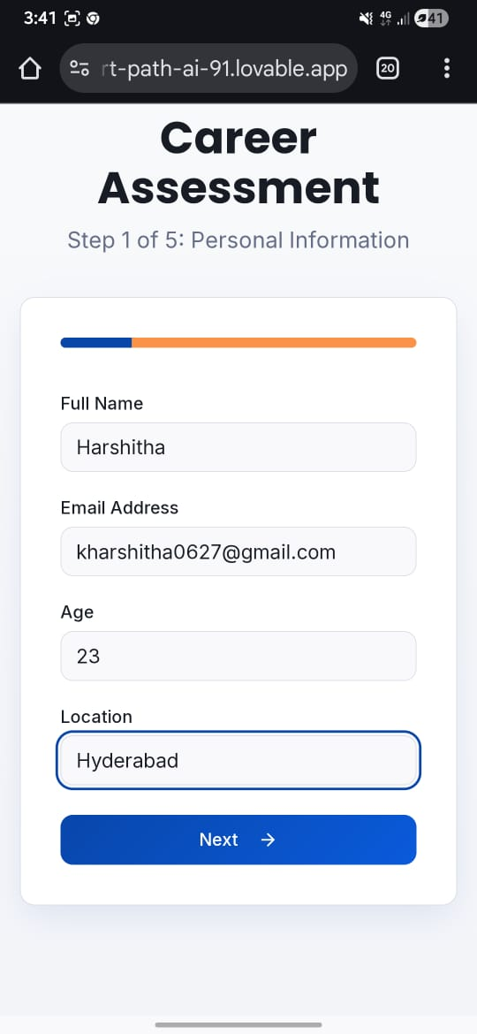
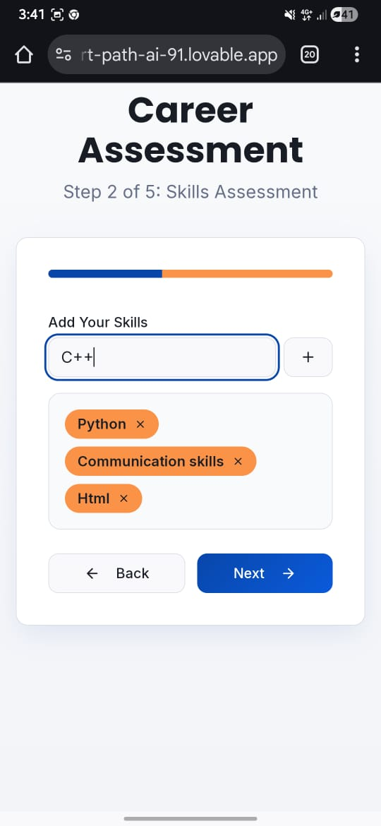
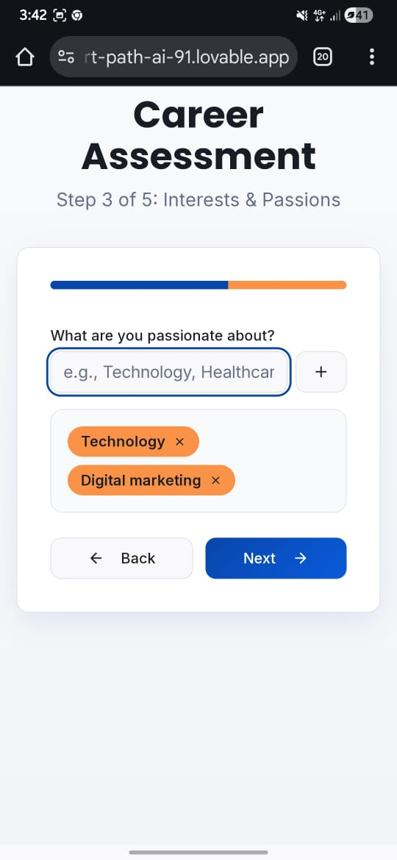
OVERVIEW

Slide 18
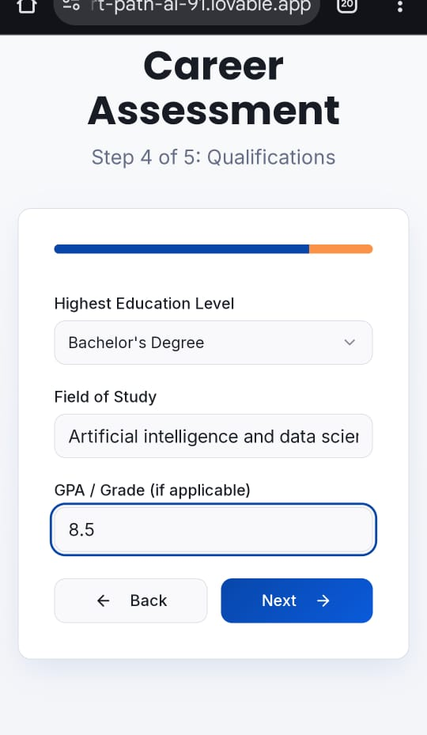
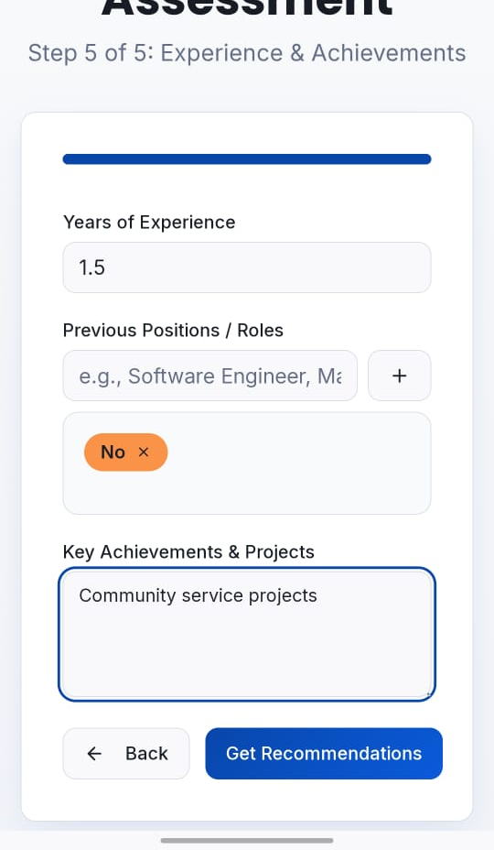
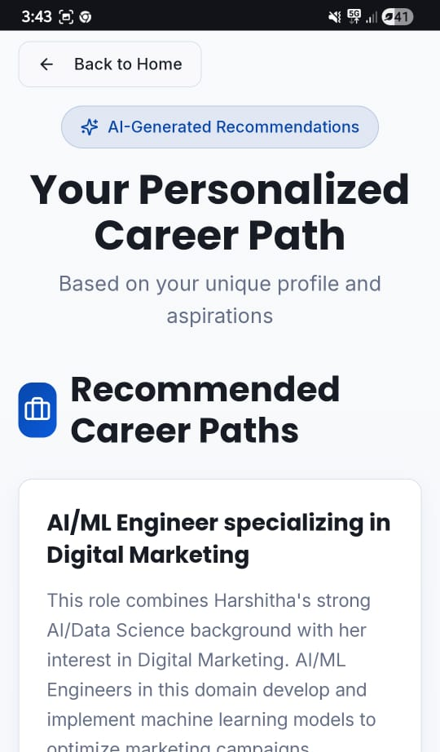

Slide 19
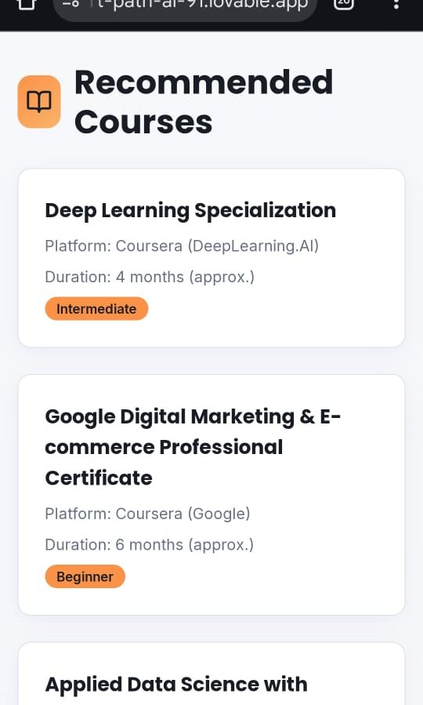
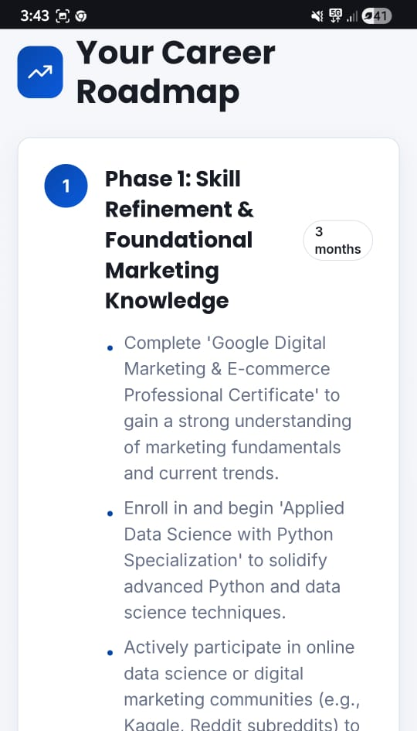
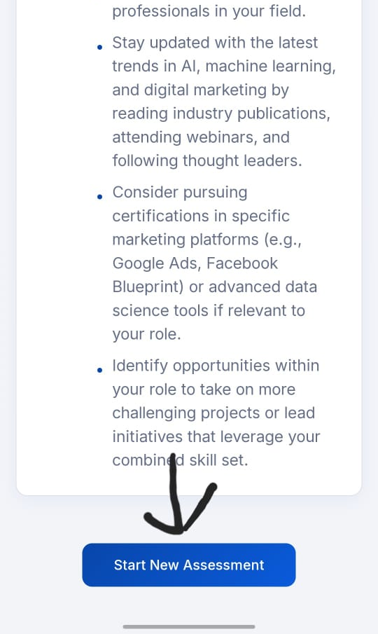

Slide 20
CONCLUSION
AI college counseling systems provide personalized guidance by analyzing student interests, academic data, and job-market trends. They make career and course selection easier, faster, and more accurate, while reducing manual workload for counselors. Although AI improves accessibility and decision-making, it should support—not replace—human experts to ensure ethical, unbiased, and well-informed student choices.

