Slide 1
Task-2 Superstore Sales Dashboard - Summary Report
Created using Power BI | Data: Superstore Dataset

Slide 2
Objective & Key Insights
Objective:
Analyze Superstore’s sales performance, profitability, and discount patterns using Power BI.
Key Insights:
• Total Sales reached $2.3M across all regions and categories.
• Overall Profit is $286K with an average margin of 12%.
• 38K items were sold with an average discount of 16%.
• Sales grew steadily from 2014 to 2017.
• Technology leads in both sales and profit among categories.
• West region performs best; Central has lower margins.
• Higher discounts reduce profit margins significantly.
Outcome:
This Power BI dashboard effectively visualizes key sales insights, helping identify growth trends, profit patterns, and areas for strategic improvement.

Slide 3
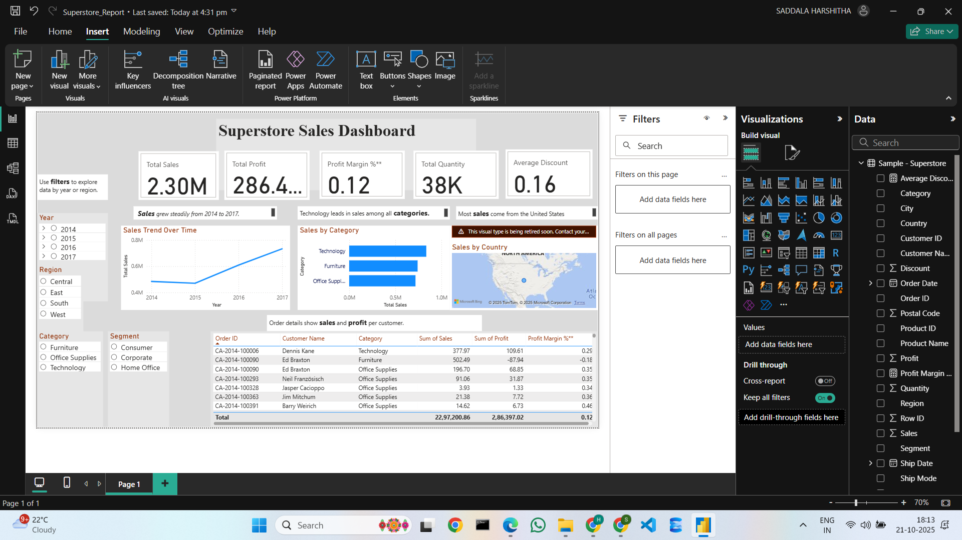
Superstore Sales Dashboard (Power BI)

