Slide 1

QNX

Slide 2
QNX is a commercial and real-time operating system which is provided by Blackberry Limited. It is an Unix-like operating system.
The kernel used in this operating system is microkernel.
It is one of the first commercially successful microkernel operating systems.
QNX Hypervisor
A hypervisor, also known as a virtual machine monitor or VMM, is software that creates and runs virtual machines (VMs).
A hypervisor allows one host computer to support multiple guest VMs by virtually sharing its resources, such as memory and processing.

Slide 3
Qualcomm is an integrated, next-generation automotive cockpit platform.
It is a 5nm system-on-chip (SoC) designed with custom hardware blocks .
Support for multiple camera sensors and and high-resolution 4K display.
Local connectivity solutions including Bluetooth and WiFi

Slide 4

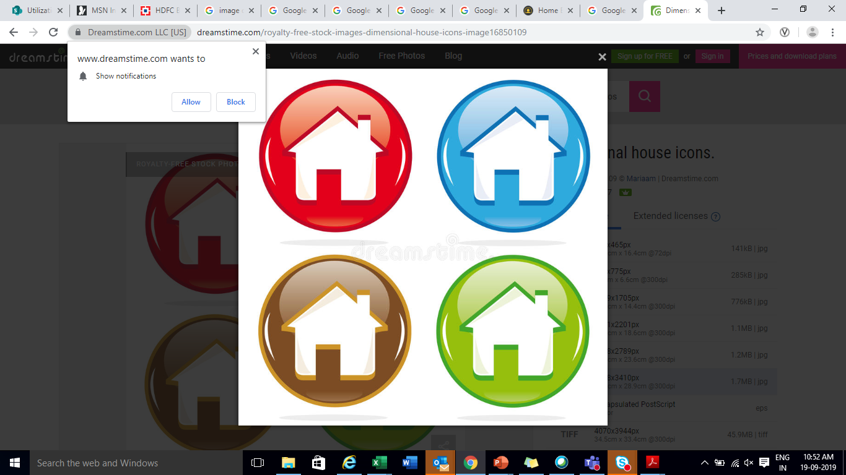
Thank You !

