Slide 1

APD DEMO

Slide 2
UP To Previous Demo
Research on how we can implement application of multi ECU in adaptive autosar and start working on the same.
Studied some of the research papers on Multi ECU application in autosar
Prepared the draft for this POC.
Stated with the implementation of this POC.

Slide 3
Work Done Till Now
Understood QT creator to design the GUI for our application
Installed the QT creator
Setting up the R-Car
Established client server communication between two system for sending software package

Slide 4
Roadmap for this week
Need to established client server communication between system and R-car to send software Packages
Need to create the GUI using QT creator to display the client server communication.
Brief understanding of scheduling policies and dead lock handling

Slide 5
Key Takeaways
Understood QT creator by creating some sample applications.
Brief understanding on software package
Brief understanding on socket programming

Slide 6

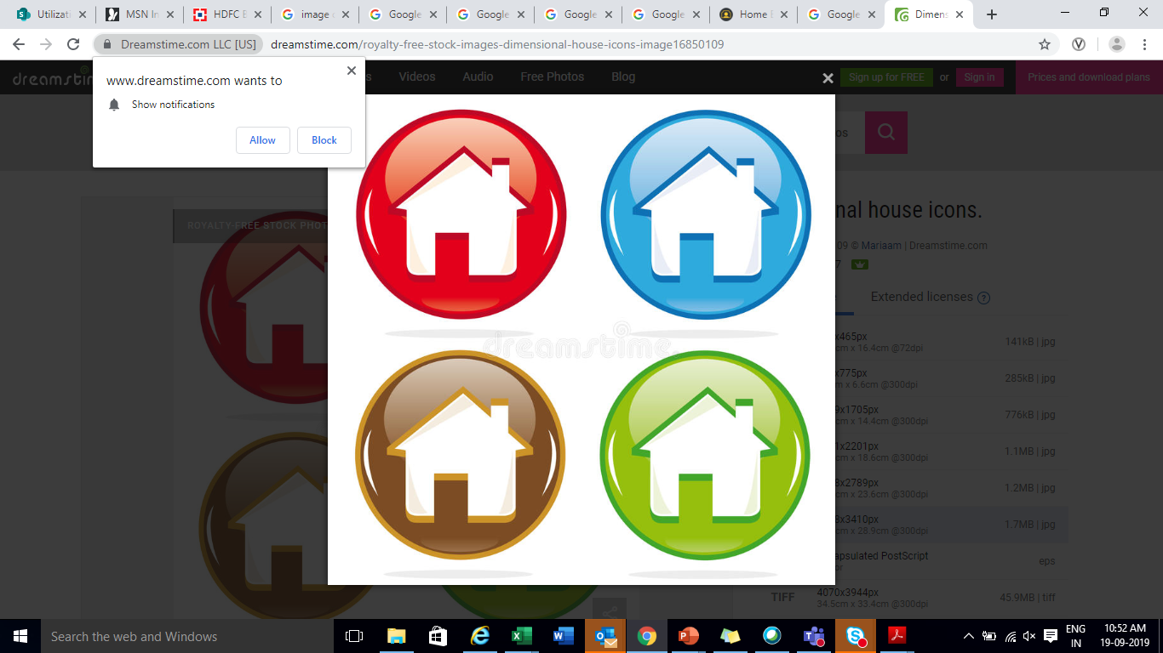
Thank You !

