Slide 1

Research presentation
On unused tv signals

Slide 2
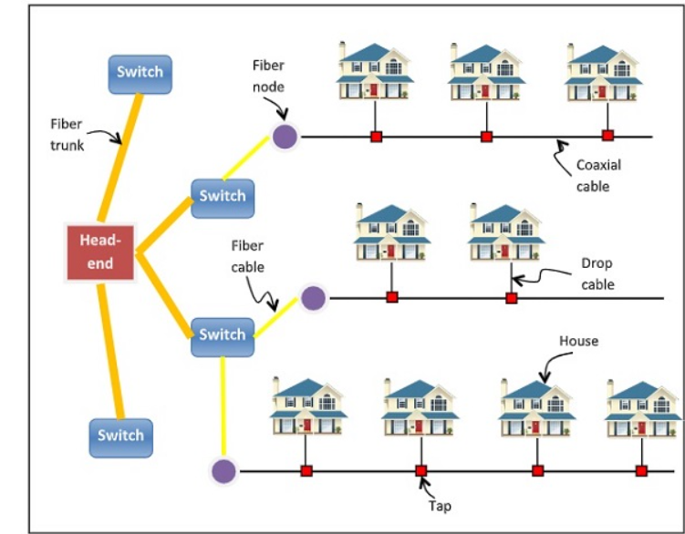
Cable internet
Cable Internet is a category of broadband Internet access that uses the infrastructure of cable TV network to provide Internet services. Cable Internet provides connectivity from the Internet service provider (ISP) to the end users in a similar manner as digital subscriber line (DSL) and fiber-to-the-home (FTTH).
It gives high speed internet .To access that we need to connect using modems.

Slide 3
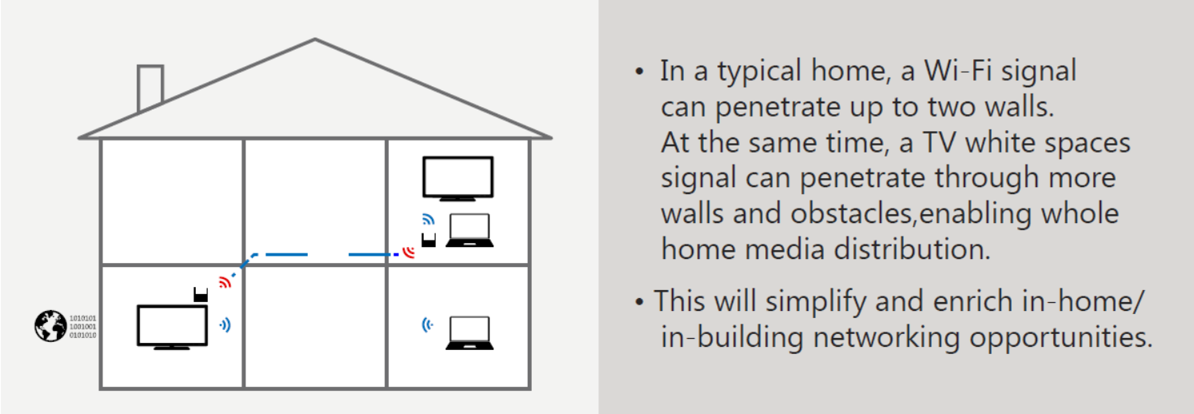
Spectrum technology
TV White Space refers to the unused TV channels between the active ones in the VHF and UHF spectrum. These are typically referred to as the “buffer” channels. In the past, these buffers were placed between active TV channels to protect broadcasting interference. It has since been researched and proven that this unused spectrum can be used to provide broadband Internet access while operating harmoniously with surrounding TV channels.
TV white spaces devices and networks will work in much the same way as conventional Wi-Fi, but because the TV signals travel over longer distances and better penetrate walls and other obstacles, they require fewer access points to cover the same area.
Because of the excellent range and obstacle penetration characteristics ,it referred as “Super Wi-Fi”.

Slide 4
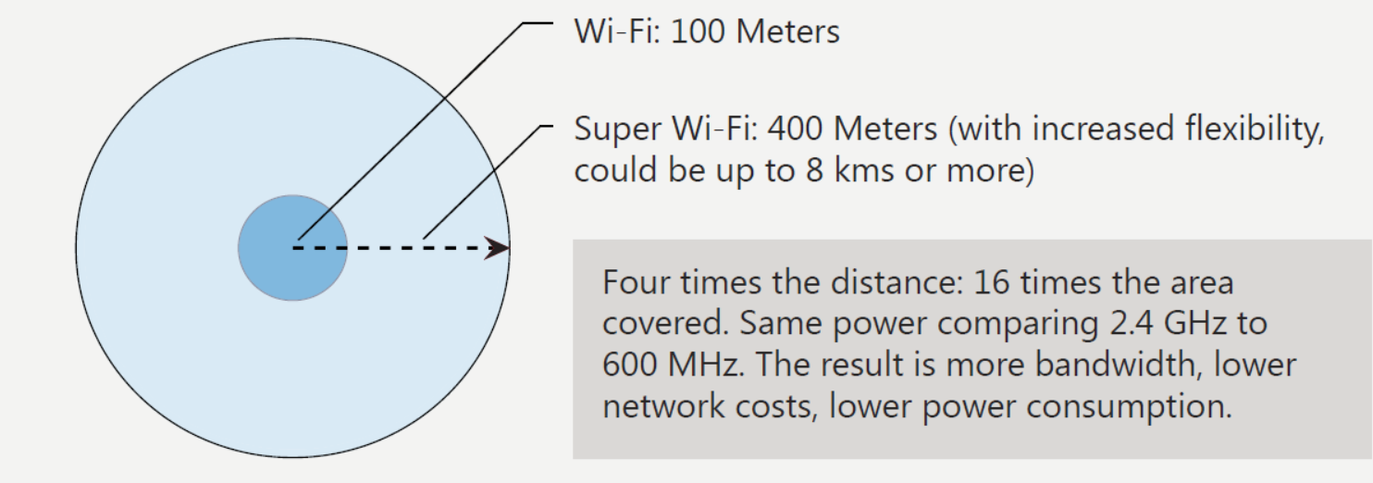
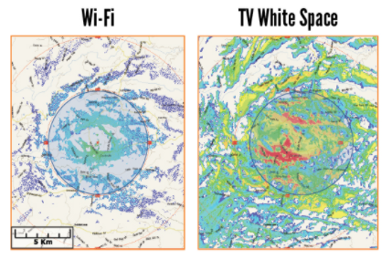
Better throughput was achieved closer to the base station. With non-contiguous and contiguous channel bonding an expected feature of second generation TV white space devices – for example, taking advantage of the 802.11af/ac Wi-Fi standard – even better throughput can be expected.
Better Coverage than Wi-Fi
While a traditional Wi-Fi router has a relatively limited range, around 100 meters under perfect conditions, and can be blocked by walls or other environmental barriers, TV White Space technology can cover an expanse of about 10 kilometers in diameter (100 times the distance)!

Slide 5
Non-Line-of-Sight (NLOS) Performance
Microwave links require line-of-sight (LOS) between the points being connected. In areas with rugged or forested terrain, the tall towers necessary to provide this line-of-sight connection make microwave an expensive and unfeasible solution. TV White Space technology provides an effective alternative to microwave by utilizing the lower-frequency UHF signals that can penetrate obstacles and cover uneven ground without requiring additional infrastructure.
IS TV WHITE SPACE TECHNOLOGY VIABLE INTERNATIONALLY?
While the United States and United Kingdom are the forerunners in developing this new technology, many other countries are following their lead, and TV White Space is on track for worldwide usage. For Canadian users, the UHF band includes spectrum available now for light licensed use. South Africa, Singapore, and New Zealand are not far behind in developing regulations and shaping the TV White Space landscape in their countries.

Slide 6


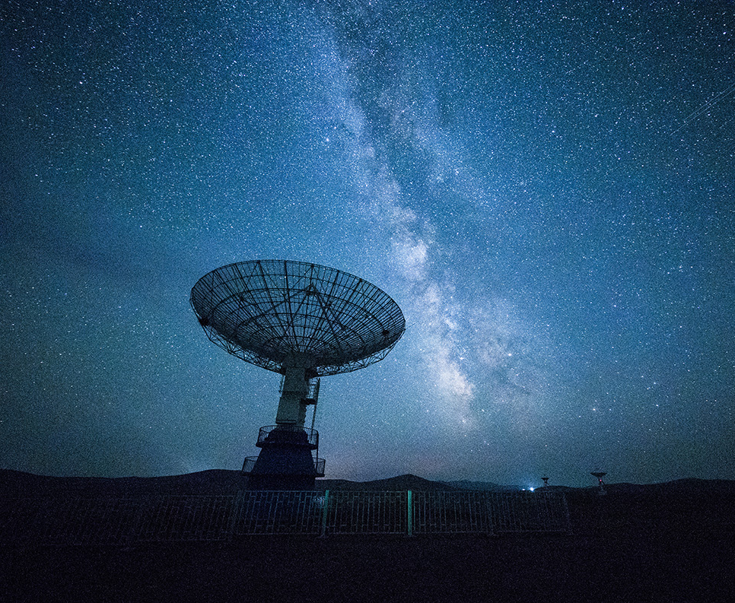
Advantages
Long distance
Propagation
Penetrates environmental
barriers
Maximum coverage
Strong signals in rural areas

Slide 7

Thank You!

