Slide 1

OIL PRICE PREDICTION
P310 Group-6
Karthik
<03/DEC/23>

Slide 2
Business Problem:
Oil is a product that goes completely in a different direction for a single market event as the oil prices are rarely based on real-time data, instead, it is driven by externalities making our attempt to forecast it even more challenging.
As the economy will be highly affected by oil prices our model will help to understand the pattern in prices to help the customers and businesses to make smart decisions.
Objective:
The obejctive of the analysis is to predict the price of the oil and to emphasize the need for a relaible model that can understand price patterns. This model aims to help customer and businesses make smart decision consedering the significant impact of oil prices on the economy.

Slide 3
Project Architecture / Project Flow
Data Collection
Data Preprocessing
Feature Engineering
Models Used
Model Training
Model Evaluation
Prediction
Forecast Visualization
Deployment

Slide 4
Exploratory Data Analysis (EDA) and
Feature Engineering

Slide 5
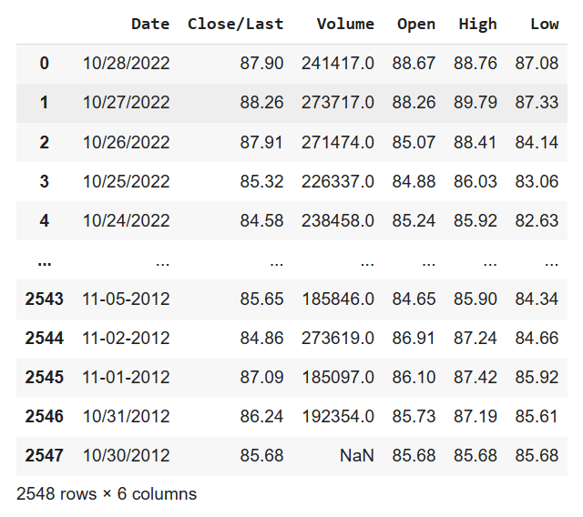
Data set details
A. Basic statistics of the dataset
Our dataset contains 2548 rows and 6 columns.

Slide 6
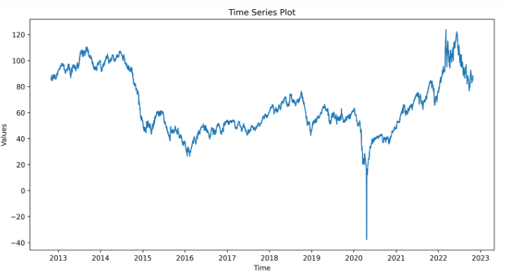
Exploratory Data Analysis (EDA)
B. Visualizations to explore trends and patterns Time series plot:
Time series plot doesn’t shows any patterns for the analysis so we can say that the data is non stationary.

Slide 7
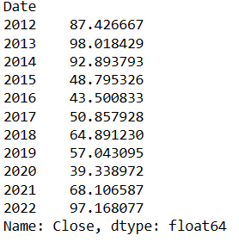
While analysing mean closing price of every year we got huge fluctuation in between the values.
EDA
C. Mean Closing price of every year

Slide 8
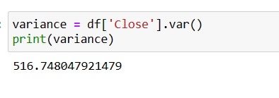
EDA
Variance value is very high,So we can say that data is not stationary
We found that the data is non stationary, so we performed first order differencing.
After differencing we did ADFuller Test
We got P Value =
As P< critical value (0.05) it shows that now our data is stationary.

Slide 9
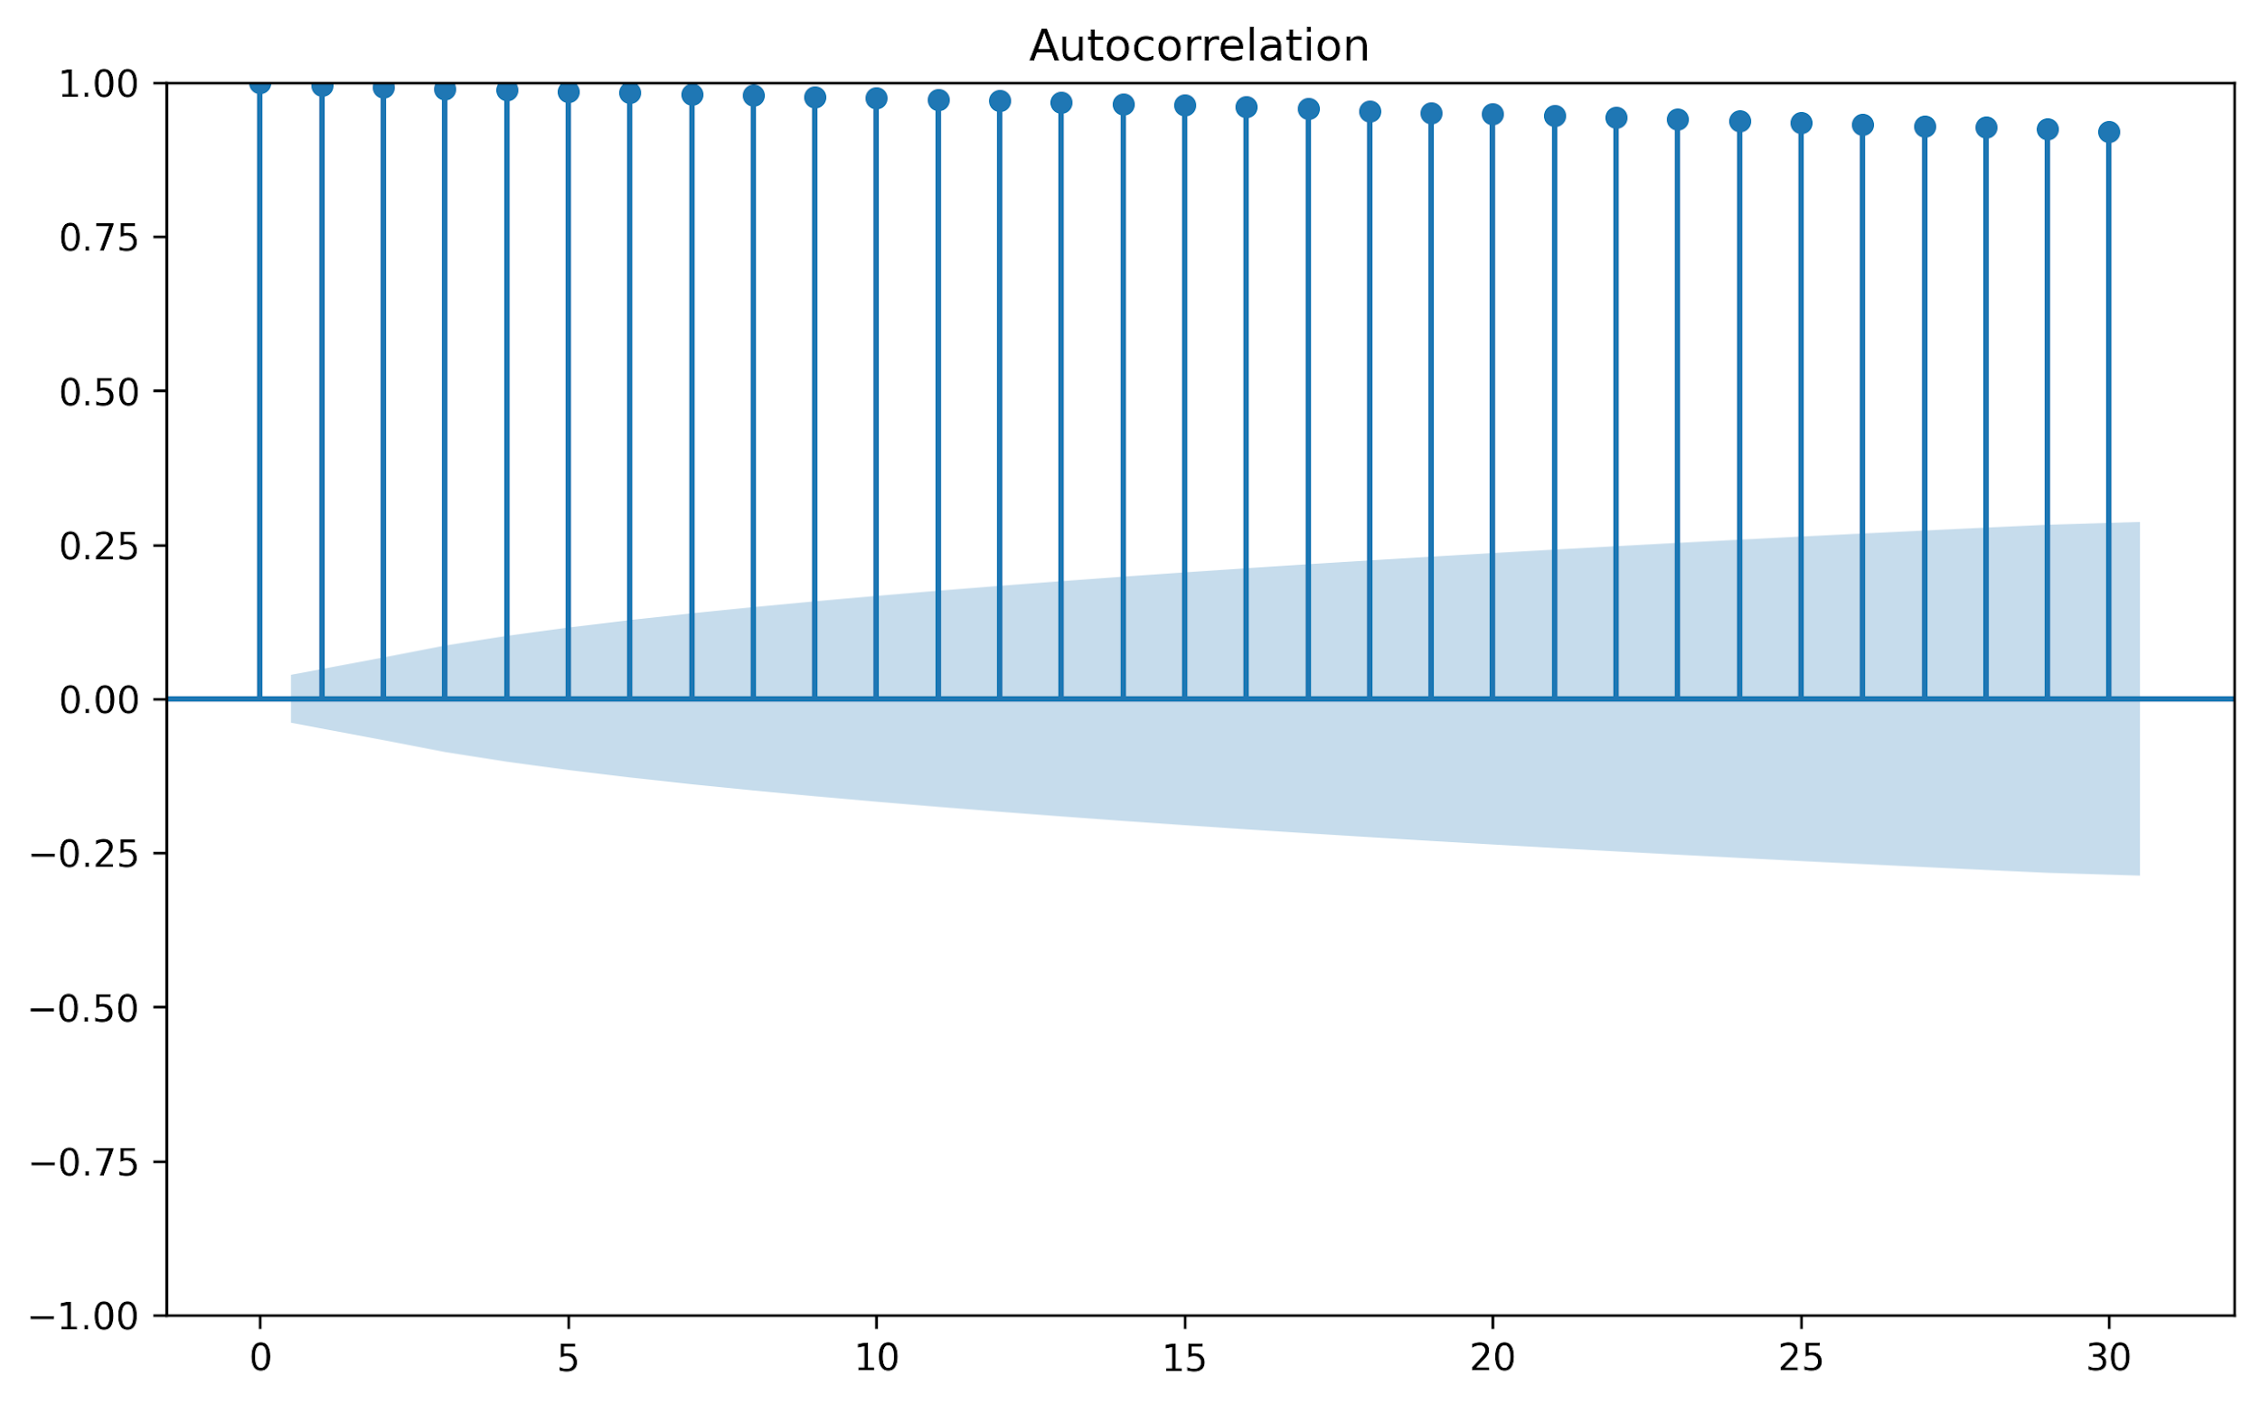
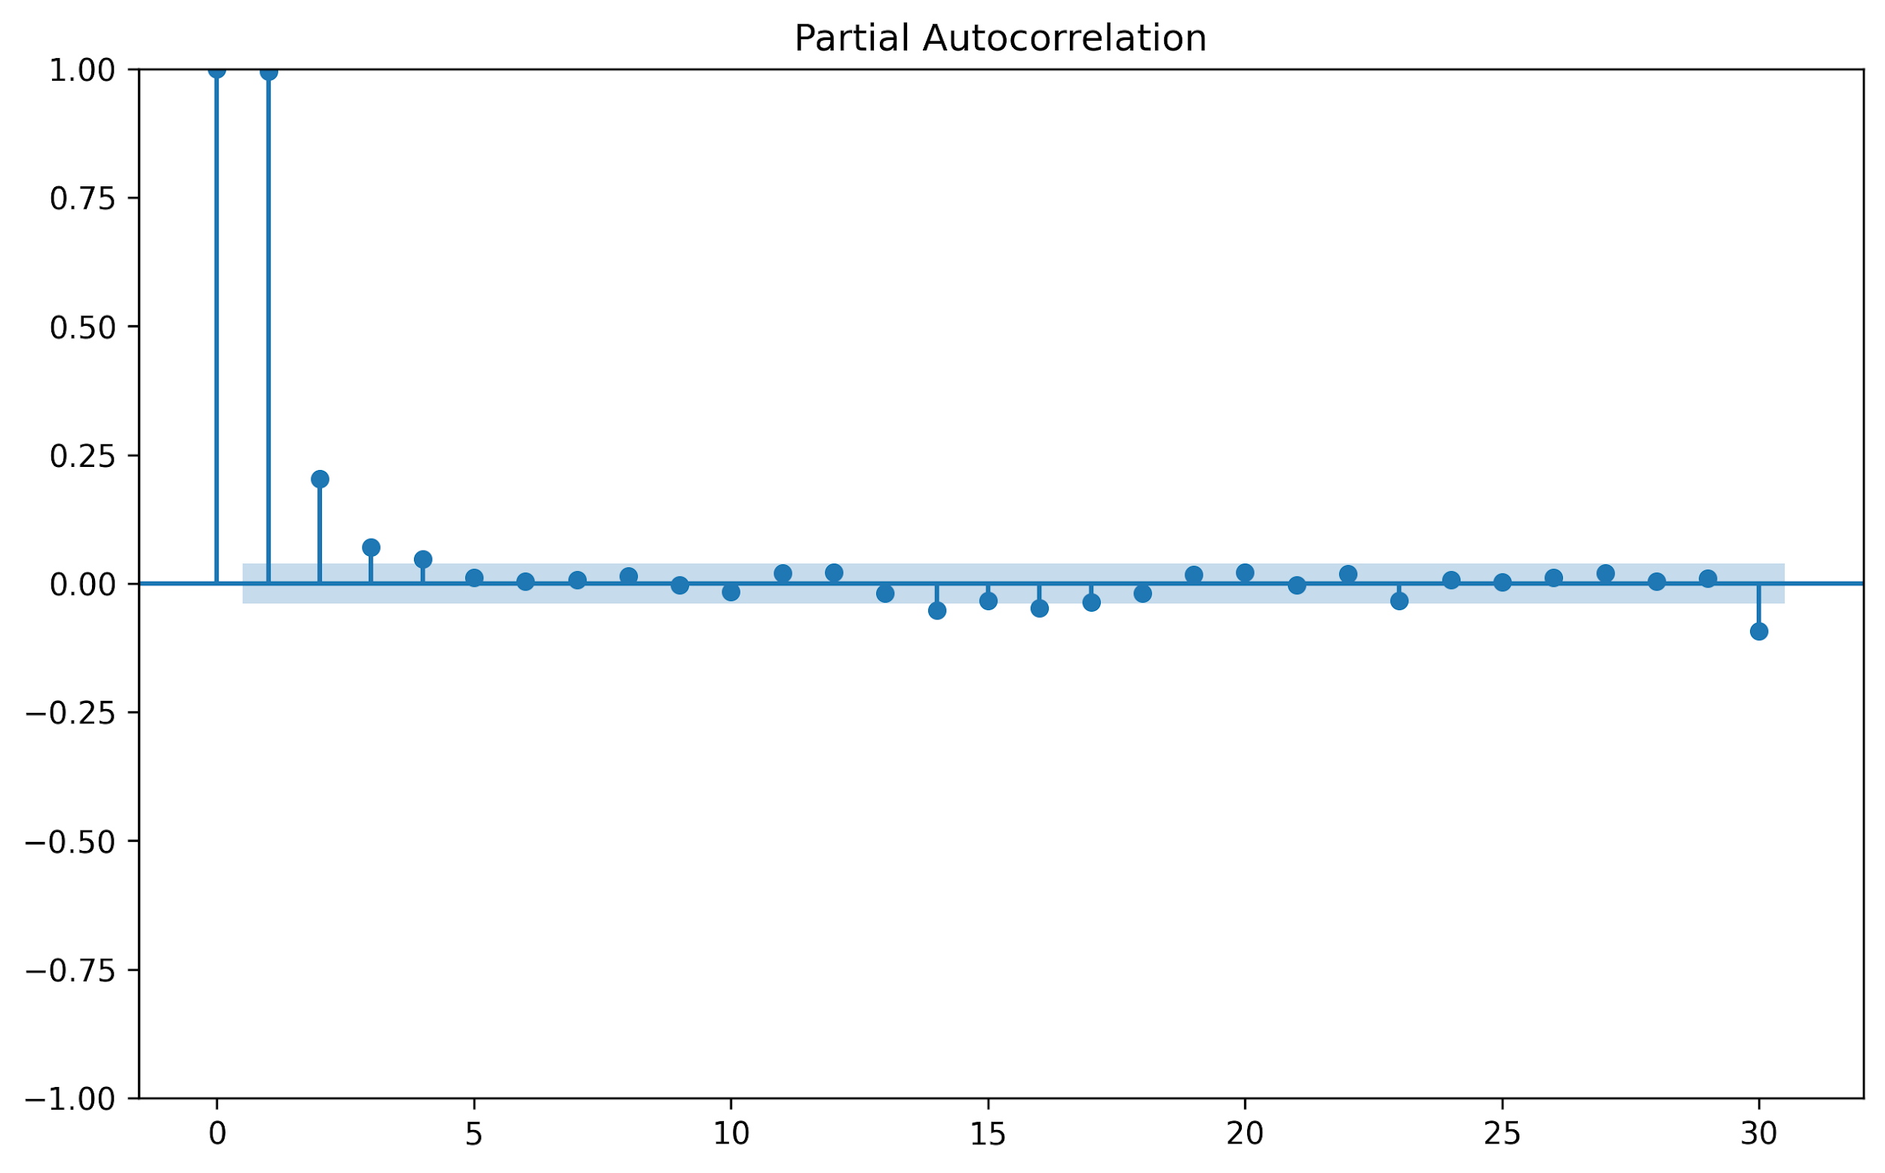
ACF and PACF Plots
(Before1st Order Differencing)
ACF plot shows gratual drop where as PACF plot show instant drop

Slide 10
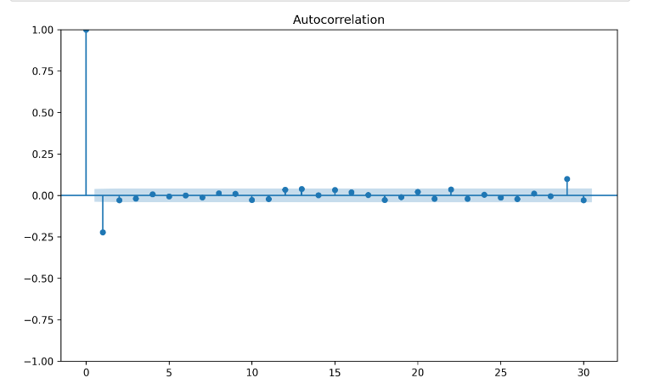
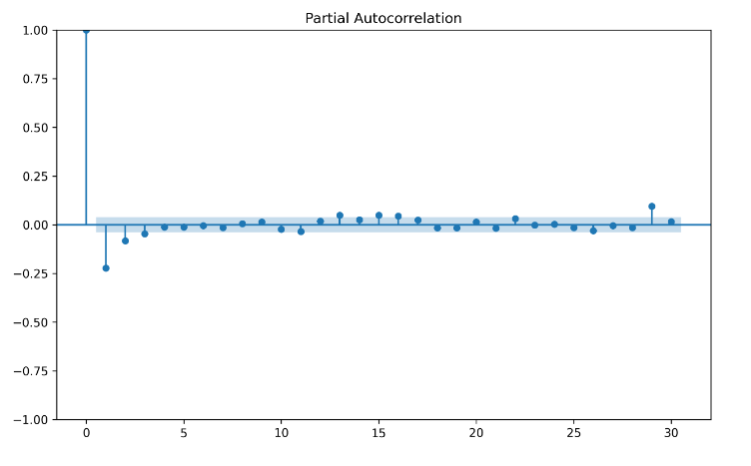
As both ACF and PACF plot are dropping instantly, so using ARIMA would not be a good fit.
ACF and PACF Plots
(After 1st Order Differencing)
A

Slide 11
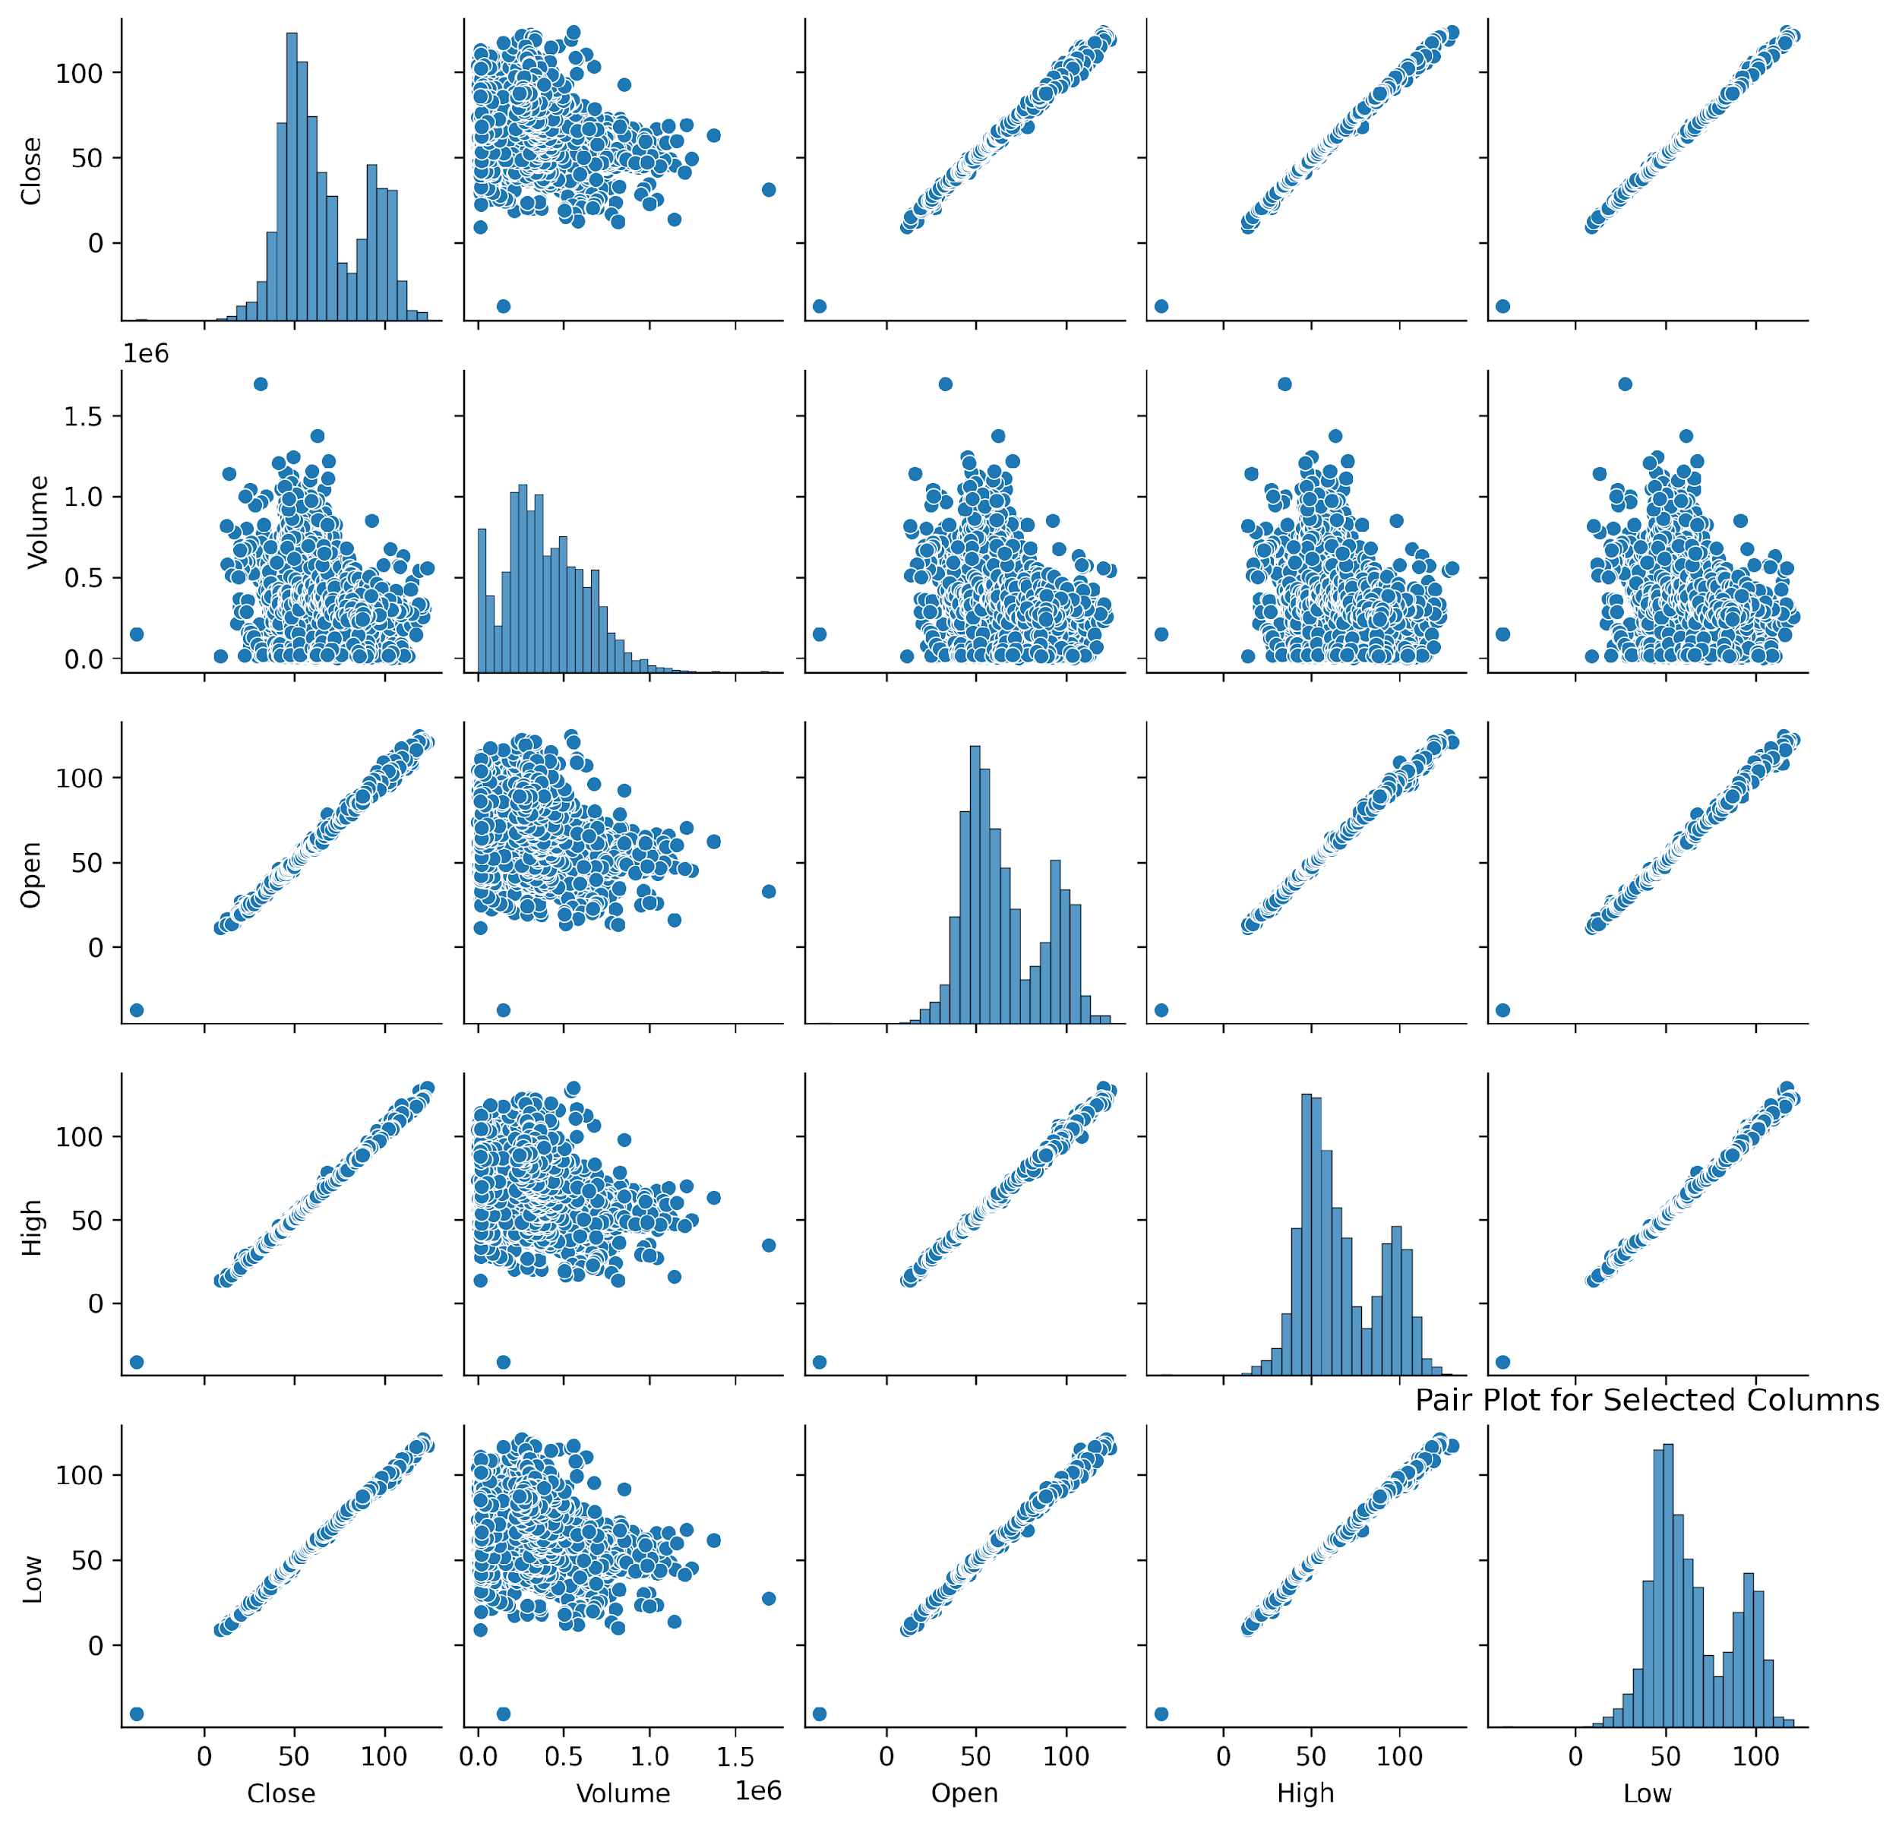
Pair Plot for Selected Columns

Slide 12
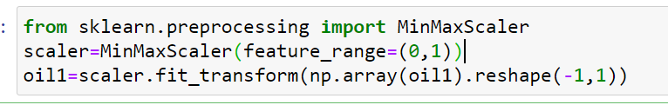
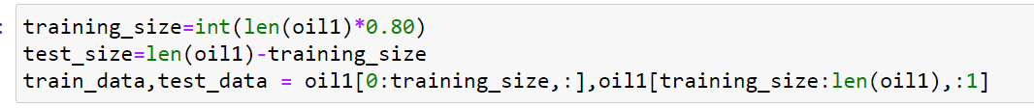

LSTM Model
After 1st order differencing :
Step 1:
As LSTM data is sensitive to the data we have to use MinMaxScaler.
Step 2:
Split the data into Training and Testing data, and convert the 2D matrix data into 3D matrix data.
Step 3:
Train the data

Slide 13
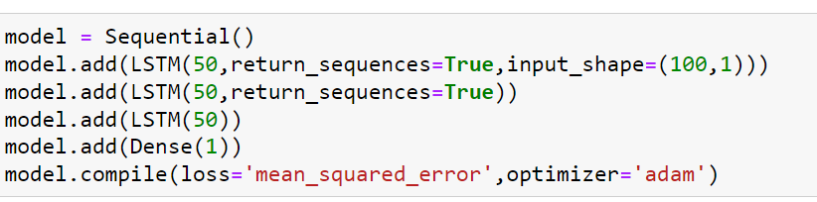
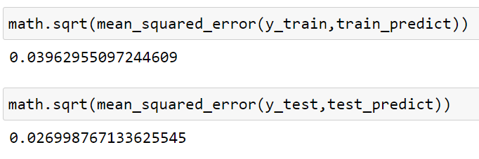
LSTM Model
Step 4:
Given the layer for lstm model
Step 5:
Step 6:
To check if model is good fitted
As we can see the MSE for train and for test is near to zero, so it is a good fit, but as fb prophet gave us more good results, so we preffered to go with Fb Prophet.

Slide 14
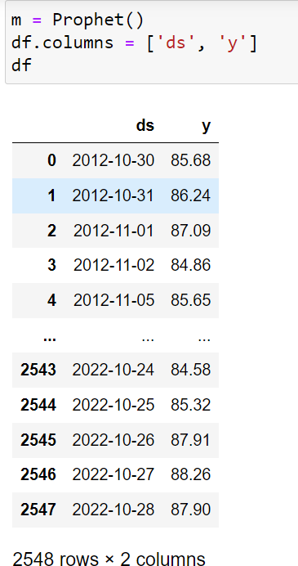
Model Result
Replace the columns Date and Close with the ds and y

Slide 15
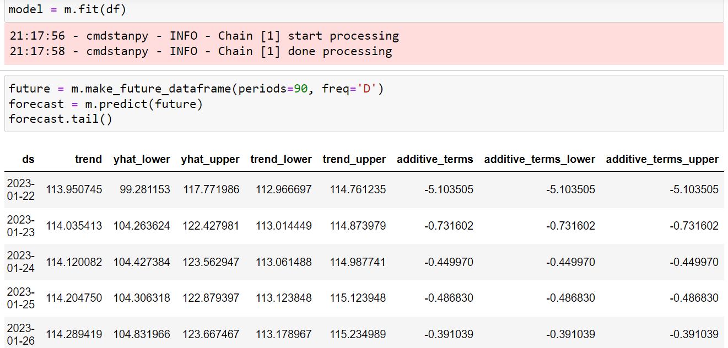
Train model:

Slide 16
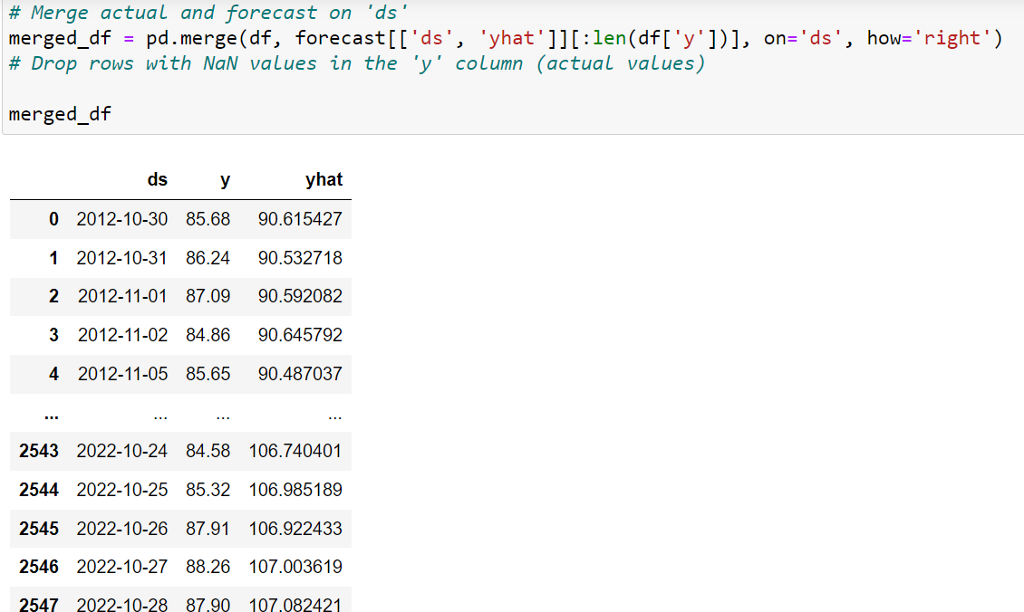
I
Input
Output

Slide 17
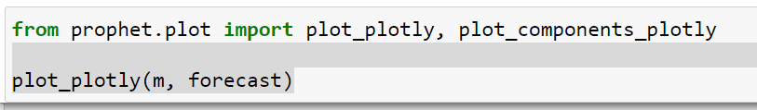
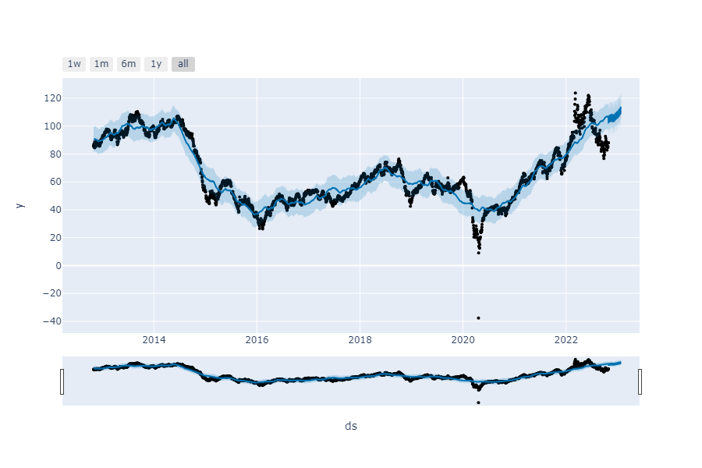
Facebook Prophet

Slide 18

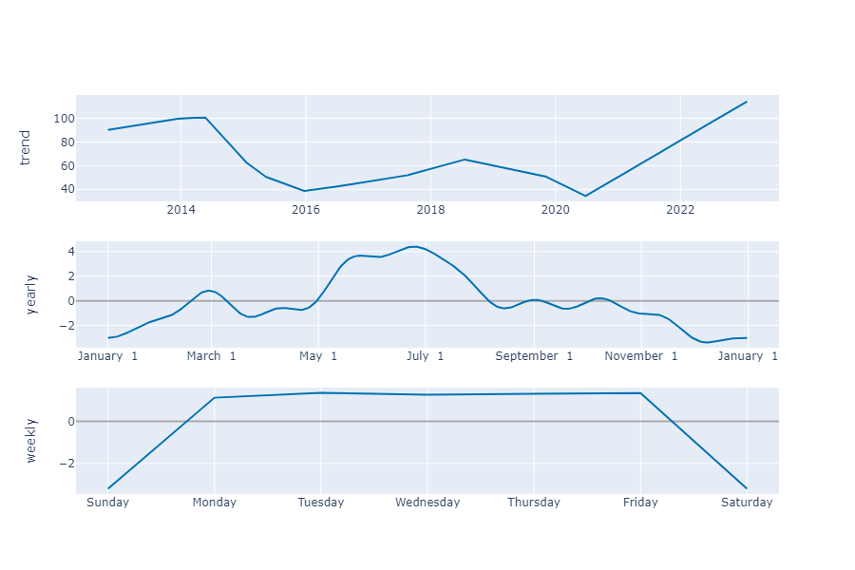
Model Results

Slide 19
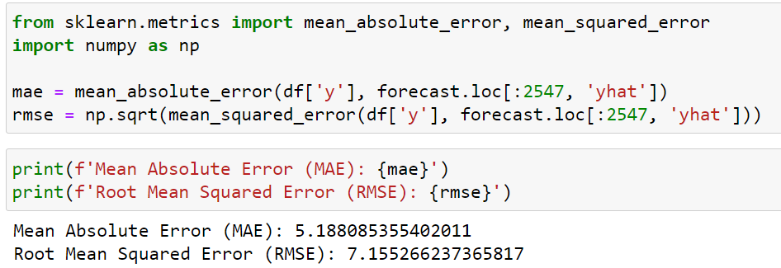
Model Results
As MAE and RMSE is near to zero, it is can be considerd as good model

Slide 20
Model Deployment using Streamlit

Slide 21
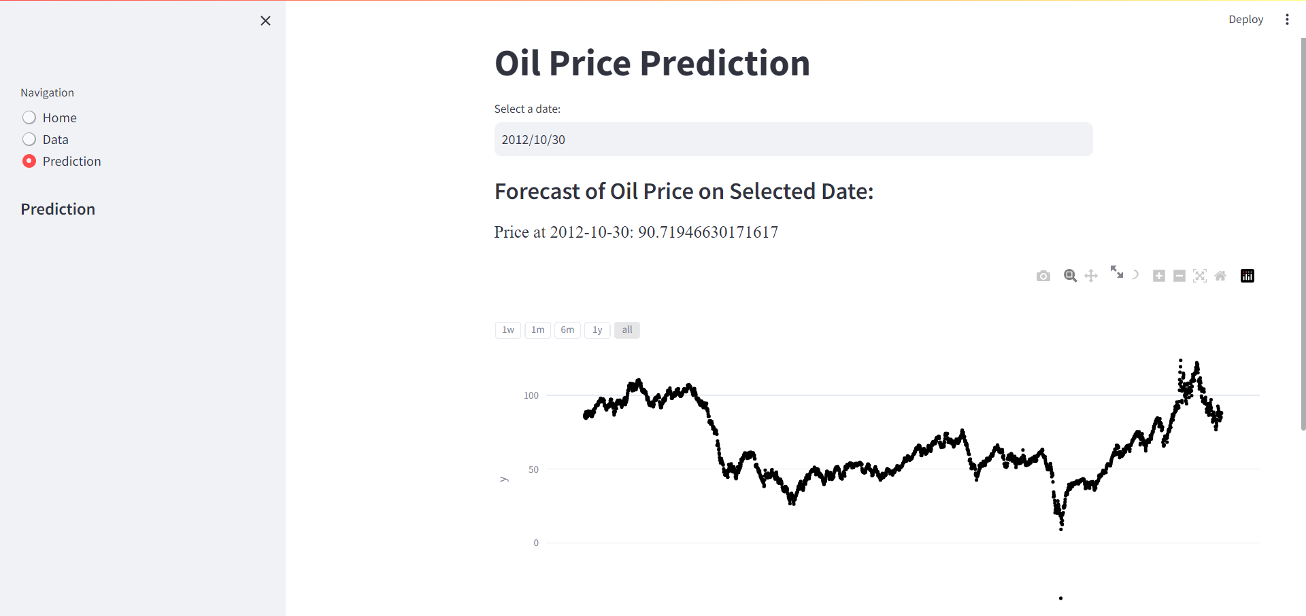
Precdition for next 30 days

Slide 22
Challenges
Challenges Faced | Solution
During EDA, we came to know that our data is non-stationary | We overcome this issue by performing 1st order difference
We used LSTM model for prediction, but we weren’t getting the accuracy correctly. | We switched to Arima model
While using LSTM model due to reshaping the data we were geting mse to high | Needed to perform inverse transform
We used Arima model for our data, but as our data didn’t showed any seasonality, trend so we needed to swtich to the fb prophet | We swtiched to the Facebook Prophet for more accuracy
Model evalution to check error | Used feature Engineering techniques

Slide 23
Thank you

