Slide 1








TO DO LIST
MANAGEMENT
ABINAYA A (811325243004)
HARSHITHA KUMARI M (811325104070)
HASHINI S (811325104071)
JAYAVARSINI J P (811325104086)

Slide 2


Abstract
Product:
A lightweight CLI utility for organized task tracking.
SYSTEM_CORE.C
Framework: Built using C fundamentals for efficient productivity management.
Logic:
Focuses on modular logic and sequential memory storage.
Objective:
Aims to solve daily organizational challenges through code.
© 2026 To-Do Management System Project

Slide 3



PRESENTATION AGENDA
01.Project Overview
02. Architecture
• System Core Features • C Data Structures
• Logic Design Patterns
• Abstract & Introduction • Problem Statements
• Research Objectives
03. Implementation
• Core Functional Modules • CRUD Operations
• Memory Management
04.Final Analysis
• System Limitations
• Future Enhancements • Conclusion
© 2026 To-Do List Management System | Technical Seminar Presentation

Slide 4

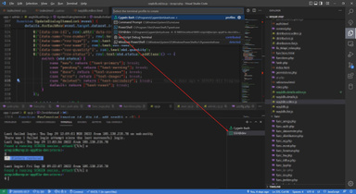

Introduc on
Produc vity Tool
Technical Founda on
A streamlined Command Line Interface (CLI) application designed for high-efficiency task tracking and management within a developer-centric environment.
Developed using core C programming principles, demonstrating modular design, robust input handling, and standard library integration.
Execu on Eﬃciency
Memory Management
Features a lightweight footprint optimized for offline use, requiring minimal system resources while maintaining instant execution speeds.
Employs direct memory management techniques to handle data structures, ensuring optimal performance and architectural stability.
To-Do List Management System | C Programming Project © 2026

Slide 5

Problem Statement
Current Fric on
Technical Requirements
Manual tracking causes organizational chaos, leading to missed deadlines and fragmented schedules.
Need for distraction-free digital tools that prioritize core functionality over cosmetic bloat.
Lack of simple offline task managers forces dependency on complex, data- heavy online platforms.
Requirement for low-resource productivity solutions optimized for system efficiency and speed.
C-Based Task Architecture © 2026 To-Do List Project Team

Slide 6




Project Objec ves
Skill Mastery
System Logic
Reinforce fundamental C programming skills through complex memory management, pointer manipulation, and data structure implementation.
Implement full CRUD (Create, Read, Update, Delete) lifecycle logic to manage task persistence and data integrity within the system.
Prac cal Bridge
Code Quality
Bridge the gap between theoretical logic and practical utility by creating a tool designed for real- world efficiency and task organization.
Develop reusable, modular source code following professional standards to ensure long-term maintainability and scalability.
©2026To-DoListManagementSystem | ProjectDocumentation

Slide 7


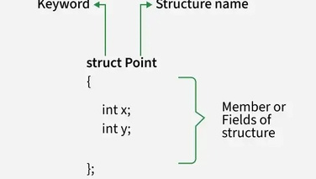
SYSTEM FEATURES
Intui ve Naviga on
Option
Functional Action
A robust, menu-driven interface designed for high efficiency and seamless user interaction within the console environment.
Option 1
Add Task: Create new entries in the system.
Option 2
View Tasks: Display the current list of activities.
Real- me Processing
Option 3
Edit Task: Modify existing task descriptions.
Immediate task addition and viewing capabilities using dynamic data structures for optimized performance.
Option 4
Delete Task: Remove completed or obsolete tasks.
Option 5
Mark as Complete: Update task status to finished.
Dynamic Task Control
Option 6
Exit: Securely close the application session.
Full CRUD (Create, Read, Update, Delete) support allowing users to modify or remove tasks on the fly.
Status Tracking
Integrated completion markers to differentiate between pending and finalized activities at a glance.
© 2026 To-Do List Management System | Technical Specification

Slide 8
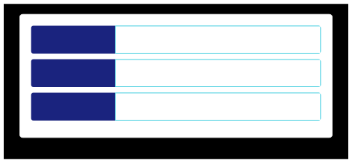



Data Structure: The System Blueprint
Custom Task Struct
The core of the application is a user-defined struct that encapsulates all properties of a single to-do item into a single memory block.
Memory Layout: `struct Task`
int id
Unique Identifier (4 bytes)
char desc[100]
Text Description (100 bytes)
Storage Strategy:
enum status
0: Pending | 1: Completed
Task taskList[MAX_TASKS];
Utilizes fixed-size array allocation for predictable performance and memory safety.
Global Task Array
Static Allocation Rationale
Task
[0]
Task
[1]
Task
[2]
...
Task
[N]
Simplicity: Avoids the complexity of pointers and manual memory management.
Performance: O(1) access time to any specific task
Contiguous memory allocation for maximum CPU cache efficiency.
via ind ex.
©2026To-DoSystemArchitecture|CProgrammingModule

Slide 9
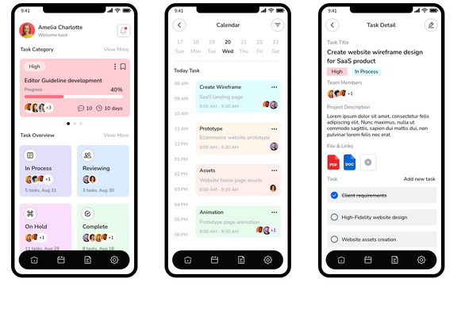

Module 1: Add Task
Auto-incrementing unique task IDs
Implements acentralcounter logictoensure every newly created task is
assigned a distinct identifier for precise data retrieval.
Captures user text description
Sanitizes and capturesinput fromthestandard input stream, managing
character limits to maintain data integrity within the C environment.
Process Flow: Input to Array Storage
Initializes status as 'Pending'
Automatesthetask lifecycle bysetting the default state to "Pending" upon
creation, requiring no manual entry for workflow tracking.
Sequential storage in memory array
Mapsthe taskstructure intotheglobaltask array, ensuring contiguous
memory allocation and facilitating efficient indexing.
© 2026 To-Do Management System Architecture | Technical Specification

Slide 10

Module 2: View Tasks
Implementa on Logic
Forma ed Output
Full iteration through task array using structural looping.
ID
Description
Status
Efficient extraction of stored data points for display.
01
Complete project report
Pending
02
Debug memory leaks
In Progress
Includes core fields: Task ID, Description, and Status.
03
Optimize pointer logic
Pending
Direct access to structural elements for maximum performance.
04
Finalize system documentation
In Progress
* Table view ensures clear visual separation of entries for better user experience.
© 2026 To-Do List Management System | C Programming Architecture

Slide 11




Module 3: Edit Task Logic
STEP 01
Search
Targeted search by Task ID within the linked list structure for precise identification.
STEP 02
Validate
Robust input validation for existing IDs to ensure data integrity and error handling.
STEP 03
Modify
In-place string buffer updates using safe memory allocation and copy functions in C.
STEP 04
Confirm
Final user confirmation and state synchronization upon successful data change.
▶
▶
▶
C Programming Technical Specifications: Task Management Project
Academic Year 2026

Slide 12


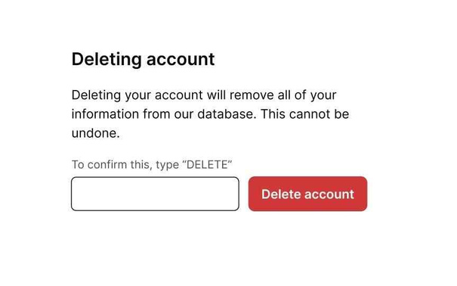
Module 4: Delete Task
Locates the specific array index target based on the user- provided identifier or selection.
Shifts all subsequent elements to the left by one position to fill the void created by the removal.
Decrements the global task counter to reflect the new size of the active dataset.
Maintains contiguous memory alignment, ensuring there are no "holes" or gaps in the C array structure.
To-Do List Management System | Logic & Flow
© 2026 Academic Development Team

Slide 13




Module 5: Complete Task
Field Toggle Logic
Implements precise toggle functionality for specific task fields within the C structure, ensuring state consistency.
Status Flag Update
Programmatically updates the internal status variable to 'Completed' upon user verification and validation.
Visual Feedback
Provides immediate UI updates to reflect the task's new status, utilizing Teal color indicators for success.
Data Integrity
Preserves all existing task metadata and timestamps during the status transition to maintain historical accuracy.
© 2026 To-Do List Management System | Technical Specification Slide

Slide 14
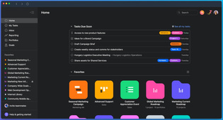
Beneﬁts & Applica ons
Zero External Dependencies
Builtpurely in C,requiring no runtime
environments, frameworks, or internet connection to function perfectly.
High Speed & Portability
Minimalist architectureensures near-instant
Target Audience
execution. The compiled binary can be easily moved across systems.
Students: Managing academic assignments and project deadlines efficiently.
Professionals: Organizing daily tasks
without the overhead of heavy software
suites.
Distraction-Free Productivity
Aclean text-basedinterface focusespurely on task
management, eliminating the notifications and clutter of modern apps.
To-DoListManagementSystem | 2026

Slide 15




Challenges & Future Work
Current Constraints
Planned Improvements
• • •
Static memory limit: 100 task capacity Volatile data: No permanent file persistence Linear search complexity for task lookups
• • •
Implement File I/O for automatic data saving Shift to Dynamic Linked Lists for scalability Integration of sorting & filtering algorithms
System Capacity Roadmap
Current (Static Array)
Future (Dynamic Allocation)
Fixed 100 Tasks
Scalable / Memory Bound
© 2026 Management System Technical Specification | Academic Project Roadmap

Slide 16
Conclusion
⽥
Successful modular C implementation ensuring codebase maintainability and logical separation.
↻
Efficient CRUD logic demonstrated through optimized pointer manipulation and data handling.
Foundational programming
➜
System architecture is ready for expansion with hooks for persistent storage and UI integration.
★
concepts applied including memory management and structured design.
© 2026 To-Do Management System Project | Slide 16

Slide 17






Ques ons and Discussion
Thank you for your attention
PRESENTED BY
Harshitha &
Hashini
PRESENTED BY
Jayavarshini &
Abinaya
Email contact: team@example.com
© 2026 To-Do List Management System Project Team

