Slide 1
EduPredict
• Student Performance Prediction Using Linear Regression
•
• Name: ______________________
• USN: ______________________
• Department: ______________________
• College: ______________________
• Academic Year: ______________________

Slide 2
Introduction
• Machine Learning: computers learn patterns from data.
• Supervised learning uses data where answers are known.
• Regression predicts continuous numeric values.
• Goal: predict final exam marks from academic behavior.

Slide 3
Problem Statement
• Predict a student's final exam marks using:
• Study hours per day
• Attendance percentage
• Previous / internal marks
• Use Linear Regression (the syllabus algorithm) from scikit-learn.

Slide 4
Objectives
• Prepare a realistic dataset of 200 students.
• Explore and clean the data.
• Train a Linear Regression model.
• Predict final marks for unseen test data.
• Evaluate using MAE, MSE, RMSE and R2.

Slide 5
Dataset & Features
• 200 records, 4 columns, all numeric.
• Study_Hours: approx. 1 - 10 hours/day
• Attendance_Percentage: approx. 50 - 100%
• Previous_Marks: approx. 30 - 95
• Final_Marks (target): approx. 30 - 100
• Split: 160 training / 40 testing, random_state = 42

Slide 6
Methodology / Workflow
• Dataset -> Data Preprocessing
• -> Exploratory Data Analysis
• -> Feature Selection -> Train-Test Split (80/20)
• -> Linear Regression Training -> Prediction
• -> Evaluation (MAE, MSE, RMSE, R2)
• -> Visualization -> Conclusion

Slide 7
Linear Regression Algorithm
• Fits: Final_Marks = b0 + b1*Study_Hours + b2*Attendance + b3*Previous_Marks
• b0 = -0.3966 (intercept)
• b1 = 1.1695 b2 = 0.3000 b3 = 0.4084
• Learned using the least-squares method in scikit-learn.

Slide 8
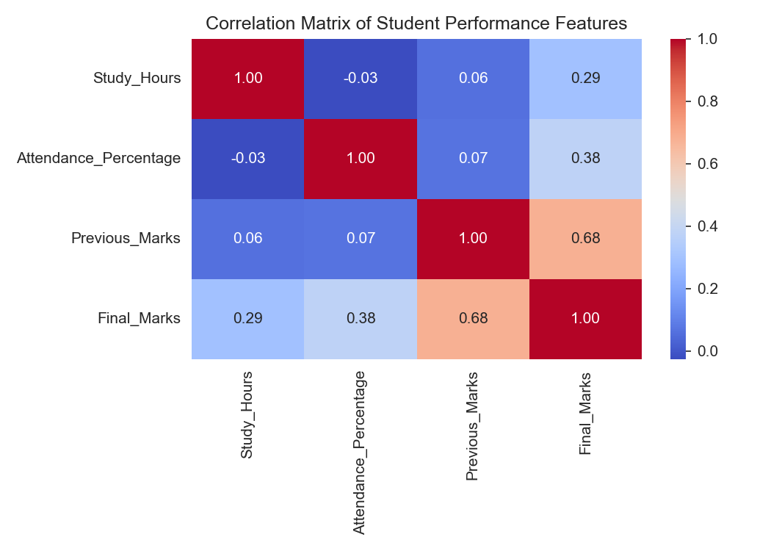
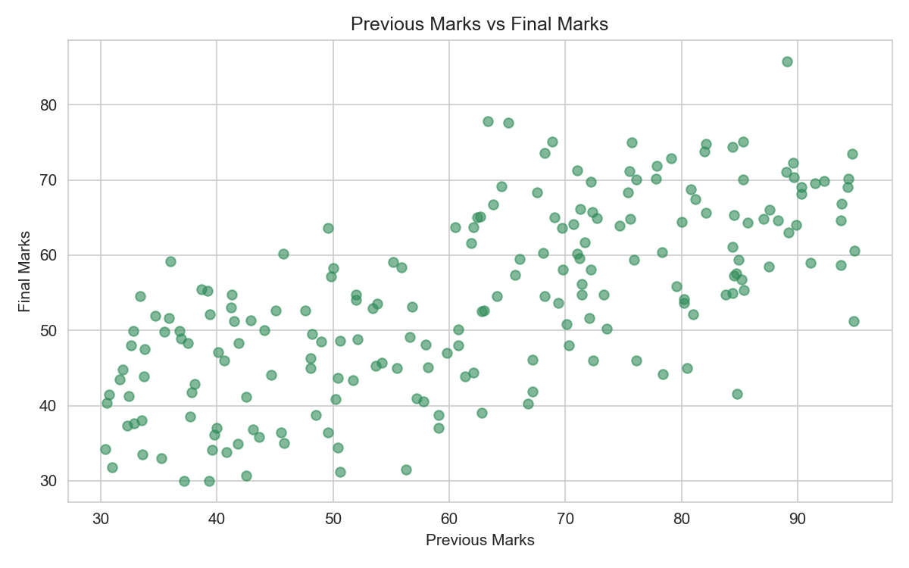
Exploratory Data Analysis

Slide 9
Model Results
• MAE = 5.6561
• MSE = 47.1436
• RMSE = 6.8661
• R2 Score = 0.6206
•
• The model explains about 62% of the variation in final marks.

Slide 10
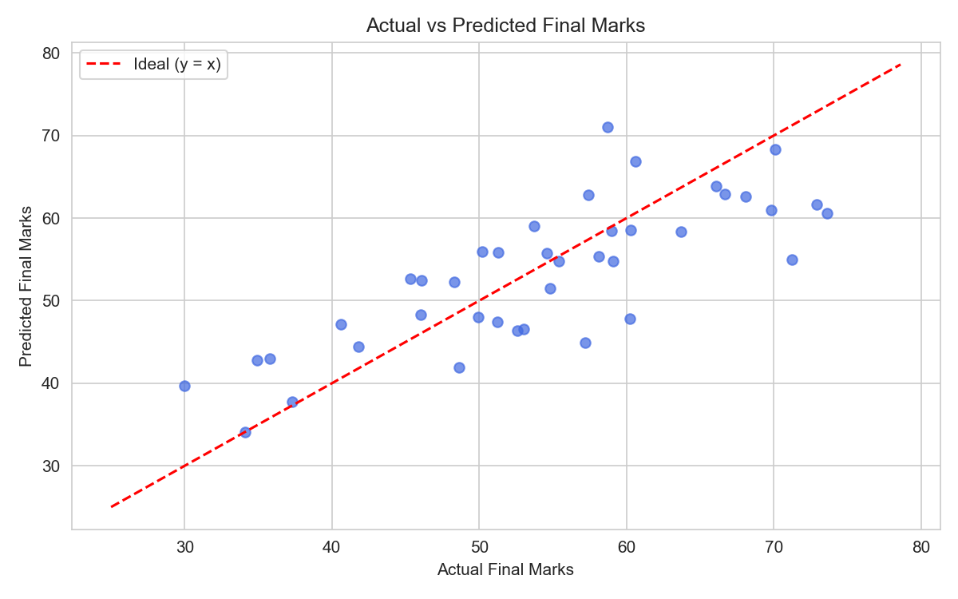
Actual vs Predicted

Slide 11
Conclusion & Future Scope
• Linear Regression gave a simple, interpretable predictor.
• All coefficients positive - matches common sense.
• Not perfect: average error about 5-6 marks.
• Future: larger real dataset, more features (assignments, sleep, consistency), comparison with other syllabus algorithms.

Slide 12
Thank You

