Slide 1
InsurCare
Insurance Policy & Claims Management System
A clean, modern platform connecting Customers, Agents, Claims Officers, and Administrators in one unified system.
Project Overview & Demonstration • FastAPI Backend • React Vite Frontend • Live SMTP Email Security

Slide 2
The Real-World Problem & Our Solution
Overcoming the pain points of traditional insurance management
❌ Traditional Insurance Pain Points
• Manual & Slow Processes: Buying or renewing insurance still involves physical paperwork and long turnaround times.
• Lack of Transparency: Customers have no clear way to see where their claim stands after filing.
• Subjective Risk Reviews: Claims adjusters manually inspect claims without immediate automated risk scores.
• Scattered Information: Agents, officers, and managers work in silos with no unified system of record.
• Basic Security: Password recovery lacks live multi-factor verification.
✅ The InsurCare Solution
• 1-Click Policy Subscriptions: Browse plans and instantly download official A4 Policy Guarantee Certificate PDFs.
• Live Claim Tracking Timeline: Clear visual milestone tracking from Submitted to Review, Approval, and Payout.
• Automated Risk Scoring Engine: Calculates risk ratings (Low, Moderate, High Risk) based on claim parameters.
• 4 Tailored Workspaces: Customized portals designed specifically for Customers, Agents, Officers, and Admins.
• Live SMTP Verification: Real-time 6-digit email OTPs for secure authentication and password recovery.

Slide 3
System Architecture: 4 Dedicated Portals
Role-Based Access Control ensuring secure and tailored experiences for every user
👤 Customer
💼 Insurance
⚖️ Claims
🛡️ Administrator
👤 Customer Portal
Self-service portal to browse plans, buy policies in 1-click, download guarantee certificates, file claims with photo/document uploads, and track real-time status.
💼 Insurance Agent
Operations workspace to manage client portfolios, issue policies, track collected revenue, and send 1-click Email & SMS renewal reminders.
⚖️ Claims Officer
Adjudication desk to review incoming claims, inspect evidentiary documents, check automated risk scores, and approve or reject payouts.
🛡️ Administrator
Control center for user administration, policy catalogue creation, company-wide revenue charts, and tamper-evident security audit logs.

Slide 4
Modern & High-Performance Tech Stack
Built with industry-standard, scalable technologies
🎨 Frontend Tier
• React 18 & Vite: Ultra-fast Single Page Application (SPA) rendering.
• Material UI (MUI v5): Modern, responsive component design system.
• Recharts Library: Interactive data visualizations and revenue analytics.
• jsPDF & AutoTable: Instant client-side A4 Policy Certificate generation.
• Axios & JWT Interceptors: Seamless, secure API communication.
⚙️ Backend Tier
• Python 3.12 & FastAPI: High-speed asynchronous REST API framework.
• SQLAlchemy 2.0 ORM: Structured database models and relational queries.
• Pydantic v2: Strict request/response schema validation.
• Passlib & Bcrypt: Cryptographic password hashing.
• Pytest Suite: Automated endpoint and business logic testing.
🔐 Services & Storage
• Live Gmail SMTP: Automated email dispatch for 6-digit OTP verification.
• JWT Role Guards: Strict role-based access for all 4 portals.
• Automated Risk Engine: Instant claim risk score calculations.
• SQLite / PostgreSQL: ACID-compliant relational database storage.
• Audit Log Engine: Detailed tracking of system modifications.

Slide 5
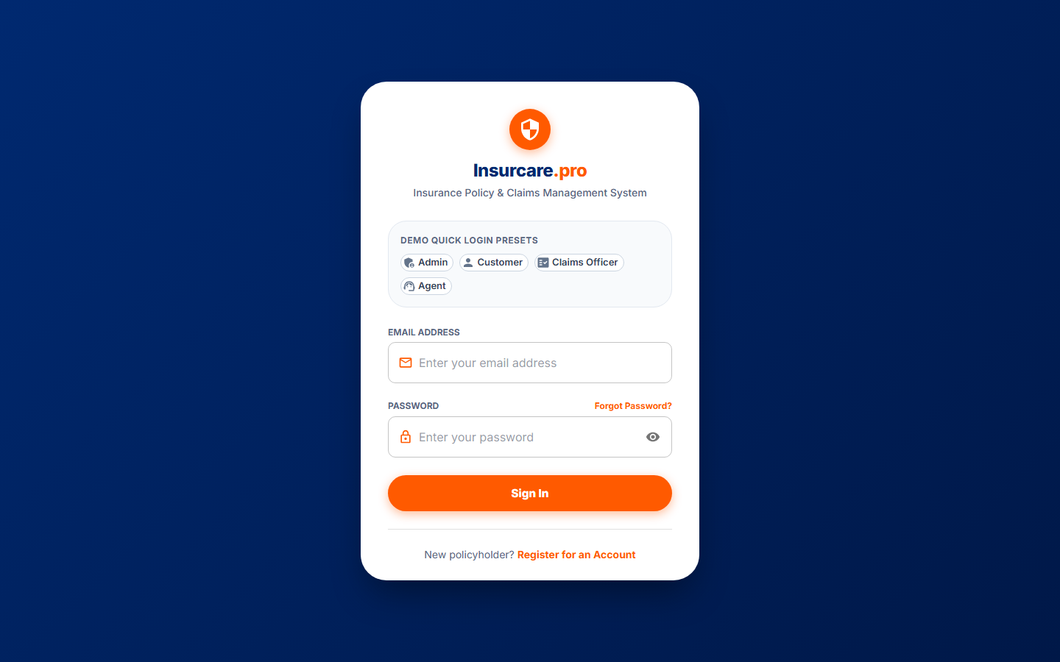
Authentication & Multi-Role Login
Secure login gateway with 1-click demo presets and role protection
Key Capabilities
• 1-Click Demo Login Chips: Easily switch between Admin, Customer, Officer, and Agent accounts during demonstrations.
• JWT Token Security: Encrypted bearer tokens carrying user identity and role-based permissions.
• Route Protection: Prevents unauthorized users from accessing other portals (e.g. customer cannot access admin).
• Customer Registration: Self-service registration form for new policyholders.

Slide 6
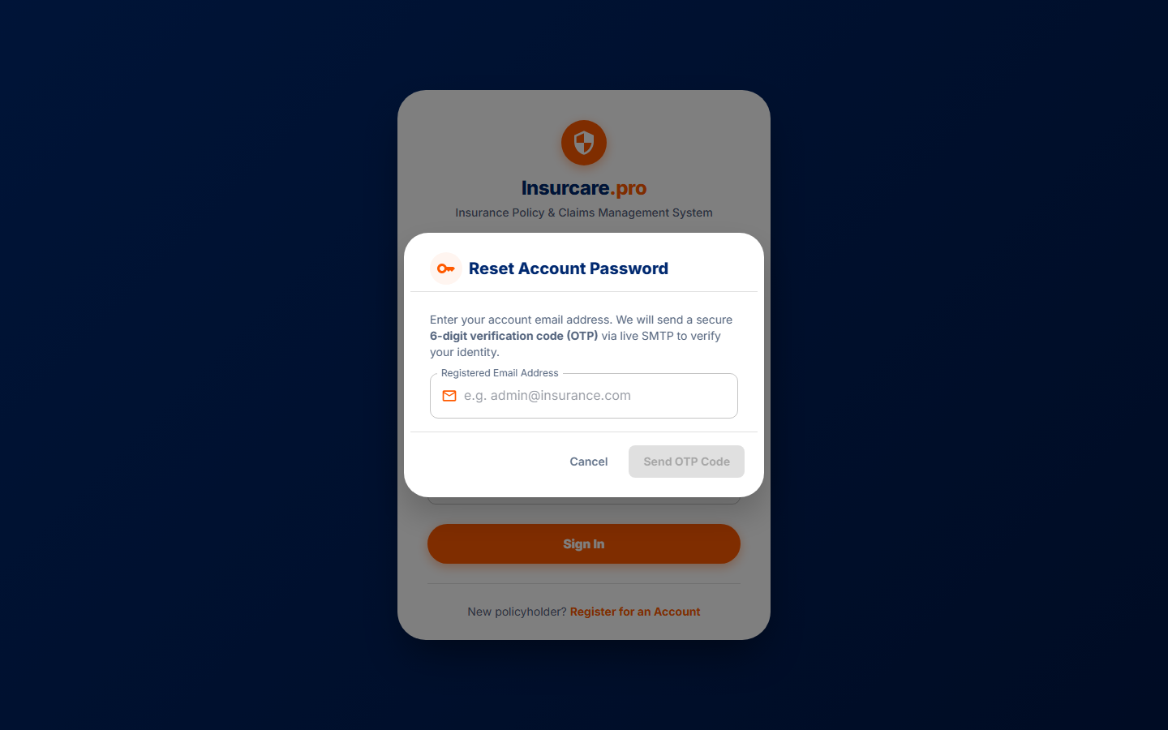
Live Email & OTP Verification Engine
Real-time Gmail SMTP integration providing secure password recovery
Key Capabilities
• Universal Role Access: Available to all 4 user roles for secure self-service password recovery.
• Live SMTP Dispatch: Sends a branded HTML email with a 6-digit verification code directly to the inbox.
• 10-Minute Expiration: Security timeout ensures OTP codes cannot be reused or guessed.
• Interactive Resend Timer: Live 60-second countdown timer prevents spam requests.
• Audit Trail Logging: Every password reset is permanently recorded in the admin audit log.

Slide 7
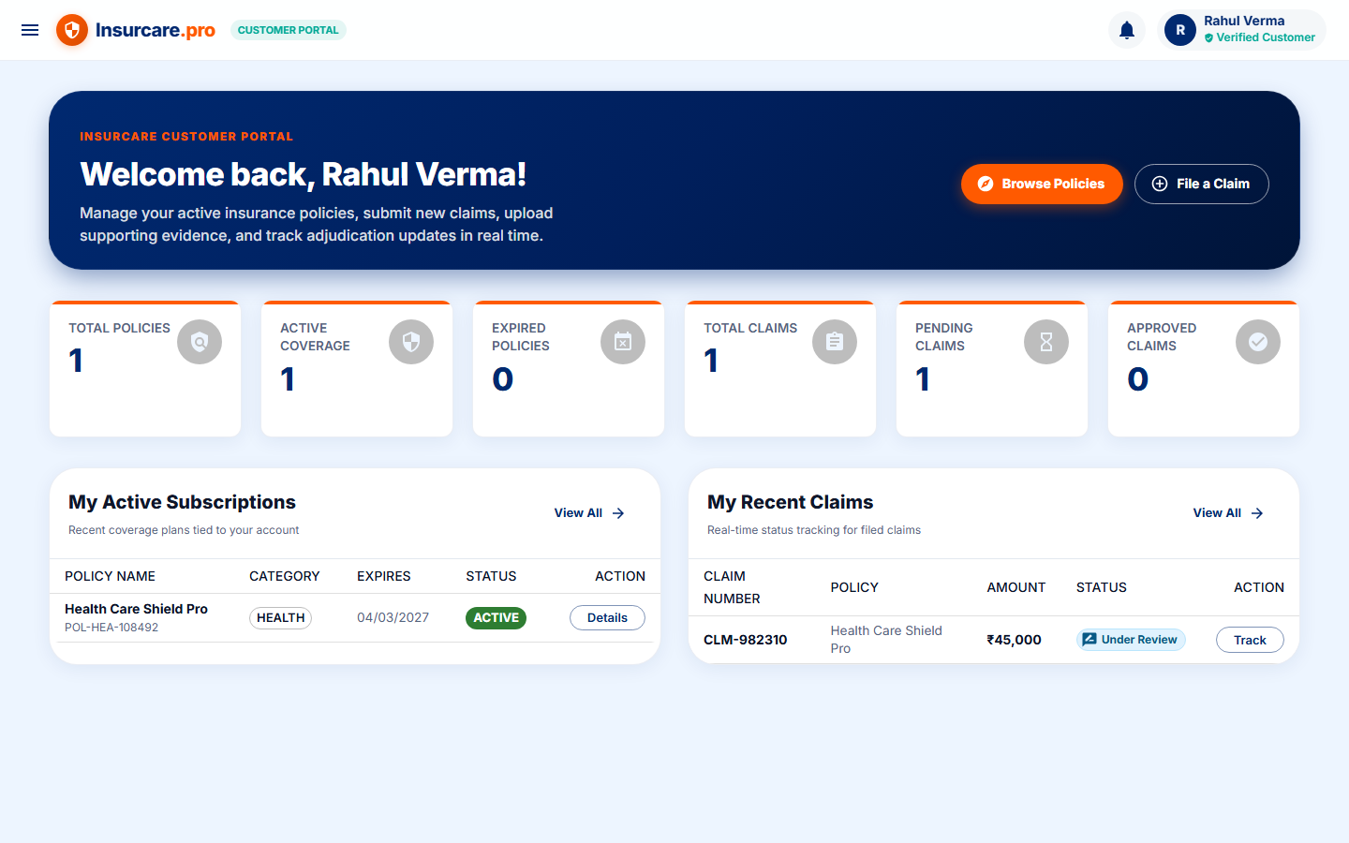
Customer Self-Service Portal
Empowering policyholders with instant plan buying and claim filing
Key Capabilities
• Policy Catalog & Filters: Browse Health, Auto, Life, and Home plans with transparent pricing and coverage limits.
• 1-Click Policy Purchase: Instant plan checkout and activation without paperwork.
• A4 Certificate Download: Immediate generation of official Policy Guarantee Certificate PDFs.
• Online Claim Submission: Easy multi-step form to describe incidents, enter amounts, and upload documents.
• Live Status Tracking: Real-time progress updates directly on the customer dashboard.

Slide 8
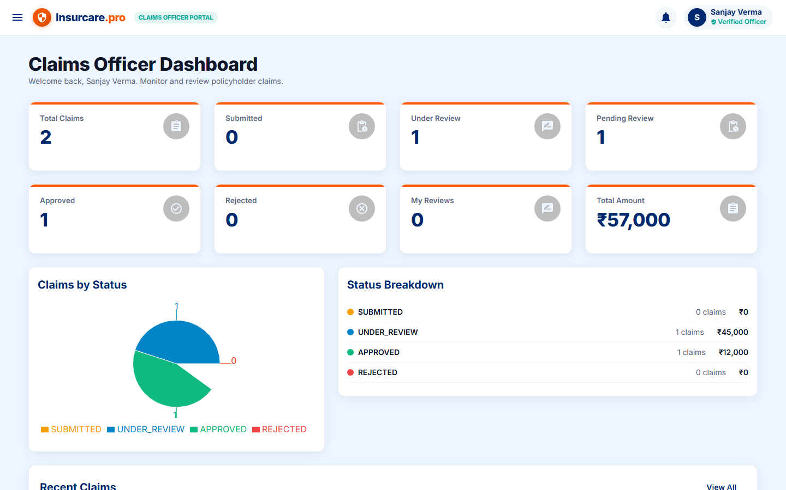
Claims Officer Adjudication Workspace
Structured review workspace with automated risk scoring and decision workflows
Key Capabilities
• Centralized Review Queue: Inspect all claims with claim numbers, policy details, and incident dates.
• Automated Risk Scoring: Calculates risk levels (Low Risk, Moderate, High Risk) instantly based on policy terms.
• Evidence Inspection: Preview uploaded damage receipts, bills, and customer descriptions.
• Formal Decision Engine: 1-click Approval or Rejection with settlement amounts and adjuster remarks.

Slide 9
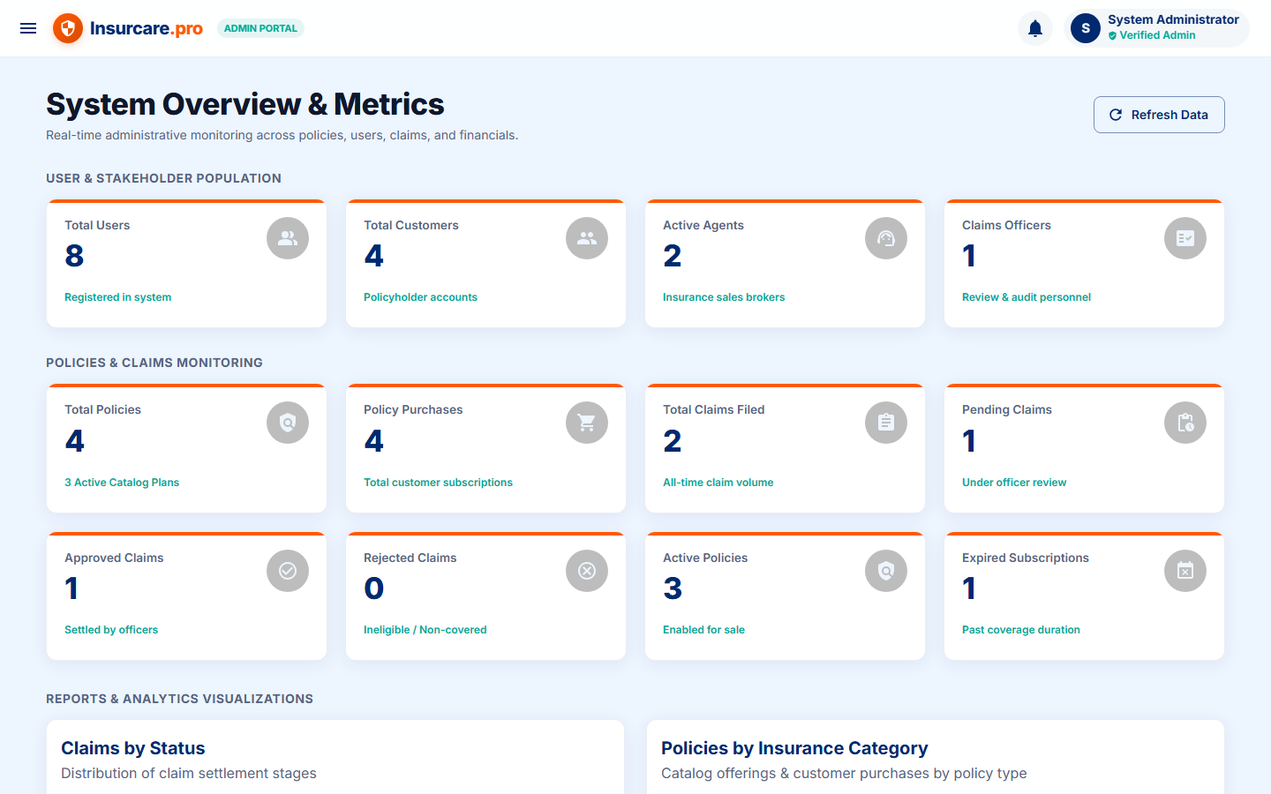
Administrator Management Center
System governance, user lifecycle management, and revenue analytics
Key Capabilities
• User Directory Management: Full CRUD operations for all user types with active/inactive status toggles.
• Insurance Policy Config: Create, update, and manage insurance offerings and coverage parameters.
• Visual Revenue Analytics: Interactive charts displaying policy distributions and collected premiums (INR).
• Security Audit Logs: Real-time event logging tracking all system updates and claims adjudications.

Slide 10
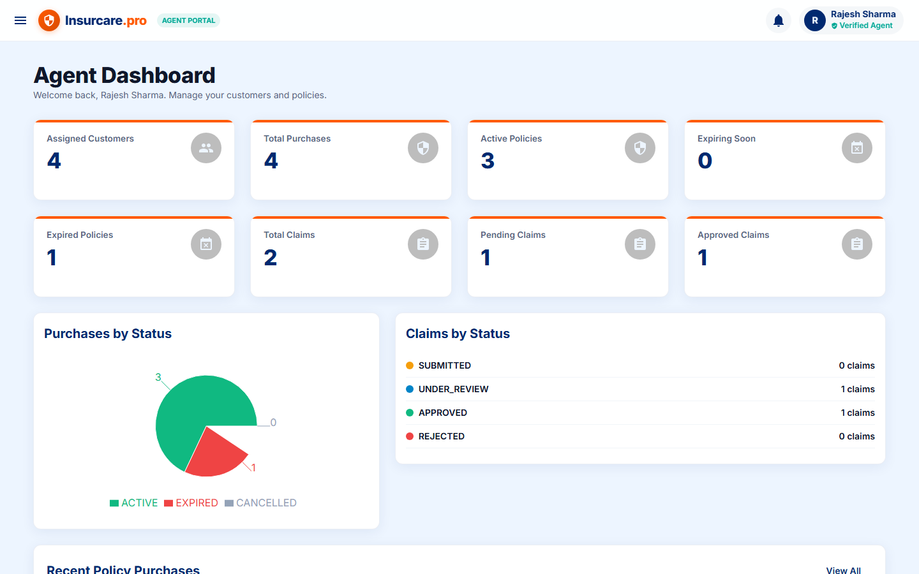
Insurance Agent Operations Desk
Client portfolio oversight, direct policy issuance, and renewal alerts
Key Capabilities
• Agent Operations KPI Cards: Track total active client policies and premium revenues collected.
• Issue Policy to Customer: Direct policy issuance modal with dynamic customer search.
• Multi-Filter Portfolio Table: Filter client policies by category, status, and validity dates.
• 1-Click Renewal Reminders: Send branded renewal notices via email and SMS with automatic audit updates.

Slide 11
End-to-End Live Demonstration Workflow
A smooth, real-world customer journey connecting all 4 system portals
Step 1: Customer Subscribes to Policy
Log in as Customer ➔ Browse catalog ➔ Subscribe to Health Insurance plan in 1 click ➔ Download official A4 Policy Guarantee Certificate PDF.
Step 2: Customer Files a Claim
Customer navigates to Submit Claim ➔ Selects active policy, enters incident description and claim amount ➔ Uploads bill / receipt ➔ Claim is submitted.
Step 3: Claims Officer Review
Log in as Claims Officer ➔ The new claim appears in the review queue ➔ Reviewer inspects the risk score and documents ➔ Enters remarks and hits Approve.
Step 4: Admin & Agent Verification
Log in as Admin ➔ Verify updated revenue reports and audit log trail. Agent can also inspect client status and trigger renewal reminders.

Slide 12
Project Summary & Demo Credentials
Demo User Accounts (Available via 1-Click Login Chips):
• 🛡️ Administrator: admin@insurance.com | Password: Admin@123 — Full system configuration, user management, and revenue analytics.
• 👤 Customer: customer@insurance.com | Password: Customer@123 — Self-service policy catalog, 1-click purchases, certificate downloads, and claims.
• ⚖️ Claims Officer: officer@insurance.com | Password: Officer@123 — Claims adjudication queue, automated risk scoring, and payout approval decisions.
• 💼 Insurance Agent: agent@insurance.com | Password: Agent@123 — Client portfolio management, issuing policies, and 1-click renewal alerts.

