Slide 1

Everyday memory
support, made familiar
SMĀRANA
Cognitive activities and shared care context
seva hackathon
Notes:
SMĀRANA is an assistive platform for cognitive engagement and memory support. It is not a diagnostic tool or a replacement for clinical care.

Slide 2
Why
we’re here
THE CHALLENGE
1
Make activities approachable and familiar.
Everyday support matters between appointments.
2
Support families across everyday moments.
An older person may need help starting an activity or following a routine. A caregiver may need a clearer picture of how the day went.
3
Work around language and unreliable connectivity.
SMĀRANA
SEVA HACKATHON
02
Notes:
The project materials identify older adults, caregivers, language and intermittent connectivity as the context. The North East is the initial focus.

Slide 3
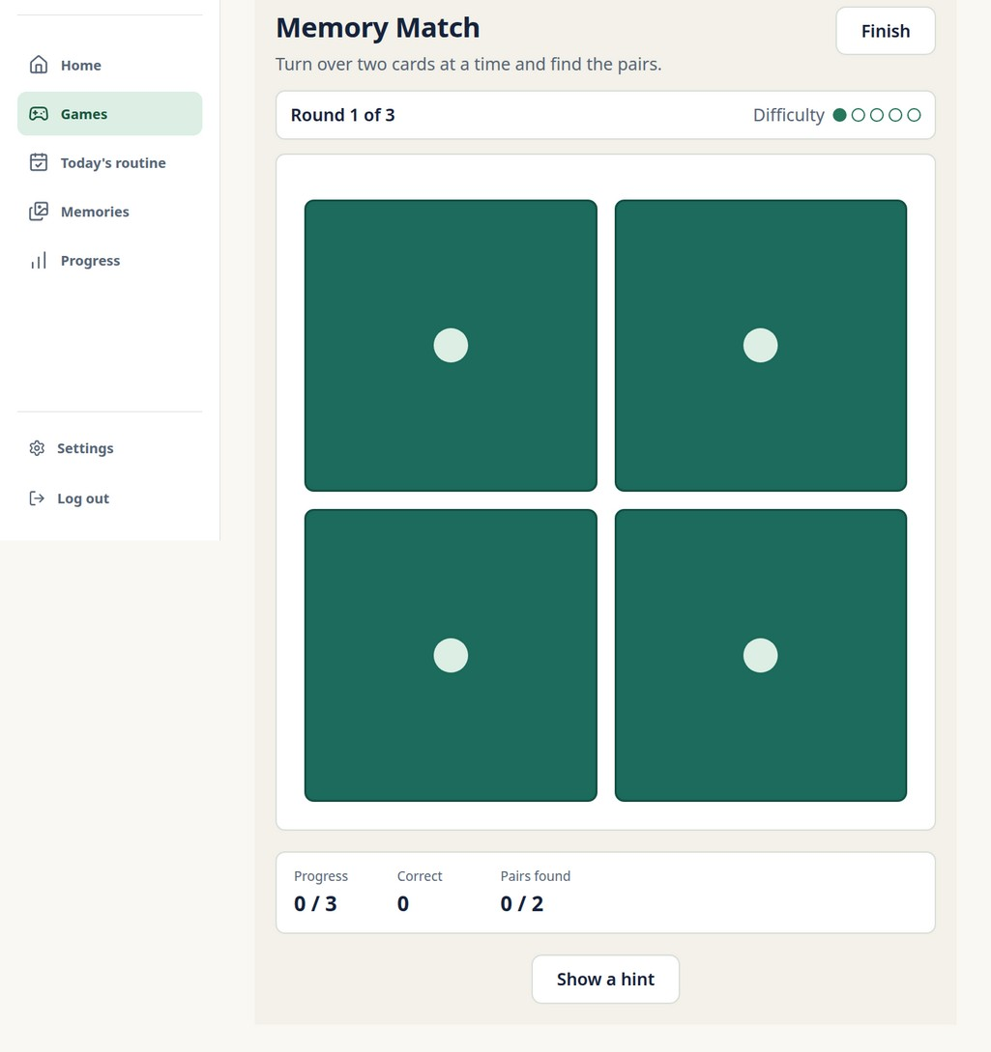
Our
idea
SMĀRANA connects short memory activities, familiar personal cues and an assigned caregiver’s view.
The broader concept also includes routine cues and regional language support.
SMĀRANA
SEVA HACKATHON
03
Notes:
The supplied materials show a memory game. Personal photos, broader routine features and language support are part of the wider concept and require verification in the current build.

Slide 4
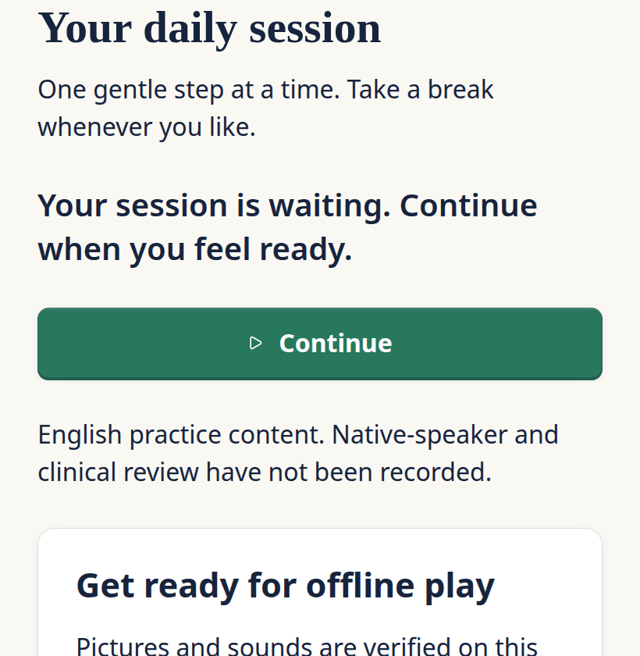
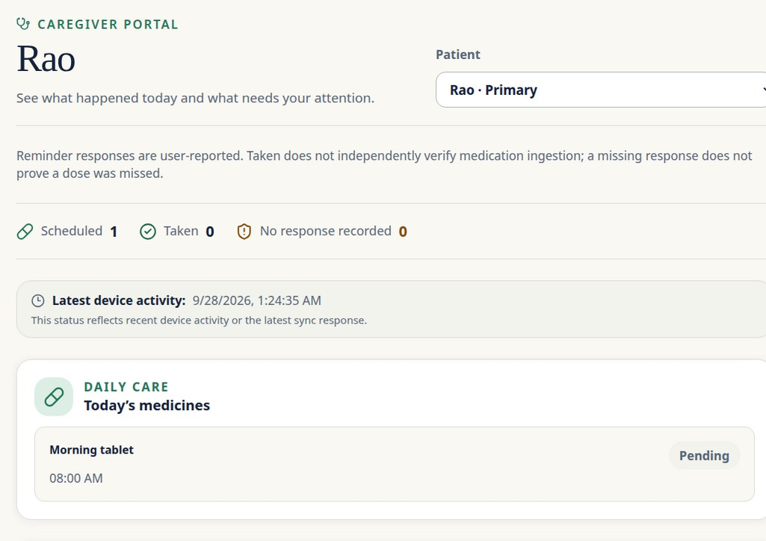
The prototype
A daily activity and a shared caregiver view
DAILY SESSION
CAREGIVER VIEW
Prototype captures use synthetic records; the caregiver view is from a separate run.
SMĀRANA
SEVA HACKATHON
04
Notes:
The browser captures use synthetic records. The caregiver view comes from a separate run.

Slide 5
How it
works
01
CHOOSE
03
SYNC
Start a short activity.
Send queued events when connected.
02
SAVE
04
REVIEW
Keep the event on the device.
The assigned caregiver sees shared context.
React PWA · IndexedDB / Dexie · Django REST · PostgreSQL
SMĀRANA
SEVA HACKATHON
05
Notes:
Local save and caregiver readback were demonstrated in an isolated browser test. Closed-app background synchronisation and phone acceptance remain unverified.

Slide 6
Where we
stand
SHOWN IN THE PROTOTYPE
NEXT TO DEVELOP OR VERIFY
Browser session and memory game
Local save and caregiver readback
Synthetic-data engineering tests
Physical-phone and language testing
Voice, alerts and wider language support
Clinical, privacy and accessibility review
Difficulty can be adjusted using accuracy, time and hints. Game performance is not a diagnosis.
SMĀRANA
SEVA HACKATHON
06
Notes:
The source describes a rules-based approach to difficulty and an Assamese interface. Voice, alerts, broad language support and clinical oversight remain proposed or require testing.

Slide 7
Next
steps
PREPARE
PILOT & LEARN
Work with clinical and language advisors to review activities, consent, safety and accessibility.
Partner with an elder-care or health organisation to test usability, engagement and caregiver usefulness.
Support needed
Clinical mentors
Native-language reviewers
A pilot partner
Pilot scope, funding and approvals are not yet confirmed.
SMĀRANA
SEVA HACKATHON
07
Notes:
A partner-led pilot is proposed. There are no confirmed partner or funding commitments and no clinical outcome claims.

