Slide 1
FIFO
FIFO - First In First Out
Application – Queue
Synchronization and Hand Shaking Mechanism

Slide 2
What is FIFO
A FIFO buffer is a type of data structure used in digital circuits where the first data element added is the first one to be removed. It operates under the principle of "First In, First Out," meaning the oldest data stored is the first to be retrieved.

Slide 3
Why FIFO
FIFO buffers are essential for managing data flow between systems operating at different speeds or with varying data rates. They serve as an intermediate storage to smooth out mismatches in processing speeds or timing. For example, in hardware systems where data is produced faster than it can be consumed, a FIFO buffer allows for temporary storage, ensuring smooth data transfer without loss.

Slide 4
LOGICAL EXPLANATION
read
write
00
00
SENDER
RECEIVER
01
01
R _ptr
W_ptr
10
10
11
11
full
empty

Slide 5
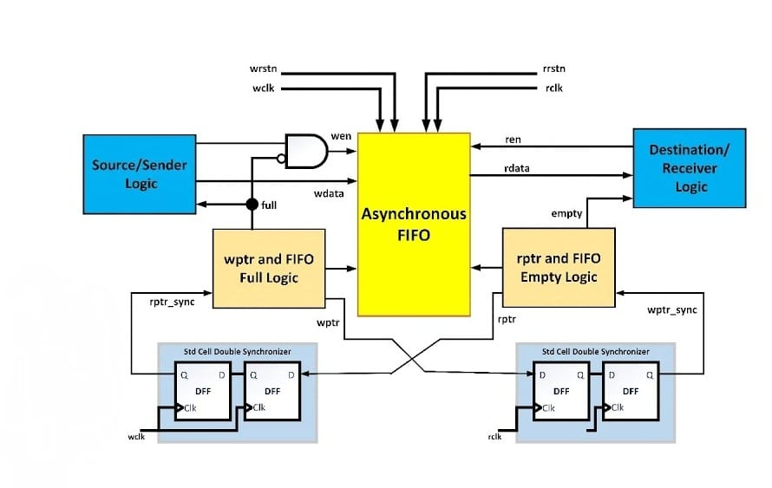
FIFO in Architectural View

Slide 6
Logic Expression Verilog HDL
FULL
(W_ptr[3] != R_ptr[3]) && (W_ptr[2:0] = R_dptr[2:0]);
OR
(~W_ptr[3],W_ptr[2:0]) == R_ptr[3:0];
EMPTY
W_ptr[3:0] == R_ptr[3:0]

Slide 7
RTL DESIGN FOR FIFO
module FIFO(
input clk, rst, read_en, wt_en,
input [Data_Width-1 : 0]data_in, // for writing
output [Data_Width-1 : 0]data_out, //for reading
output empty, full );
parameter DEPTH = 16; //Depth Of FIFO
parameter DATA_WIDTH = 8; //Width of data
parameter ptr = 5; //Address pointer size
reg [DATA_WIDTH – 1: 0] memory[0 : DEPTH-1];
reg [ptr–1 : 0]W_ptr;
reg [ptr-1 : 0]R_ptr;
reg empty_reg;
reg full_reg:
[7:0] memory[0:15]
0
8- bit
1
8- bit
2
15
8- bit

Slide 8
//When Data should be written
//Pointer
always @ (posedge clk or rst)
begin
if (rst)
W_ptr <= 0; //Non Blocking Assignment
else if (write_en && !full_reg)
W_ptr <= W_ptr + 1;
end

Slide 9
//FULL
always @(posedge clk or rst)
begin
if(rst)
full_reg < = 0;
else if(W_en && (W_ptr[size -1]!=R_ptr[size-1])&&(W_ptr[size-2 = 0] == R_ptr[size-2:0])
full_reg < =1;
end

Slide 10
//EMPTY
always @ (posedge clk or rst)
begin
if(rst)
empty_reg <= 1;
else if( write_en && !Full_reg && (W_ptr ! = R_ptr))
empty_reg < = 0;
else if( read_en && (W_ptr == R_ptr))
empty_reg < = 1;
end

Slide 11
//READ POINTER
always @(posedge clk or rst)
begin
if(rst)
R_ptr <= 0;
else if( read_en && !empty_reg)
R_ptr <= R_ptr + 1; //increments only when rd_enable is generated
end

Slide 12
//DATA STORAGE
always @(posedge clk or rst)
begin
if(rst)
//Initial Location of memory will be High impedance
memory <= { Default : DATA_WIDTH{1’bz}}; //replication operator
else if(write_en && !Full_reg)
memory[W_ptr] <= data_in;
end
Refers to register array used to store data in FIFO
NBA assignment should be occurred after current time step

Slide 13
//DATA RETRIEVAL
always@(posedge clk or posedge rst)
begin
if(empty_reg)
read <= hx; //Don’t cares
else
read <= memory[R_ptr];
End
//STATUS (For Information of user)
assign empty = empty_reg;
assign full = full_reg;
endmodule

