Slide 1
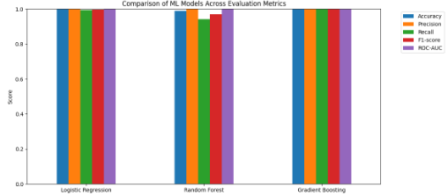
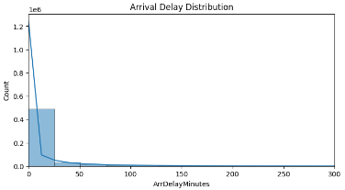
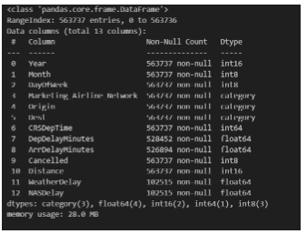
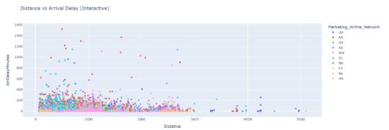
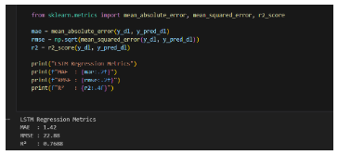
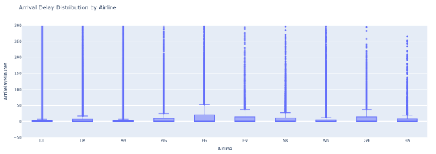
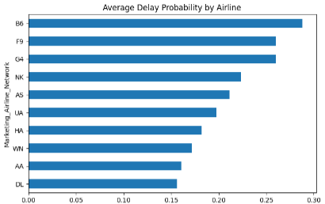
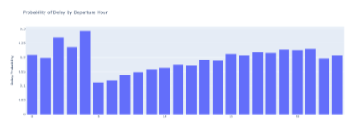
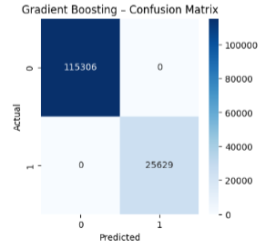
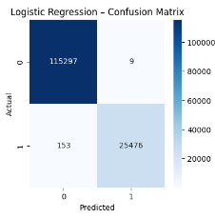
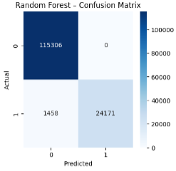
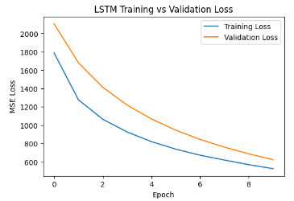
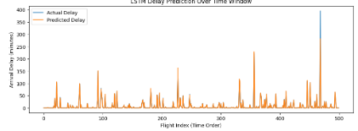
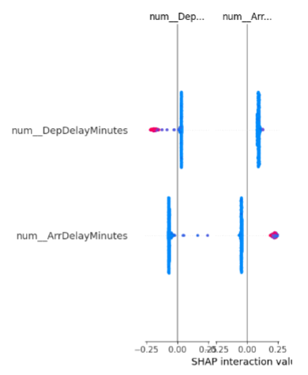
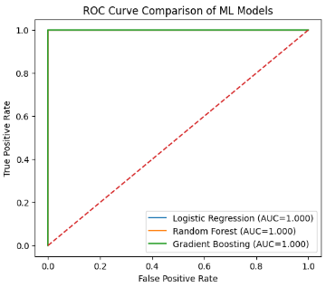
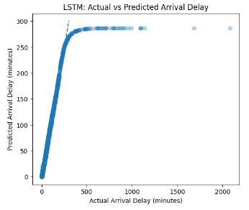
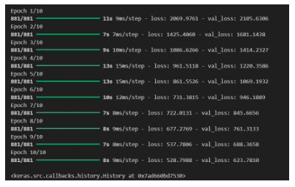

Python-Based Visual Analytics and Machine Learning Framework for Airline Flight Delay Prediction
Poster No
MSc DS CST4090
INTRODUCTION
DATA AND METHODOLOGY
RESULTS
The aviation industry plays a crucial role in global connectivity; however, flight delays remain a persistent operational challenge affecting airlines, airports, and passengers. Delays result from complex interactions between weather conditions, airport congestion, airline scheduling inefficiencies, and air traffic control limitations. Traditional statistical methods often fail to capture these nonlinear relationships within large aviation datasets. Recent advancements in data science, particularly Python-based visualization tools and machine learning (ML) models, offer improved analytical capabilities. This study proposes an integrated, open-source framework that combines visual analytics, machine learning, deep learning, and explainable artificial intelligence (XAI) to enhance delay prediction accuracy and interpretability (Nunez-Portillo et. al., 2024)..
The study utilises a publicly available Kaggle flight delay dataset comprising 563,737 domestic flight records. Data preprocessing included missing value treatment, categorical encoding, feature engineering, and temporal transformation. Exploratory Data Analysis (EDA) was conducted using Python libraries such as Matplotlib, Seaborn, and Plotly.Machine learning models including Logistic Regression, Random Forest, and Gradient Boosting were implemented for binary delay classification, while an LSTM deep learning model was used for continuous delay prediction. Model performance was evaluated using accuracy, precision, recall, F1-score, ROC-AUC, MAE, RMSE, and R² metrics.
Ensemble models outperformed baseline models with Gradient Boosting achieving highest accuracy (≈91%) and ROC-AUC (≈0.95)The LSTM model demonstrated strong regression performance with R² ≈ 0.77Peak delays were observed during high-traffic hours and seasonal demand periodsExplainable AI confirmed domain-relevant delay factors
Figure 14: Bar Chart Comparison of Metrics
Figure 16: Arrival Delay Distribution
Figure 1: Distance vs Arrival Delay
Figure 2: Dataset information
Figure 8: LSTM Performance Metrics
Figure 11: Arrival Delay Distribution by Airline
Figure 5: Random forest confusion matrix
Figure 17: Probability of Delay by Departure Hour
Figure 3: Gradient Boosting confusion matrix
Figure 4: Logistic regression confusion matrix
Figure 12: LSTM Delay Prediction Over Time Window
Figure 15: Average Delay Probability by Airline
Figure 9: LSTM Training vs Validation Loss
CONCLUSIONS
The proposed framework successfully integrates visual analytics, machine learning, deep learning, and explainable AI into a single, scalable Python-based system. The approach enhances predictive accuracy while ensuring interpretability—addressing a major gap in existing aviation analytics tools (Degife and Lin, 2023). This framework supports informed operational decision-making and offers a reproducible, open-source solution for future aviation delay research and industry applications.
Figure 6: ROC Curve Comparison of ML Models
Figure 7: Explainable AI Evaluation Using SHAP
Figure 10: LSTM delay prediction
Figure 13: LSTM: Actual vs Predicted Arrival Delay
AIM AND OBJECTIVES
VISUAL ANALYTICS AND EXPLAINABLE AI
Aim:
To design and evaluate a Python-based visual analytics and machine learning framework for predicting airline flight delays with improved accuracy and transparency.
Objectives:
Preprocess and analyse large-scale flight delay data
Develop interactive visualisations to explore delay patterns
Implement ML and deep learning models for delay prediction
Apply explainable AI techniques to interpret model decisions
Compare performance with traditional predictive approaches
REFERENCES
Interactive dashboards were developed to visualise delay trends by airline, airport, month, distance, and departure hour. These visualisations enhanced pattern recognition and supported decision-making.Explainable AI was integrated using SHAP (Shapley Additive Explanations) to identify key predictors influencing delay outcomes (Deng, 2025). Features such as departure hour, flight distance, and airline identity showed significant impact, improving model transparency and stakeholder trust.
Nunez-Portillo, J., Valenzuela, A., Franco, A. and Rivas, D., 2024. Predicting Air Traffic Congestion under Uncertain Adverse Weather. Aerospace, 11(3), p.240. https://www.mdpi.com/2226-4310/11/3/240
Degife, W.A. and Lin, B.S., 2023. Deep-learning-powered gru model for flight ticket fare forecasting. Applied Sciences, 13(10), p.6032. https://www.mdpi.com/2076-3417/13/10/6032
Deng, G., 2025. TasVisAn and InsPy--Python Packages for Triple-Axis Spectrometer
Data Visualization, Analysis, Instrument Resolution Calculation, and Convolution. arXiv
preprint arXiv:2506.18216. https://arxiv.org/abs/2506.18216

