Slide 1

Container 1
Container 2
App 1
App 2
BINS/LIBS
BINS/LIBS
Docker Engine
Host OS
Docker

Slide 2
Docker in a Nutshell
Container
Image
Staging
Server
Container
Container
Docker
File
Virtual Machine
Docker
Hub
Docker Image
Docker
Container
Image
Container
Production
Server
Container
Container

Slide 3
Docker Example
Jenkins
Server
Testing
Docker
File
Git Repo
Staging
Production

Slide 4
Docker Components
Docker Registry : Docker Registry is a Storage Component for Docker Images.
We Can Store the Images in either Public/Private repositories.
Docker Hub is Docker Own Cloud Repository.

Slide 5
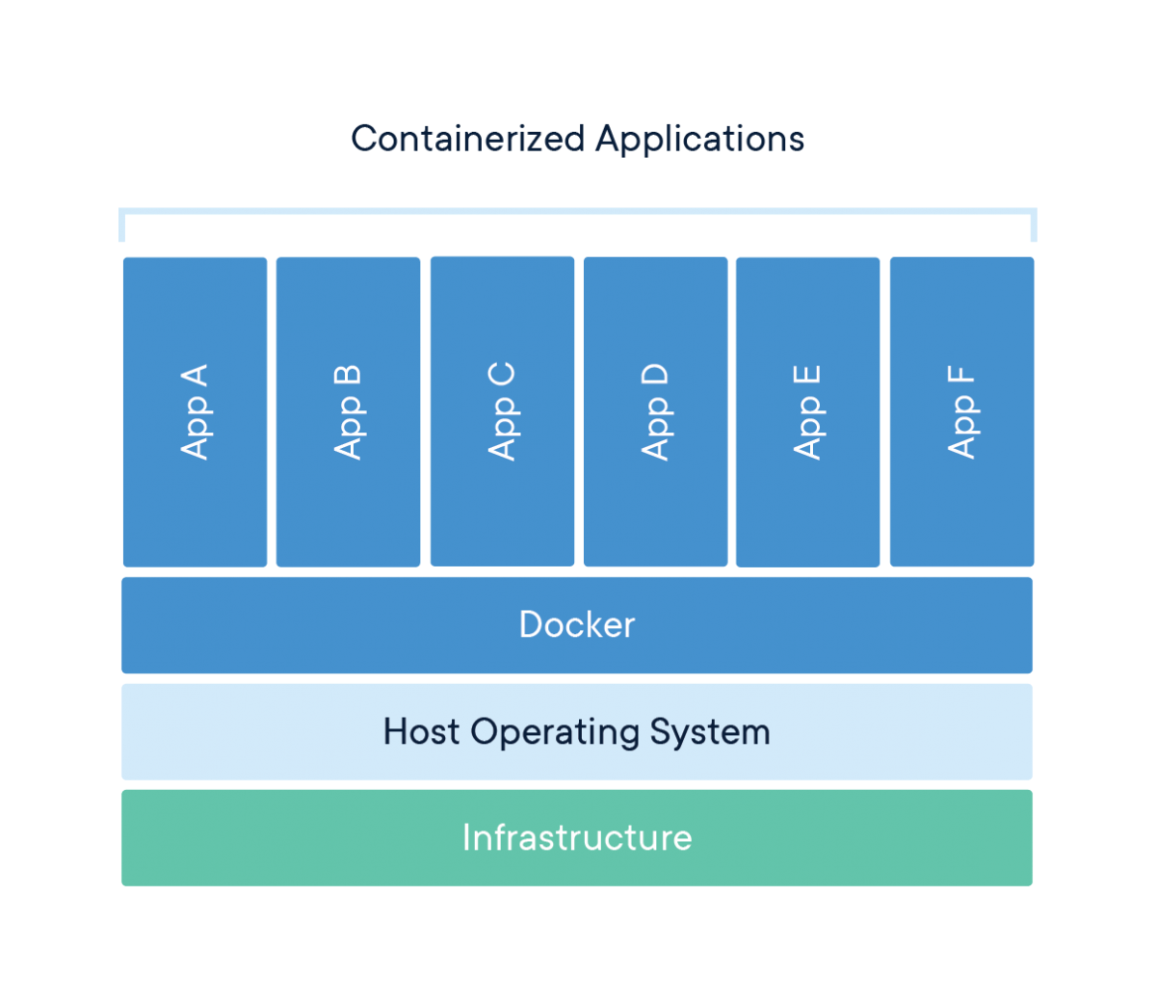
Docker Images & Containers
Run
Docker Images
Docker Containers

Slide 6
Docker Compose
ubuntu
Docker
Compose
File
redis
mysql
Run all containers with a single command
- Docker Compose
Containers

Slide 7
Docker For Windows
Avoids “Works on My Machine and but does not work on Production”
Improves Productivity
Earlier Docker Run on windows with linux as a middle ware but recently native windows kernel support was introduced
Enables Native Networking

