Slide 1
Container
NODE V7.4
NODE V7.6
NODE V7.9
APPLICATION
KERNEL
---------------------------------------------------------------------------------------------------
Windows/MAC/Linux
Hardware
NODE V7.6

Slide 2
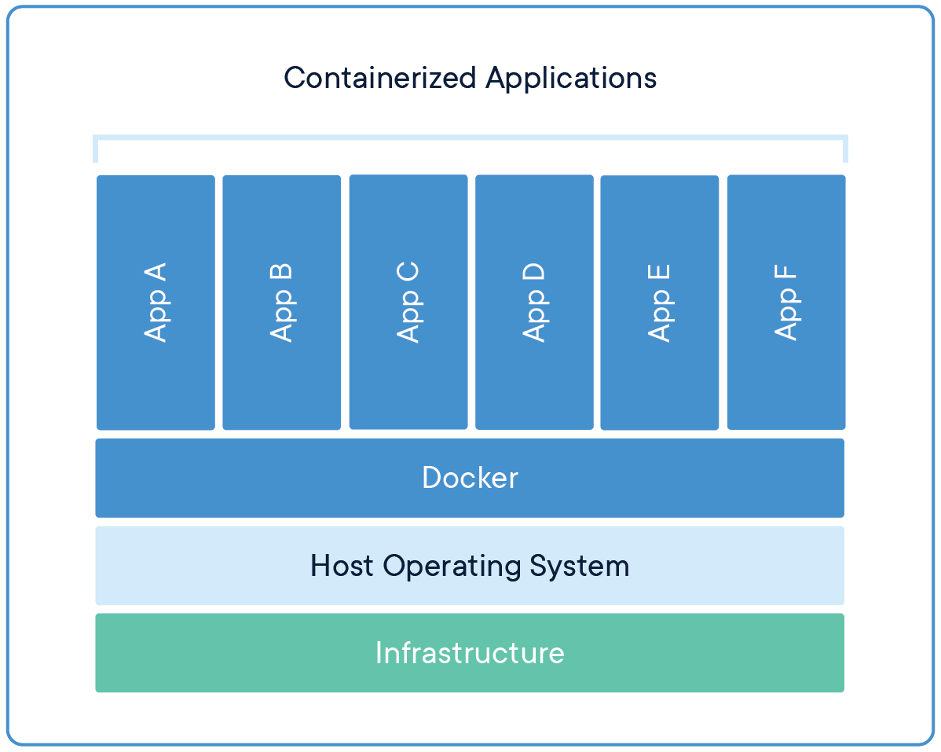

Slide 3
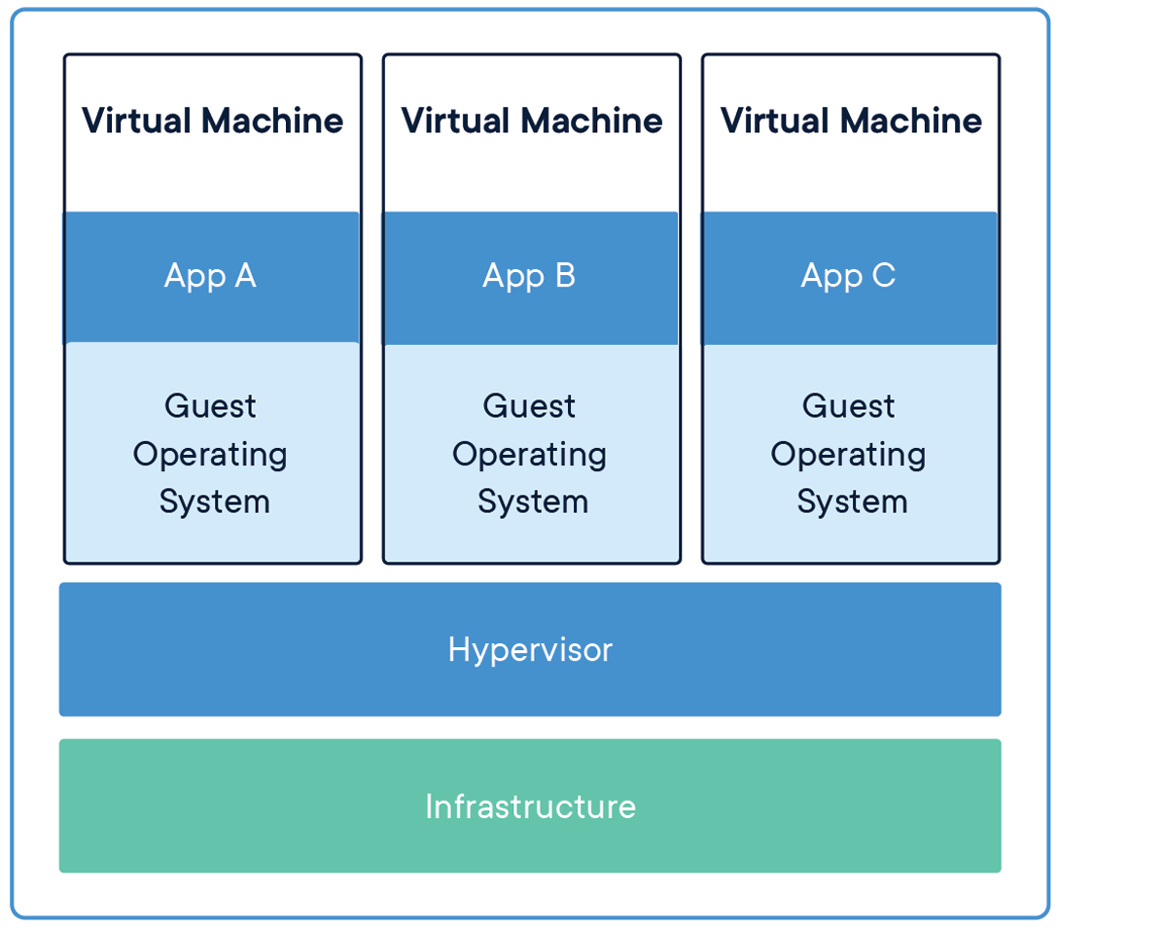

Slide 4

DOCKER IMAGE
Hardware
DEFAULT COMMANDS
----------------------------------------------------
Config/files

Slide 5
exec in Docker
stdout
--------------->
<---------------
stdin
-i and -t
container
M:\
C:\

