Slide 1
FERTILIZER REQUIREMENT
PREDICTION
Using Regularized Logistic Regression
A Machine Learning Approach for Data-Driven Agriculture
Presented by
Harshith Reddy | 2520090114
Sai Snehith | 2520090149
Guide: [Haritha] • [CSIT] • [KLH University]
Academic Year 2026–2027

Slide 2
Introduction
Fertilizers supply essential nutrients required for healthy plant growth.
Incorrect application can increase costs, reduce crop performance, and harm the environment.
Machine learning can identify patterns in agricultural data to support fertilizer decisions.
This project explores regularized logistic regression to classify fertilizer requirements from selected input features.
FERTILIZER REQUIREMENT PREDICTION • 2026–2027
02

Slide 3
Problem Statement
Fertilizer decisions are sometimes made using generalized advice or experience alone.
Excess application can contribute to nutrient runoff, soil degradation, and unnecessary expenses.
Insufficient application may limit crop growth and productivity.
Farmers and agricultural advisors need consistent, data-supported recommendations.
The model's usefulness depends on the quality and relevance of the training data.
FERTILIZER REQUIREMENT PREDICTION • 2026–2027
03

Slide 4
Motivation
Explore a practical application of machine learning in agriculture.
Support more informed and consistent fertilizer planning.
Demonstrate how data preprocessing and classification work together in a real-world problem.
Use regularization to help control model complexity and reduce overfitting.
Build a foundation that can later be extended into a farmer-facing tool.
FERTILIZER REQUIREMENT PREDICTION • 2026–2027
04

Slide 5
Project Objectives
01 Analyze data
02 Prepare data
03 Train model
Inspect agricultural features and target classes.
Clean, encode, and transform input variables.
Fit a regularized logistic regression classifier.
04 Evaluate
05 Predict
Measure generalization with suitable classification metrics.
Return a fertilizer requirement class for new inputs.
FERTILIZER REQUIREMENT PREDICTION • 2026–2027
05

Slide 6
Existing System
Traditional approach: farmer experience, visual crop assessment, and general fertilizer guidance.
Some recommendations rely on periodic soil testing and expert consultation.
Limitations include delayed access to advice, inconsistent information, and limited use of historical data.
A generic recommendation may not reflect the exact soil, crop, or local conditions.
Machine learning can complement—not replace—soil testing and expert knowledge.
FERTILIZER REQUIREMENT PREDICTION • 2026–2027
06

Slide 7
Proposed System
Load a labeled agricultural dataset and identify relevant input features.
Preprocess missing values, categorical variables, and numerical features as needed.
Train a logistic regression classifier with L1 or L2 regularization.
Evaluate the trained model on held-out test data.
Show the predicted fertilizer requirement category with appropriate limitations.
FERTILIZER REQUIREMENT PREDICTION • 2026–2027
07

Slide 8
System Architecture / Block Diagram
INPUT DATA
Soil / crop / weather features
↓
PREPROCESSING
Cleaning • encoding • scaling
↓
FEATURE MATRIX
Training and test split
↓
ML MODEL
Regularized logistic regression
↓
EVALUATION
Accuracy • precision • recall • F1
↓
OUTPUT
Predicted requirement class
FERTILIZER REQUIREMENT PREDICTION • 2026–2027
08

Slide 9
Methodology / Workflow
1
Collect dataset
2
Inspect and clean
3
Encode / scale features
4
Split train and test
5
Train regularized model
6
Evaluate performance
7
Predict and present results
Use a stratified split when appropriate and keep all preprocessing inside the training pipeline.
FERTILIZER REQUIREMENT PREDICTION • 2026–2027
09

Slide 10
Technology Stack
Language
Python
Model development
Notebook
Google Colab / Jupyter
Interactive experiments
Data
Pandas • NumPy
Cleaning and transformation
ML
Scikit-learn
Pipeline, logistic regression, metrics
Charts
Matplotlib • Seaborn
Confusion matrix and comparisons
Optional UI
Streamlit
Simple prediction interface
FERTILIZER REQUIREMENT PREDICTION • 2026–2027
10

Slide 11
System Modules / Components
Data collection
Preprocessing
Load the labeled dataset.
Handle missing data and encode categories.
Feature engineering
Model training
Select and transform model inputs.
Fit logistic regression with regularization.
Prediction
Evaluation & visualization
Generate class predictions for new records.
Report metrics, plots, and sample outputs.
FERTILIZER REQUIREMENT PREDICTION • 2026–2027
11

Slide 12
Implementation
Import pandas, NumPy, and scikit-learn libraries.
Read the dataset and inspect its columns, data types, and class distribution.
Separate target labels from predictor features.
Create a preprocessing pipeline and train/test split.
Fit LogisticRegression with a selected regularization setting.
Generate predictions, calculate metrics, and save screenshots of real outputs.
FERTILIZER REQUIREMENT PREDICTION • 2026–2027
12

Slide 13
Dataset / Input Data
POTENTIAL INPUT FEATURES
DATASET DETAILS TO INSERT
Soil pH and nutrient levels (N, P, K)
Crop type and soil type
Soil moisture, temperature, and rainfall
Other fields available in the selected dataset
Dataset name and source
Total records and feature count
Target variable and class labels
Missing-value handling and encoding
Use only features actually present in your dataset; do not claim fields that are absent.
FERTILIZER REQUIREMENT PREDICTION • 2026–2027
13

Slide 14
Algorithm / Model
What it does
Why regularize?
Key parameters
Estimates class probabilities using a logistic function; supports binary and multiclass classification.
Penalizes large coefficients to reduce model complexity and help limit overfitting.
C, penalty (L1/L2), solver, max_iter, and multiclass setup.
Model selection should be based on validation performance—not training accuracy alone.
For multiclass labels, use a compatible solver and scikit-learn configuration.
FERTILIZER REQUIREMENT PREDICTION • 2026–2027
14

Slide 15
Results and Evaluation
Accuracy
Precision
Overall proportion of correct predictions
How many predicted positives are correct
Recall
F1-score
How many actual positives are identified
Harmonic mean of precision and recall
INSERT YOUR MEASURED TEST RESULTS HERE
Accuracy: ____ Precision: ____ Recall: ____ F1-score: ____
Recommended visuals: confusion matrix, class-wise report, and baseline comparison.
FERTILIZER REQUIREMENT PREDICTION • 2026–2027
15

Slide 16
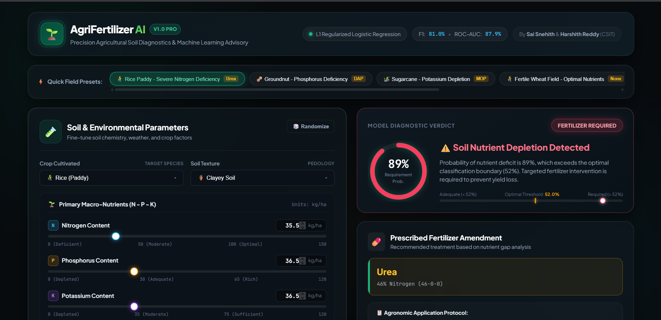
Screenshots / Demo
01 Dataset preview
Show the first rows and column names.
02 Preprocessing
Show transformed features and train/test split.
03 Model training
Show the notebook cell that fits the model.
04 Evaluation
Show the real classification report and confusion matrix.
05 Prediction
Show one sample input and predicted class.
FERTILIZER REQUIREMENT PREDICTION • 2026–2027
16

Slide 17
Advantages
Offers consistent, repeatable predictions from structured data.
Can classify multiple fertilizer requirement categories when trained with suitable labels.
Regularization can help reduce overfitting.
Built with accessible, open-source Python libraries.
Can be extended with a simple web interface and updated data.
Supports decisions but should be used alongside soil testing and expert guidance.
FERTILIZER REQUIREMENT PREDICTION • 2026–2027
17

Slide 18
Applications
Precision agriculture
Support nutrient planning using soil and crop records.
Farm advisory tools
Provide a preliminary data-driven class prediction.
Agricultural research
Compare model behavior across datasets and regions.
Education
Demonstrate an end-to-end supervised ML workflow.
Digital farming
Potential integration into farm-management applications.
FERTILIZER REQUIREMENT PREDICTION • 2026–2027
18

Slide 19
Limitations
Results depend on data quality, label accuracy, and class balance.
A dataset from one region may not generalize to another.
Logistic regression may miss complex nonlinear relationships.
Incorrect soil measurements or unseen crop conditions can reduce reliability.
The model predicts learned classes; it does not independently determine a scientifically validated fertilizer dose.
Real deployment requires field validation and agronomic review.
FERTILIZER REQUIREMENT PREDICTION • 2026–2027
19

Slide 20
Future Scope
Expand training data across crops, seasons, and geographic regions.
Compare against Random Forest, gradient boosting, and other suitable models.
Add soil-test report upload and a mobile-friendly interface.
Integrate weather and crop-stage information when reliable data are available.
Provide confidence estimates and explanations for predictions.
Deploy as a cloud-based advisory tool after field validation.
FERTILIZER REQUIREMENT PREDICTION • 2026–2027
20

Slide 21
CONCLUSION
Machine learning for
more informed fertilizer planning
This project demonstrates an end-to-end workflow: data preparation, regularized logistic regression, evaluation, and fertilizer requirement classification.
Key message
Reliable results require suitable data, honest evaluation, and validation with agricultural expertise.
THANK YOU • QUESTIONS?

