Slide 1

Library Management System
Group Members:
2510030326-Hemanth
2510030327-Anshith
2510040102-Harshith
Guided By:
DR.Mahesh Babu Arrama

Slide 2
Project Explanation
This project is a Library Management System developed using Java.
It is used to manage book records efficiently in a library.
The system allows users to add, search, issue, and return books.
It reduces manual work and helps maintain accurate records.
It provides quick access to book information using simple operations.

Slide 3
DATA STRUCTURES AND CONCEPTS USED :
Array (Book[])
Used to store and manage multiple book records
Queue (Array Implementation)
Used for reservation system (FIFO order)
Stack (Conceptual)
Can be used for tracking recent operations (future enhancement)
Linked List (Conceptual)
Alternative structure for dynamic storage of books
Exception Handling
Handles file and runtime errors using try-catch blocks
File Handling (Read/Write)
Stores and updates book data in a file (library_output.txt)

Slide 4
WORKING FLOW OF THE LMS:
The system starts with a menu-driven interface where the user selects an operation.
Based on user input, the corresponding method is executed (Add, Issue, Return, Search).
Book data is stored in an array and updated after each operation.
The issued status of a book is tracked using a boolean value.
Reservation requests are handled using a queue (FIFO).
All operations are recorded using file handling for persistence.

Slide 5
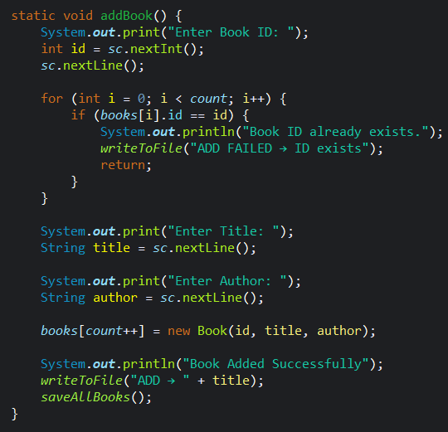
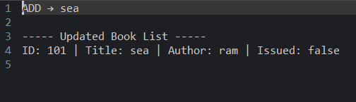
Add Book
• Adds new book to system
• Stores ID, title, author
• Avoids duplicate IDs
code
output

Slide 6
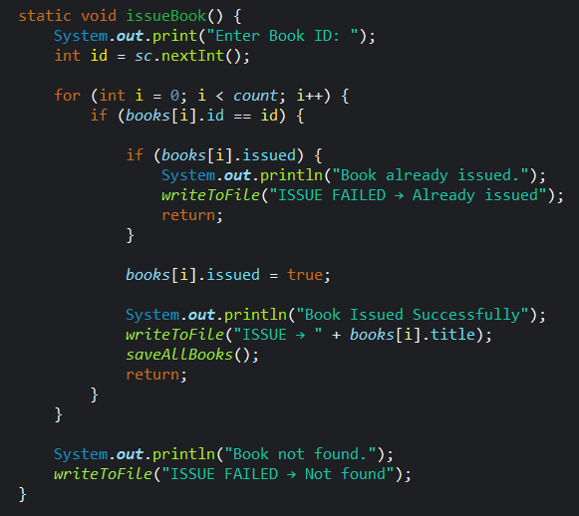


Issue Book
• Issues book to user
• Checks availability
• Updates issued status
code
output

Slide 7
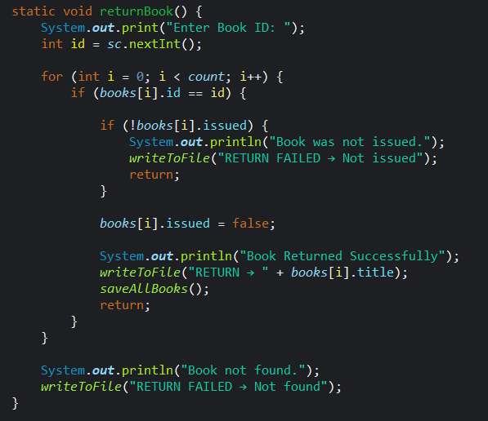

Return Book
• Returns issued book
• Updates availability
• Prevents wrong return
Code
Output

Slide 8
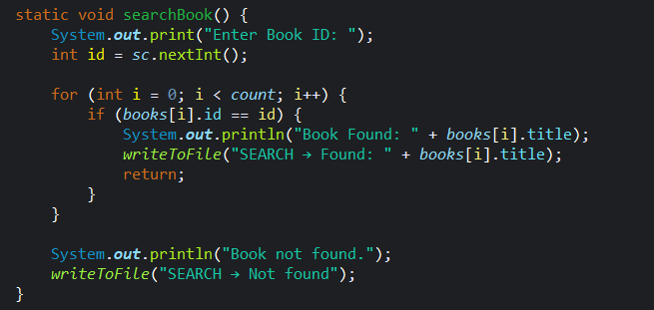
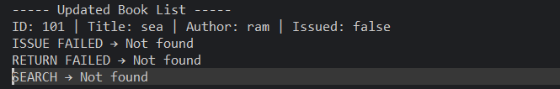
Search Book
• Searches book by ID
• Displays result if found
• Shows not found message
code
output

Slide 9
Reserve Book
Adds user to reservation queue when book is unavailable
Stores user name and maintains order using queue
Follows FIFO principle for fair allocation of books
code
output

Slide 10
Display Queue
•Displays all users in the reservation queue
•Shows names in FIFO (First In First Out) order
•Indicates if there are no reservations in the queue
code
output

Slide 11
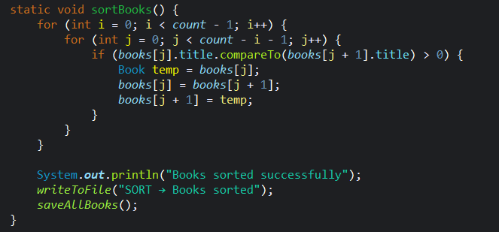
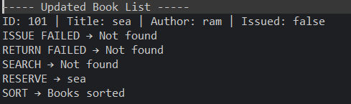
Sort Books
•Sorts all books alphabetically based on title
•Uses sorting logic (Bubble Sort) for arrangement
•Improves organization and easy searching of books
code
output

Slide 12
“This project demonstrates how basic data structures and programming concepts can be used to build a real-world application like a Library Management System.”
THANK YOU

