Slide 1
AR/VR MEDICAL TRAINING TEAM
M S HARSHITH REDDY
21BD1A6611
CSM A

Slide 2
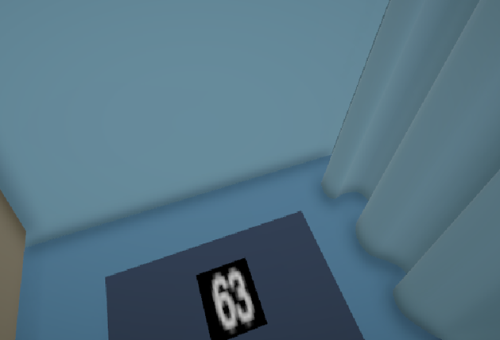
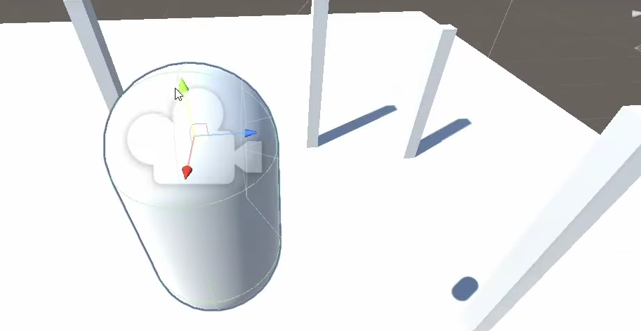
UNITY – First Person Perspective Based Model
1. a) Creating a Weighing Machine
Create a cube, which you can find under the GameObject tab
Create a quad, which will act as the monitor of the weighing machine and place the quad on the weighing machine.
Create an empty GameObject and add the TextMesh component.
Initialize the text property of the TextMesh Component to ""
Capsule
Create an empty GameObject and name it as Player. Create a Capsule GameObject as its child.
Main Camera
Drag the Main Camera and place it under the Player GameObject. Position the Main Camera at the top of Capsule.
Script
Write a C# Script to add a FPS Controller. Add this Script as a component under Player GameObject.
b) Creating a First Person Controller

Slide 3
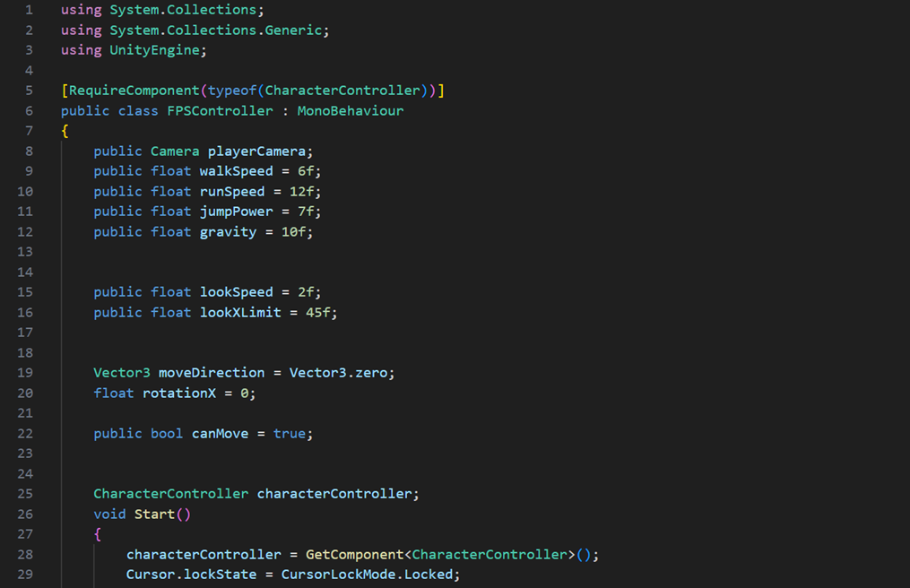
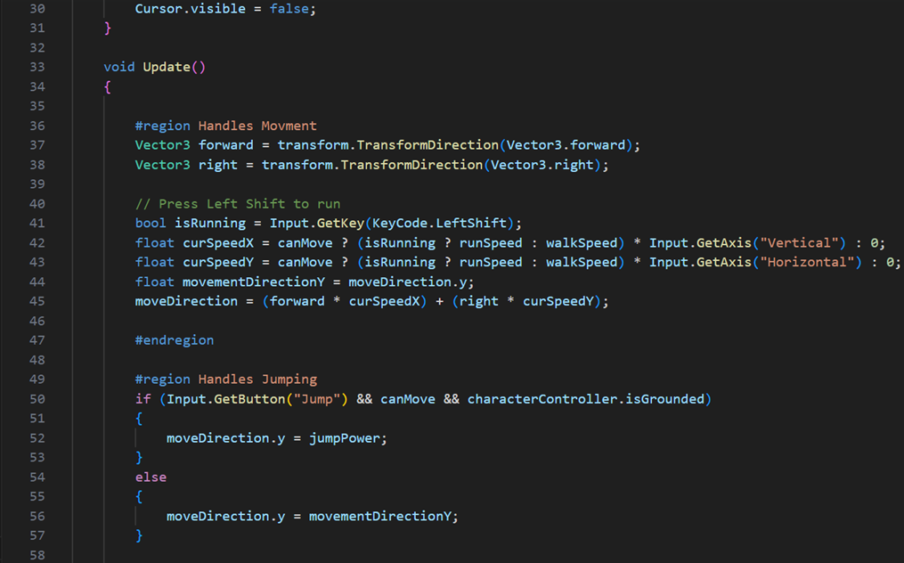
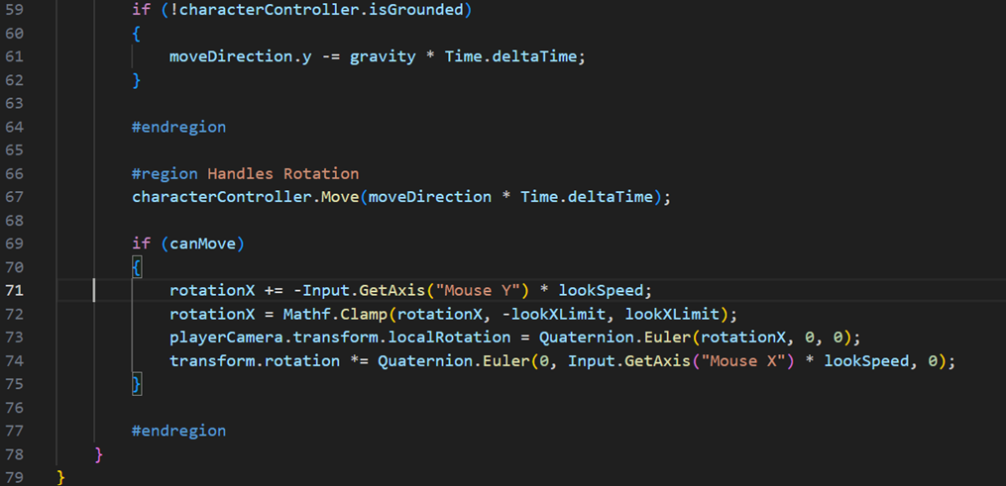
C# SCRIPT TO CREATE AN FPS CONTROLLER

Slide 4
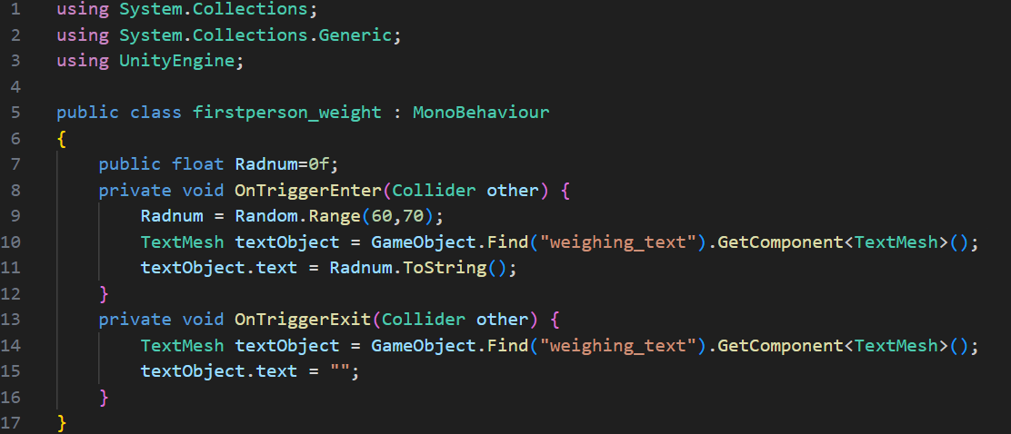
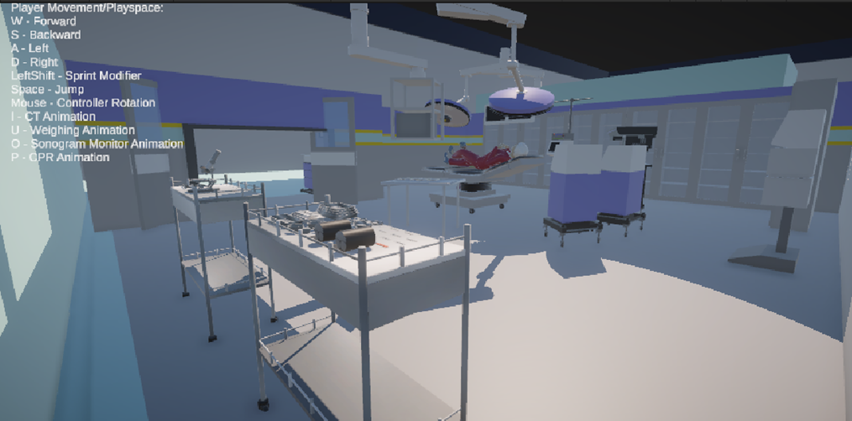
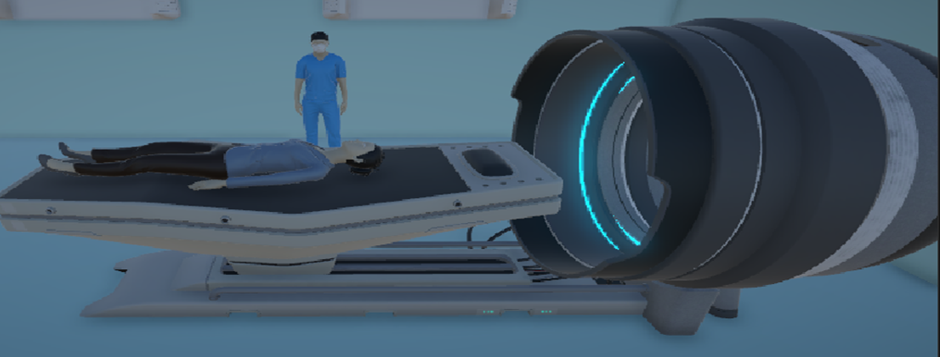
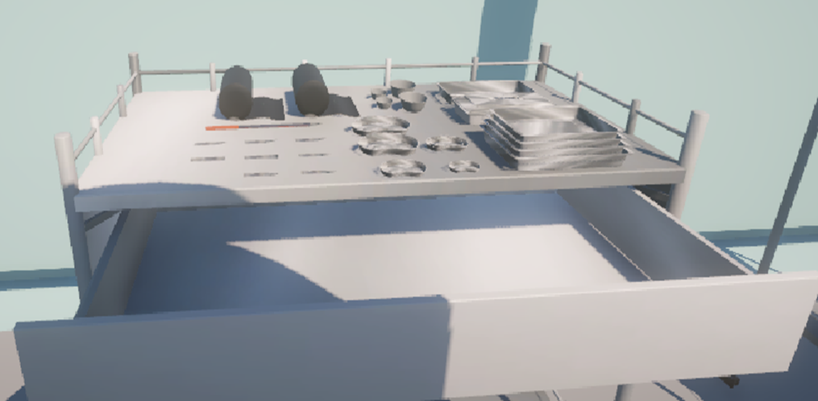
c) Adding a Box Collider to our Weighing Machine
Interactive Weighing Machine
Select the Weighing Machine GameObject and add the Box Collider Component. Select the isTrigger option.
Write a C# Script to add a Trigger. Add this Script as a component under Weighing Machine GameObject
Hit the Play button
Operation Theatre
CT Scan Animation
Interactive Draw

Slide 5
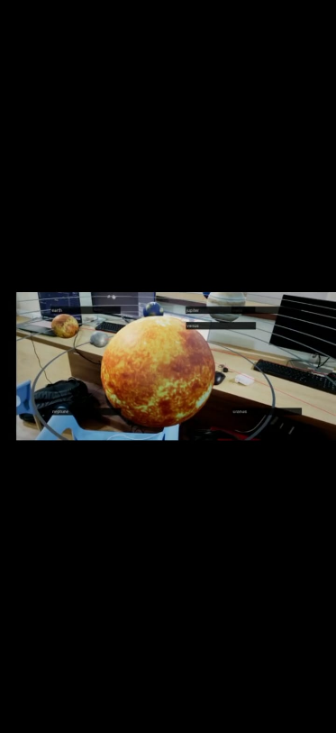
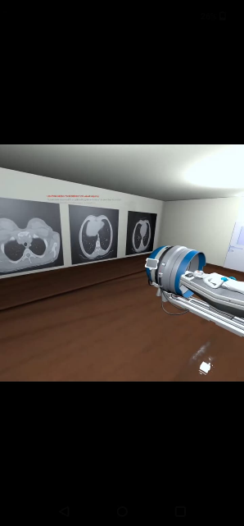
UNREAL – AR/VR Projects
AR Project
Create a new blueprint actor
Add a Static Mesh Component
Start the AR Session
Create a Material Interaction Event
Create Material Display Functionality
Compile and Save
VR Project
Create a new blueprint actor
Add a Static Mesh Component
Import Assets
Add a Level Sequencer
Create Material Display Functionality
Compile and Save

Slide 6
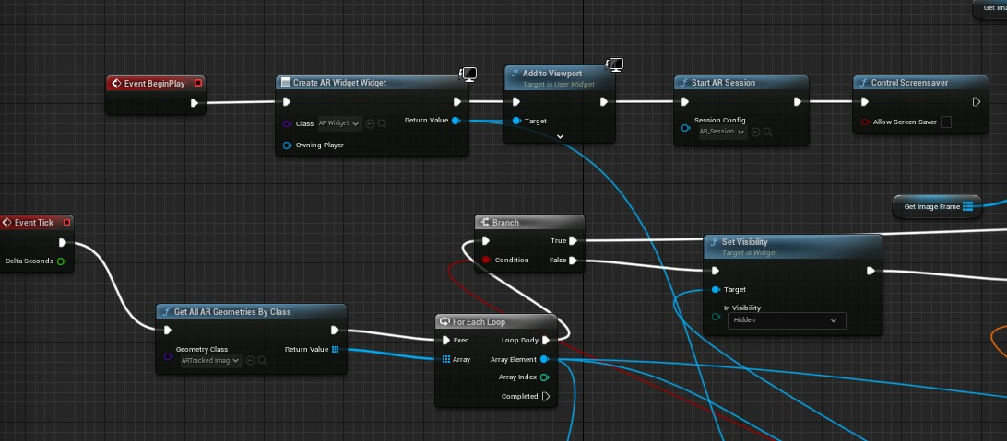
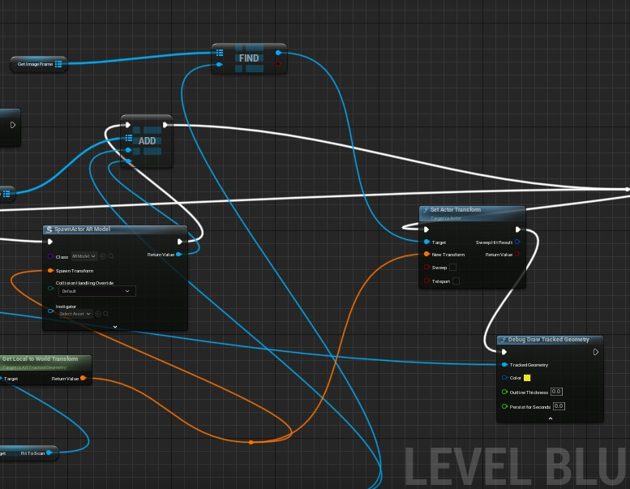
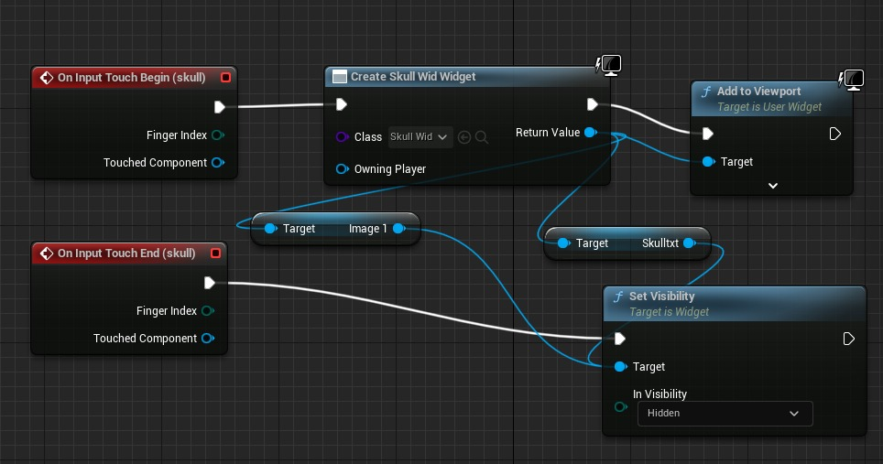
TRIGGERING AN AR SESSION
Displaying a Widget on Input Touch Begin

Slide 7
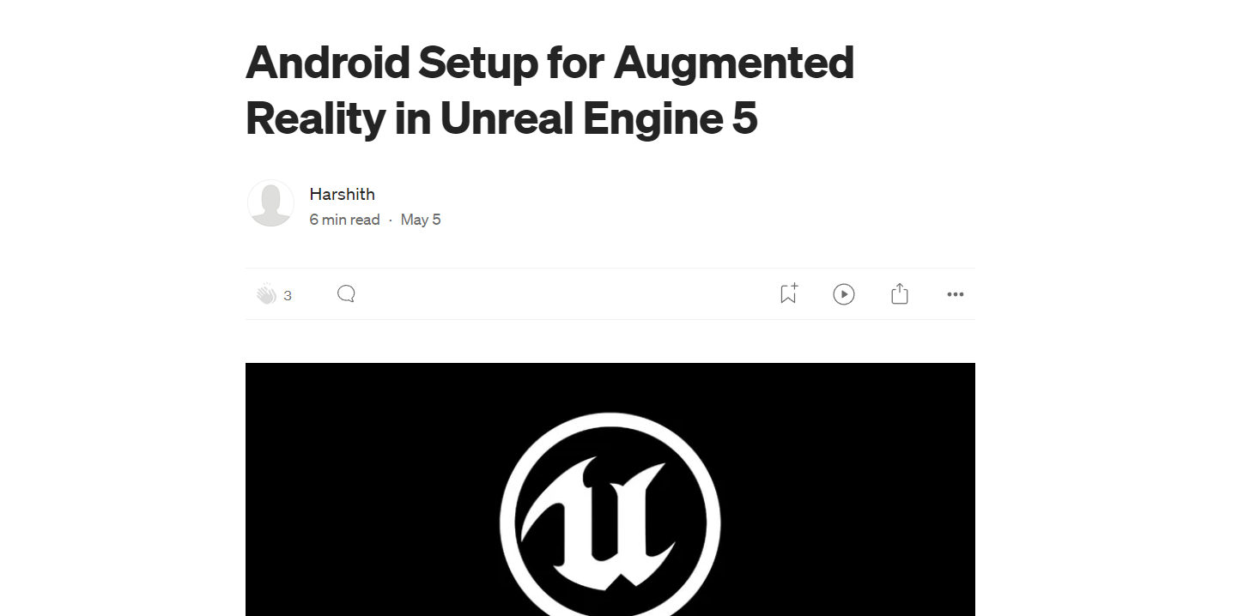
Contribution:

