Slide 1
BasicFlow: Lightweight SteadyFlow-Based Video Stabilization
Arnav Sharma (2023111033) Harshith Seera (2023101064)
CS7.404 Digital Image Processing
BasicFlow

Slide 2
Introduction & Problem Statement
Videos often suffer from jitter, wobble, parallax effects, and distortions due to handheld motion or scene depth changes.
Video stabilization aims to correct these issues by estimating camera motion and producing a smoother visual trajectory between frames.
SteadyFlow achieves high-quality stabilization by creating a spatially coherent optical flow, allowing us to smooth pixel profiles rather than feature trajectories.
Our method, BasicFlow, provides a lightweight alternative by using RAFT flow, simple spatial masking, and efficient temporal smoothing.
BasicFlow

Slide 3
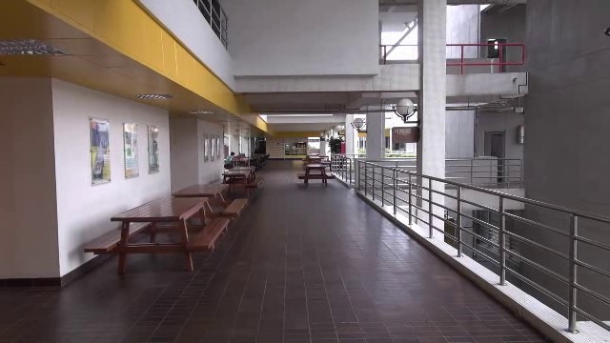

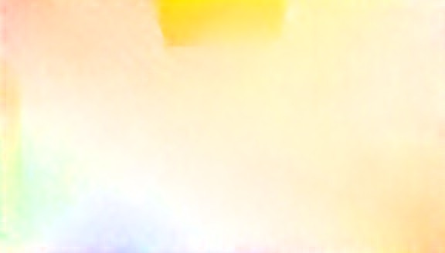
Optical Flow
Optical Flow describes the apparent motion of pixels between two consecutive video frames. It provides a 2D motion vector (u, v ) at each pixel, indicating how that pixel has moved.
Original Frame
Initial Optical Flow
BasicFlow
BasicFlow

Slide 4
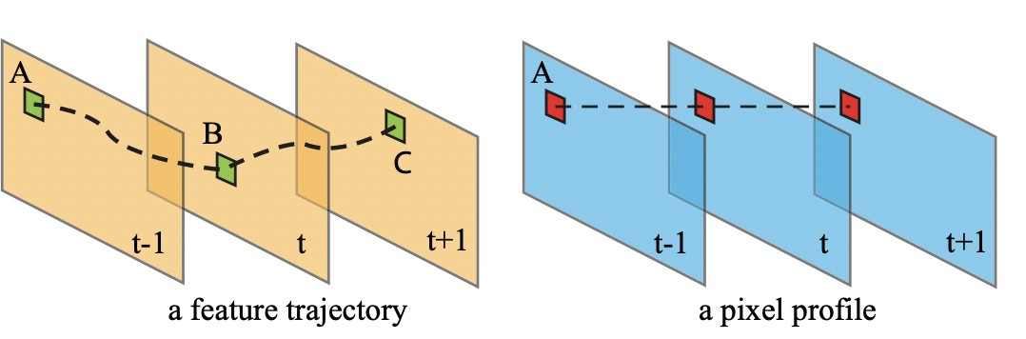
Feature Trajectories vs Pixel Profiles
Feature trajectories track the motion of specific feature points across frames, but can break if features disappear or move out of view.
Pixel profiles track the motion at the same pixel location over time, providing dense and stable information for every pixel.
BasicFlow

Slide 5
Traditional Methods & Their Limitations
Traditional stabilization uses global 2D models like affine or homography to approximate camera motion.
These models assume the entire scene moves rigidly, which fails in the presence of depth variation or parallax.
Feature-based tracking can be unreliable when features disappear, drift, or become unevenly distributed.
Dynamic objects introduce inconsistent motion that global models cannot represent.
As a result, traditional methods often produce wobble, distortion, or over-smoothing in complex scenes.
BasicFlow

Slide 6
SteadyFlow
SteadyFlow is a dense-flow video stabilization method designed to handle spatially-varying motion such as parallax and depth changes.
Instead of relying on sparse feature trajectories, it analyzes pixel-wise motion across time using pixel profiles.
The core idea is to build a spatially smooth optical flow field and then temporally smooth each pixel’s motion to obtain a stable camera path.
BasicFlow

Slide 7
SteadyFlow: The Process
Initialization: Estimate dense optical flow and a global homography to capture coarse camera motion.
Discontinuity Identification: Detect unreliable flow regions using spatial gradients and temporal inconsistency.
Motion Completion: Fill in missing or inconsistent flow using
mesh-based as-similar-as-possible warping to enforce spatial smoothness.
Pixel Profile Stabilization: Build motion profiles for each pixel across time and smooth them using temporal optimization.
Iterative Refinement: Repeat discontinuity detection and completion until the flow field becomes stable.
BasicFlow

Slide 8
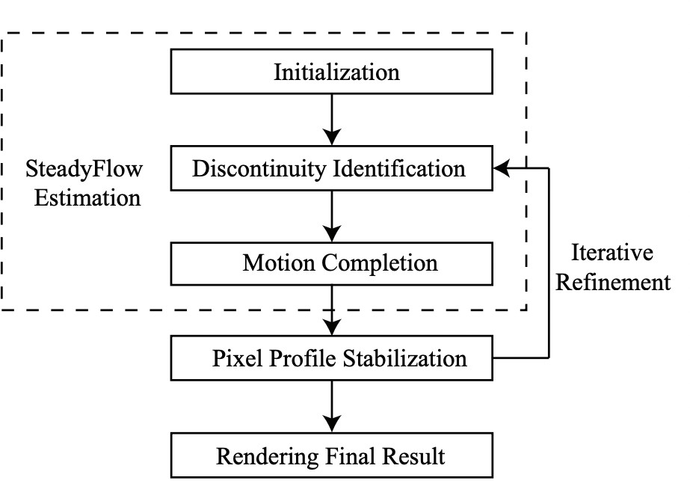
SteadyFlow Pipeline
Iteratively refines discontinuous flow into a smooth field. Stabilizes the video by smoothing pixel motion profiles.
BasicFlow

Slide 9
MeshFlow
MeshFlow is a lightweight, online video stabilization method that replaces dense flow with a sparse mesh-based motion model.
Instead of computing dense pixel motion, it tracks sparse features and propagates their motion to mesh vertices.
Two median filters remove outliers and enforce spatial smoothness across the mesh.
It avoids SteadyFlow’s heavy flow refinement and ASAP motion completion.
Predicts stabilization strength using PAPS (Predicted Adaptive Path Smoothing), removing the iterative search used by SteadyFlow.
BasicFlow

Slide 10
Smoothing Formulas
SteadyFlow
!
Σ
Σ
E (P) =
2
2
P(t) − C (t) + λ w
P(t) − P(r )
t t,r
t
r
MeshFlow (PAPS)
(1) (2)
λ = max 0, min(λ , λ )
t
t t
λ⁽¹⁾ = −1.93 Tv + 0.95, λ⁽²⁾ = 5.83 Fa + 4.88
t t
PAPS predicts the same smoothing weight λt used in the SteadyFlow energy, but estimates it directly from translation magnitude (Tv ) and affine deformation (Fa), instead of performing SteadyFlow’s slow iterative search.
BasicFlow

Slide 11
What is BasicFlow?
BasicFlow is a lightweight stabilization pipeline we developed, combining ideas from SteadyFlow and MeshFlow with modern deep optical flow.
Uses RAFT (Recurrent All-Pairs Field Transforms) to obtain dense, accurate optical flow. RAFT performs iterative refinement over an all-pairs correlation volume, giving very reliable flow even in low-texture or complex regions.
Instead of SteadyFlow’s heavy discontinuity analysis, BasicFlow applies a
simple spatial gradient mask to detect unreliable flow areas.
Replaces SteadyFlow’s ASAP motion completion with iterative diffusion
(selective blurring) to smooth and fill discontinuities.
Uses MeshFlow’s PAPS (Predicted Adaptive Path Smoothing) to choose smoothing strength λ_{t} without iterative search.
Produces the final stabilization by smoothing per-pixel motion profiles, similar in spirit to SteadyFlow but far more efficient.
BasicFlow

Slide 12
BasicFlow: Pipeline
Dense Optical Flow (RAFT) Compute high-quality dense optical flow between consecutive frames using RAFT with padding + cropping.
Discontinuity Detection Compute Sobel gradients of the flow. Mark pixels with large gradient magnitude as unreliable (spatial mask).
Motion Completion via Diffusion Run several iterations of selective blurring. Only update pixels inside the discontinuity mask → smooth, hole-free flow.
Pixel Profile Construction Accumulate cleaned flows over time to build motion profiles C (t) for every pixel.
Homography-Based Weight Estimation Compute homographies between frames. Derive smoothing weights λt from translation and affine components.
Pixel Profile Smoothing (Jacobi Iteration) Iteratively smooth each pixel’s temporal motion profile to obtain stabilized motion trajectories P(t).
Frame Warping and Output Compute warp fields from P(t) − C (t), warp each frame, crop borders, and write the stabilized video.
BasicFlow

Slide 13
BasicFlow: Deviations from Literature
No temporal outlier detection SteadyFlow uses spatial and temporal discontinuity checks; BasicFlow uses only a one-pass spatial gradient threshold.
No ASAP motion completion SteadyFlow fills holes via a large sparse linear solve (ASAP warping); BasicFlow replaces this with simple iterative diffusion (selective blurring).
Lambda estimation from MeshFlow (PAPS) SteadyFlow searches iteratively for the best λt ; BasicFlow directly predicts it using MeshFlow’s regression model.
Dense deep flow from RAFT Removes reliance on sparse feature tracking (MeshFlow) or classical flow (SteadyFlow).
Simplified, linear pipeline No iterative refinement, no heavy optimization →
significantly faster in practice.
BasicFlow

Slide 14
Performance Metrics
Stability Score Measures how well the output video suppresses unintended camera shake. Higher values indicate smoother global motion.
Distortion Score Evaluates geometric faithfulness of the stabilized video. Penalizes warping artifacts, local stretching, and shape deformation.
Cropping Ratio Represents how much of the original frame content is retained after stabilization. Higher ratios mean less cropping and better field-of-view preservation.
BasicFlow

Slide 15
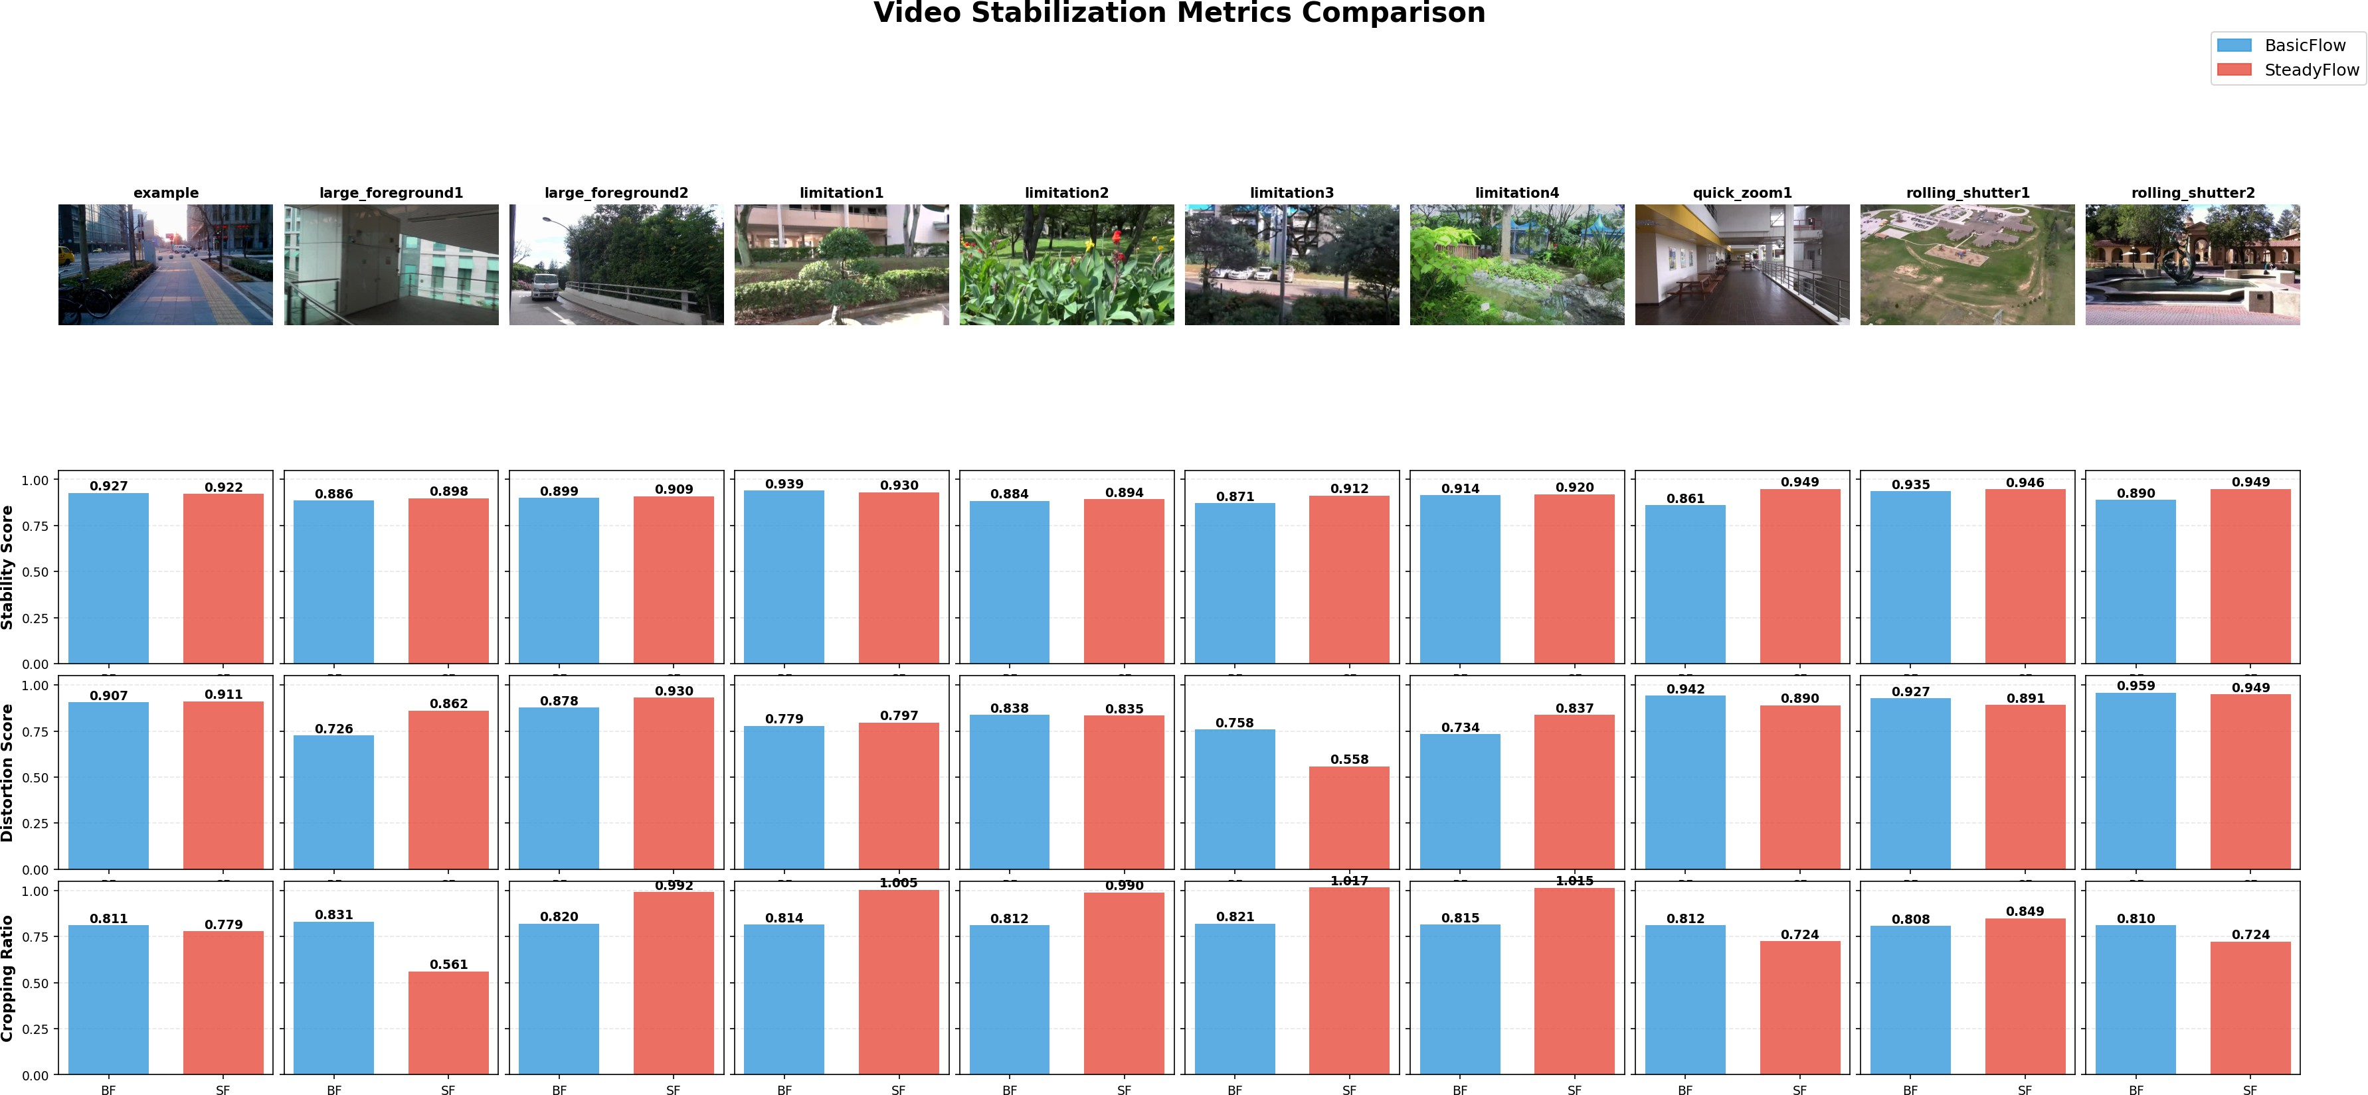
Metrics Comparison
BasicFlow achieves similar or better performance across most videos, particularly in sequences involving large foreground motion, while maintaining comparable stability, lower distortion, and strong cropping ratios.
BasicFlow

Slide 16
Dominating Foreground
Link:
https://youtu.be/1FxWuKNQEiM
BasicFlow

Slide 17
Quick Zoom
Link:
https://youtu.be/n95WHZevxD8
BasicFlow

Slide 18
Rolling Shutter
Link:
https://youtu.be/QkzGF9ZRE0I
BasicFlow

Slide 19
All Comparisons
Link:
https://www.youtube.com/playlist?list=PL2gpCaN0OukK0CCQrF3CXxn65Ktbnit_8
BasicFlow

Slide 20
Issues Addressed by BasicFlow
High computational cost in SteadyFlow Replaces ASAP warping + iterative refinement with simple diffusion and predicted smoothing (PAPS), making the pipeline much faster.
Brittleness of feature tracking in MeshFlow Uses dense RAFT optical flow instead of sparse features, avoiding failures in low-texture or uneven regions.
Latency from iterative parameter search Removes SteadyFlow’s iterative search for λ_{t} ; BasicFlow predicts it instantly through MeshFlow’s PAPS model.
BasicFlow

Slide 21
Thank You!
Questions?
BasicFlow

