Slide 1
Comparative 3D Depth Rendering System
Z-BUFFER
Test depth at every pixel
VS
PAINTER'S
Sort far to near, then overwrite
Z-Buffer vs Painter's Algorithm for real-time 3D rendering
Computer Graphics Microproject | IT (AR/VR) | Harshith S
Notes:
Introduce the project: we built a Python application that renders the same 3D scenes with two different hidden-surface algorithms, Z-Buffer and Painter's, side by side, and measures how they behave.

Slide 2

The problem: what is visible?
A 3D scene is projected onto a flat 2D screen.
Many surfaces land on the same pixel.
The renderer must pick the nearest one. This is hidden surface removal.
A wrong choice makes objects look inside-out or cut through each other.
Far
Middle
Viewer
Near
Z-Buffer and Painter's Algorithm answer this question in very different ways.
One pixel, three competing surfaces. Which one is drawn?
Notes:
Explain that the screen is 2D, so several triangles can cover the same pixel. Visibility algorithms decide which one wins. If we get it wrong, the image looks physically impossible.

Slide 3



Project objective
Compare
Demonstrate
Measure
Contrast how Z-Buffer and Painter's Algorithm resolve visibility for the same scene.
Render identical 3D scenes side by side in a live, interactive Python window.
Track frame time, overdraw, memory use and pixel errors for each algorithm.
Key idea: both algorithms share one rasterizer, so any difference we see comes only from how they handle visibility.
Notes:
Three goals: compare, demonstrate, measure. Stress the fairness: both panels use the same triangle-filling code, so only the visibility method differs.

Slide 4


Z-Buffer algorithm
1
2
3
4
Clear buffers
Rasterize triangle
Depth test
Update
Colour buffer = background. Depth buffer = infinitely far.
Find every pixel the triangle covers.
Compare this pixel's depth with the stored depth.
If nearer, write colour and new depth. Otherwise discard.
Strengths
Costs
Correct for any triangle order
Handles intersections and cycles
No sorting needed
Extra depth buffer (300 KB at 320x240)
A depth test for every covered pixel
We store 1/z so depth stays perspective-correct
Notes:
Walk through the four steps. Emphasise that the depth test happens per pixel, which is why intersecting objects come out right. Mention that we interpolate 1/z so depth is correct under perspective.

Slide 5




Painter's algorithm
Compute depth
Where it breaks
One depth per triangle: centroid or farthest vertex.
Intersecting objects: no triangle order is correct
Cyclic overlap: A over B over C over A
Overdraw: hidden pixels are still painted
Sorting cost grows with triangle count
Sort far to near
Order all triangles by depth, farthest first.
Paint in order
Nearer triangles overwrite farther ones. No depth test.
Notes:
Painter's works like a painter layering a canvas: far things first, near things last. It needs no depth buffer, but it decides visibility per triangle, so any case where no single order works produces errors.

Slide 6
System architecture
1 Scene
3 test scenes built from triangles
2 Transform & cull
Rotate, move to camera, drop back faces
3 Project & shade
Perspective divide and flat lighting
4 Shared rasterizer
Same NumPy triangle fill for both
Z-BUFFER PATH
Depth buffer plus a per-pixel test using interpolated 1/z.
PAINTER'S PATH
Sort triangles far to near, then overwrite. No depth buffer.
Metrics and display: frame time, overdraw, memory and % pixel error shown live in the Pygame window
Notes:
Walk the pipeline left to right. The first four stages are shared. Only the visibility step differs, which keeps the comparison fair. Metrics are computed every frame and drawn in the HUD.

Slide 7




Implementation in Python
Python 3
Key features
Core language for the whole model
Three test scenes, switch with keys 1, 2, 3
Rotate and tilt the scene, pause the motion
Toggle back-face culling and the Painter's sort key
Depth-map view of the Z-buffer
Screenshot key for poster images
Benchmark mode that exports CSV and a chart
NumPy
Vectorised rasterizer: barycentric coordinates and depth interpolation
Pygame
Real-time window, keyboard controls and live HUD graphs
Matplotlib
Benchmark charts for the poster and report
Notes:
List the tools and why each is used. NumPy does the heavy lifting in the rasterizer, Pygame gives the real-time interface, Matplotlib produces the benchmark chart. The whole model is one Python file.

Slide 8
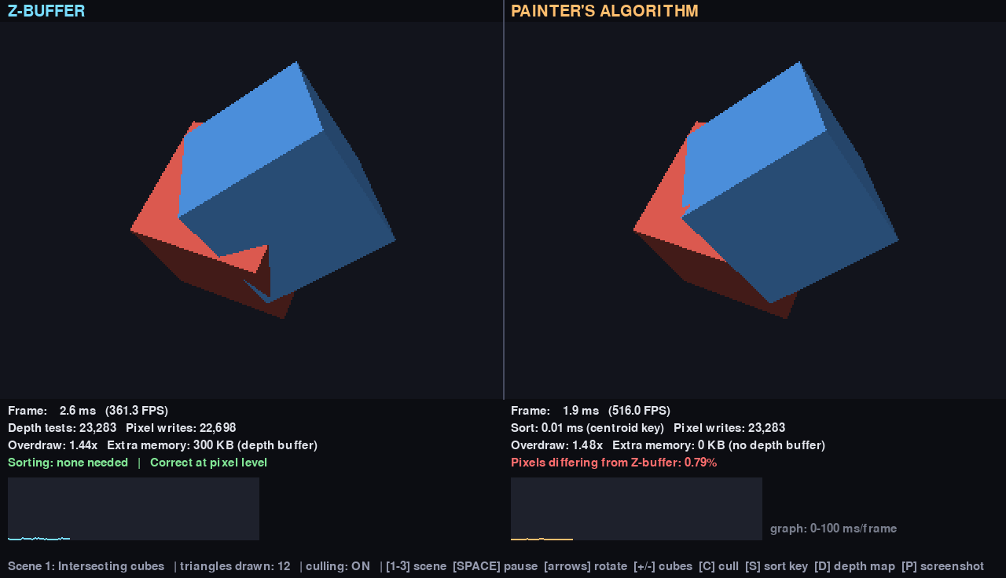
Test scenes and live output
1 Intersecting cubes
Two cubes pass through each other. About 1% of pixels are wrong in Painter's.
2 Cyclic overlap
Three bars, each in front of the next. No correct draw order exists.
3 Stress test
Random cubes, up to 150. Shows how cost scales with triangle count.
Scene 1 running live: Z-Buffer (left) and Painter's (right)
Notes:
Show the screenshot: on the left the Z-Buffer draws the true intersection of the cubes; on the right Painter's gets the intersection wrong. The red percentage in the HUD shows how many pixels differ from the Z-Buffer image.

Slide 9
Performance results
6.1%
of pixels wrong in Painter's at 444 triangles
3.3x vs 1.8x
overdraw: Painter's vs Z-Buffer at 444 triangles
300 KB
depth buffer the Z-Buffer needs at 320x240
Measured at 320x240 with a NumPy software rasterizer, back-face culling on.
Notes:
Painter's is a little faster per frame because it skips the depth test, but it does more wasted drawing (overdraw) and its error grows with scene complexity. Z-Buffer pays for a depth buffer and gets correct pixels. These numbers came from one benchmark run; re-run the benchmark mode on your own machine and replace them with your own results if they differ.

Slide 10
Comparison and conclusion
Criterion | Z-Buffer | Painter's
Visibility decision | Per pixel, using a depth buffer | Per triangle, using draw order
Intersections and cycles | Always correct | Fails (wrong pixels)
Sorting each frame | Not needed | Required
Extra memory | Depth buffer (300 KB here) | None
Overdraw (444 triangles) | 1.8x | 3.3x
Frame time (444 triangles) | 48.5 ms | 41.6 ms
Best suited for | Complex, real-time 3D scenes | Simple, non-overlapping layers
Conclusion: Z-Buffer is the robust general-purpose choice. Painter's is simpler and cheaper, but only reliable when objects never intersect or overlap in a cycle.
Notes:
Summarise the table, then give the conclusion: modern real-time engines use Z-buffering because correctness per pixel matters more than the extra memory. Painter's still teaches the core idea and works for simple layered scenes.

