Slide 1
PROJECT ONE
Adaptive
Focus Studio
Focus Studio
Deep Work
40 min
Focused
Scout
Offline-first focus sessions with explainable, user-controlled recommendations.
History
12 logs
TEAM BOOMERS
Harshit Jain • Parsh Jadon
CSC 6360 · Graduate Pathway
01

Slide 2
01 · PRODUCT
A study timer is easy. Building a repeatable focus habit is not.
We designed the experience around planning, completing, and learning from focus sessions.
FRICTION
DESIGN GOAL
OUTCOME
Too much setup
Local by default
One continuous loop
Students should not need accounts, cloud sync, or a complicated workflow just to focus.
Presets, session history, settings, insights, and helper logic remain available offline.
Plan → focus → finish → review → use recent history to plan the next session.
INPUTS
label · mood · duration · session actions · settings
OUTPUTS
presets · logs · insights · Session Scout suggestion
02

Slide 3
02 · EXPERIENCE
Five screens. One focused workflow.
The presentation demo follows the same path a student would use in the app.
01
02
03
04
05
Dashboard
Preset Editor
Focus Session
History
Settings
→
→
→
→
Choose a preset
Create / edit
Run the timer
Review results
Personalize
OFFLINE-FIRST CORE FLOW
SQLite records • SharedPreferences settings • no cloud backend required
03

Slide 4
03 · LIVE DEMO
Preset catalog + validation
Create, edit, validate, save, and return to a refreshed dashboard.
LIVE DEMO
Dashboard
Create Preset
I1
Reusable UI
Deep Work
40 min
Label
required
Preset cards render consistent data; form/timer interactions use mutable state.
Exam Prep
25 min
Mood
Focused
I2
State → validation → render
Quick Focus
15 min
Duration
40 min
Form values are transient until Save; persisted preset data then refreshes the dashboard.
SHOW, DON’T TELL
Enter one invalid value → show feedback → correct it → Save.
04

Slide 5
04 · CORE WORKFLOW
A timer that logs exactly once
The session state is separated from the UI so pause, reset, navigation, and finish remain predictable.
Focus Session
READY
→
RUNNING
→
PAUSED
→
FINISHED
40:00
READY
Start · Pause
Resume
RIVERPOD
SAFETY
State outside the widget
No duplicate logs
Finish
creates 1 log
The screen reacts to timer state and sends user actions to the provider.
Finish creates the SessionLog once; reset remains a separate action.
LIVE
Start → Pause → Resume → Finish → verify in History
05

Slide 6
05 · ENGINEERING
Clean boundaries make the app easier to test and change
A1 + A3: UI renders state; Riverpod coordinates; repositories and services own data work.
UI
STATE
DOMAIN
DATA
Screens · reusable widgets
→
Riverpod · timer · DI
→
Session Scout · insights
→
Repositories · local services
LOCAL STORAGE
SQLite: FocusPreset + SessionLog
SharedPreferences: settings
VS CODE
Show one provider + one repository call. Do not scroll through entire files.
06

Slide 7
06 · DATA LAYER
Structured records where they belong. Lightweight settings where they belong.
Parsh section · D1 / D2 / D3
SQLITE
SQLITE
SHARED PREFERENCES
FocusPreset
SessionLog
Settings
id · label · moodTag · plannedSeconds
CRUD through repository interfaces; presets drive the session workflow.
id · presetId · startedAt · completedSeconds · mood snapshot · status · source · note
Default duration
Session reminders
Sound
Restored after relaunch.
INVALID INPUT / CONSTRAINT
Reject inconsistent data → show feedback → let the user recover.
07

Slide 8
07 · SMART HELPER
Session Scout is explainable by design
R4 · Rule-based helper, not machine learning.
1
2
3
4
5
Mood
→
History
→
Median
→
Clamp
→
Apply
Selected mood tag
3 most recent FINISHED matches
completed minutes
10–60 minutes
prefill only
NO-DATA STATE
BASELINE
USER CONTROL
“Not enough history.”
Fixed 25 minutes
Edit before saving
08

Slide 9
08 · EVALUATION
Same five held-out cases. Two methods.
Fixed synthetic evaluation cases, separate from normal development examples.
RESULT
BASELINE
1.20 min
9.20 min
Session Scout MAE
Fixed 25-minute MAE
HEAD-TO-HEAD
5 / 5
Scout had lower absolute error in every evaluation case.
LIMITATION
Small synthetic evaluation ≠ real-world predictive accuracy.
09

Slide 10
09 · GRADUATE FEATURES
Advanced features that support the product, not distract from it
Riverpod
compute()
Notifications
state + DI
background insights
session complete
File export
Animations
Offline
local summary
implicit + explicit
core workflow
PHYSICALLY VERIFIED ON ANDROID
notification · export · persistence · offline flow · release APK
10

Slide 11
10 · QUALITY
Evidence across unit, widget, integration, and device testing
T1 + T3
50
30.07%
1
APK
automated tests passing
measured coverage
end-to-end integration flow
release tested on Android
UNIT
WIDGET
INTEGRATION
DEVICE
Scout + repositories
UI behavior
focus workflow
offline + persistence
SECOND DEVICE
Separate Android acceptance evidence completed by Parsh.
11

Slide 12
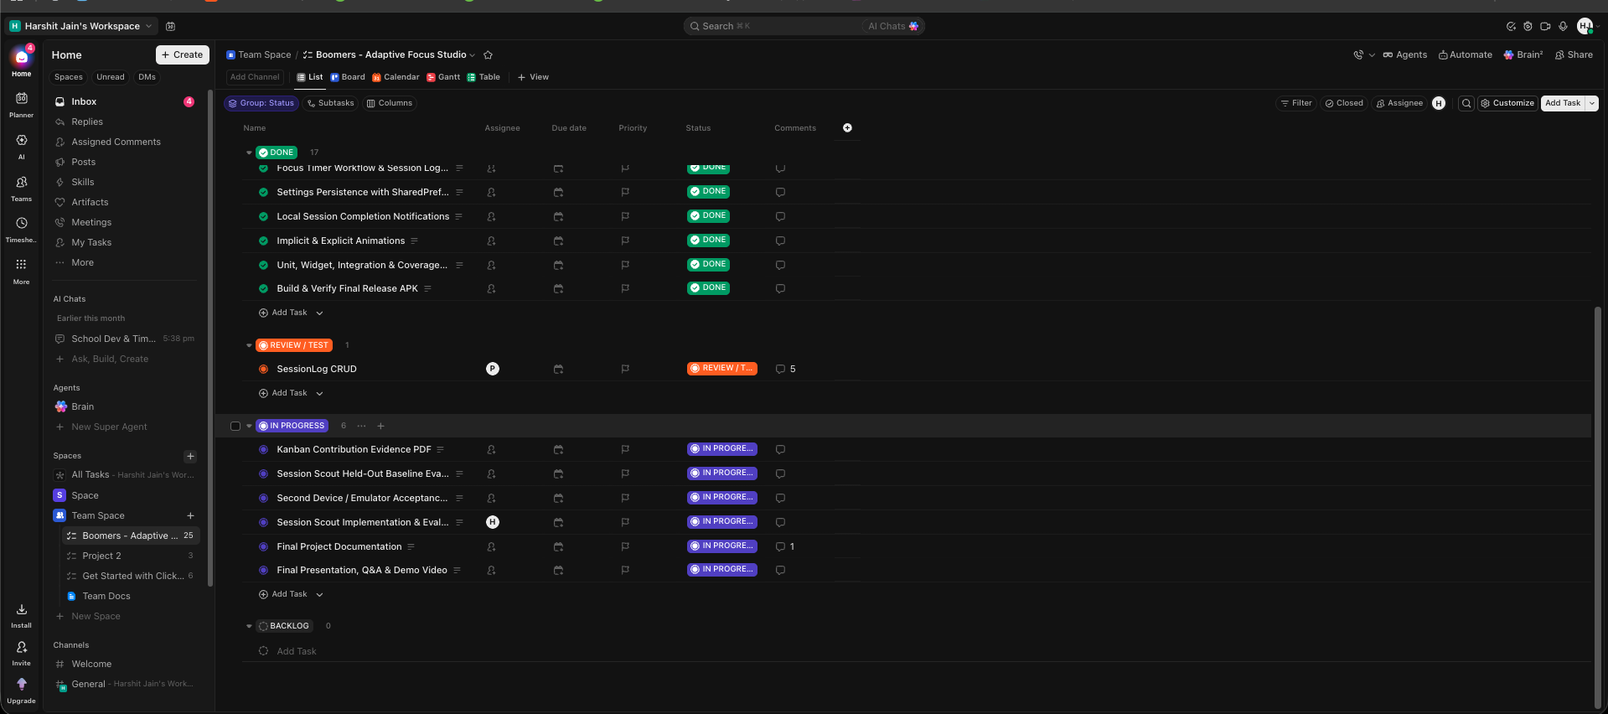
11 · COLLABORATION
Tasks → commits → tests → review
R1 · ClickUp and GitHub provide traceability, not just activity counts.
58
Harshit commits
28
Parsh commits
TRACE EXAMPLE
Session Scout task → commits → tests
12

Slide 13
12 · REFLECTION
What we would improve next
We kept the limitations visible instead of hiding them behind the demo.
LIMITATION 01
LIMITATION 02
NEXT ITERATION
Only 3 recent matches
Small synthetic evaluation
Evaluate with real usage
The helper is intentionally simple. A short unusual period can influence the recommendation.
Five held-out cases satisfy the comparison requirement, but they do not establish real-world accuracy.
Use a larger local dataset while keeping explanation, override, privacy, and offline behavior.
DESIGN PRINCIPLE
More intelligence should never remove user control.
13

Slide 14
ADAPTIVE FOCUS STUDIO
Plan. Focus.
Learn. Repeat.
PROJECT CHECK
✓
5-screen workflow
✓
SQLite + settings
✓
Riverpod state
A complete offline workflow with local persistence, explainable recommendations, testing, and graduate-level Flutter features.
✓
Session Scout
✓
50 tests passing
✓
Release APK
Thank you
14

