Slide 1
CS102 PROJECT PRESENTATION
G1T2
Charis, Charlotte, Harshit, Yash, Yun

Slide 2
TABLE OF CONTENTS
01
03
05
PROJECT DEMONSTRATION AND LEARNING POINTS
PROJECT ARCHITECTURE
OPEN SOURCE LIBRARIES USED
02
04
CLIENT-SERVER COMMUNICATION
DESIGN PRINCIPLES

Slide 3
Project Architecture
Section 1

Slide 4
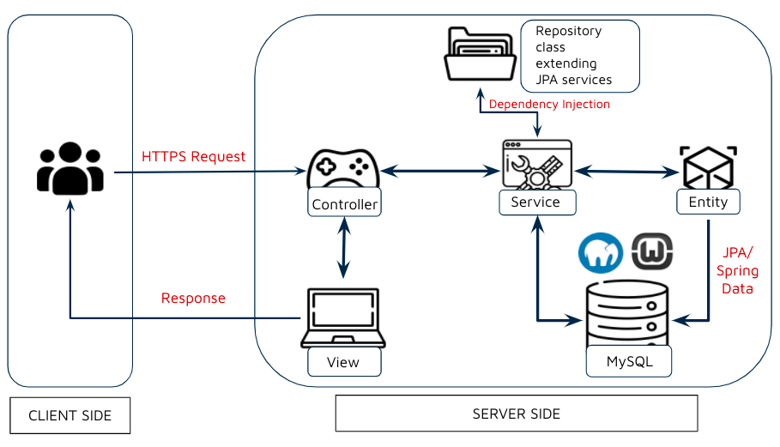
Spring Boot Flow Architecture

Slide 5
Client-Server Communication
Section 2

Slide 6
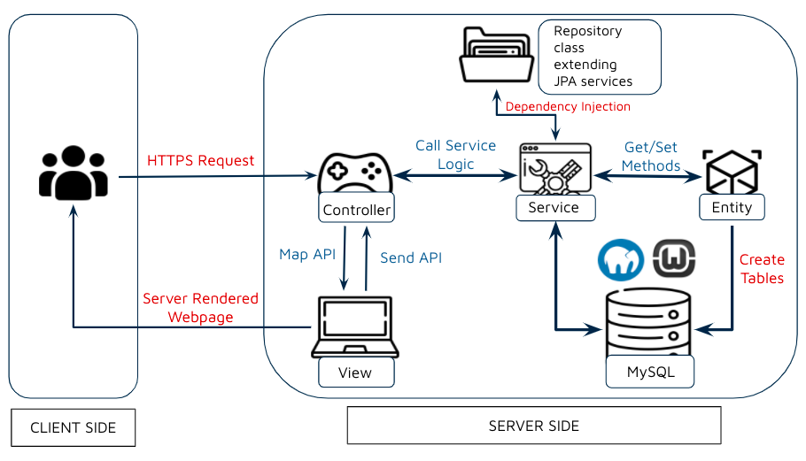
Client-Server Communication

Slide 7
Open-Source Libraries
Section 3

Slide 8


Open Source Libraries (Backend)
Spring framework
an application framework and inversion of control container for the Java platform
framework's core features can be used by any Java application, with extensions for building web applications on top of the Java EE platform
Apache Tomcat
an open-source implementation of the Java Servlet, JavaServer Pages, Java Expression Language and WebSocket technologies
provides a "pure Java" HTTP web server environment in which Java code can run

Slide 9



Open Source Libraries (Backend)
Gson
an open-source Java library to serialize and deserialize Java objects to JSON
Json
an open standard file format, and data interchange format, that uses human-readable text to store and transmit data objects consisting of attribute–value pairs and array data types
MySQL connector
Official JDBC driver for MySQL
Used to connect our java database to our MySQL database
Notes:
JDBC - java database connectivity
HTTP (Hypertext Transfer Protocol)

Slide 10


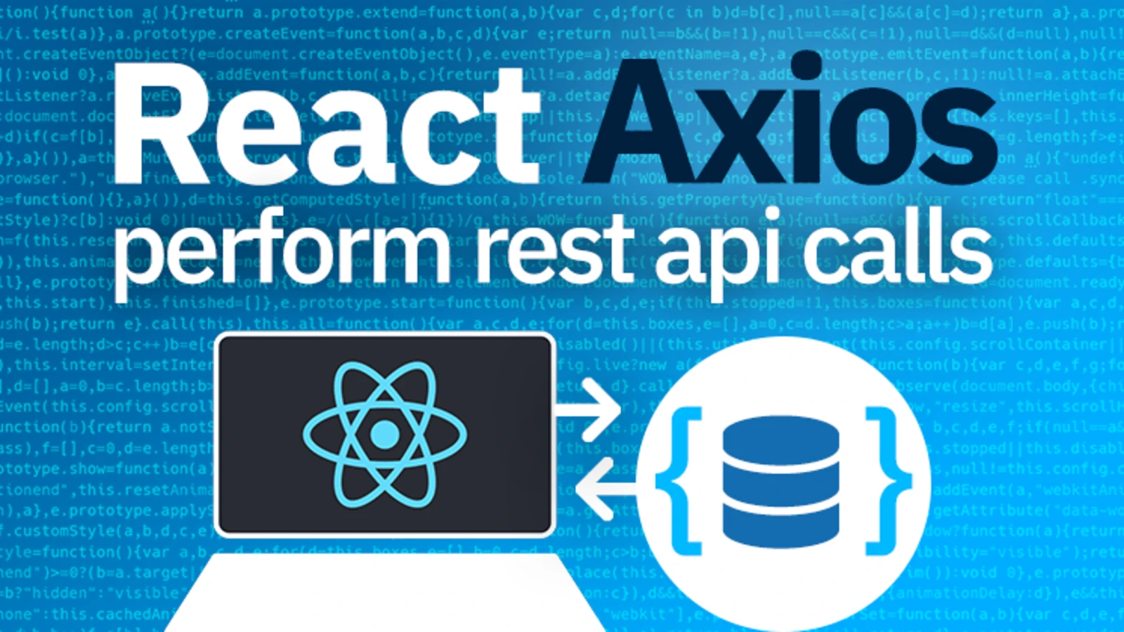
Open Source Libraries (Frontend)
Redux
a predictable state container designed to assist in writing JavaScript apps that behave consistently across client, server, and native environments
ReactJS
an open-source, front end, JavaScript library for building user interfaces or UI components
can be used as a base in the development of single-page or mobile applications
Axios
JavaScript library used to perform HTTP requests
Notes:
DOM - Document Object Model
axios
react-bootstrap
react-dom
react-table
redux

Slide 11

Open Source Libraries (Frontend)
React-BootStrap
React-Bootstrap replaces the Bootstrap JavaScript.
Used to theme and customise styles
React-table
Used to design our tables
React-DOM
used at the top level of our app and as an escape hatch to get outside of the React model when we need to

Slide 12
Design Principles
Section 4

Slide 13



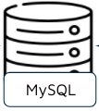
Application Layers
Presentation Layer
Authentication
JSON Translation
Business Logic
Validation
Authorisation
Business Layer
Persistence Layer
Storage
Database
Actual Database

Slide 14
Design Principles
Single Responsibility Principle
Every module, class or function should have should have a single part of the program’s functionality, and it should encapsulate that part.
Don’t Repeat Yourself Principle
Every piece of knowledge or logic must have a single, unambiguous representation within a system.

Slide 15
Design Principles
Open-closed Principle
Classes, objects and methods should be open for extension but closed for modification.
Chain-of-responsibility Principle
Each processing object contains logic that defines the types of command objects that it can handle; the rest are passed to the next processing object in the chain.

Slide 16
Project Demonstration
Section 5

Slide 17
Learning Points
Section 6

Slide 18
Learning Points
Challenges Faced
Learning Points
Integrating backend and frontend technologies to create a full stack web application
Debugging
Entirely new to Spring-boot and ReactJS
Importance of writing clean and maintainable code
Importance of compiling every file and running the program at every small checkpoint
Collaborating with the team
Independent learning and self-research
Notes:
integrating backend and frontend technologies to create a full stack web application

Slide 19
References
https://stackabuse.com/object-oriented-design-principles-in-java/
https://www.flaticon.com/search?word=pig
https://stackify.com/solid-design-principles/

Slide 20
QnA

