Slide 1
LibTinyML-C
A Modular Static and Shared Library for Benchmarking Quantized Edge-AI Algorithms
Mini Hackathon • Batch 09 • Team 7
Harshit Karnwal • Arnab Pranjal • Samiksha Frasi • Bhavya
Primary implementation & development: Harshit Karnwal • Presentation & demonstration: All four members

Slide 2
1. Problem & objective
Why quantized Edge-AI arithmetic matters
Edge devices have limited RAM, storage and compute resources.
FP32 values use 4 bytes; INT8 values use 1 byte.
Goal: build a reusable C library and measure memory, error and execution time instead of assuming performance.
FP32 → INT8
4× smaller inputs
Measured accuracy cost
Measured speed

Slide 3
2. What we built
College-standard modular C implementation
Public API: include/libtinyml.h
Modules: quantization, activation, matrix, benchmark
Static library: libtinyml.a
Shared library: .dylib on macOS / .so on Linux
Demo executable, CSV benchmark and 10 automated tests
Makefile commands: make, make test, make benchmark

Slide 4
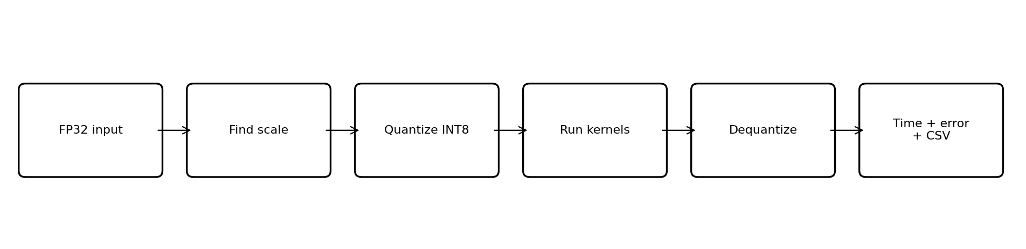
3. Program flow
Same data, two arithmetic paths, measurable comparison
Quantization happens before kernel timing, so FP32 and INT8 matrix operations are compared fairly.

Slide 5
4. Quantization logic
Symmetric INT8 mapping used in the library
scale = max(|x|) / 127
One shared scale per input array.
INT8 multiplication accumulates into int32_t to reduce overflow risk.
Dequantized output is compared against FP32 using MAE and maximum absolute error.
q = clamp(round(x / scale), −127, 127)
x̂ = q × scale

Slide 6
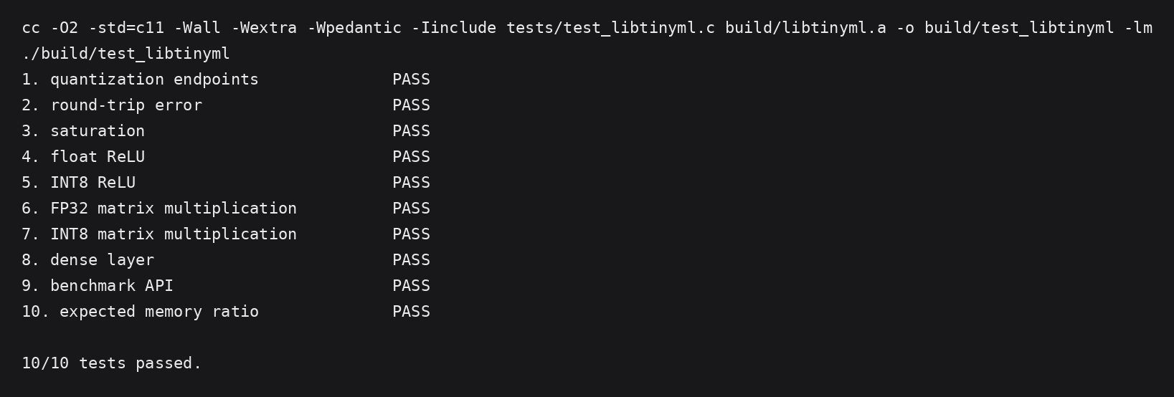
5. Automated verification
The implementation is tested before benchmarking
10/10 tests pass.
Tests cover quantization, saturation, ReLU, FP32/INT8 matrix multiplication, dense layer, benchmark API and memory ratio.

Slide 7
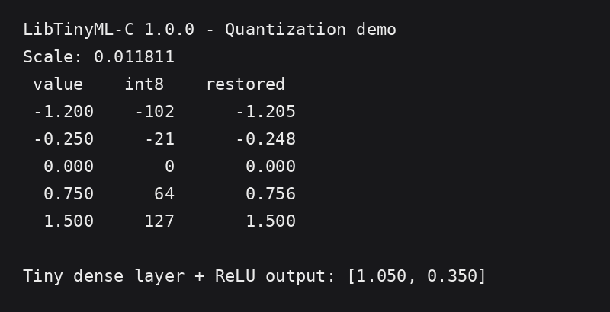
6. Demo output
Quantization and a tiny dense layer + ReLU

Slide 8
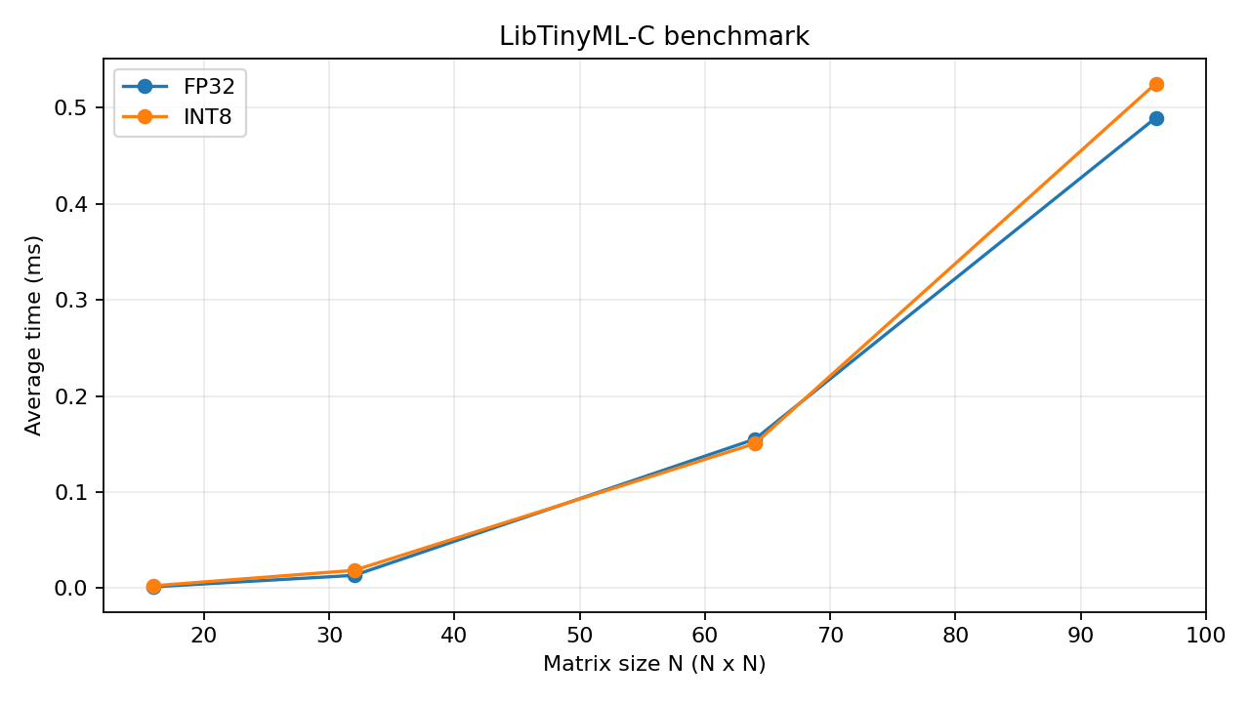
7. Benchmark results
Actual sample run from the build environment
INT8 inputs use 4× less memory than FP32.
MAE remained small in these synthetic matrix tests.
Scalar INT8 was not consistently faster than FP32; speed depends on CPU/compiler and optimized SIMD support.

Slide 9
8. C concepts demonstrated
Why this is more than a single C program
Modular compilation and header files
Structures and reusable APIs
Pointers, arrays and dynamic memory
Integer vs floating-point arithmetic
File I/O for CSV export
Static and shared library creation
Makefile automation and compiler warnings
Automated tests and command-line execution

Slide 10
9. Limitations & future scope
Claims are kept realistic and explainable
Current kernels are educational scalar C, not a production inference engine.
Synthetic matrices are used instead of a trained model dataset.
No ARM NEON/SIMD acceleration is implemented yet.
Future: NEON vectorization, per-channel quantization, convolution kernels and testing on an embedded board.
Key viva point: quantization guarantees the storage reduction here; speedup must be measured on the target hardware.

Slide 11
10. Conclusion
Submission-ready prototype
LibTinyML-C successfully turns the project idea into a reusable C library with static/shared builds, quantized arithmetic, tests, benchmarking and reproducible CSV results.
10/10 tests passed
4× input-memory reduction
Measured, not exaggerated
Thank you • Questions?

