Slide 1
Bootstrap
By-
Harshit Khandelwal IT35
Khushi Jaiswal IT40
Mahak Chauhan IT47

Slide 2
What is Bootstrap?
Bootstrap is a free and open-source CSS framework directed at responsive, mobile-first front-end web development. It contains HTML, CSS and JavaScript-based design templates for typography, forms, buttons, navigation, and other interface components.

Slide 3
Front-end framework: bootstrap is primarily A front-end framework, providing A set of pre-designed and pre-built html, css, and javascript components. These components can be easily integrated into web projects, allowing developers to create responsive and visually appealing websites or web applications. Responsive design: one of the main features of bootstrap is its emphasis on responsive design. The framework includes A responsive grid system and components that adapt to different screen sizes, making it easier to create websites that look good on various devices, from desktops to tablets and smartphones. Ease of use: bootstrap is known for its ease of use and quick development capabilities. By using predefined classes and components, developers can save time and effort in creating common design elements, allowing them to focus more on the functionality and unique aspects of their projects. Pre-designed components: bootstrap comes with A variety of pre-designed ui components such as navigation bars, buttons, forms, modals, carousels, and more. These components can be customized and combined to build consistent and aesthetically pleasing user interfaces.
FEATURES OF BOOTSTRAP

Slide 4
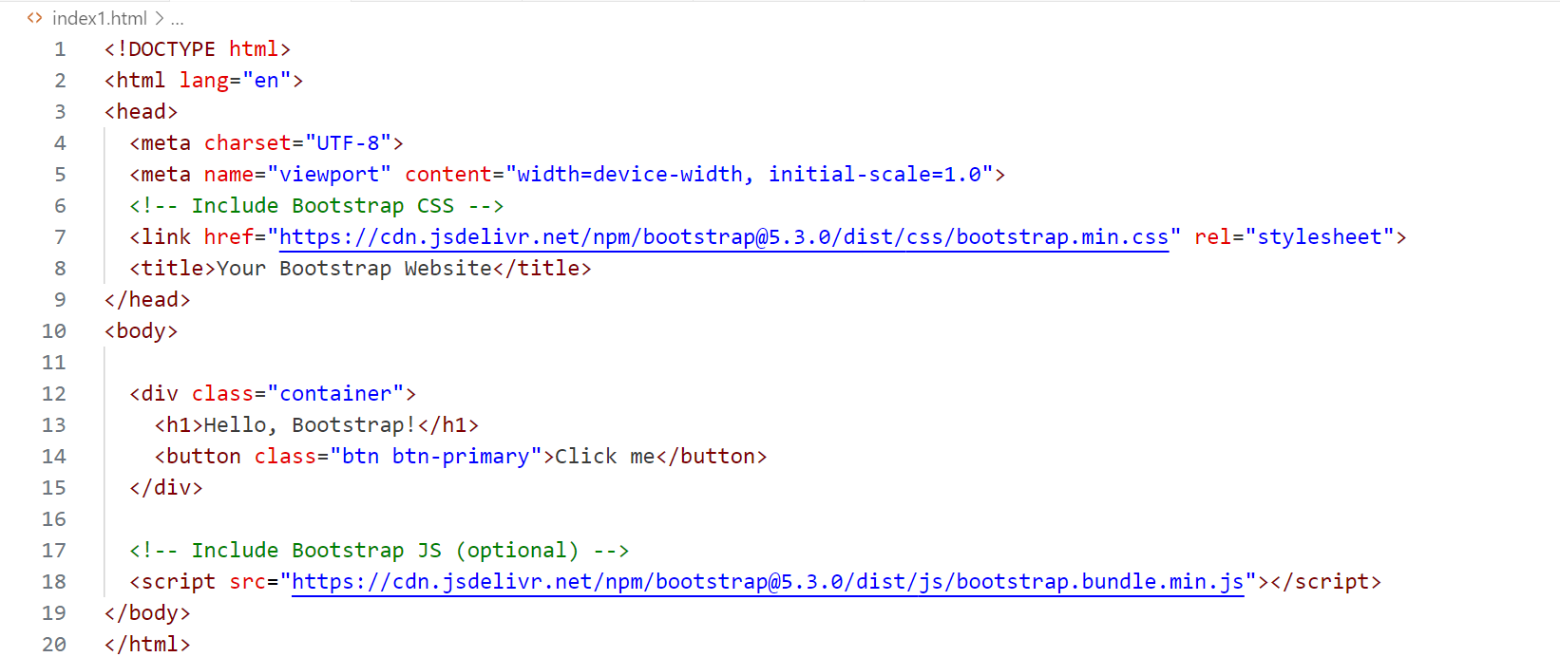
Here's a simple example of how you might include Bootstrap in an HTML file:l

Slide 5
Advantages of Bootstrap
Fewer Cross browser bugs
A consistent framework that supports major of all browsers and CSS compatibility fixes
Lightweight and customizable
Responsive structures and styles
Several JavaScript plugins using the jQuery
Good documentation and community support
Loads of free and professional templates, WordPress themes and plugins
Great grid system

Slide 6

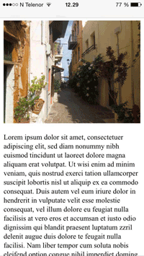
Viewport
The viewport is the user's visible area of a web page.
The viewport varies with the device, and will be smaller on a mobile phone than on a computer screen.
<meta name="viewport" content="width=device-width, initial scale=1.0">

Slide 7
BREAKPOINTS
Breakpoints are customizable widths that determine how your responsive layout behaves across device or viewport sizes in Bootstrap.
Breakpoints are the building blocks of responsive design. Use them to control when your layout can be adapted at a particular viewport or device size.
Use media queries to architect your CSS by breakpoint. Media queries are a feature of CSS that allow you to conditionally apply styles based on a set of browser and operating system parameters. We most commonly use min-width in our media queries.
Mobile first, responsive design is the goal. Bootstrap’s CSS aims to apply the bare minimum of styles to make a layout work at the smallest breakpoint, and then layers on styles to adjust that design for larger devices. This optimizes your CSS, improves rendering time, and provides a great experience for your visitors.

Slide 8
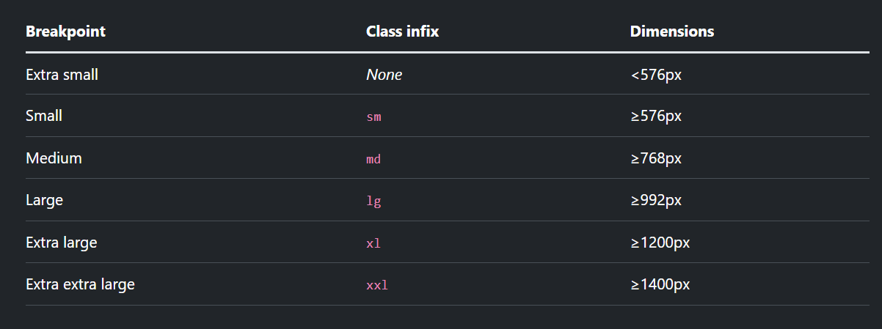
Available breakpoints

Slide 9
Containers
Containers are a fundamental building block of Bootstrap that contain, pad, and align your content within a given device or viewport.
Containers are the most basic layout element in Bootstrap and are required when using our default grid system. Containers are used to contain, pad, and (sometimes) center the content within them. While containers can be nested, most layouts do not require a nested container.
Bootstrap comes with three different containers:
.container, which sets a max-width at each responsive breakpoint
.container-{breakpoint}, which is width: 100% until the specified breakpoint
.container-fluid, which is width: 100% at all breakpoints

Slide 10
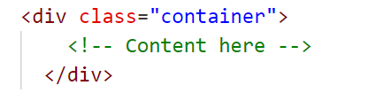
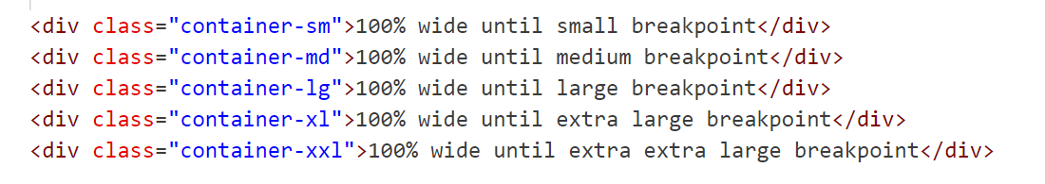
Default container Our default .container class is a responsive, fixed-width container, meaning its max-width changes at each breakpoint. RESPONSIVE CONTAINERS Responsive containers allow you to specify a class that is 100% wide until the specified breakpoint is reached, after which we apply max-widths for each of the higher breakpoints. For example, .container-sm is 100% wide to start until the sm breakpoint is reached, where it will scale up with md, lg, xl, and xxl.

Slide 11
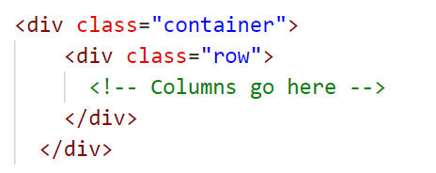
Grid SYSTEM
Bootstrap's grid system is a powerful layout system that allows developers to create responsive and flexible designs. The grid system is based on a 12-column layout, and it's used to organize content on a web page. Here are some key concepts of Bootstrap's grid system:
Rows: Inside the container, you create rows using the .row class. Rows are horizontal containers for columns.

Slide 12
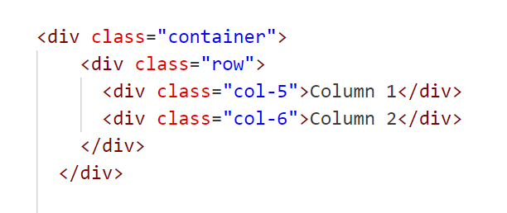
Columns: Columns are the building blocks of the grid system. You define the number of columns each element should span using classes like .col-, where the number represents the number of columns to span.

Slide 13
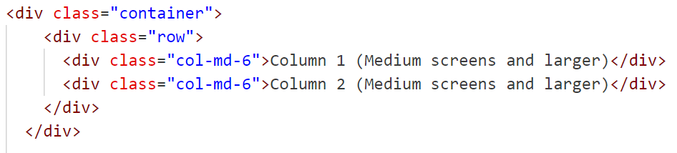
Responsive Classes:
Bootstrap provides responsive classes to control the layout at different screen sizes.
Classes like .col-sm-, .col-md-, .col-lg-, and .col-xl- can be used to define different column widths for small, medium, large, and extra-large screens.

Slide 14
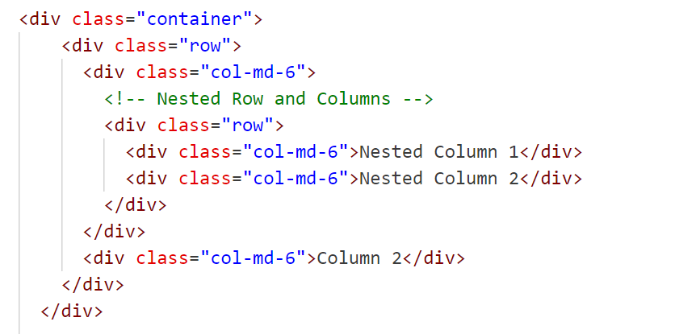
Nesting Columns:
Columns can be nested inside other columns to create more complex layouts.

Slide 15
Float
In Bootstrap, the ‘.float’ class was used to set the alignment of an element by floating it to the left or right within its containing element. However, as of Bootstrap 4, the ‘.float’ class has been replaced with the ‘.float-{breakpoint}-{direction}’ utility classes.
.float-{breakpoint}-{direction}: This class defines the float behavior at different breakpoints. ‘{breakpoint}’ can be ‘sm’, ‘md’, ‘lg’, or ‘xl’, and ‘{direction}’ can be ‘left’ or ‘right’.

Slide 16
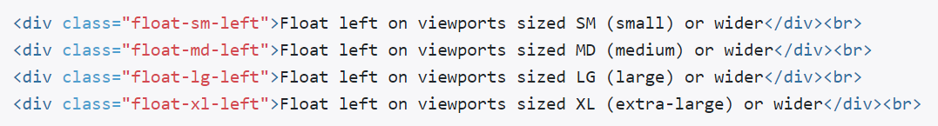
Responsive variations also exist for each float value.
{breakpoint} is the minimum viewport width at which the class takes effect. {direction} is the direction the element should float.
All the support classes of float are:
.float-left | .float-sm-left | .float-md-left | .float-lg-left | .float-xl-left
.float-right | .float-sm-right | .float-md-right | .float-lg-right | .float-xl-right
.float-none | .float-sm-none | .float-md-none | .float-lg-none | .float-xl-none

Slide 17
INTERACTIONS
Interactions is a utility class that controls how elements of a website are interacted with (how the user interacts with them). Utility classes like text selection and pointer events help to interact with the website.
TEXT SELECTION : Text selection helps us to change the way when a user tries to select the content displayed.
user-select-all: When this class is active the entire text will get selected.
user-select-auto: When this class is active user can select any amount of text.
user-select-none: When this class is active user cannot select any text.

Slide 18
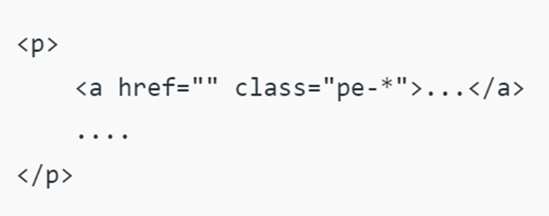
POINTER EVENTS : Pointer events in Interactions come with pe-none and pe-auto classes, to prevent or add element interactions.
pe-none: The pe-none class is used to prevent element interaction. If you use the pe-none class inside the anchor tag, the link will be not accessible.
pe-auto: This class helps to add the interactions with the pointer. Basically, this shows the default behavior. For example, if you use the pe-auto class inside the anchor tag, the link can be easily accessible.
Syntax:

Slide 19
Positions
Bootstrap facilitates different Position values, i.e. the top, right, bottom, and left property values which can be used to position an element. These define the separation between an HTML element and the viewport’s edge.
position-static: This class when added to an element sets its position to be static.
position-relative: This class when added to an element sets its position to be relative with respect to the elements on top of it.
position-absolute: This class when added to an element sets its position relative to the closest parent and it set its position absolute with that.
position-fixed: This class when added to an element sets its position to be relative with respect to the viewport and it will stay in the same place if the page is scrolled.
position-sticky: This class when added to an element sets its position either relative or fixed with respect to the scroll position.

Slide 20
Flexbox
Bootstrap utilizes Flexbox, a CSS layout model, to create responsive and efficient designs. Flexbox provides a more efficient way to lay out, align, and distribute space among items in a container, even when their size is unknown or dynamic.
How is Flexbox integrated and used in Bootstrap ?
Enabled by Default: Flexbox is enabled by default. This means that many of the Bootstrap components and grid system are built with Flexbox.
Responsive Grid System: Bootstrap's grid system uses Flexbox to provide a series of responsive, mobile-first flexbox containers, rows, and columns for layout purposes.
Utility Classes: Bootstrap provides a wide range of utility classes that leverage Flexbox.

Slide 21
Flex Containers: To define a flex container (d-flex, d-inline-flex).
Direction: To set the direction of flex items (flex-row, flex-row-reverse, flex-column, flex-column-reverse).
Justify Content: To align items horizontally (justify-content-start, justify-content-end, justify-content-center, justify-content-between, justify-content-around).
Align Items: To align items vertically (align-items-start, align-items-end, align-items-center, align-items-baseline, align-items-stretch).
Align Self: To individually align items (align-self-start, align-self-end, align-self-center, align-self-baseline, align-self-stretch).
Fill and Grow: To control the flex item sizing (flex-fill, flex-grow-0, flex-grow-1).
Wrap: To control the wrapping of items (flex-wrap, flex-nowrap, flex-wrap-reverse).

Slide 22
THANK YOU

Slide 23
QnA

