Slide 1

QA Tool
Krushil Gajjar & Team

Slide 2
Introduction
QA, or quality assurance, is part of the testing process that helps to ensure that the best possible product or service is delivered to end users. In the programming sense, we want to release a streamlined product with zero bugs. QA practices offer tools that help teams achieve the required level of software reliability.
Kindly find the following global URL for Qa Tool
http://192.168.0.39:8000/
In This Tutorial, we are going to demonstrate how to create a Rules Json for any project to validate respective files

Slide 3
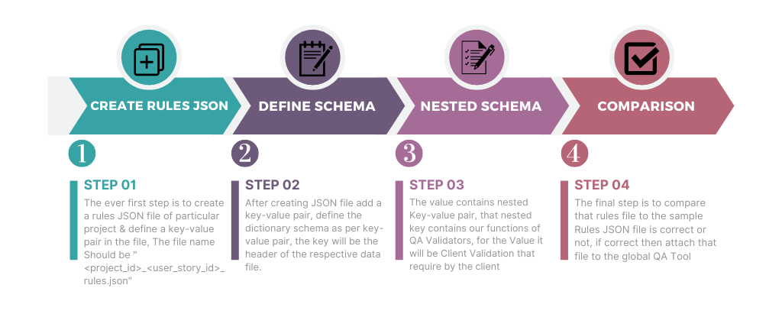
Process Flow Chart

Slide 4
How to create Rules Json
In This section, we are having a chunk of functions that needed to be applied in the Rules Json file
has_empty
data_type
data_length
depend_header
data_redundant
greater_than
less_than
in_between
double_depend
fix_header
date_format
other_depend
not_match_found
get_non_ld_indicesc
cell_contains
cell_value_start_end_with

Slide 5
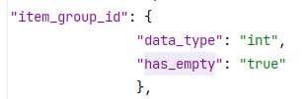
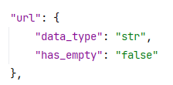
has_empty
This function finds blank values and gives the return ‘No’
has_empty (Exception)
This function finds blank values but blank values are considered in columns and gives the return ‘Yes(Warning)’.

Slide 6

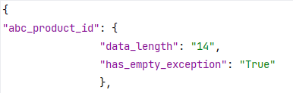
2. data_type
In this function check the headers data type if all headers rows contain the same data type which is given by the client then return verify yes.
3. data_length
In this function check header length if all header rows contain the same length which is given by the client then return verify yes.

Slide 7
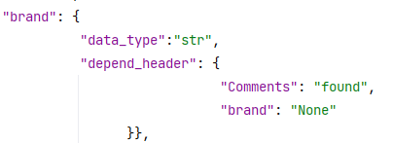
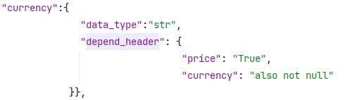
4. depend_header
In This function, it will check the header with the dependency of another header & validate it as condition

Slide 8
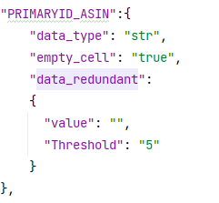
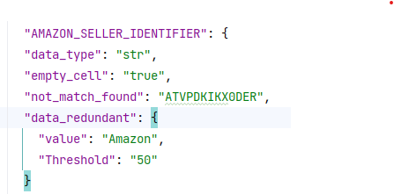
5. data_redundant
For checking duplicate values and finding percentages on the basis of a given threshold.

Slide 9
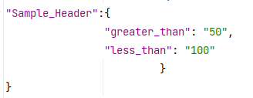
6. greater_than
In this function check the headers with greater value as the user define, if not then it returns verify “No”
7. less_than
In this function check the headers with lesser value as the user define, if not then it returns verify “No”

Slide 10
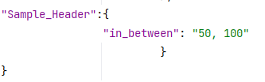
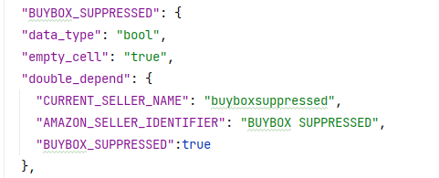
8. in_between
In this function check the headers with in between values as the user define, if not then it returns verify “No”
9. double_depend
This function checks dependent headers all header rows fulfill all rules which are given by the client than returns verify yes.

Slide 11
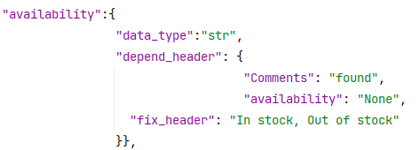
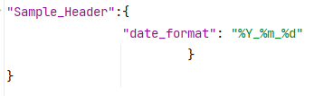
10. fix_header
Those headers have fixed datatype such as int, str, bool.
11. date_format
Check date format is in the correct form as per Rules Json.

Slide 12
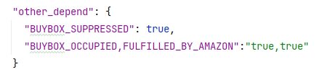
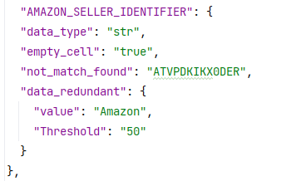
12. other_depend
This function checks dependent headers of other header rows fulfill all rules which are given by the client then return verify yes
13. not_match_found
All values are in string, Boolean, or integer.

Slide 13
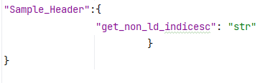
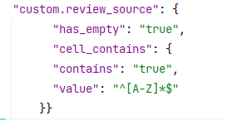
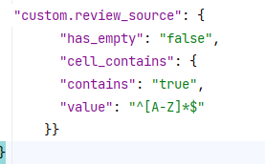
14. get_non_ld_indicesc
It Checks the list of types in a cell
15. cell_contains
This example works with given Regex as per true & false condition for cell contains or not

Slide 14
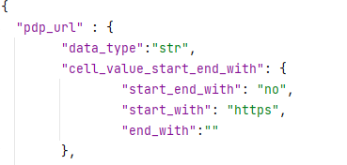
16. cell_value_start_end_with
It Checks the value that starts & ends from a given rule

Slide 15
Thank You

