Slide 1

Case Study: How Does a Bike-Share Navigate Speedy Success?
Author: Harshit Koodi
July 2023

Slide 2
Background
Cyclistic revolutionized the bike-sharing industry in 2016 with the launch of a highly successful bike-share program. Over the years, the program has experienced remarkable growth, boasting an impressive fleet of 5,824 bicycles meticulously tracked through cutting-edge geo-tracking technology. These bikes are strategically stationed across Chicago, with a network encompassing 692 stations.
Previously, Cyclistic relied on a marketing strategy that primarily focused on generating widespread awareness and catering to a diverse range of consumers. One key factor that contributed to their accomplishments was the adaptability of their pricing plans, which encompassed single-ride passes, full-day passes, and annual memberships. Customers who opt for single-ride or full-day passes are classified as casual riders, while those who choose annual memberships gain the esteemed title of Cyclistic members.

Slide 3
Problem
What is the most effective strategy of converting Cyclistic’s casual riders to annual memberships?
How do annual members and casual riders use Cyclistic bikes differently?

Slide 4
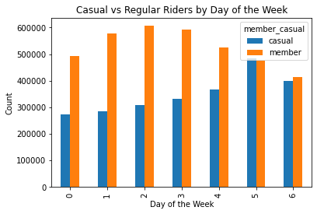
What did the data tell us: Rides per week

Slide 5
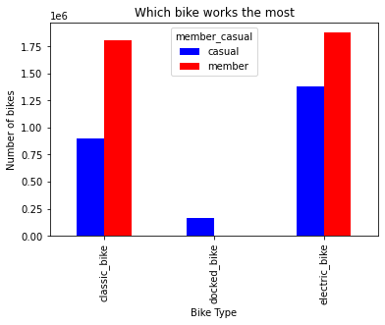
What did the data tell us: Which bike is popular

Slide 6
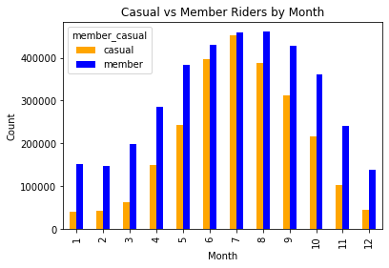
What did the data tell us: Rides per month

Slide 7
Key findings: Summary
Casual users tended to ride more in the warmer months of Chicago, namely June-August. Their participation exceeded that of the long term members.
To further that the casual demographic spent on average a longer time per ride than their long-term counterparts.
The days of the week also further showed that casual riders prefer to use the service during weekends as their usage peaked then. The long term members consequently utilized the service throughout the typical work week i.e. (Monday-Friday)

Slide 8
Long term riders tended to stick to classic bikes as opposed to the docked or electric bikes. This might suggest the more available classic bikes, the pricing between each option might be a factor.

Slide 9
Recommendations:
Introducing plans thats may be more appealing to casuals for the summer months. This marketing should be done during the winter months in preparation.
The casual users might be more interested in a membership option that allows for per-use balance card. Alternatively, the existing payment structure may be altered in order to make single-use more costly to the casual riders as well as lowering the long-term membership rate.

Slide 10
Membership rates specifically for the warmer months as well as for those who only ride on the weekends would assist in targeting the casual riders more specifically

Slide 11
Additional Points
Things to consider:
Age and gender: This would add a dynamic to whether or not customers are being targeted across demographic lines. Is the existing marketing effective? Is there potential for more inclusive targeting?
Pricing structure: THe actual pricing plans data was not provided and would give further insight to which plans are the most popular and by (how much) when comparing them. It would also be effective to understanding the spending behaviour of casual user.
Household income data: Pinpointing the average income of the long-term members as compared to the casual counter-parts would allow for further analysis of what is the typical economic standing of each type of member, as well as providing the ability to analysis overall price sensitivity between the two different membership types.

