Slide 1
Recognition of Hand Written English Characters & Numerals
CS771
Machine Learning : Tools, Techniques & Application
Gaurav Krishna Y9227224 Harshit Maheshwari 10290 Pulkit Jain 10543
Sayantan Marik 13111057

Slide 2
Outline
Preprocessing
Feature Extraction
Classification Techniques
Brief Discussions on Results
Parameter Selection
Comparative Results for Different Techniques
Final Results

Slide 3
Preprocessing
We have 55 examples for each of the 62 classes
Problems Handled and Preprocessing Steps
Varied Size of characters
Resized the characters in images of size 32X32
ILL centered Centered the Images
Varied thickness of strokes Thinning ( Done only for 13 Features)
These steps were done in MATLAB

Slide 4
Feature Extraction
Following Features are Considered
SET 1*
Haralick Texture Features
Zoning Feature
Eccentricity
Raw Moment
Covariance
SET 2
Contour Feature
Histogram Feature
13 Point Feature
Holes Feature
We used Java( jFeatureLib Library) to extract these features
* In graph plotting, when we say all feature we mean set 1

Slide 5
Classification Techniques Used
Random Forest Classifier
Neural Network
Single Hidden Layer
Double Hidden Layer
SVM Classifier ( Using SMO Algorithm)
K-Nearest Neighbour

Slide 6
BRIEF DISCUSSION OF RESULTS

Slide 7
Effect of Scaling the Images
Used features is image pixel values

Slide 8
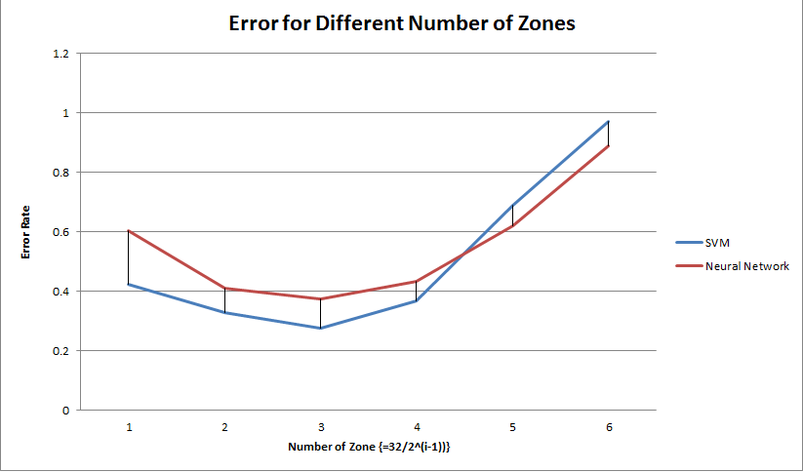
Determining Zoning Parameter

Slide 9
Deciding SVM Complexity Parameter
Zoning, Haralick Features and Eccentricity without Thinning

Slide 10
SVM Classification on Individual Features
Haralick | 9.6774
Histogram | 1.7595
Raw moments + Covariance | 7.0381
Eccentricity | 5.8651
Holes | 2.346

Slide 11
Using Different Feature Sets on SVM

Slide 12
Using all the extracted features with SVM

Slide 13
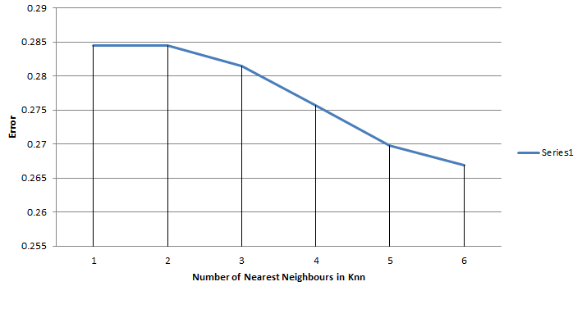
Nearest Neighbors in K-NN
Features: Haralick, Eccentricity, Zoning

Slide 14
Using Neural Network
Feature Set 1 {Zoning, Haralick, Eccentricity, Raw Moments}

Slide 15
Using Random Forest Classifier

Slide 16
Final Results
We divided the data into 90% Training Set and 10% Test Set.
We got the accuracy of 78.8% (Using SVM on Haralick, Zoning (8X8), Eccentricity)
Ten fold cross validation gives the accuracy of 77.39%
Training error of 5% obtained.
Training and Testing on whole dataset gave 95% accuracy.

Slide 17
References
THE MNIST DATABASE of handwritten digits http://yann.lecun.com/exdb/mnist/
The Chars74K dataset Character Recognition in Natural Images http://www.ee.surrey.ac.uk/CVSSP/demos/chars74k/
Handwritten Character Recognition using Neural Networks http://home.iitk.ac.in/ sunithb/NN.pdf

Slide 18
Thanks

Slide 19
END

