Slide 1

UNJUDE
“ A Safe Space to Talk Without Fear of Being Judged”
AI + HUMAN EMOTIONAL SUPPORT
PRESENTED BY :
Aisha
Shivani
Amrita

Slide 2
THE PROBLEM
“Many people want to talk, but fear being judged.”
Fear of judgment
Lack of privacy
Loneliness & stress
Difficulty asking for help
“Sometimes, the biggest problem is not having nobody to talk to — it’s not feeling safe enough to talk.”

Slide 3
OUR SOLUTION
One app. Two ways to talk.
AI LISTENER
HUMAN LISTENER
Available anytime
Text or voice
Supportive conversation
Trained listener
Private conversation
Human connection
YOU CHOOSE HOW YOU WANT TO TALK.

Slide 4
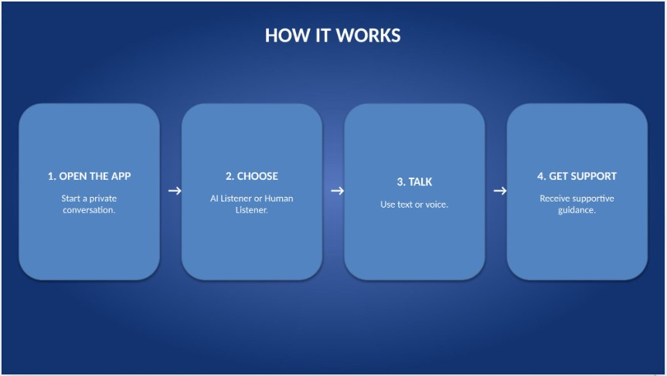

Slide 5
WHAT MAKES UNJUDGE DIFFERENT?
AI + HUMAN
Two ways to receive support.
PRIVACY-FIRST
Designed to protect personal conversations.
NO SOCIAL PRESSURE
Talk without worrying about friends or followers.
SMART HAND-OFF
Guidance toward professional support when needed.

Slide 6
TRUST & SAFTEY
PRIVACY
Personal conversations are protected.
USER CONTROL
Users choose how they communicate
TRAINED LISTENERS
Respectful and responsible communication.
SAFETY SUPPORT
Help when needed.

Slide 7
WHO BENEFITS?
STUDENTS
A safe starting point for difficult conversations.
YOUNG ADULT
Support during stress and difficult situations.
PEOPLE WHO FEEL ALONE
A place to start a supportive conversation.
SCHOOLS & ORGANISATIONS
Another pathway to emotional support.

Slide 8
HOW CAN UNJUDGE GROW?
SOCIAL MEDIA
Short campaigns that encourage people to talk.
SCHOOLS & COLLEGES
Make support easier to discover.
PARTNERSHIPS
Work with wellbeing organizations and professionals.
BUSINESS MODEL
Free basic support + optional paid human sessions.

Slide 9
IS IT PRACTICAL?
EXISTING TECHNOLOGY
AI, voice and secure cloud systems already exist.
START SMALL
Begin with AI text support, then expand.
SAFETY BY DESIGN
Build privacy and safety features from the start.
FUTURE EXPANSION
Partner with schools, colleges and organisations.

Slide 10
