Slide 1


HACK YOUR REALITY HACKATHON

Slide 2
TEAM NAME: itisha11_c025
AKANKSHA PRASAD
HARSHIT MITTAL
ITISHA GOYAL
NISHANT JAIN
Theme Name: Immersive Marketing
Idea Name: Live it

Slide 3
PROBLEM STATEMENT
Sightseeing can become drab and boring when the guides tell us about events and the socio-economic importance in history of the place we visit. At the end of the day, we take away with us a bleak memory of innumerable facts that was told and fail to really connect with what was told to us.
What if we get to travel in time and see the place just the way it was as our guide describes it?
Something that will make us look forward to such trips and make this experience etched in our memory forever?

Slide 4
SOLUTION
We build an AR app that will quench the thirst of travelers, history geeks and everyone who wishes to learn about monuments and historical places of relevance by allowing them to live those moments instead of just seeing a dull, tall, curved building.
The solution will not only benefit the people who get to live the past, but also the companies who will be organizing these trips, collaborating our idea and application.
It will engage more people in knowing about the history of the world, the history on which they can build a better future. Various metrics such as annual tourist reports, increased case studies can be used to infer the impact our application will create.
With the common usage of smart phones around the globe, our application enriches the user experience.

Slide 5
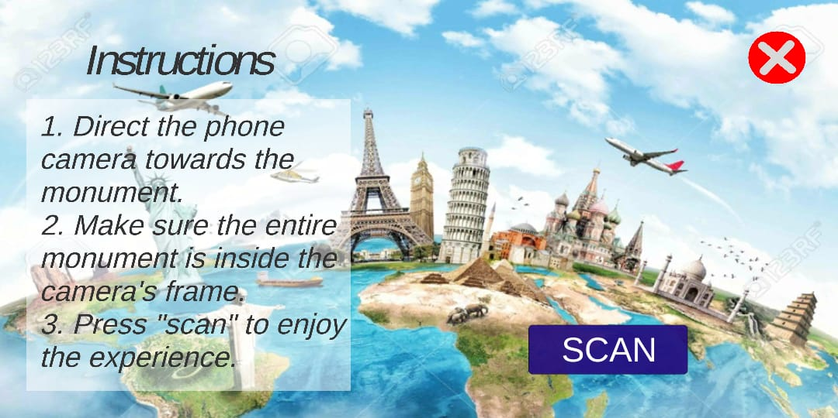
How does this work?
Once the user installs our android application on his/her phone, all he has to do is to open the app and press the SCAN button.
The home page of our application

Slide 6
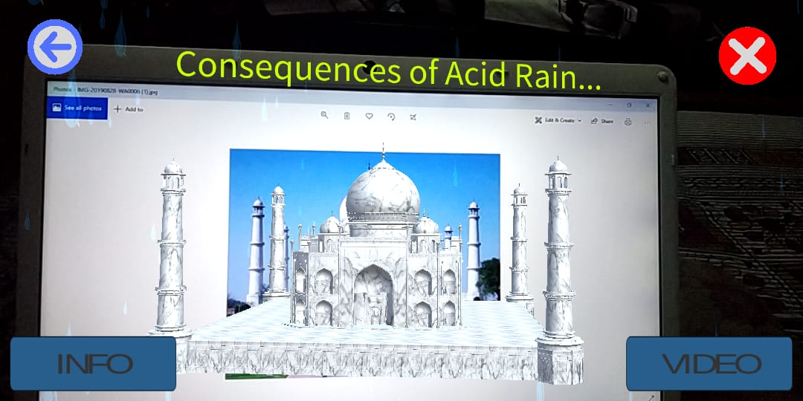
As soon as he does that, the mobile camera opens and the user has to scan the monument/building in front. (We have taken an image for now but the app will work the same with real monument as well or even better)
The augmented version of Taj Mahal is overlaid

Slide 7
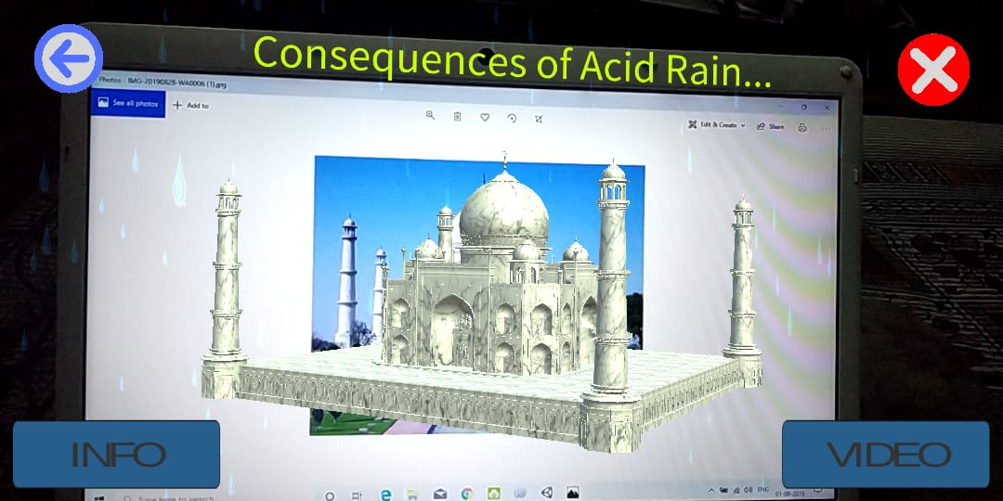
Once the building is detected, a beautiful augmented 3-D model of the same is overlaid with relevant animations and an important message.
The rotating Taj Mahal with an important message, (white marble turning yellow)

Slide 8
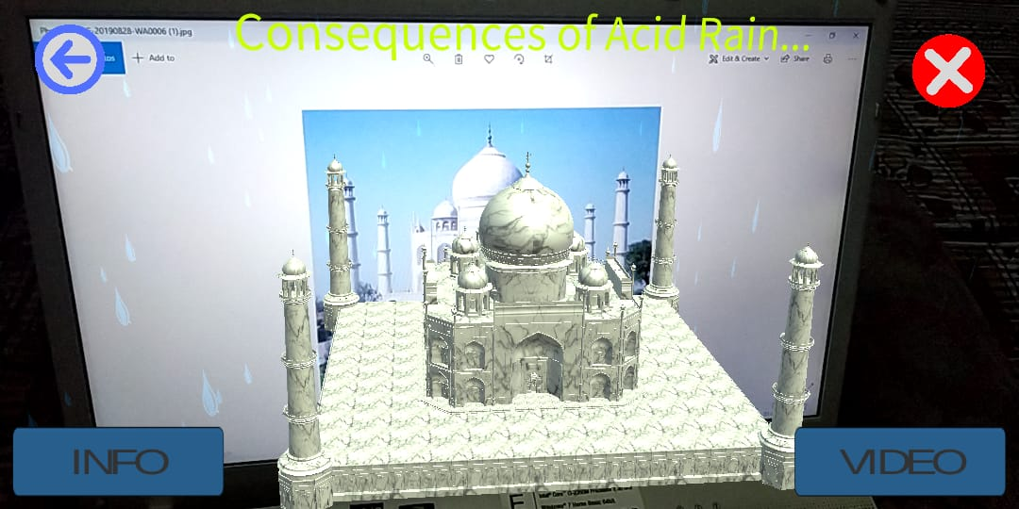
The user also has the option to explore more about the monument, by pressing the info button which displays everything about the building and a video button which shows a mesmerizing video associated with the monument.
Various UI buttons like “INFO”, “VIDEO”, “BACK” and “CROSS”

Slide 9
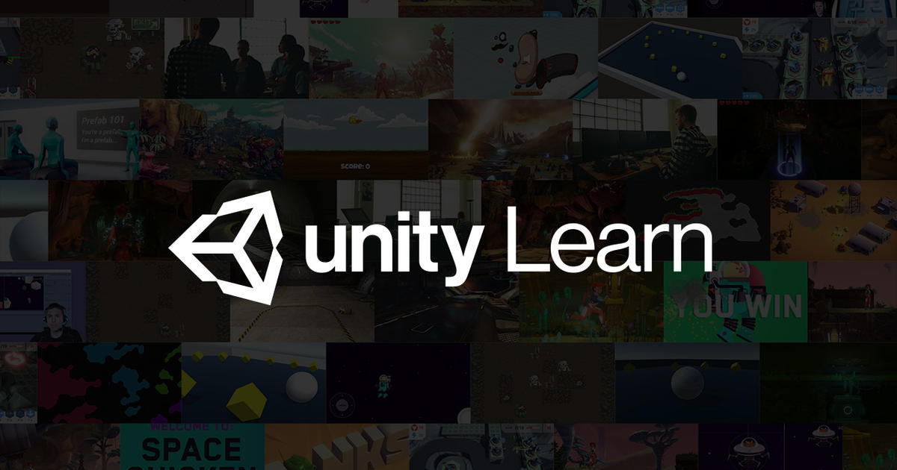
How was it built?
We designed this app with the help of UNITY software. We built various scenes for different stages of application.

Slide 10

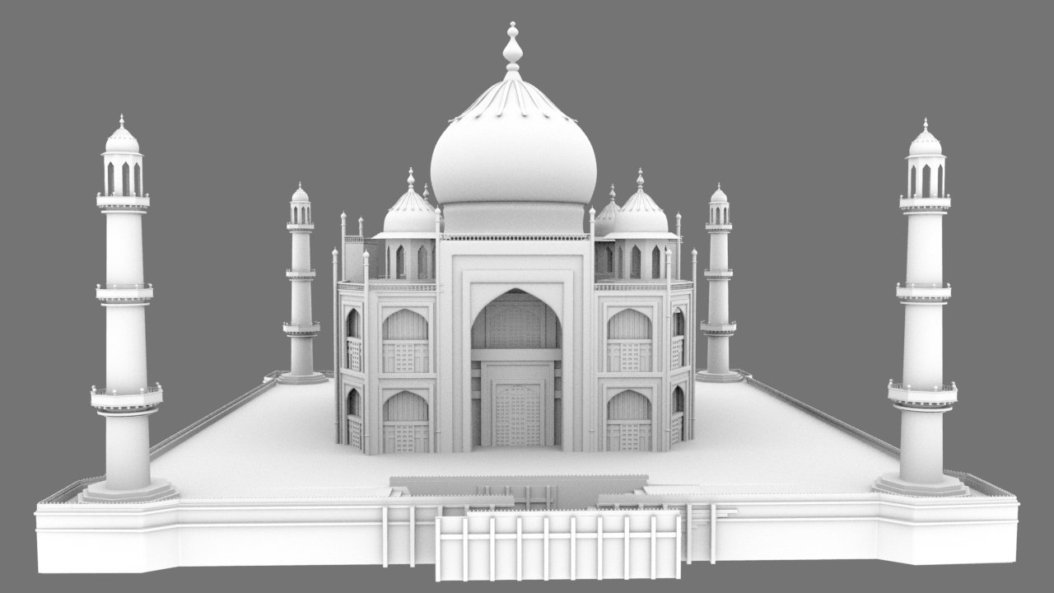
The database for image target was made with the help of Vuforia and was then imported in UNITY.
The model of Taj Mahal was then made in UNITY to which we added various effects and transformations.

Slide 11
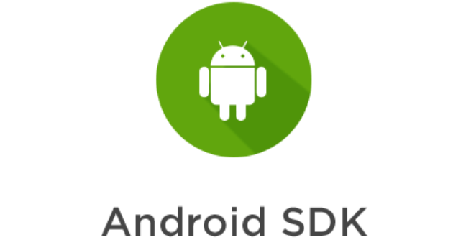
An instruction as well as various UI buttons were created to help the user navigate through the app.
Once the app was ready, we built the apk with the help of Android SDK manager.

Slide 12
The future development
Once the campaign is successfully completed, we plan to develop various things in our android AR application:
We plan to build on the suggestions given by the respective jury and develop our app to a marketing level.
We plan to add more buildings and monuments to our database and make models for the same so that the users can enjoy the experience globally.
We plan to make the application more optimized and add various other features.
At last, we plan to launch the application on Google play store and make this real useful to everyone instead of dumping it just as a normal hackathon project.

Slide 13
THANK YOU
☺

