Slide 1
Data Analytics Project
Car Sales Performance Dashboard Analysis

Slide 2
Objective
Analyze car sales performance by brand, car type, region, and fuel type to identify top performers and growth opportunities.

Slide 3
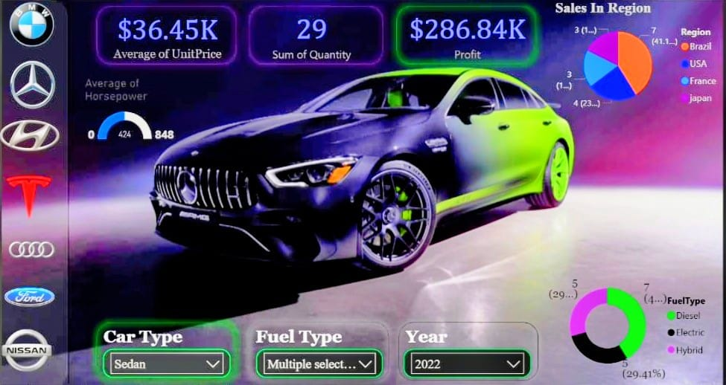
Dashboard Analysis
Brand-wise and car type sales distribution.
Ford leads revenue, convertibles and sedans dominate.

Slide 4
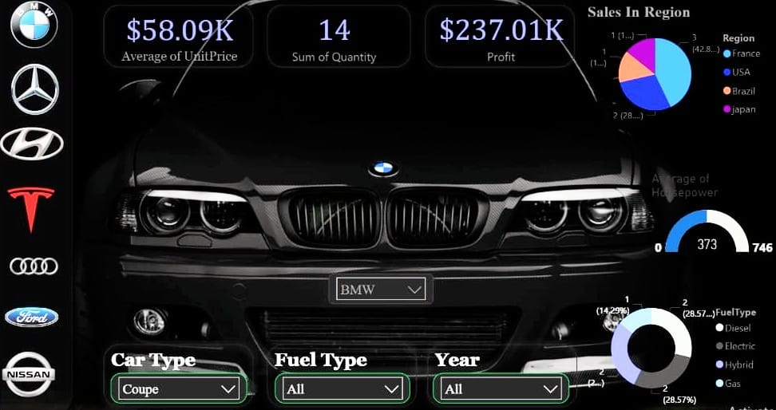
Dashboard Analysis
Regional sales distribution shows USA as top market followed by Brazil and France.

Slide 5
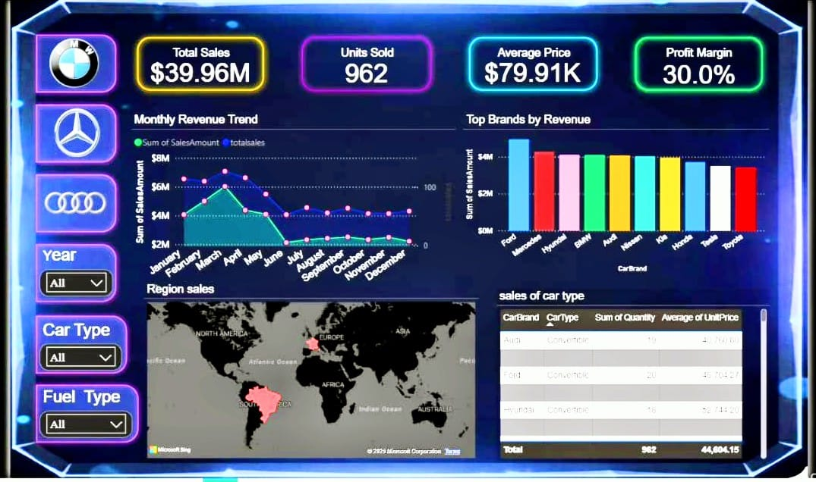
Dashboard Analysis
Fuel type mix highlights future growth in Hybrid and Electric vehicles.

Slide 6
Key Insights
• Ford leads revenue (~$4M+)
• USA is the top sales region
• Convertibles and Sedans dominate
• Electric /Hybrid vehicle demand rising

Slide 7
Recommendations
• Focus marketing on United States market
• Expand Hybrid and Electric vehicle portfolio
• Strengthen convertible and sedan offerings
• Target Brazil and France for growth

Slide 8
Conclusion
Ford dominates revenue.
Growth potential lies in electric vehicle/Hybrid vehicle
Expansion and regional campaigns.

