Slide 1

Analyzing Amazon Sales Data
Detailed Project Report
By - Harshit Kumar Pathak

Slide 2
PROJECT DETAIL
Project Title | Analyzing Amazon Sales Data
Technology | Business Intelligence
Domain | E-Commerce
Project Difficulty Level | Advanced
Tools | Jupyter Notebook, PowerBI, MS Power Point,

Slide 3
PROBLEM STATEMENT
Sales management has gained importance to meet increasing competition and the need for improved methods of distribution to reduce cost and to increase profits. Sales management today is the most important function in a commercial and business enterprise.
Do ETL : Extract-Transform-Load some Amazon dataset and find for me Sales-trend -> month wise , year wise , yearly_month wise
Find key metrics and factors and show the meaningful relationships between attributes.
OBJECTIVE
Finding Sales & Profit Trend month wise, year wise and yearly-month wise.

Slide 4
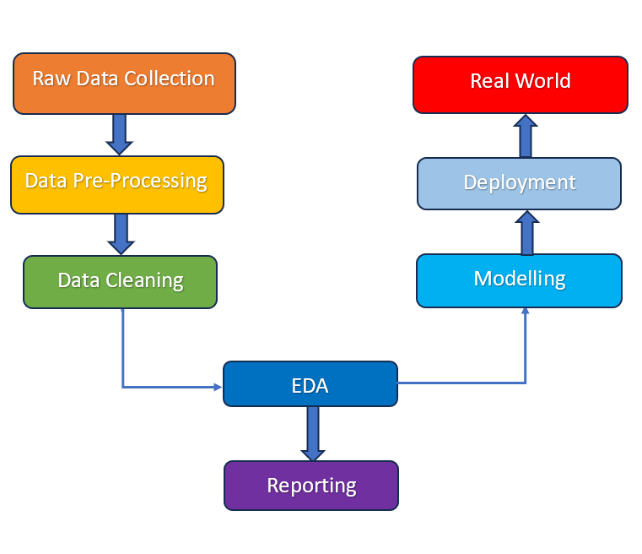
ARCHITECTURE

Slide 5
DATASET INFORMATION
The dataset contains Sales data of Amazon for the year 2010 to 2017
Amazon Sales Data Contains :
Region, Country, Item Type, Sales Channel, Order Priority, Order Date, Order, Ship Date, Unit Sold Unit Price Unit Cost, Total Revenue, Total Cost, Total Profit

Slide 6
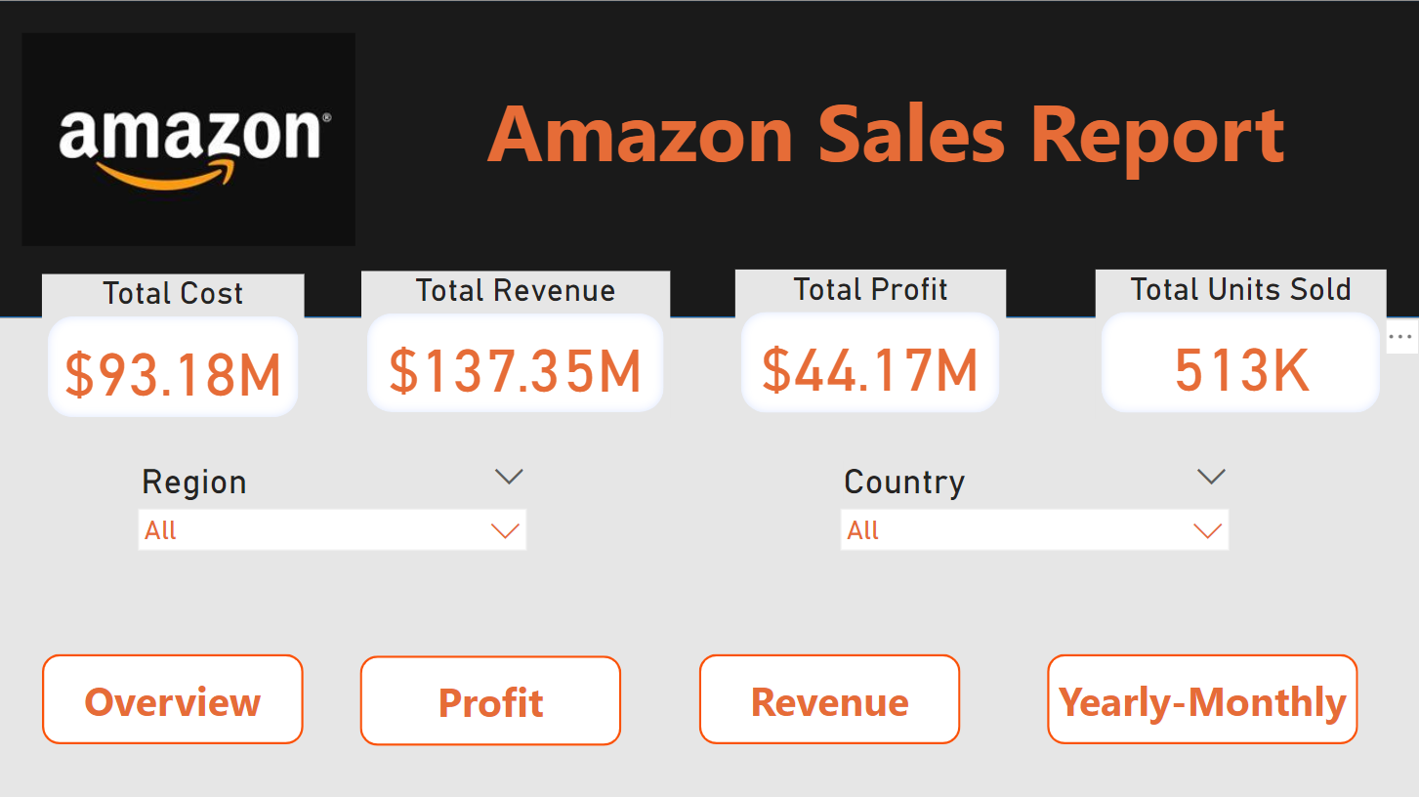
Overview

Slide 7
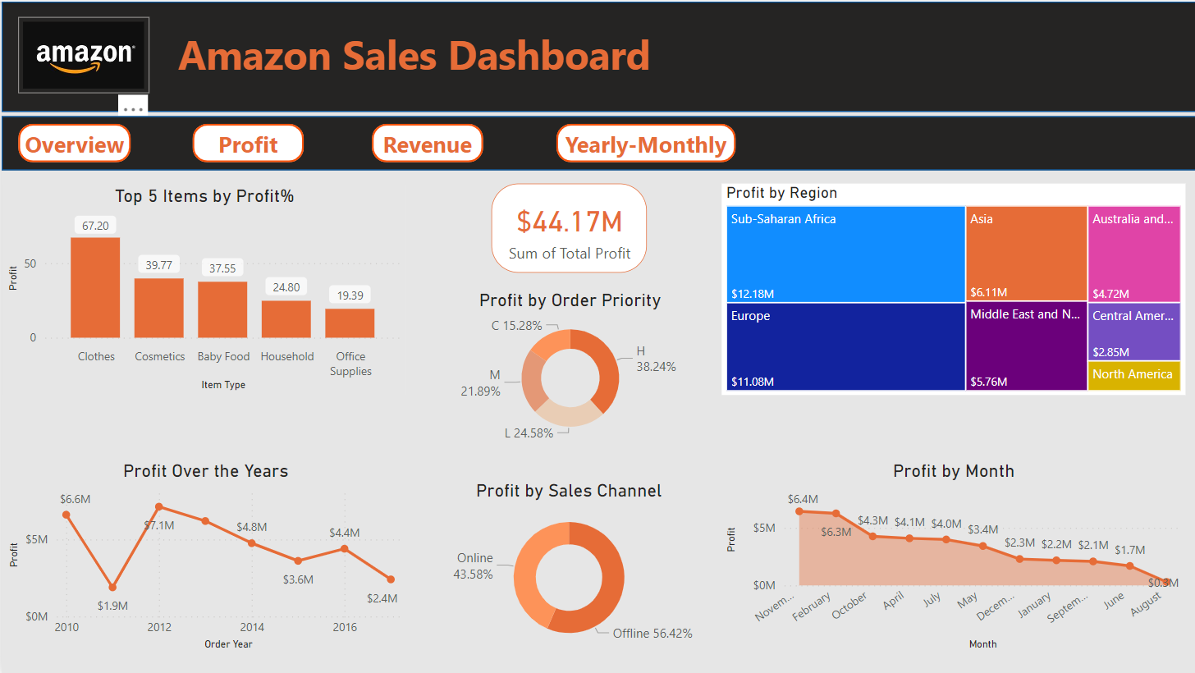
Profit

Slide 8
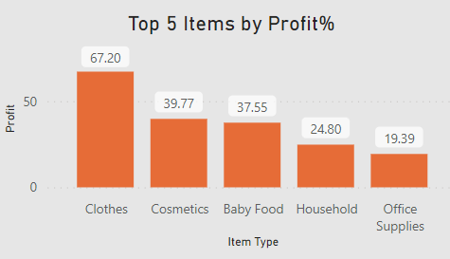
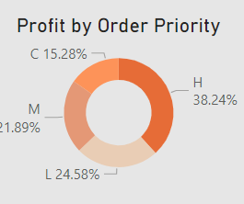
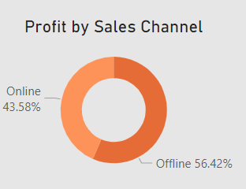

Slide 9
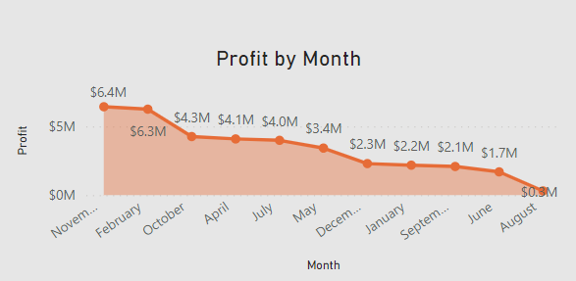
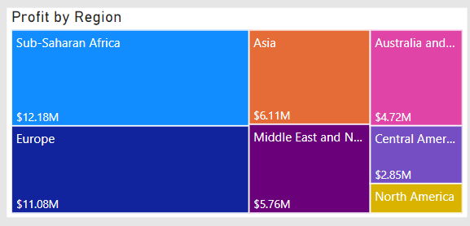
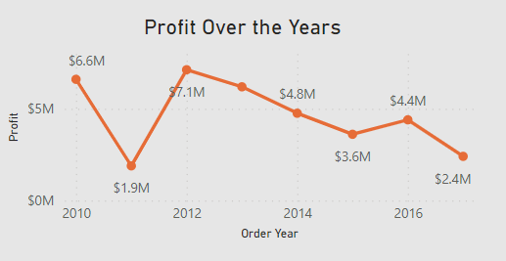

Slide 10
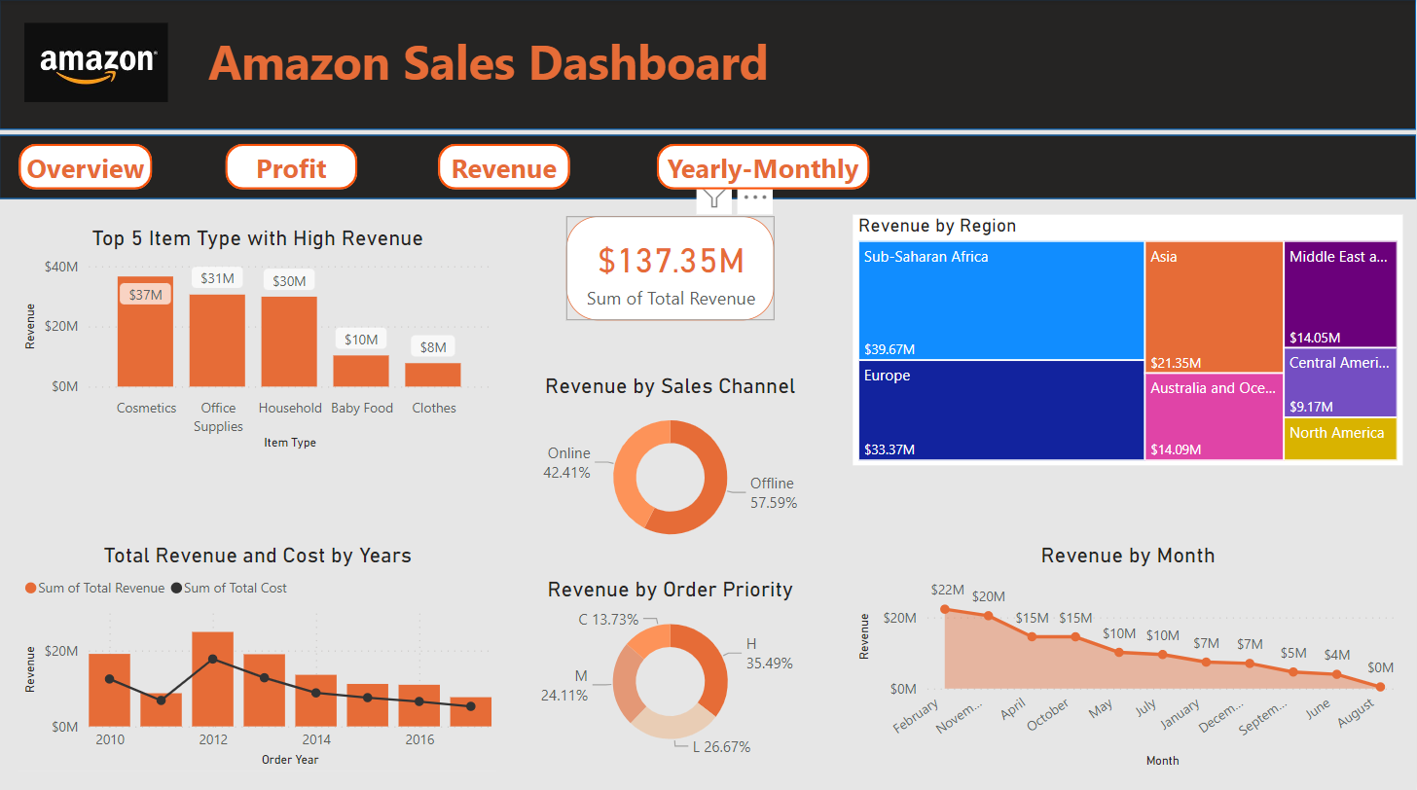
Revenue

Slide 11
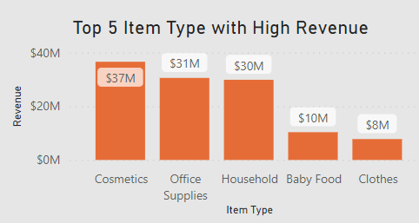
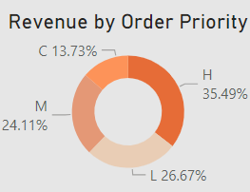
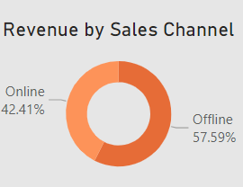

Slide 12
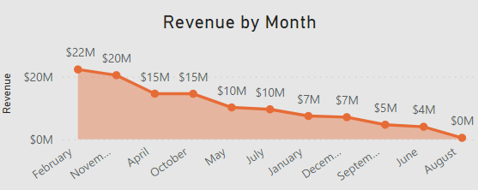
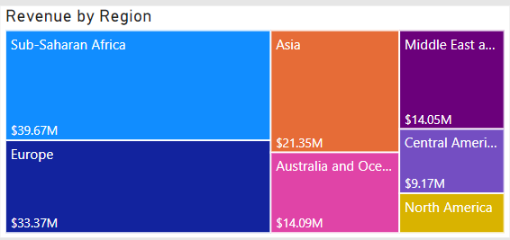
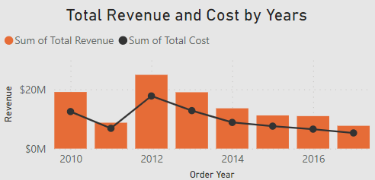

Slide 13
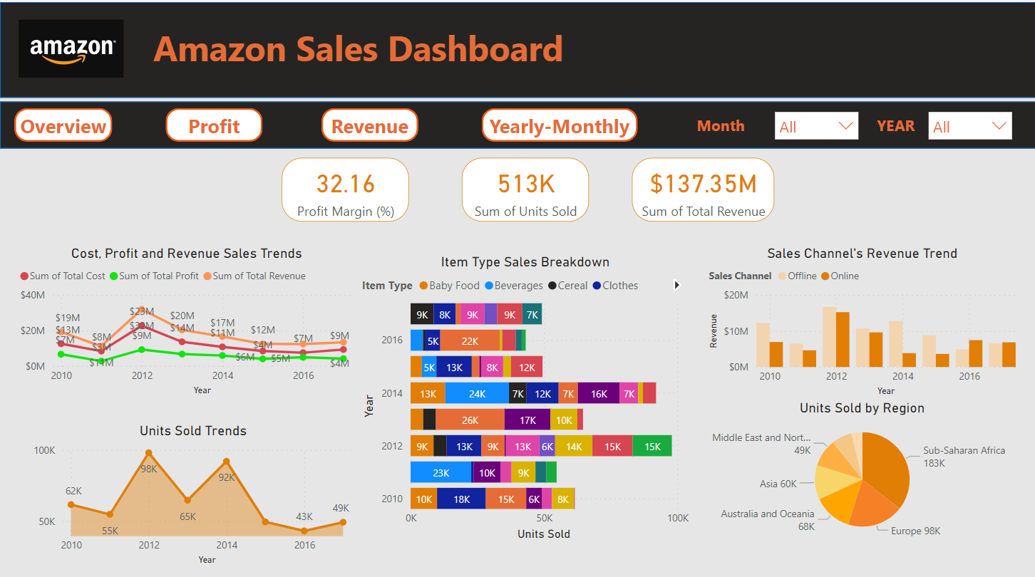
Yearly-Monthly

Slide 14
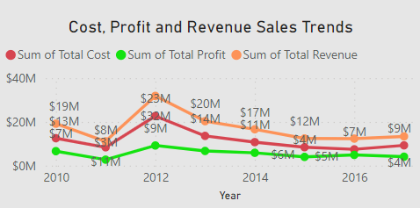
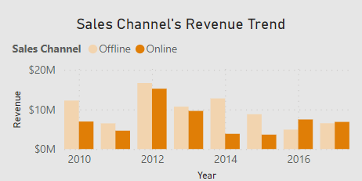
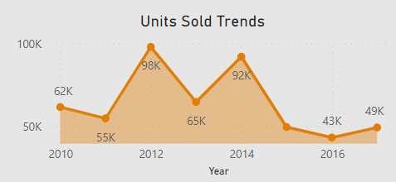

Slide 15
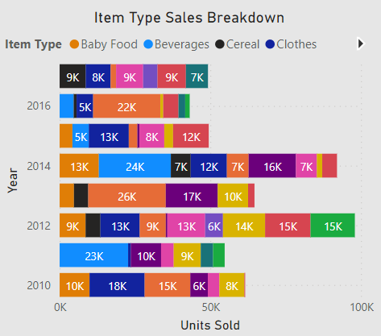
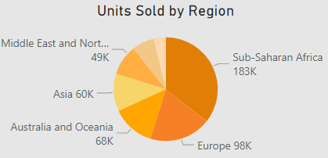

Slide 16
CONCLUSION
Top 5 Items with highest Profit Margin are- Clothes with 67.20% profit margin followed by Cosmetics, Baby Food, Household & Office Supplies
Cosmetics, Office Supplies, Household, Baby Food and Clothes were our top 5 highest revenue generated segments.
Highest Revenue and Profit was in year 2012 but decline is experienced from 2014 to 2017
Most of our profit, revenue, and sales come from offline channels.
From 2010 to 2015, Offline Channel generated more revenue and from 2016-2017, Online Sales Generated more revenue.
Highest revenue and profits are in the month of February followed by November.
The Sub-Saharan Africa region was the most profitable and revenue generated region, followed by Europe & Asia.
In 2012, maximum number of units were sold and in 2016 least number of units were sold
From year 2010 to 2014, Consistently 50K+ Units were sold each year
Sub-Saharan Africa Region has maximum number if units sold and least units are sold to North America
Most selling item in a single year was baby food that was in year 2013

